Slide 1

Sally Gibson
Head of Programmes, Living Sport

Slide 2
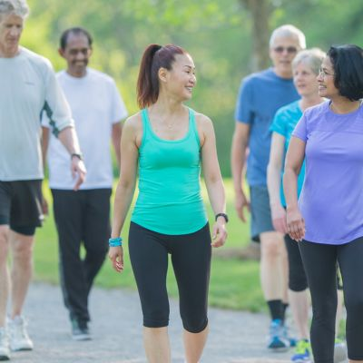
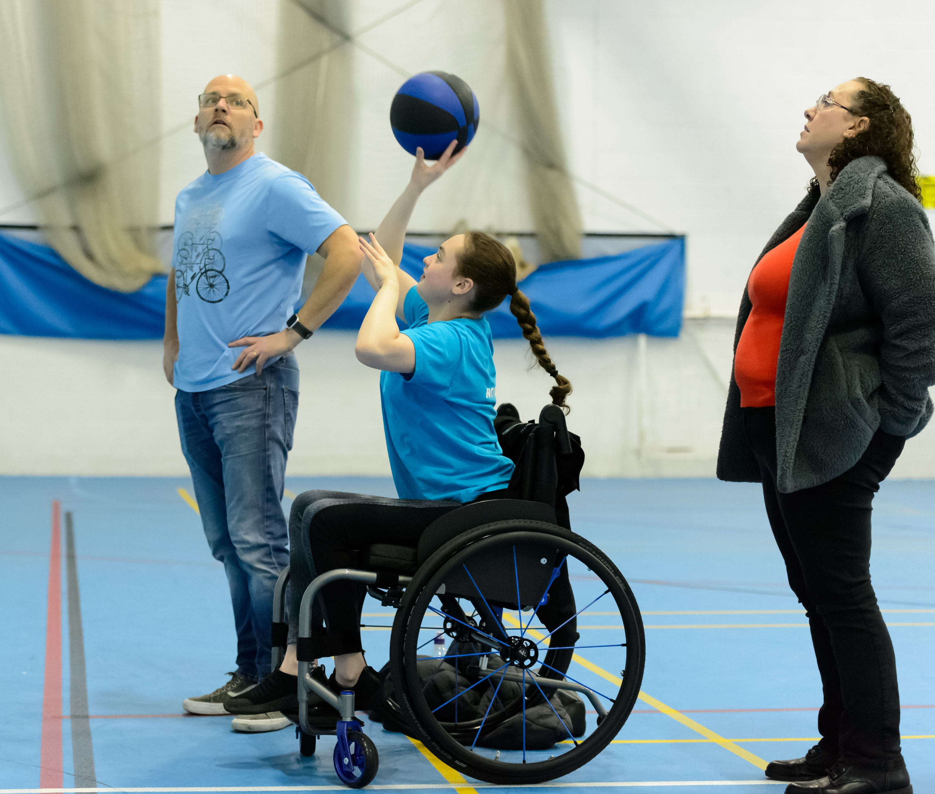
About Living Sport
We are a locally based independent charity focused on improving the health, happiness and wellbeing of the people of Cambridgeshire & Peterborough.
One of 43 Active Partnerships in England, supported by Sport England to embed physical activity focused outcomes.
We support communities to thrive by becoming more resilient. We work to embed community voice, motivations and empowerment within our work. We aim to break down any barriers which the community may face to sport and physical activity.
Our strategic focuses are around communities, children & young people and health, wellbeing & social care.

Slide 3
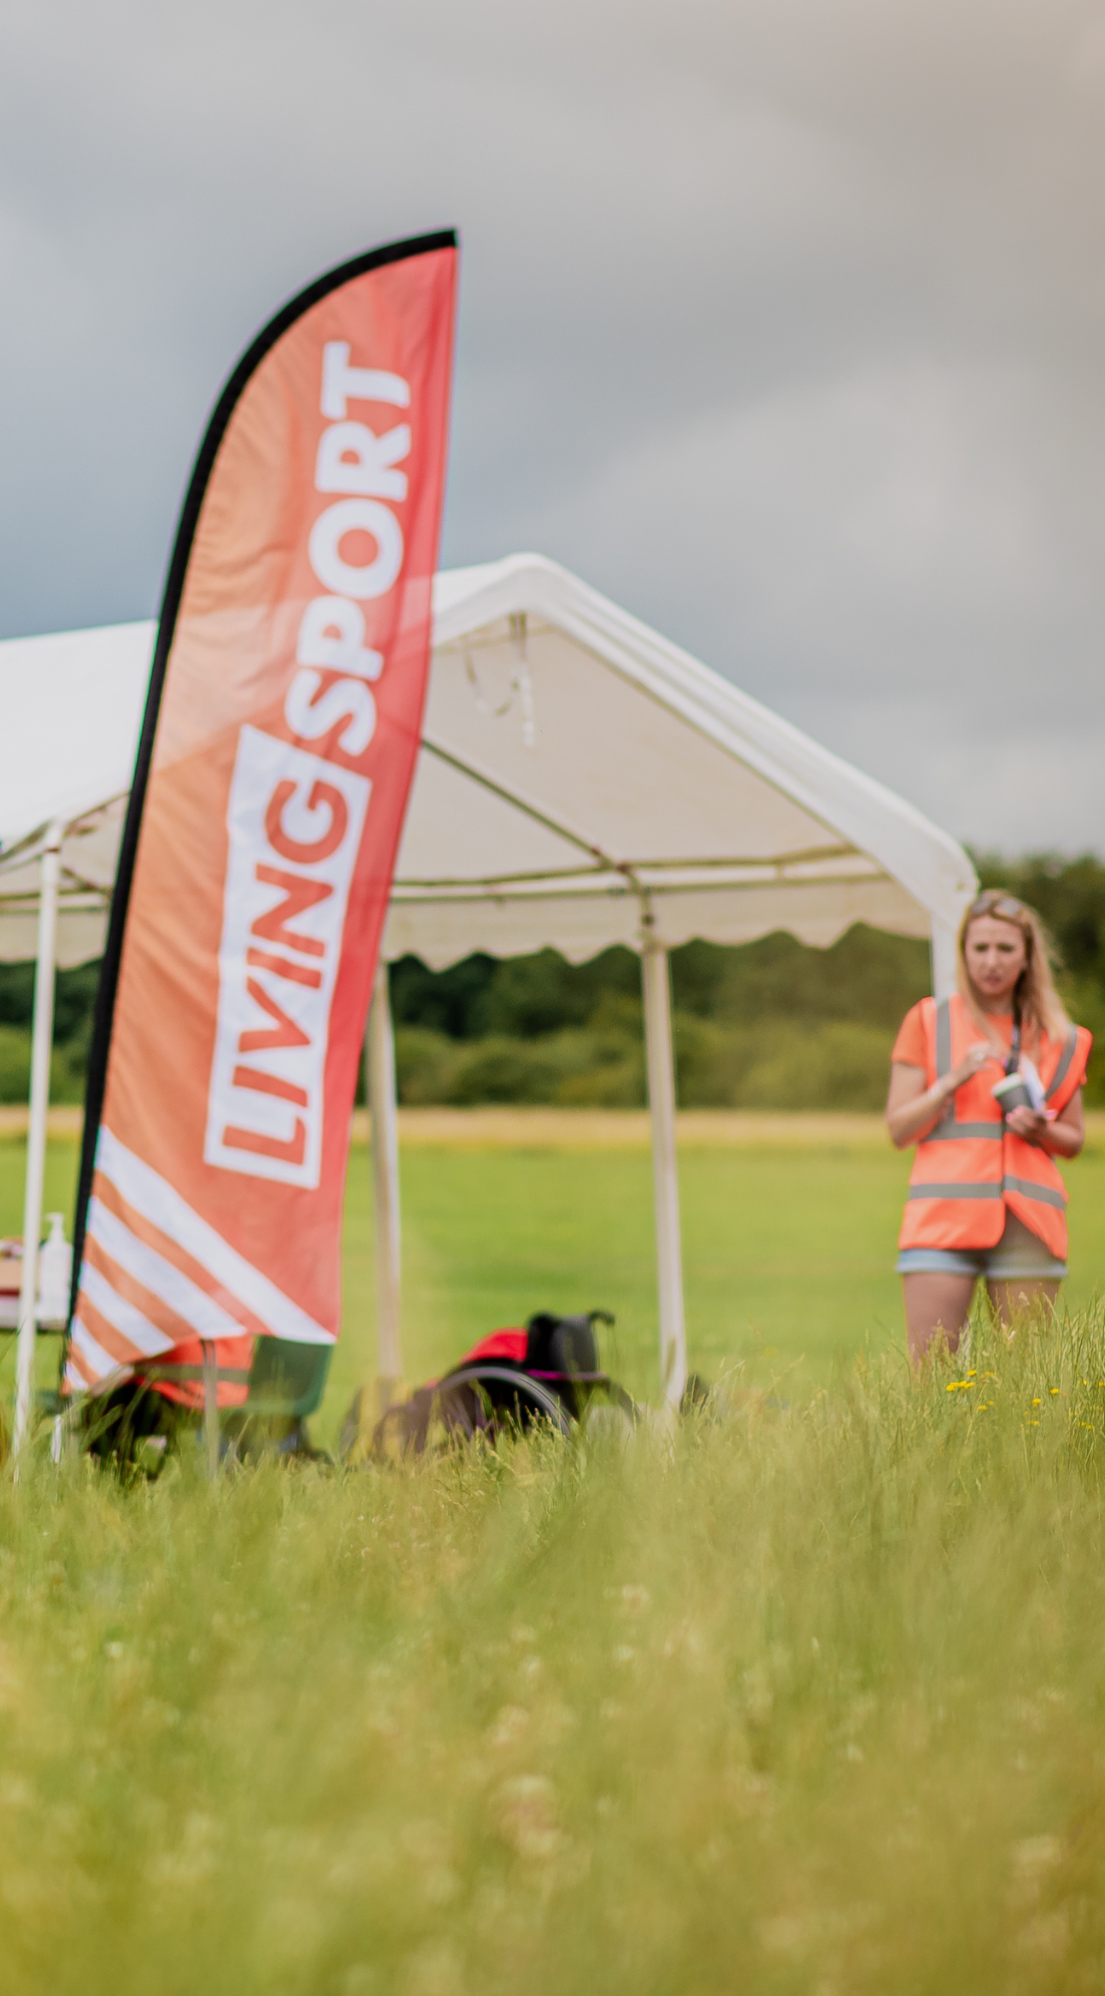
Living Sport's Work with Urban & Civic
and South Cambridgeshire District Council
Sport & Physical Activity Development Planning for Waterbeach in consultation with you as residents as the community continues to grow and thrive.
Support with Community Activation and Engagement activities – new events, enhance existing events and opportunities.
Information and resource building for existing provision, signposting in the local community.
Support with developing a healthy and active community in Waterbeach.

Slide 4
Key Priorities in short term....
Understand community landscape through surveys and community voice to ensure local people can share their thoughts and ideas.
Engage in pop up pilot activities in community spaces, shaped by you.
Support at your community events and enhance your offer through sport, physical activity and movement opportunities.

Slide 5
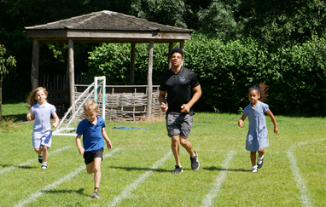
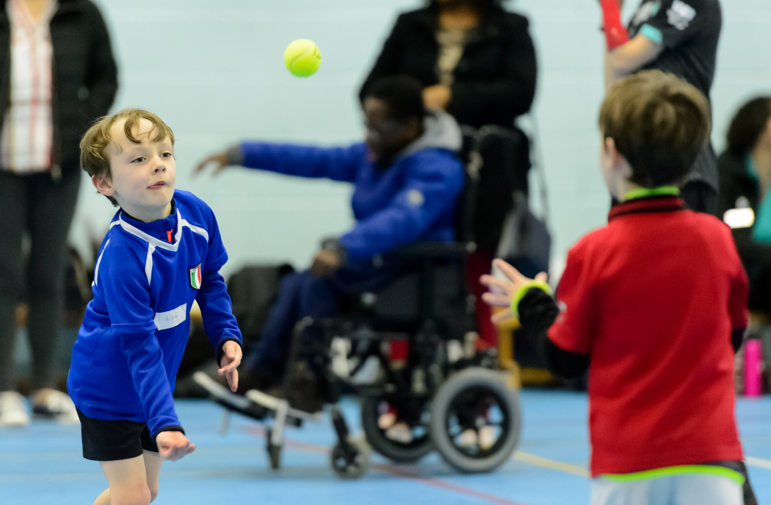
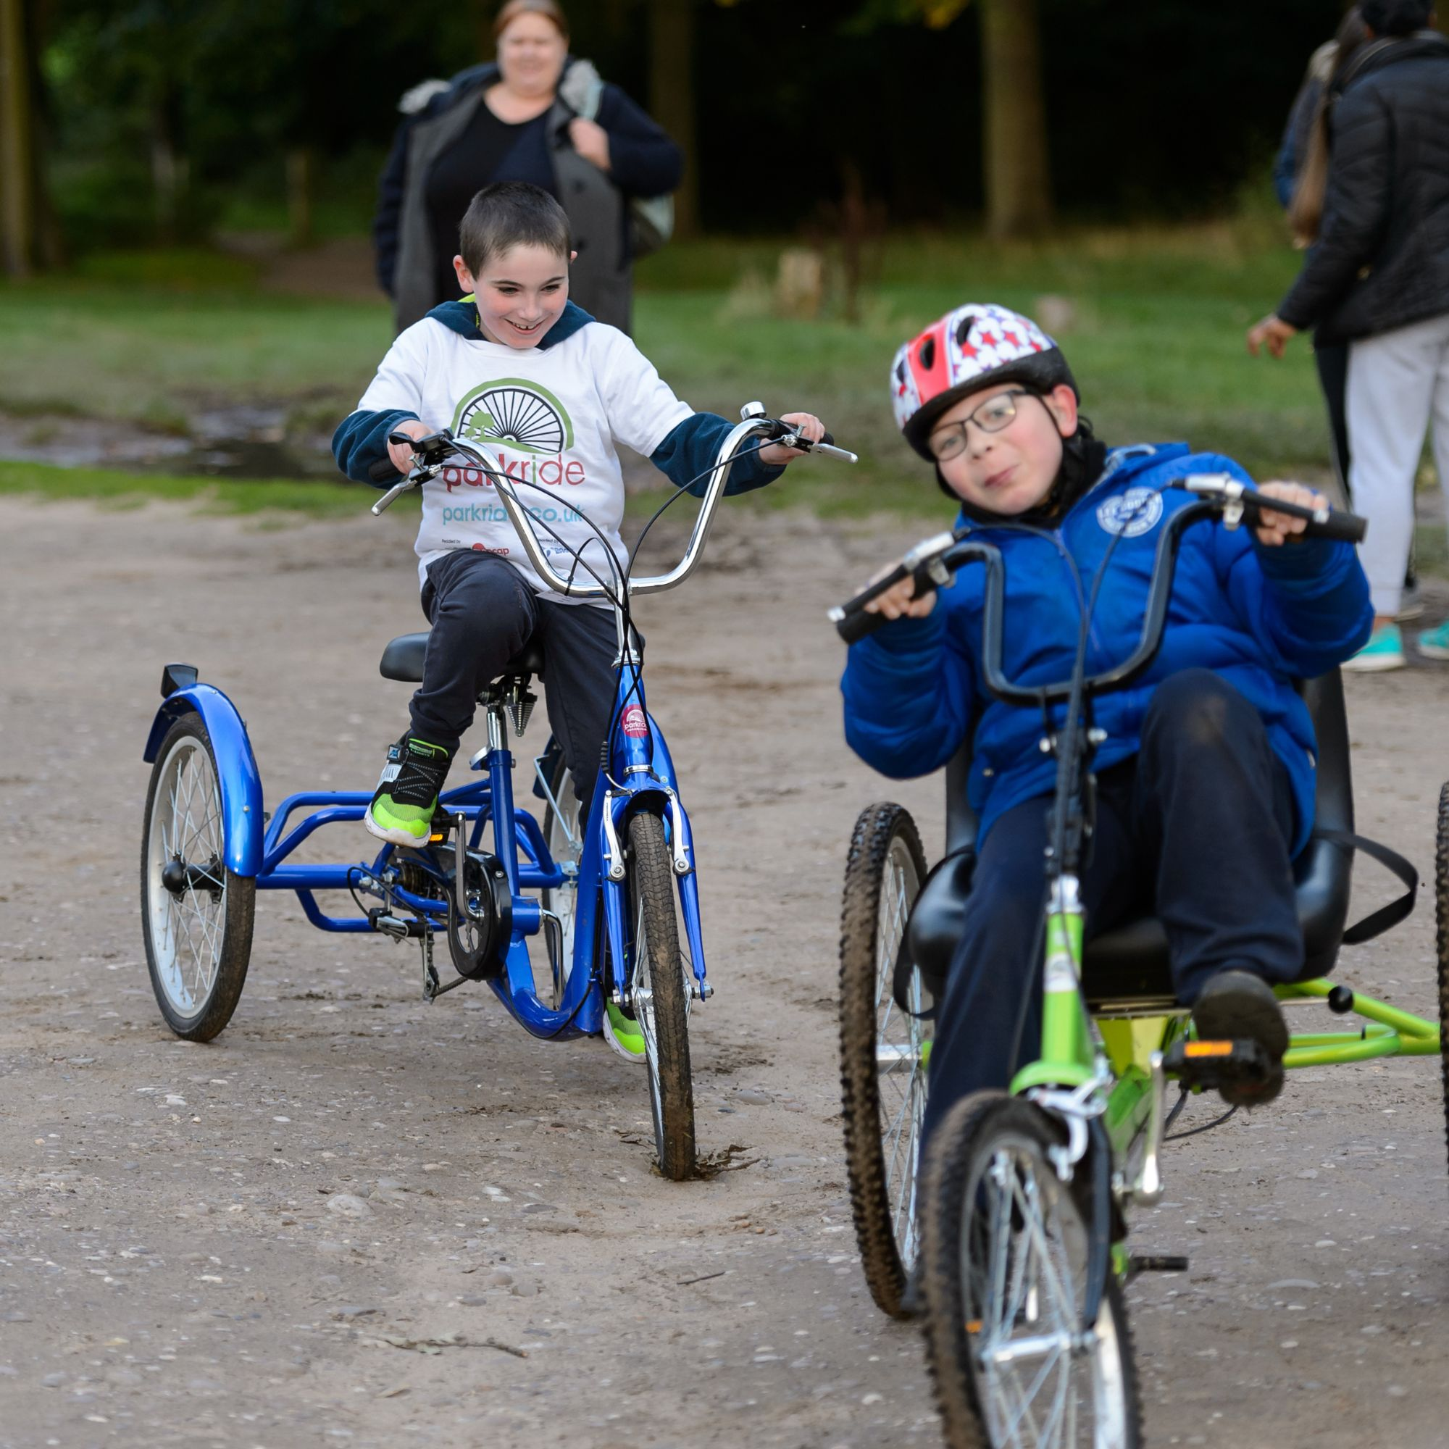
Active Waterbeach
Follows successful trial in Northstowe and Alconbury Weald
Signposting into existing provision and working in partnership with sports clubs and groups
Develop resident led delivery of activities
Keen to explore Park Run, Park Play, Ping table tennis, Daily Mile etc
Inclusive and accessible sports, walking sports
Development of active travel initiatives such as walking, running and cycling

Slide 6
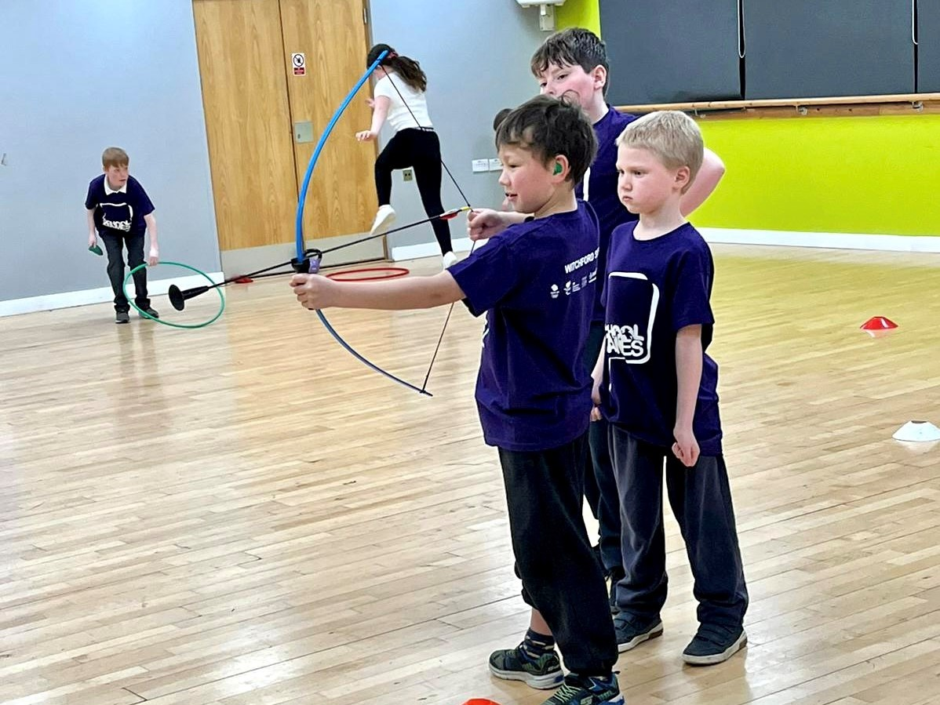
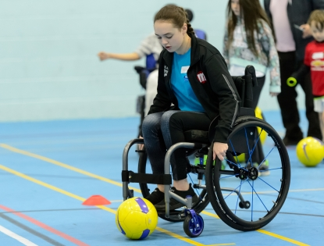
Active Waterbeach
New extra curricular provision for 11-16 yrs through Opening School Facilities - CVC
Development of Sport and Wellbeing Group
Support facilitation around community use
Co-ordinate NGB programmes
New sports clubs for new and existing residents
Link with partner agencies to support residents

Slide 7
Contact us:
Sally Gibson: Head of Programmes: sally.gibson@livingsport.co.uk
David Welch: Children and Young People Manager: david.welch@livingsport.co.uk
Kieran Spitzer: Programme Delivery Officer: kieran.spitzer@livingsport.co.uk
Place and Communities Manager: in post mid November 2023 to lead Active Waterbeach

