Slide 1

Waterbeach New Town
16th November 2022
Planning update
Mike Huntington
Principal Planner – Strategic Sites
Mike.Huntington@greatercambridgeplanning.org
or 0770 4018477

Slide 2
Vision for the new town

Slide 3
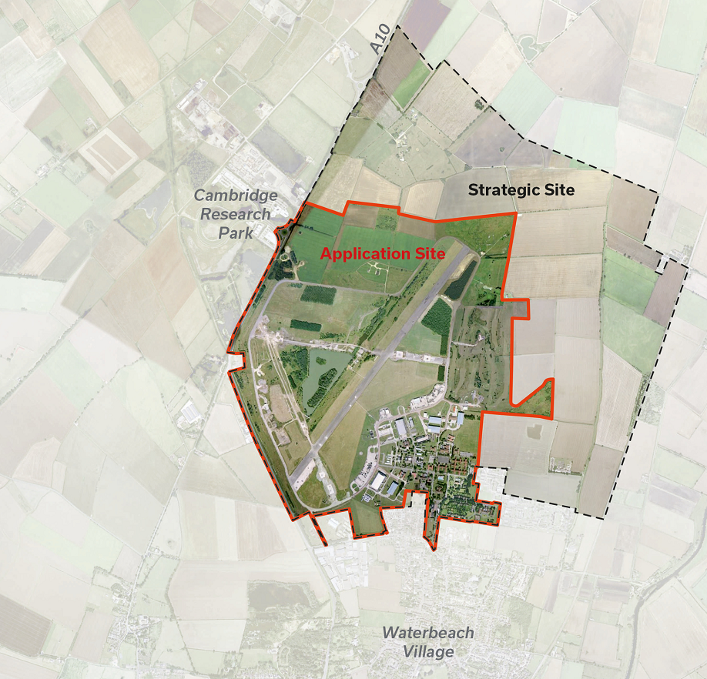
Western half of new town
- land owned by the MoD
- Development partner U&C

Slide 4
Planning permission granted for up to 6500 dwellings and associated infrastructure
The planning permission was approved with a section 106 agreement
This is an image of the indicative masterplan, showing where all the housing, schools and open space would be broadly located

Slide 5
First phase – known as Key Phase 1, and divided into key phase 1 north and key phase 1 east
Covered by relevant Conditions and s106 triggers

Slide 6
Regulatory plan to guide development for key phase 1
Shows where houses, schools, commercial uses, roads, open space, will go.
Development currently taking place on site includes infrastructure and housing

Slide 7
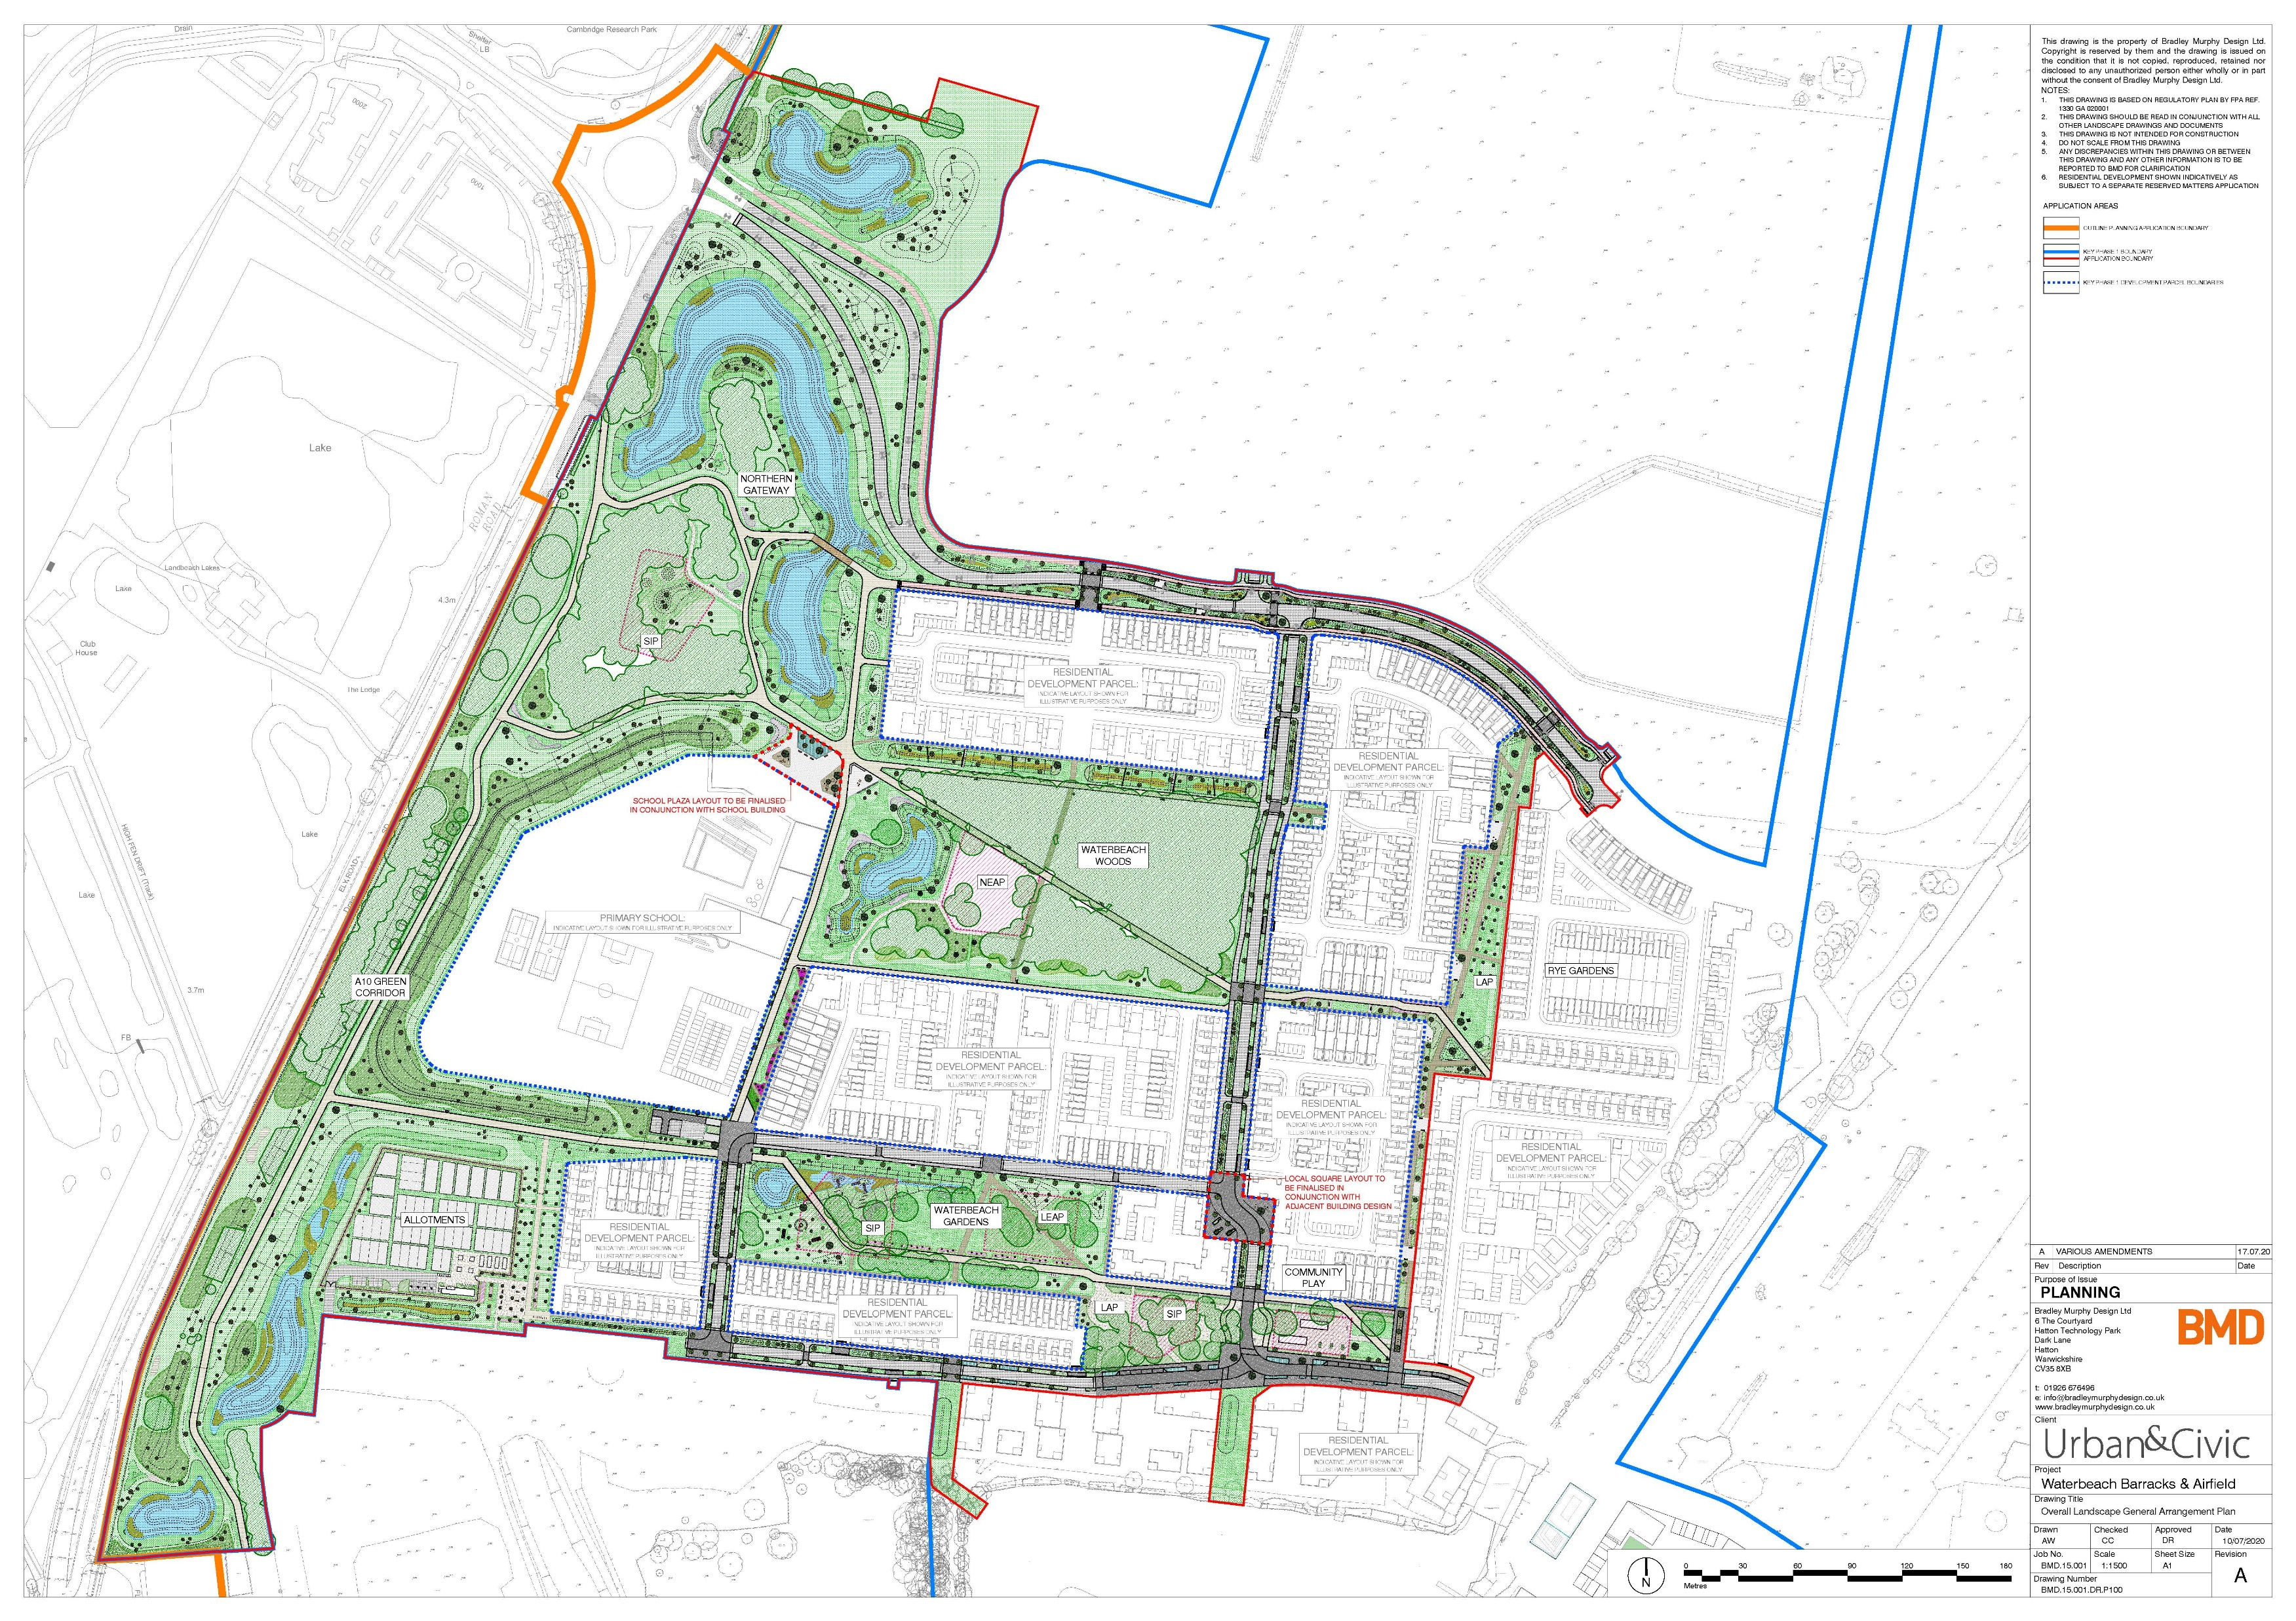

Slide 8
This is over a year old, but shows progress on northern part of key phase 1 – laying out the infrastructure to serve the northern part of this phase

Slide 9
A more detailed aerial photo of development under construction by the lake – things have progressed since this photo was taken.

Slide 10
Eastern half
RLW planning application
Resolution to grant permission at planning committee 2021
Finalising the s106 agreement with County Council colleagues at the moment
Various conditions to approve before development takes place on site

Slide 11
Thank you for listening

