Slide 1

Waterbeach New Town
7th June 2023
Planning update
Mike Huntington
Principal Planner – Strategic Sites
Mike.Huntington@greatercambridgeplanning.org
or 0770 4018477

Slide 2
Vision for the new town
2 developers
Western half – U&C with MoD
Eastern half - RLW

Slide 3
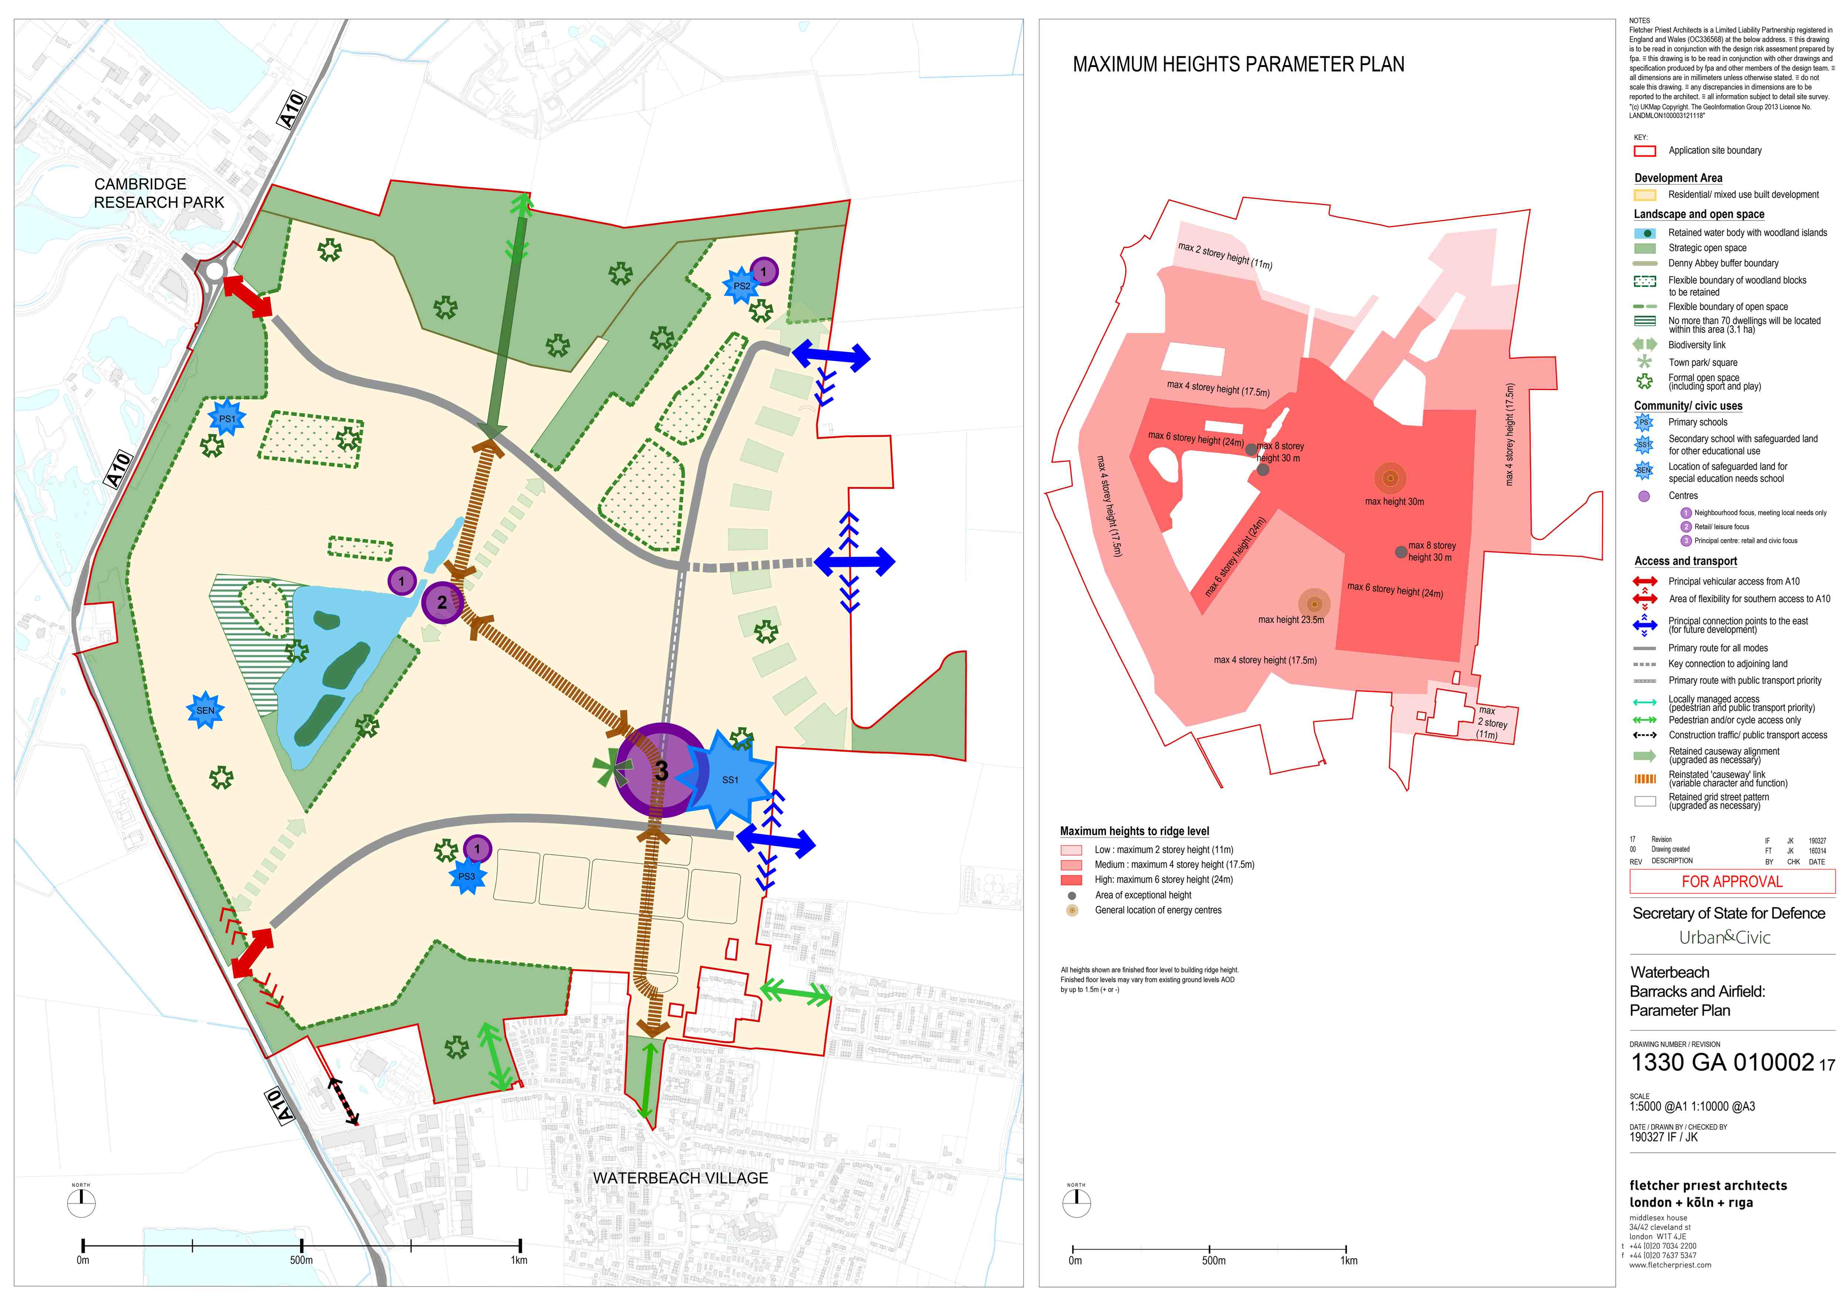

Slide 4
Indicative masterplan for the western half

Slide 5
First phase – known as Key Phase 1, and divided into key phase 1 north and key phase 1 east
Covered by relevant Conditions and s106 triggers monitored by SCDC
E.g. early delivery of community space and transport infrastructure

Slide 6
Regulatory plan to guide development for key phase 1
Shows where houses, schools, commercial uses, roads, open space, will go.

Slide 7
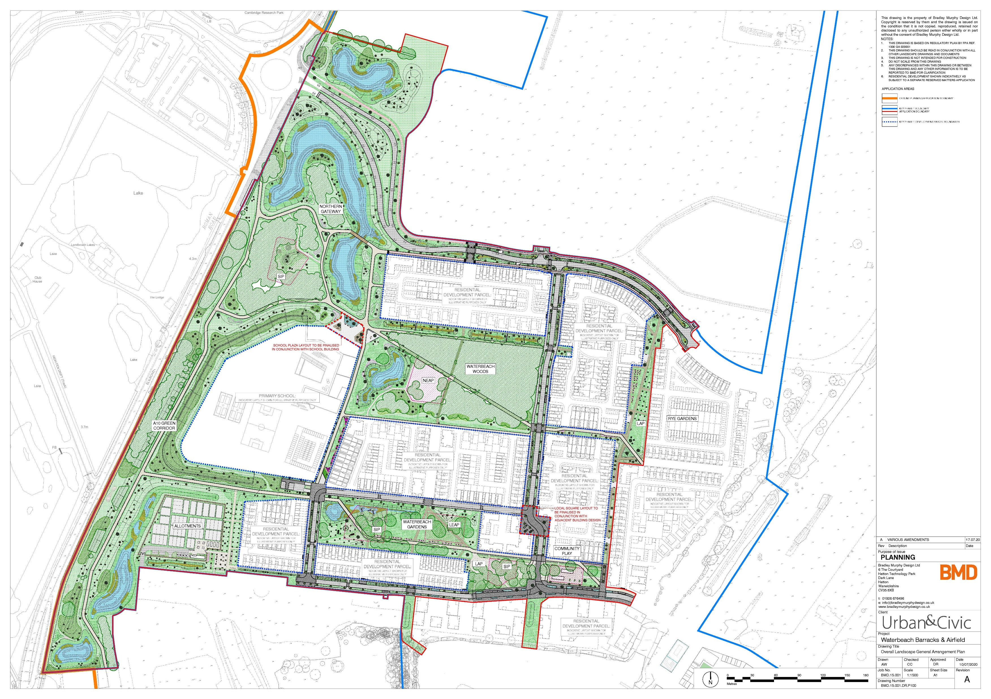
Development currently taking place on site includes
infrastructure and housing parcels 1 and 2.1.

Slide 8
Eastern half
RLW planning application
Finalising the s106 legal agreement with County Council colleagues at the moment
Various conditions to approve before development takes place on site
Relocated railway station – lawful development certificate granted

Slide 9
Anglian Water – update
1. Cambridge Waste Water Relocation project
2. Existing Waterbeach Water Recycling Centre

Slide 10
Thank you for listening

