Slide 1




CamVC and CamSF Updates
Frankie Rose,
AAP: Head of Sixth Form, Cambourne Village College
@SFCambourne

Slide 2
Current picture of growth
Year 7-11 |  |  |  |  |  | Sixth Form | Whole School
Tutor Groups | 7 | 8 | 9 | 10 | 11 | 12
Year Totals | 292 | 291 | 276 | 280 | 250 | 74
Grand Totals |  |  | 1389 |  |  |  | 1463
Applications for 2025 entry First choice: 307
Total: 489 (for 300 spaces) – 33% growth in 4 years Planned move from 10 to 11 form entry with PAN of 300

Slide 3
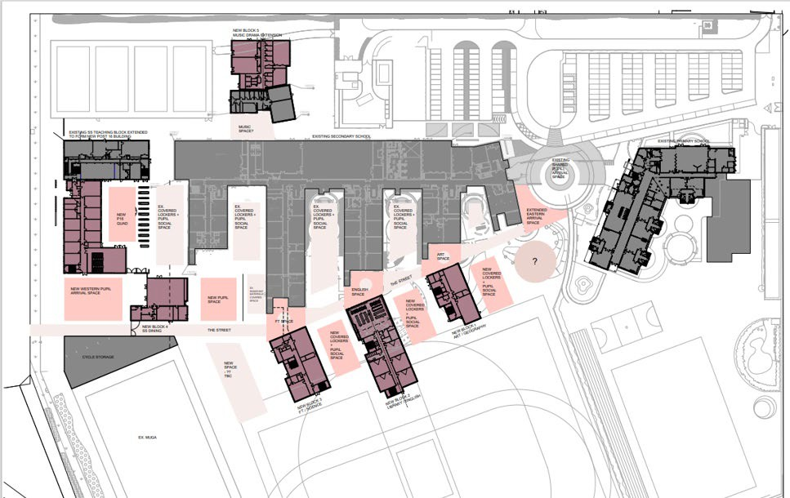
Growth of our site
Cambourne Village College
Hardwick and Cambourne Primary School
Cambourne Sixth Form

Slide 4
Community Representation
47 languages spoken by our students
109 Cantonese speaking students; 22 Urdu speakers; Malayalam (20); Polish (20);
Arabic (16).
Helena Ground, International Lead – responsible for community meetings for Cantonese speaking parents, runs home language qualifications and support for non-native English speakers in lessons.

Slide 5
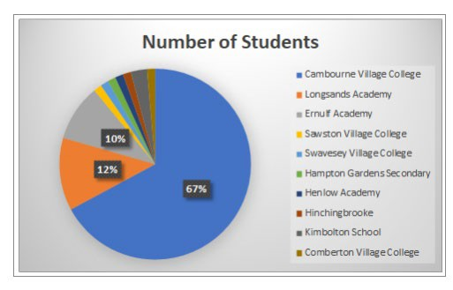
Sixth Form: 2024 cohort
Composition of student body

Slide 6

CamSF: ethos and values

Slide 7
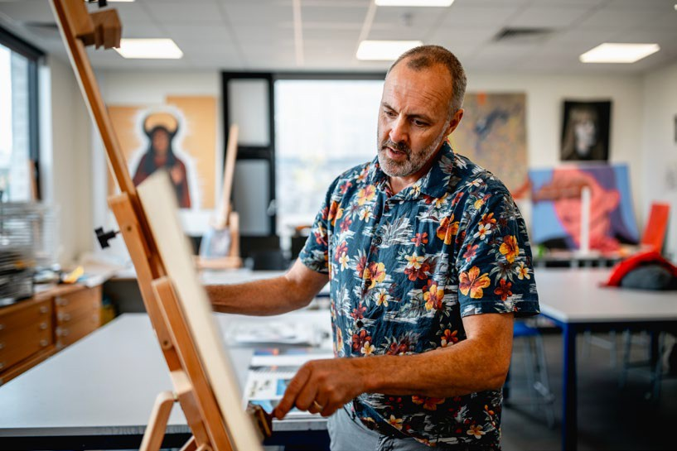
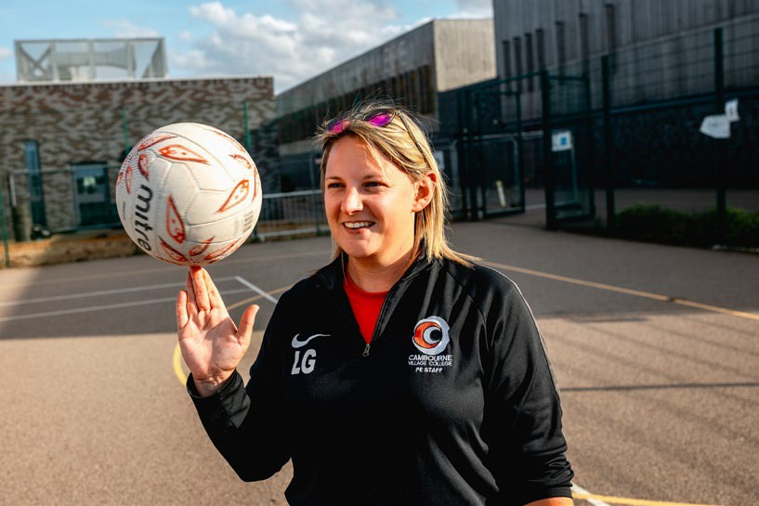
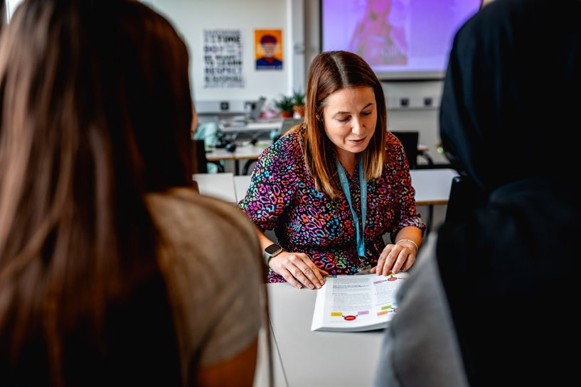
CamSF Experience
Quality of teaching
Specialists in every subject who are passionate about their teaching and bring the subject to life; many with experience of teaching A Level.
Results
CamVC’s excellent track record of progress at GCSE; the Trust’s excellent record at KS5.
Range of subjects offered
31 subjects, plus additional qualifications; huge range to cater for your interests and aspirations.
4. Independence
A distinct area of the campus for your facilities, services and teaching.

Slide 8
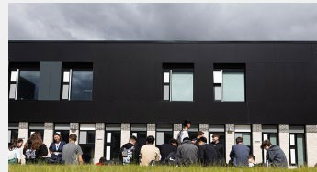
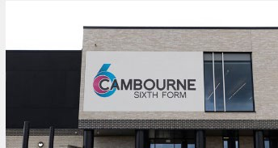
Our facilities
Brand new and purpose-built, designed for Sixth Form study
Purpose built STEM facilities including Computer Lab, five Science labs and bespoke Design Technology suite
Specialist Art, Photography and Music Technology rooms
A superbly-stocked sixth form library, staffed by qualified librarian, alongside independent study space
A lecture hall
A café and outside courtyard for socialising
The state-of-the-art performance hall and sports facilities of the mainstream school are available for sixth form use.

Slide 9
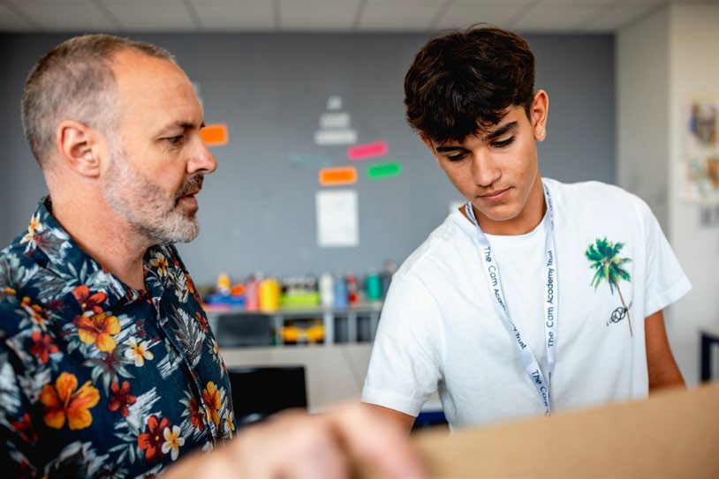
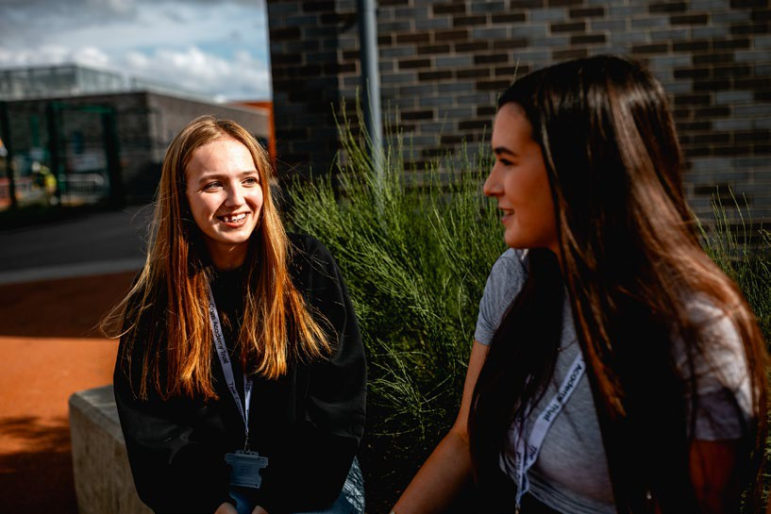
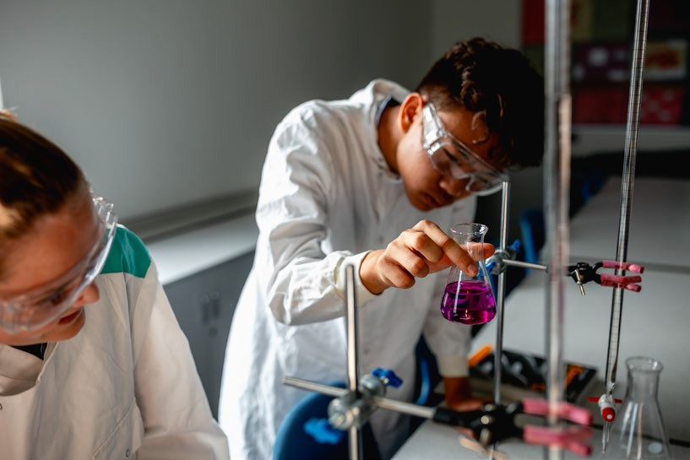
Our curriculum
Subject choices A Levels
Art and Design Biology Cantonese Business Chemistry
Computer Science
Media Music
Music Technology Photography Physical Education Physics Psychology Philosophy Sociology
Spanish
Design Technology: Product
Design
Drama and Theatre Studies Economics
English Language English Literature Environmental Science French
Geography German
Government and Politics History
Maths Double Maths
Applied courses
L3 BTEC Enterprise and
Entrepreneurship (Business) L3 BTEC Sport
Additional Courses Cambridge IPQ Extended Project (EPQ) Core Maths
L2 Maths and English (resit)

Slide 10
Entry requirements and admissions
A Levels | Applied courses
To study A Levels, we require a minimum of five Grade 5s at GCSE, with Grade 4 or higher in English and Maths. Many subjects also have an additional entry requirement, such as a Grade 6 or higher in a related GCSE subject. | Applied courses require a minimum of five Grade 4s at GCSE, including English and Maths.
Aiming to admit an increased roll of 100-120 students for 2025 entry, but this is not capped.
Significant interest from CamVC, St. Neots based schools and out of area; application deadline 14th Jan.

Slide 11
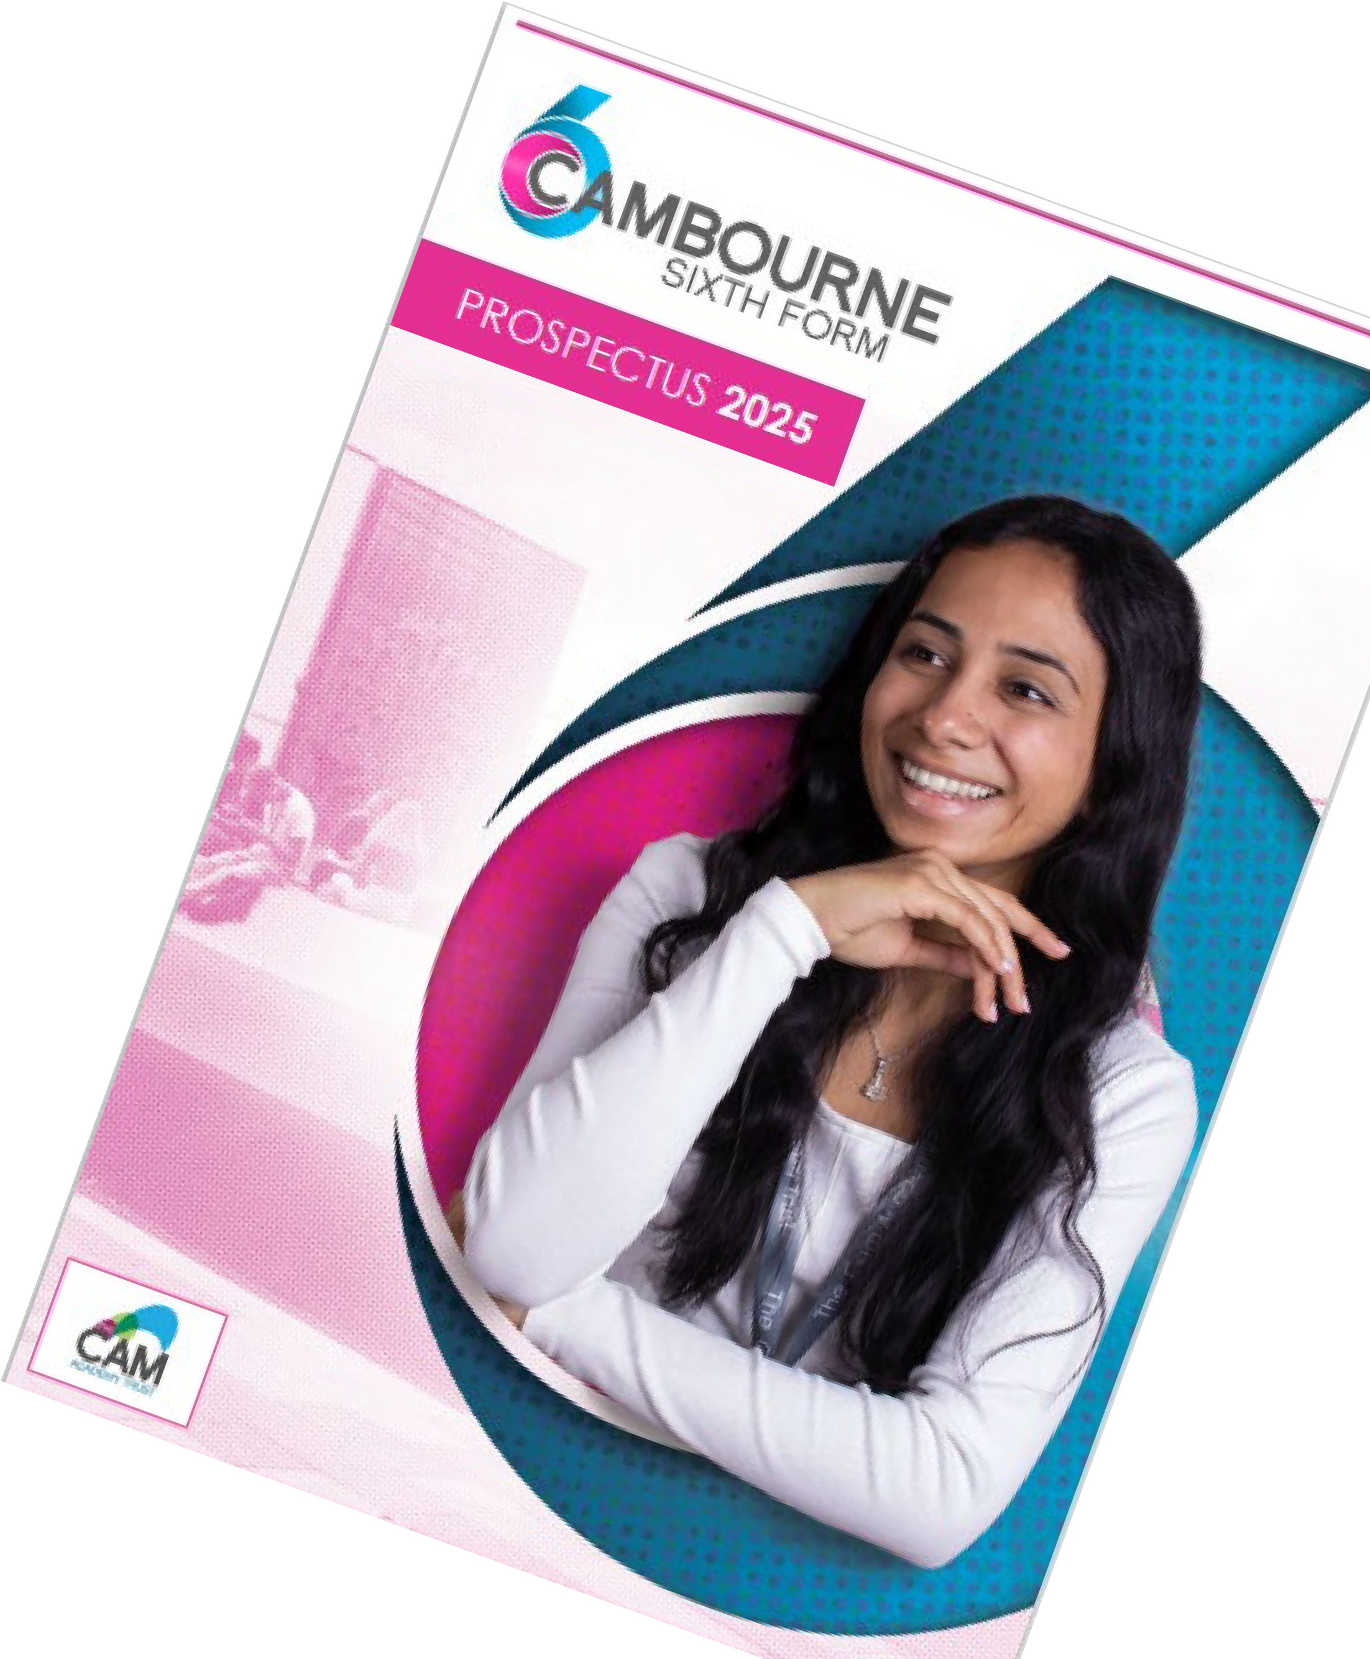



How can I find out more?
Students in current Y11 may contact us for a tour.
Visit our website www.cambournesixthform.org, where you can see our whole prospectus and read the specification for each qualification.
Follow us on socials:
X (Twitter): @SFCambourne Facebook: CambourneSixthForm Email: info@cambournesixthform.org

