Slide 1

Zero Carbon Communities Grant Scheme online Briefing and Q&A

Slide 2
Welcome
Cllr Pippa Heylings

Slide 3
Agenda
Welcome Cllr Pippa Heylings, Chair of Climate & Environment Advisory Committee
Introduction Siobhan Mellon, Development Officer, Climate & Environment
This year’s themes:
Cycling Emma Dyer, Project Officer for Zero Carbon Communities Community buildings Siobhan Mellon
Tree-planting and other nature-based solutions Emma Dyer
How to apply and what happens next Emma Dyer
Case studies and expert advice
Sean Moroney, Cambridge Electric Transport
Antony Gough and Tony Cook, PECT
Q&A Session

Slide 4
Aims of the ZCC grant scheme
support communities to promote behavioural change and reduce reliance on fossil fuels
aligns with aspiration for net zero carbon by 2050 in our Zero Carbon Strategy
£100k total budget

Slide 5
Round 1 of the grant
Allowed for a broad range of projects to be considered
We received 42 applications
We funded 19 projects

Slide 6



This year there will be three funding streams:
Cycling
Community buildings
Tree-planting and other ‘nature-based solutions’

Slide 7

Cycling Options-
Improvements to cycling infrastructure
Electric bike or electric cargo trike
Kickstart a commercial electric share-bike scheme
Any other cycling project

Slide 8

Community building options
Energy conservation or efficiency measures
Energy survey
Solar PV and/or battery storage system for solar PV

Slide 9

Solar Together Cambridgeshire
Local authority led group-buying scheme
Launches 1 September
Register (for free) before 6 October
Auction takes place 6 October
Offers sent out 26 Oct
Decide by 7 December
Installations complete by end of May 2021

Slide 10

Tree-planting and other ‘nature-based solutions’
Funding for all aspects of tree-planting schemes including project management and consultancy

Slide 11
Some examples to consider….
planting of one landmark tree.
planting of a small tree population,
community orchard project
community tree nursery project
hedge project
larger village-wide tree canopy project.
This is not an exhaustive list.

Slide 12
Cambridge Electric Transport
Sean Moroney

Slide 13
Shared Community E-bikes to promote healthy living in South Cambridgeshire
Cambridge Electric Transport (CET) has been operating its bizbike commuter bike share service for employment centres in Cambridge since July 2018.

Slide 14


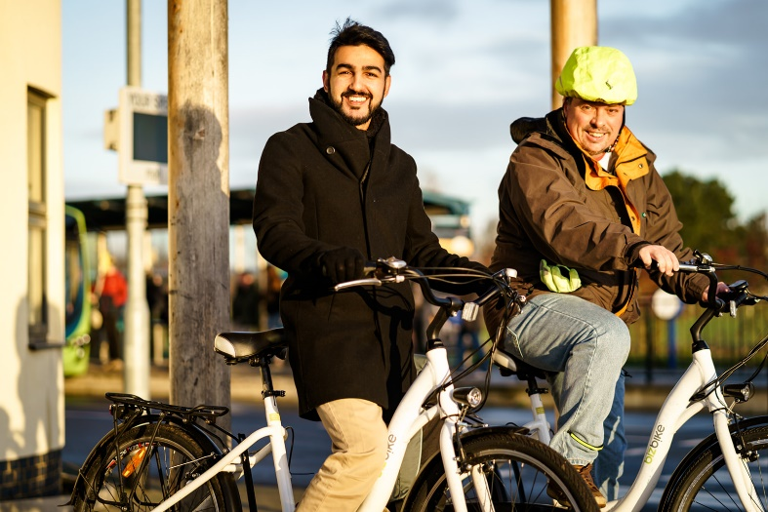
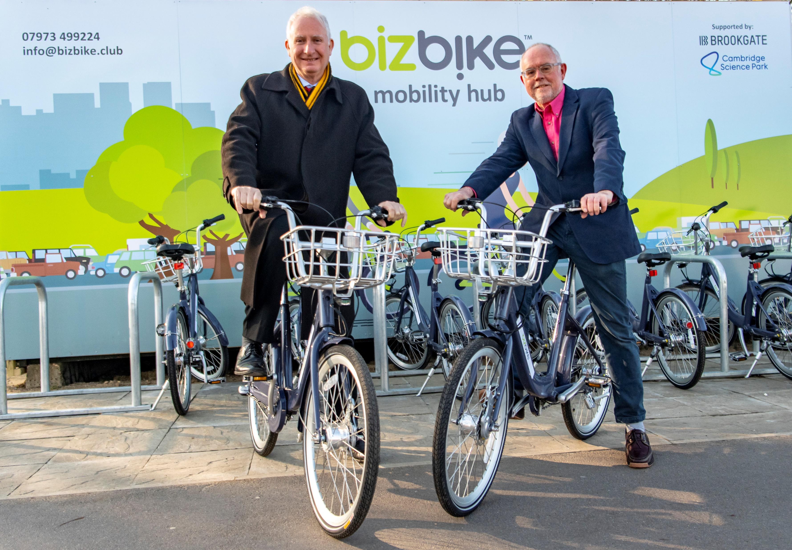
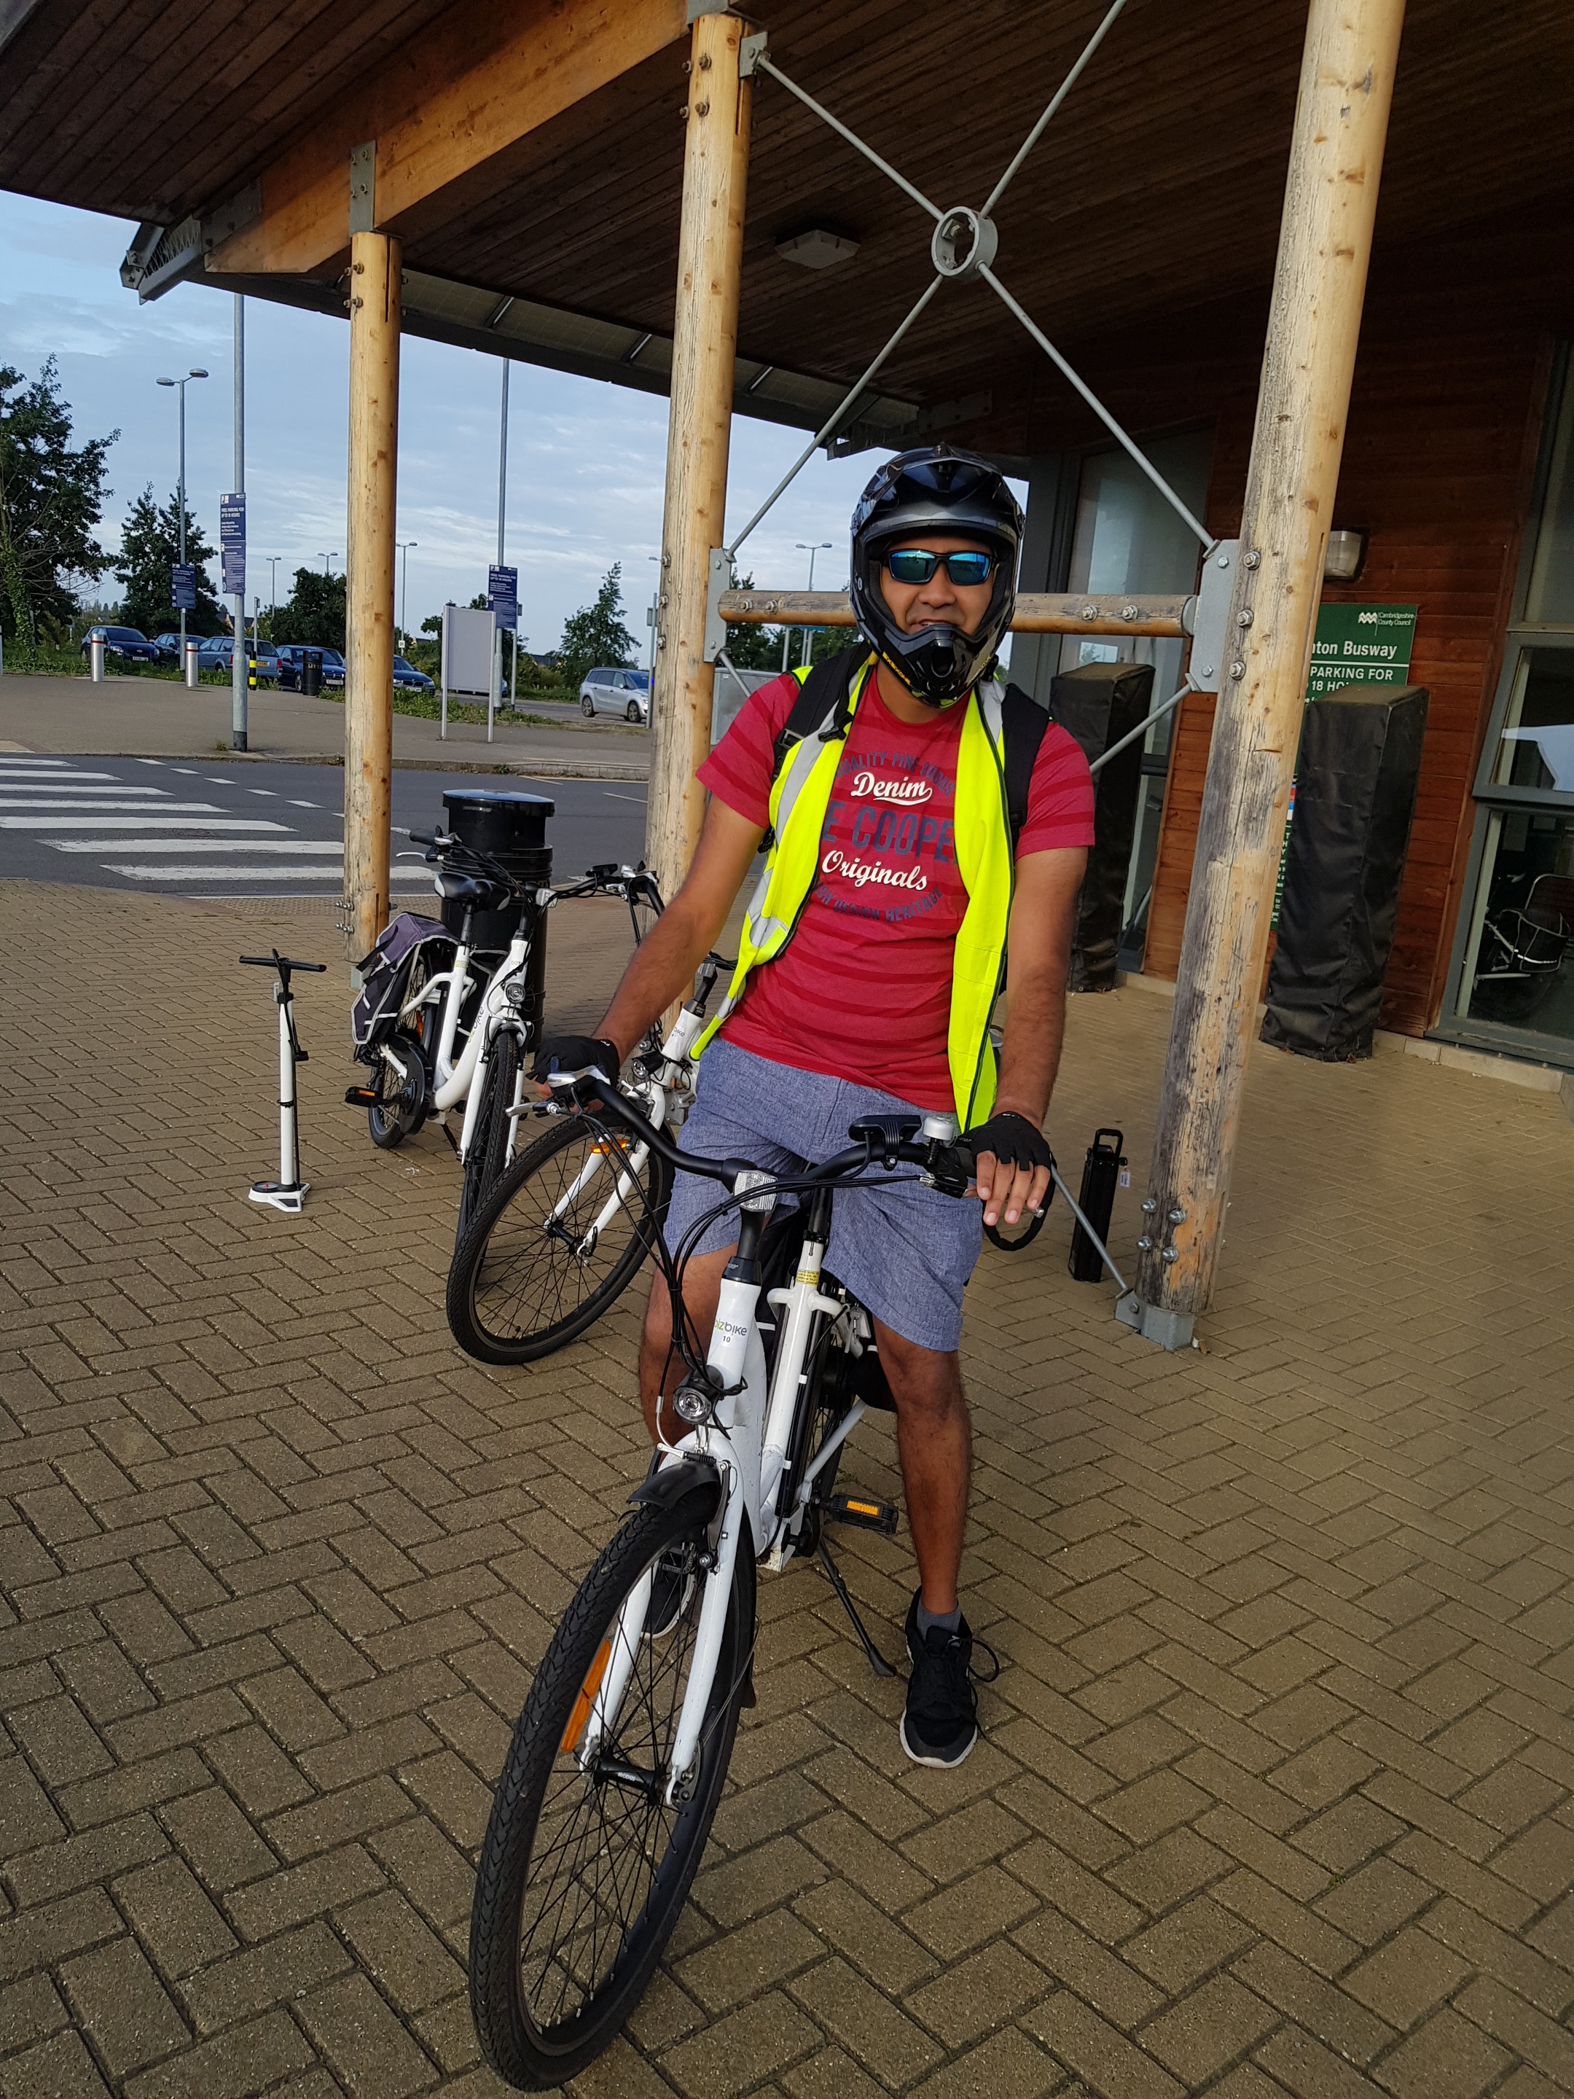
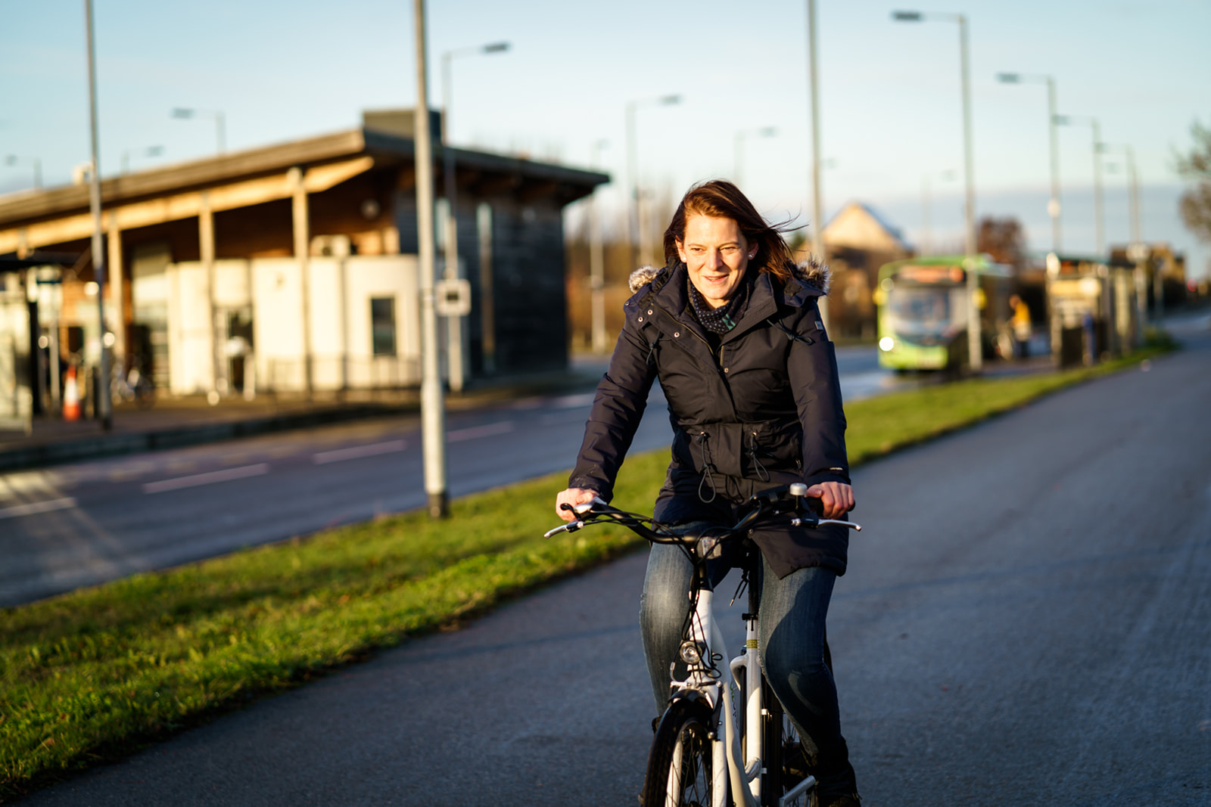
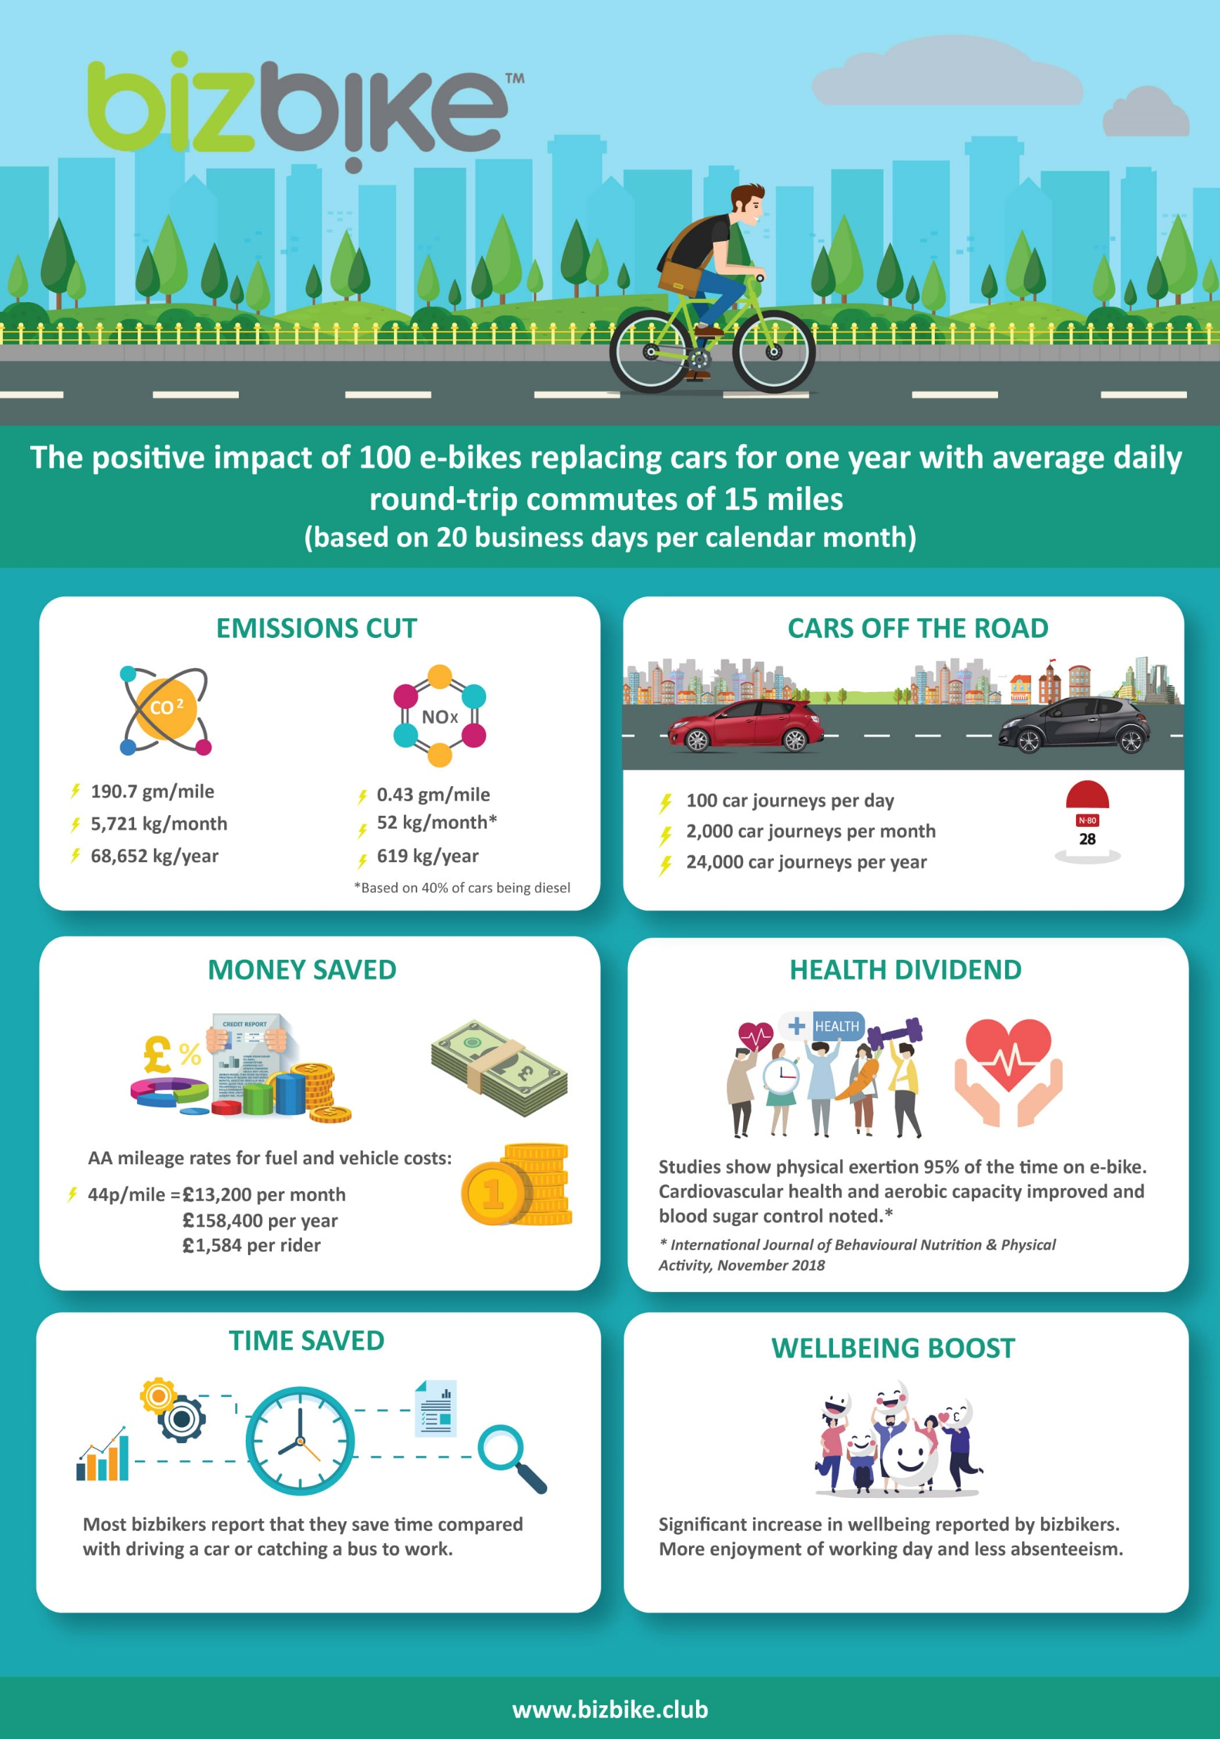

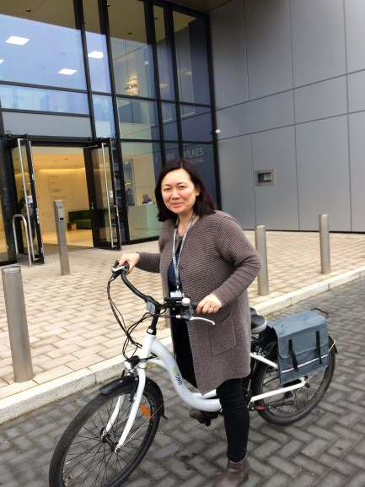
Working with Cambridge communities and employers to promote healthy emission-free micromobility
Notes:
14

Slide 15
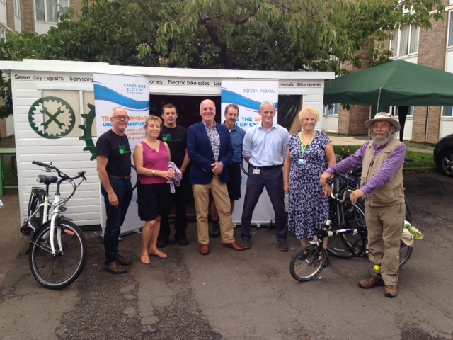
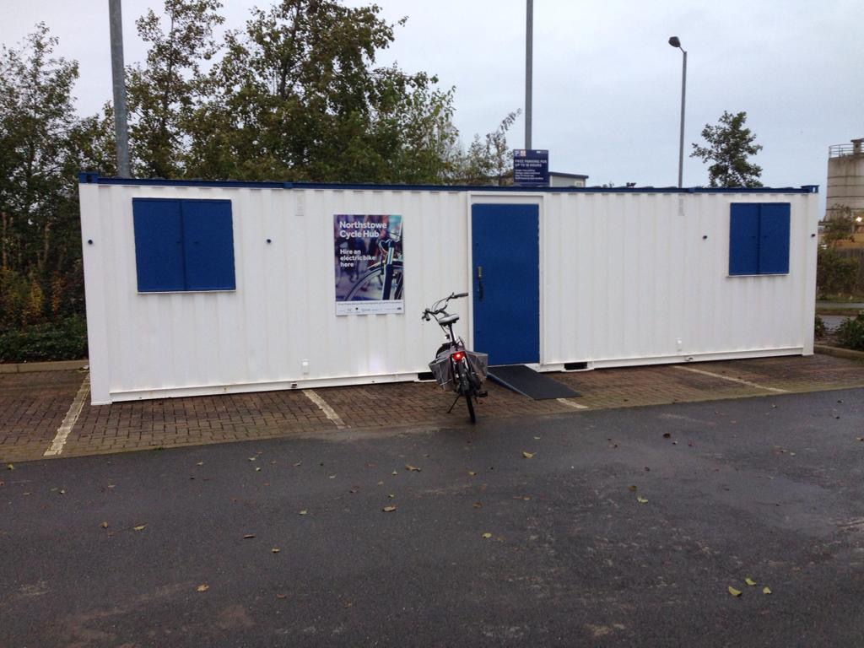
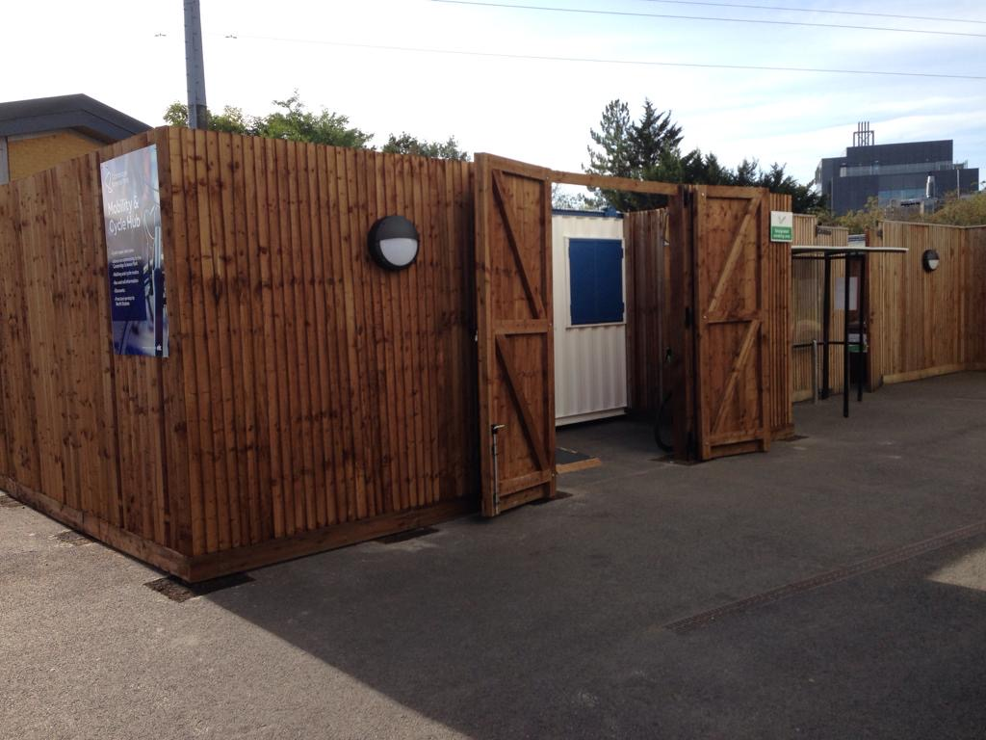
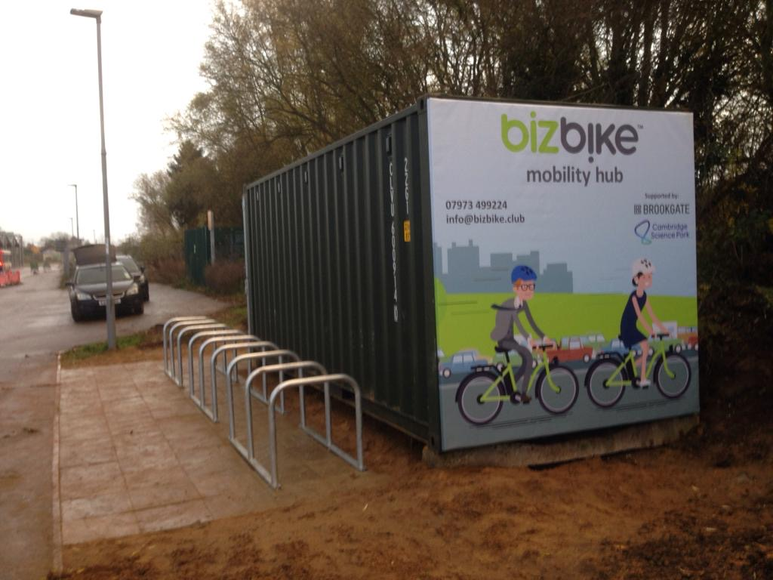
Infrastructure Development
Campus Cycle Hub, Addenbrooke’s/CBC – Bike repair and servicing
Mobility Hub, Longstanton P&R
Mobility & Cycle Hub, Science Park - Bike repair and servicing
Mobility Hub, Cambridge North Station

Slide 16
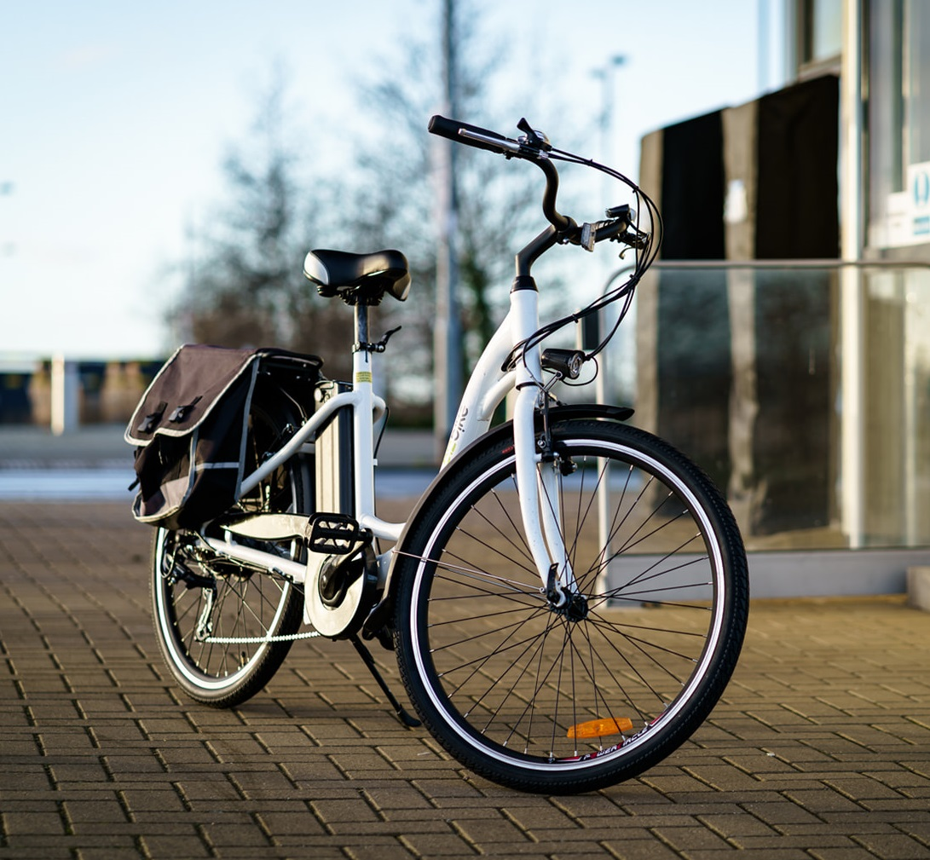
Community E-bikes
Launching Community E-bike services in Northstowe and Teversham in August.
The model developed in consultation with the Northstowe community team and South Cambridgeshire Zero Carbon Communities Fund is to encourage e-bike usages through a subsidy structure that offers residents from participating communities with discounted rides approximately 50% less than commercial rates.

Slide 17
The E-bike
Easy step-through frame
Three levels of motor assist
Six deralliur gears
Front and rear lights operating from bike battery
Pannier bags to carry bags and shopping.
An instruction video on the bike and app operations will be available on our web site.
Riders advised to use their own safety helmets.

Slide 18
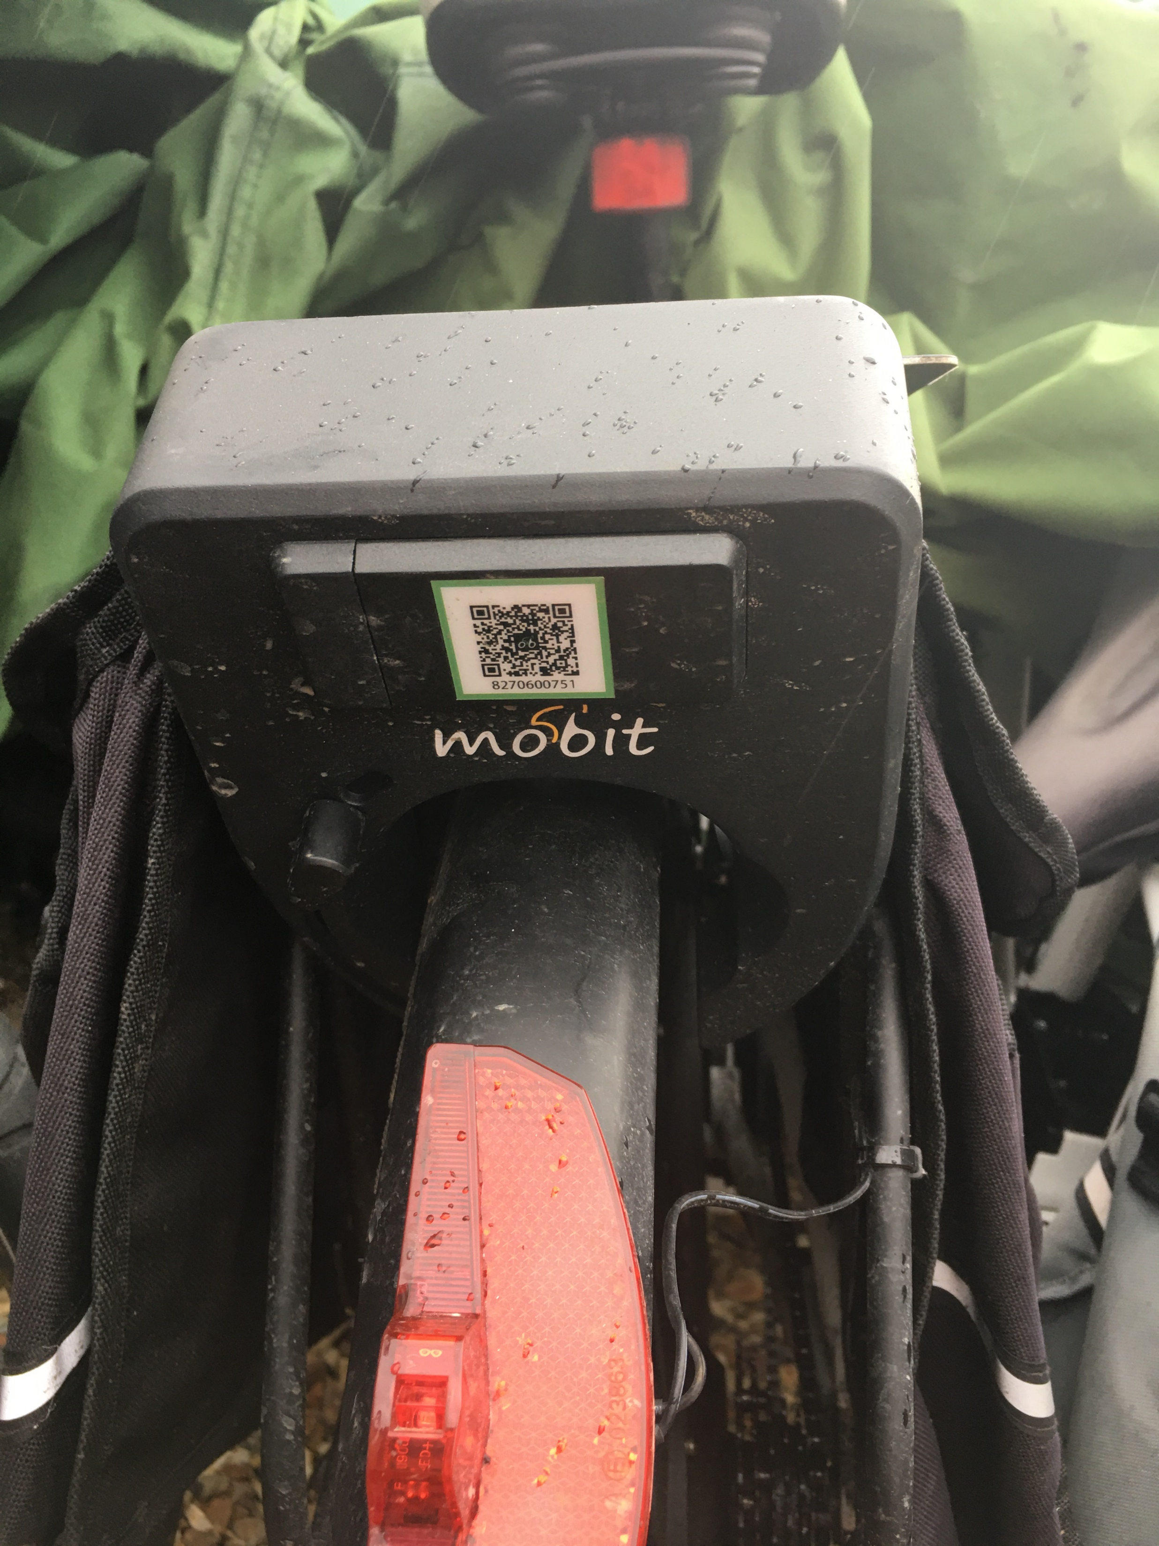
The Lock
Open app on your handset, scan Q-code to unlock bike.
When you pause or finish your ride, lock the bike via the app.
Bike is tracked GPS for security
You have to finish your ride at the station you picked it up from.

Slide 19
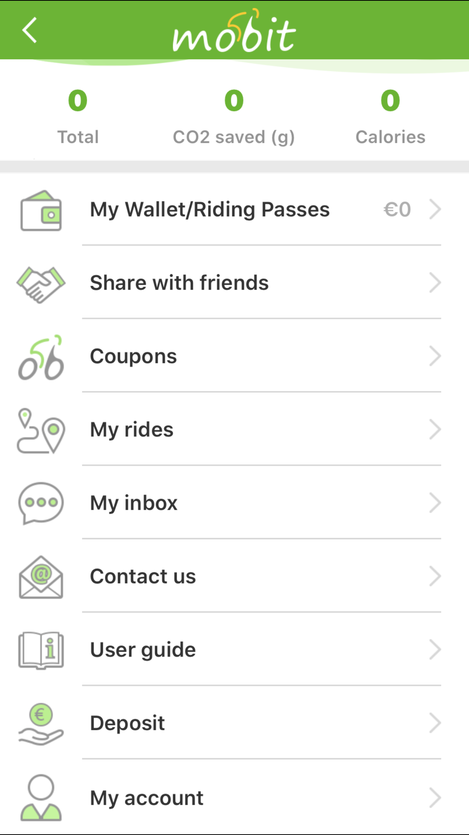
The App
Download the app from Appstore and register.
Residents can register with an initial £1 payment.
Your community postcode will qualify you for the discounted rates subsidised by South Cambs.
If you don’t have a smart phone we will issue you a smart card with ride credits loaded which you can pay for via our web site.
Helpline to assist with any problems.

Slide 20
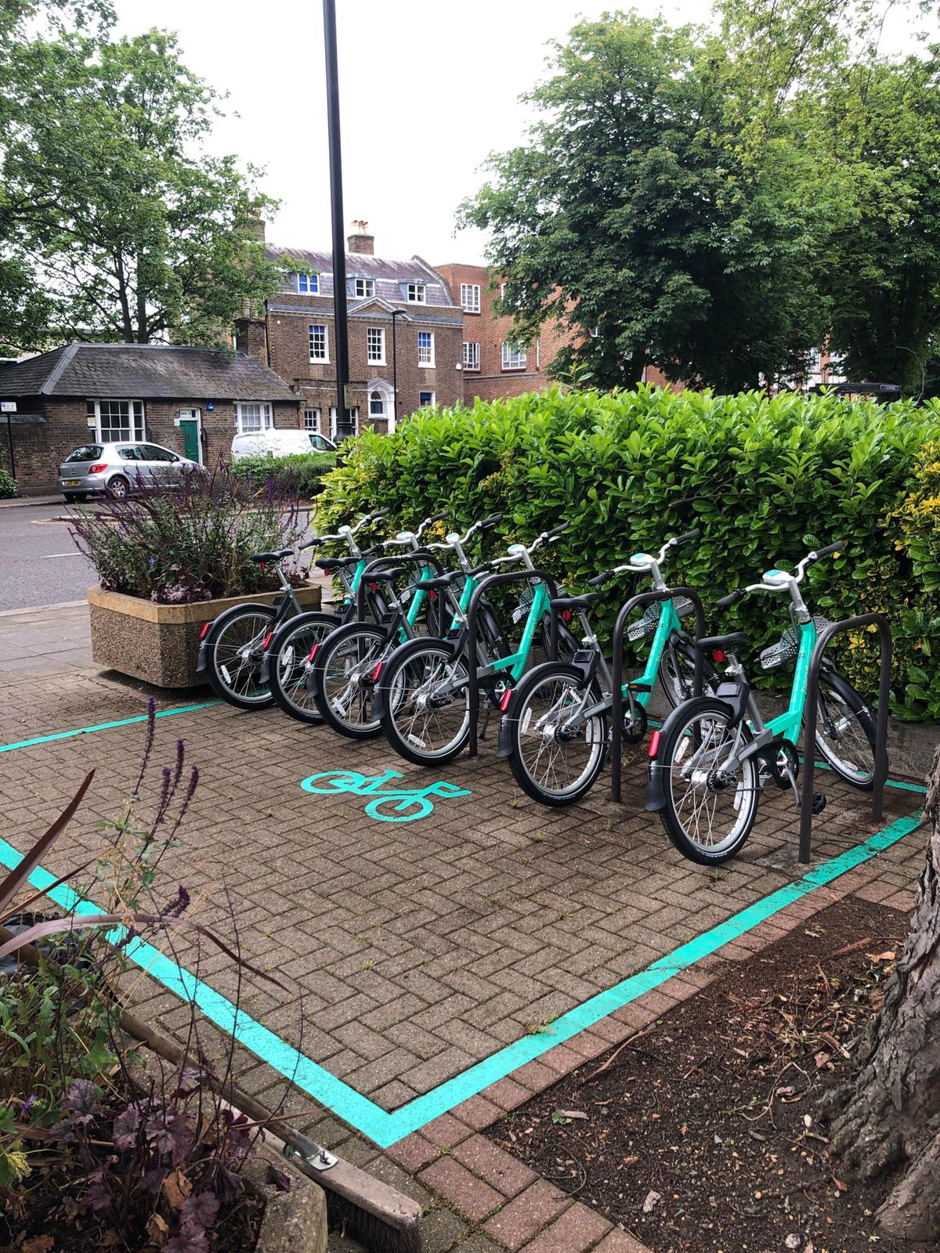
The Stations
E-bikes will be free-standing at bike stations set up in designated spaces in participating communities.
No bike racks or other infrastructure needed apart from approved road markings.
Stations will be geofenced and riders must return bikes to the station they were picked up from.
Security will be provided by GPS tracking and network of operations staff in Greater Cambridge area.
E-bikes will be regularly checked and cleaned, serviced at least every six months. Long-range batteries, swopped with charged ones as needed.

Slide 21
The Rates
BizBike Community E-bike rates
Hour | Rate | Cumulative
1 | £0.50 | £0.50
2 | 0.5 | 1
3 | 0.4 | 1.4
4 | 0.4 | 1.8
5 | 0.4 | 2.2
6 | 0.4 | 2.6
7 | 0.4 | 3
8 | 0.4 | 3.4
9 | 0.3 | 3.7
10 | 0.3 | 4
11 | 0.3 | 4.3
12 | 0.3 | 4.6
13 | 0.3 | 4.9
14 | 0.3 | 5.2
15 | 0.3 | 5.5
16 | 0.3 | 5.8
17 | 0.3 | 6.1
18 | 0.3 | 6.4
19 | 0.3 | 6.7
20 | 0.3 | 7
21 | 0.3 | 7.3
22 | 0.3 | 7.6
23 | 0.3 | 7.9
24 | 0.3 | 8.2
1 hour – 50p
2 hours - £1
3 hours – £1.40
8 hours - £3.40
12 hours - £4.60
18 hours - £6.40
24 hours - £8.20
Above are discounted rates approximately 50% of commercial rates, subsidised by South Cambridgeshire Zero Carbon Communities Fund.

Slide 22
Any questions?
Contacts:
Sean Moroney
Cambridge Electric Transport
seanm@cambridgeelectrictransport.co.uk
01223 667798
07973 499224
www.cambridgeelectrictransport.co.uk

Slide 23
PECT
Antony Gough
Tony Cook

Slide 24

Zero Carbon Communities Workshop
6th July 2020

Slide 25


What we do?

Slide 26
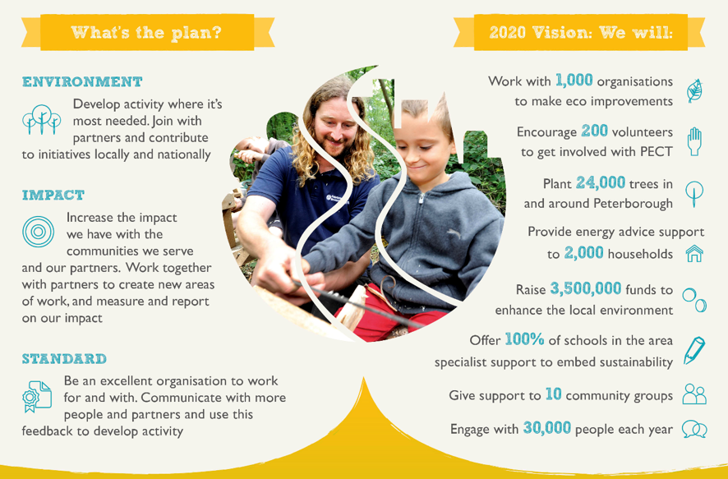

Slide 27

Energy Efficiency Reviews
What’s Involved?
Impartial advice from an experienced energy advisor
  Site Visit to identify key energy efficiency improvement opportunities
  Concise report including;
    Key recommendations
    Indicative costs
    Pay back periods
  Follow-up support

Slide 28
What is covered?
The Building
Construction materials.
Insulation – wall and pipes.
Building condition – age and fabric.
Openings – doors, windows etc.
Building Energy Use
Space heating and domestic hot water.
Ventilation.
Cooling – air conditioning.
Lighting.

Slide 29
What is covered?
Installed Systems
Boiler service needs/history.
Local temperature controls.
Areas of simultaneous heating/cooling.
Process Energy Use
Computers & Office Equipment

Slide 30
Typical Energy Efficiency Measures
Heating | Infrared /Controls
Building fabric | Insulation & Windows
Lighting | LED lights & Occupancy sensors
Renewables | Solar PV/ Solar Thermal /Energy storage
Transport | Electric Vehicles / EV Charging Points

Slide 31
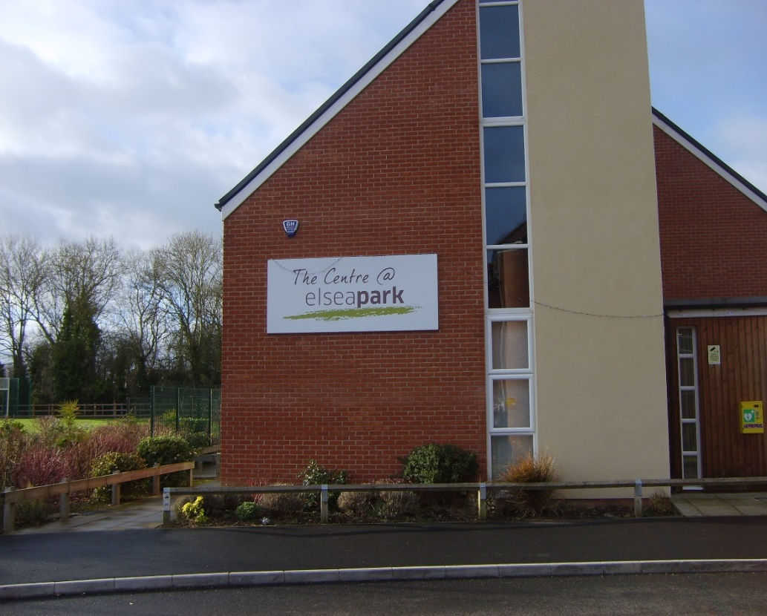
Case Study
Elsea Park
Community Trust

Slide 32
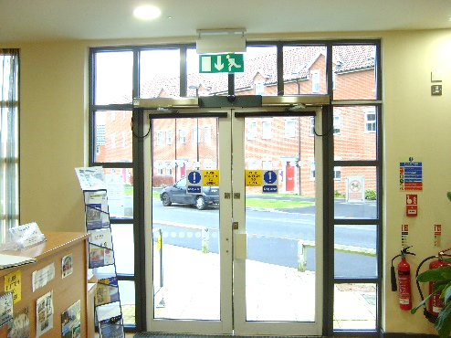
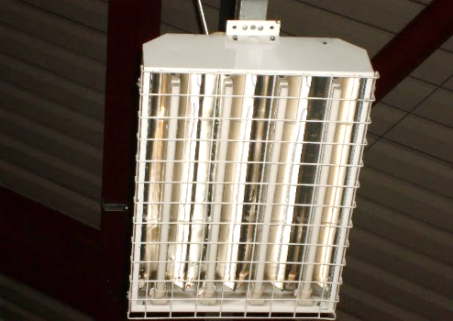
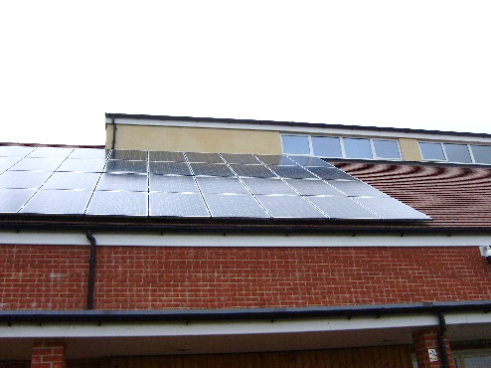
What did they do?
Heating & Cooling | Infrared radiators in reception and workshop areas replaced inefficient electric-fan heaters Replaced air conditioning system to a more efficient climate control system
Lighting | Further retrofitting of LED lights & occupancy sensors
Renewables | Solar PV had already been installed

Slide 33
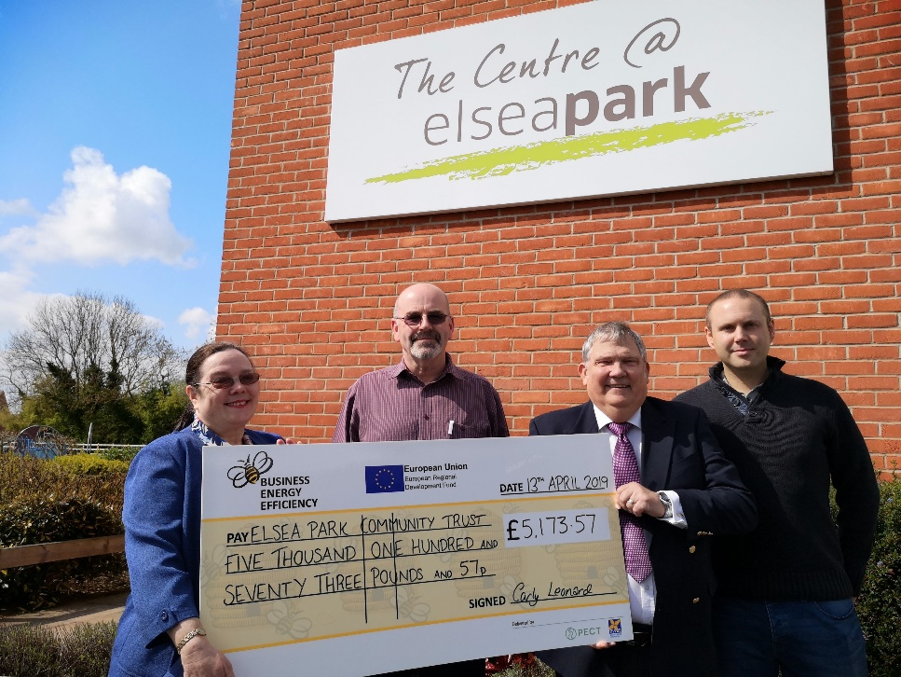
What were the benefits?
Value of Investments | £20,692
Cost Savings (Per Annum) | £4,000
Payback (Years) | 5.2
Grant Funding | £5,173
Reduced Payback | 3.8

Slide 34
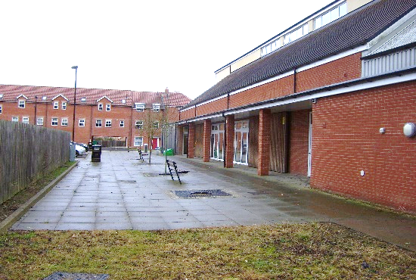

What were the benefits?
Carbon Saving (Per Annum) | 12 tonnes
Opening Hours | Extended - better climate control enabled longer use of building in evenings without issues around noise
Income | Increased - key health sector clients with very specific needs around temperature/comfort extended use of hall
Working Environment | Improved – better comfort for staff in reception and workshop areas

Slide 35
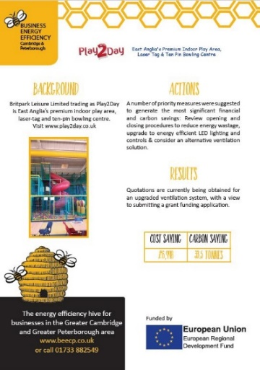
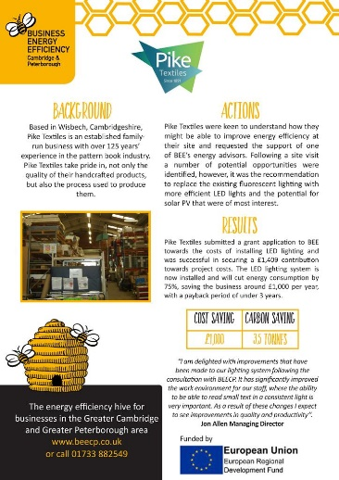
Energy Efficiency Case Studies
www.beecp.org/case-studies

Slide 36

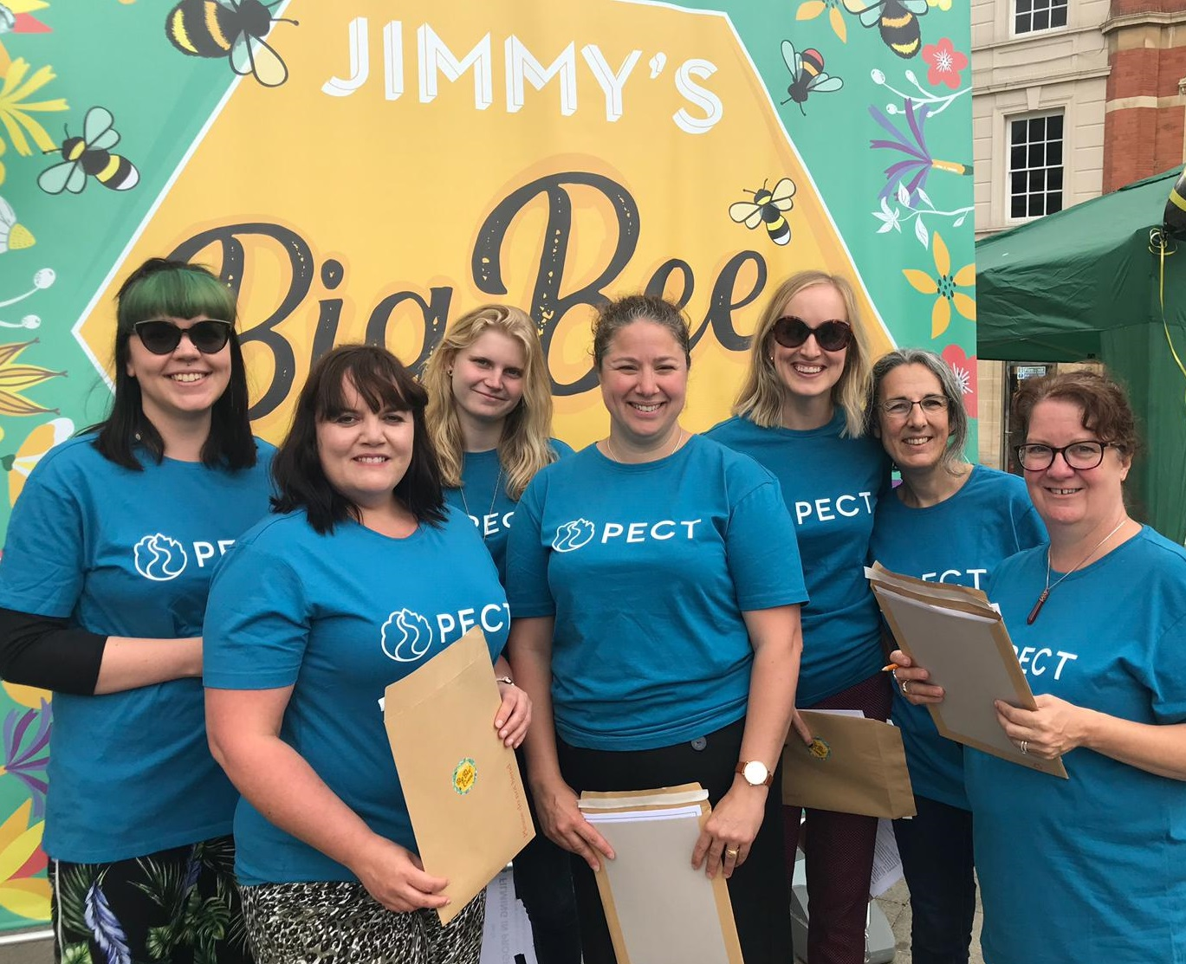
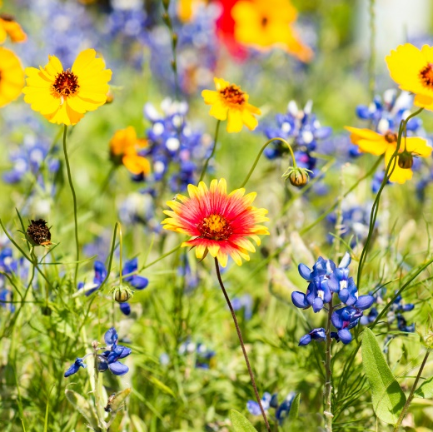
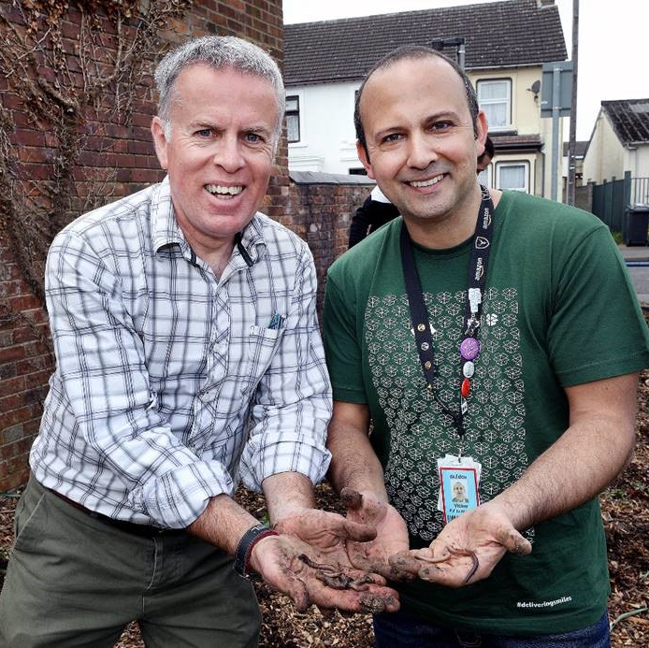
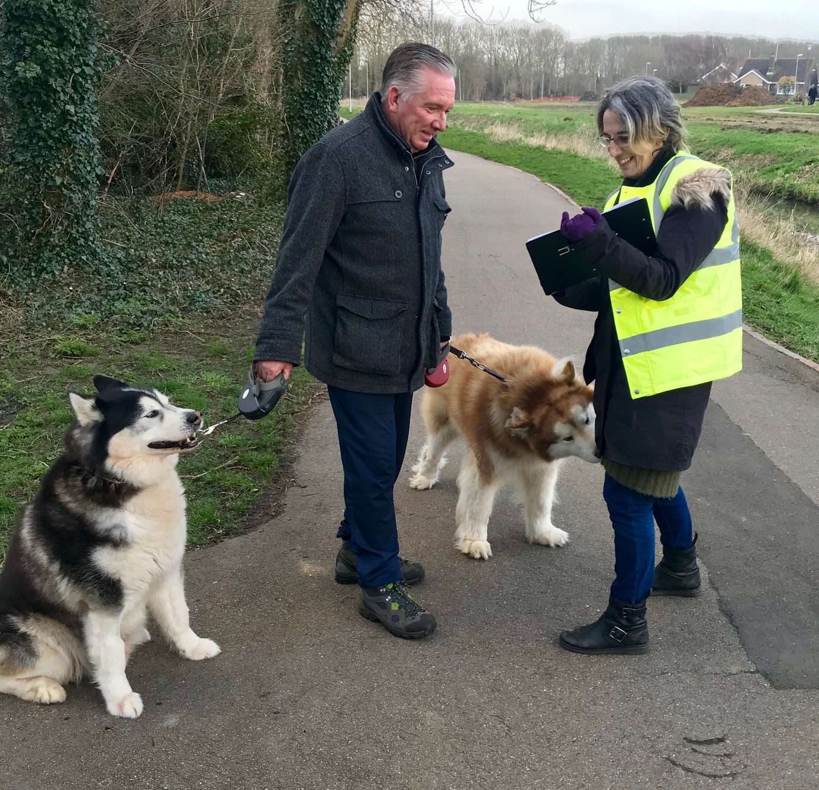
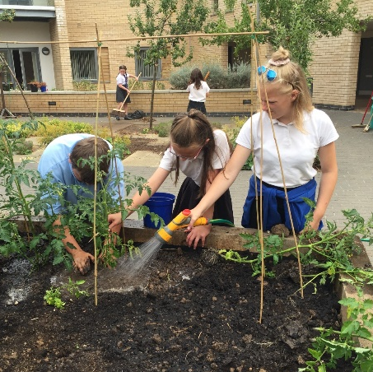
Natural Environment

Slide 37
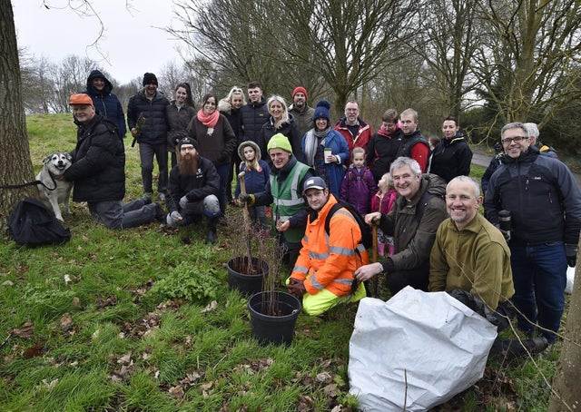
Community Activities

Slide 38
Natural enhancement planting
Assessment
Identify
Objectives
Community
Agreement
Formal Plan
of action

Slide 39
Enhancement Projects
Local Value
Integrating national targets and initiatives
Structure
(flora)
Cover per unit area
Ecosystem
elements
Review at landscape level

Slide 40
Enhancing the community
Green infrastructure
The people within the community
Participatory legacy
Well-being
Skills, training & education
Developing all aspects of the community

Slide 41
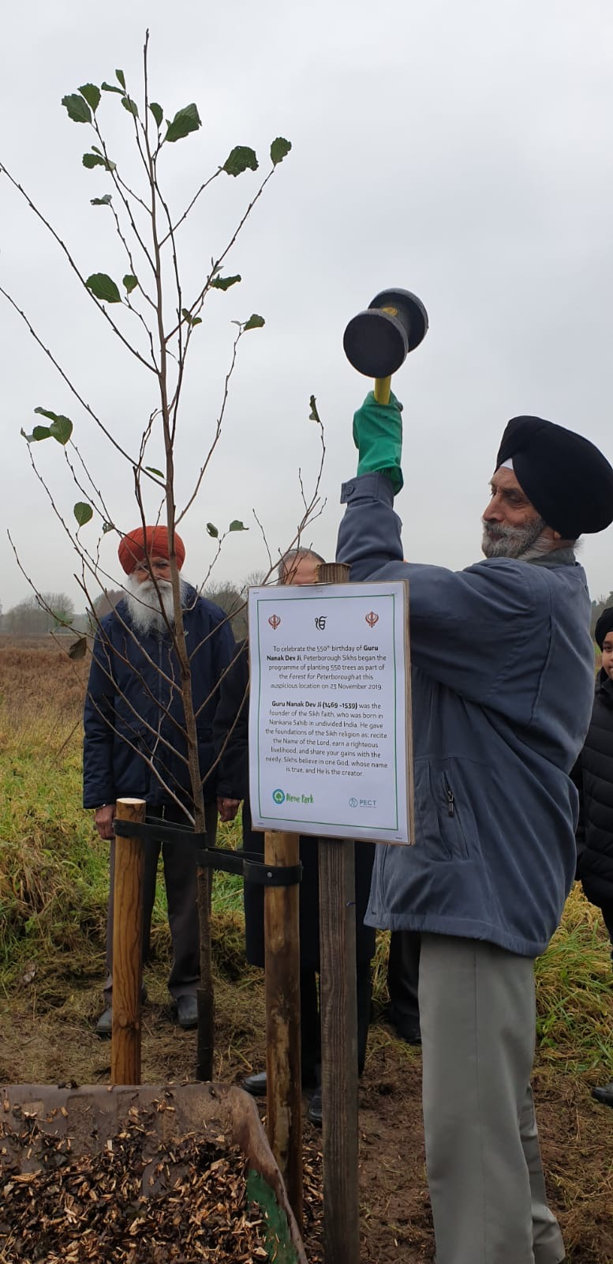
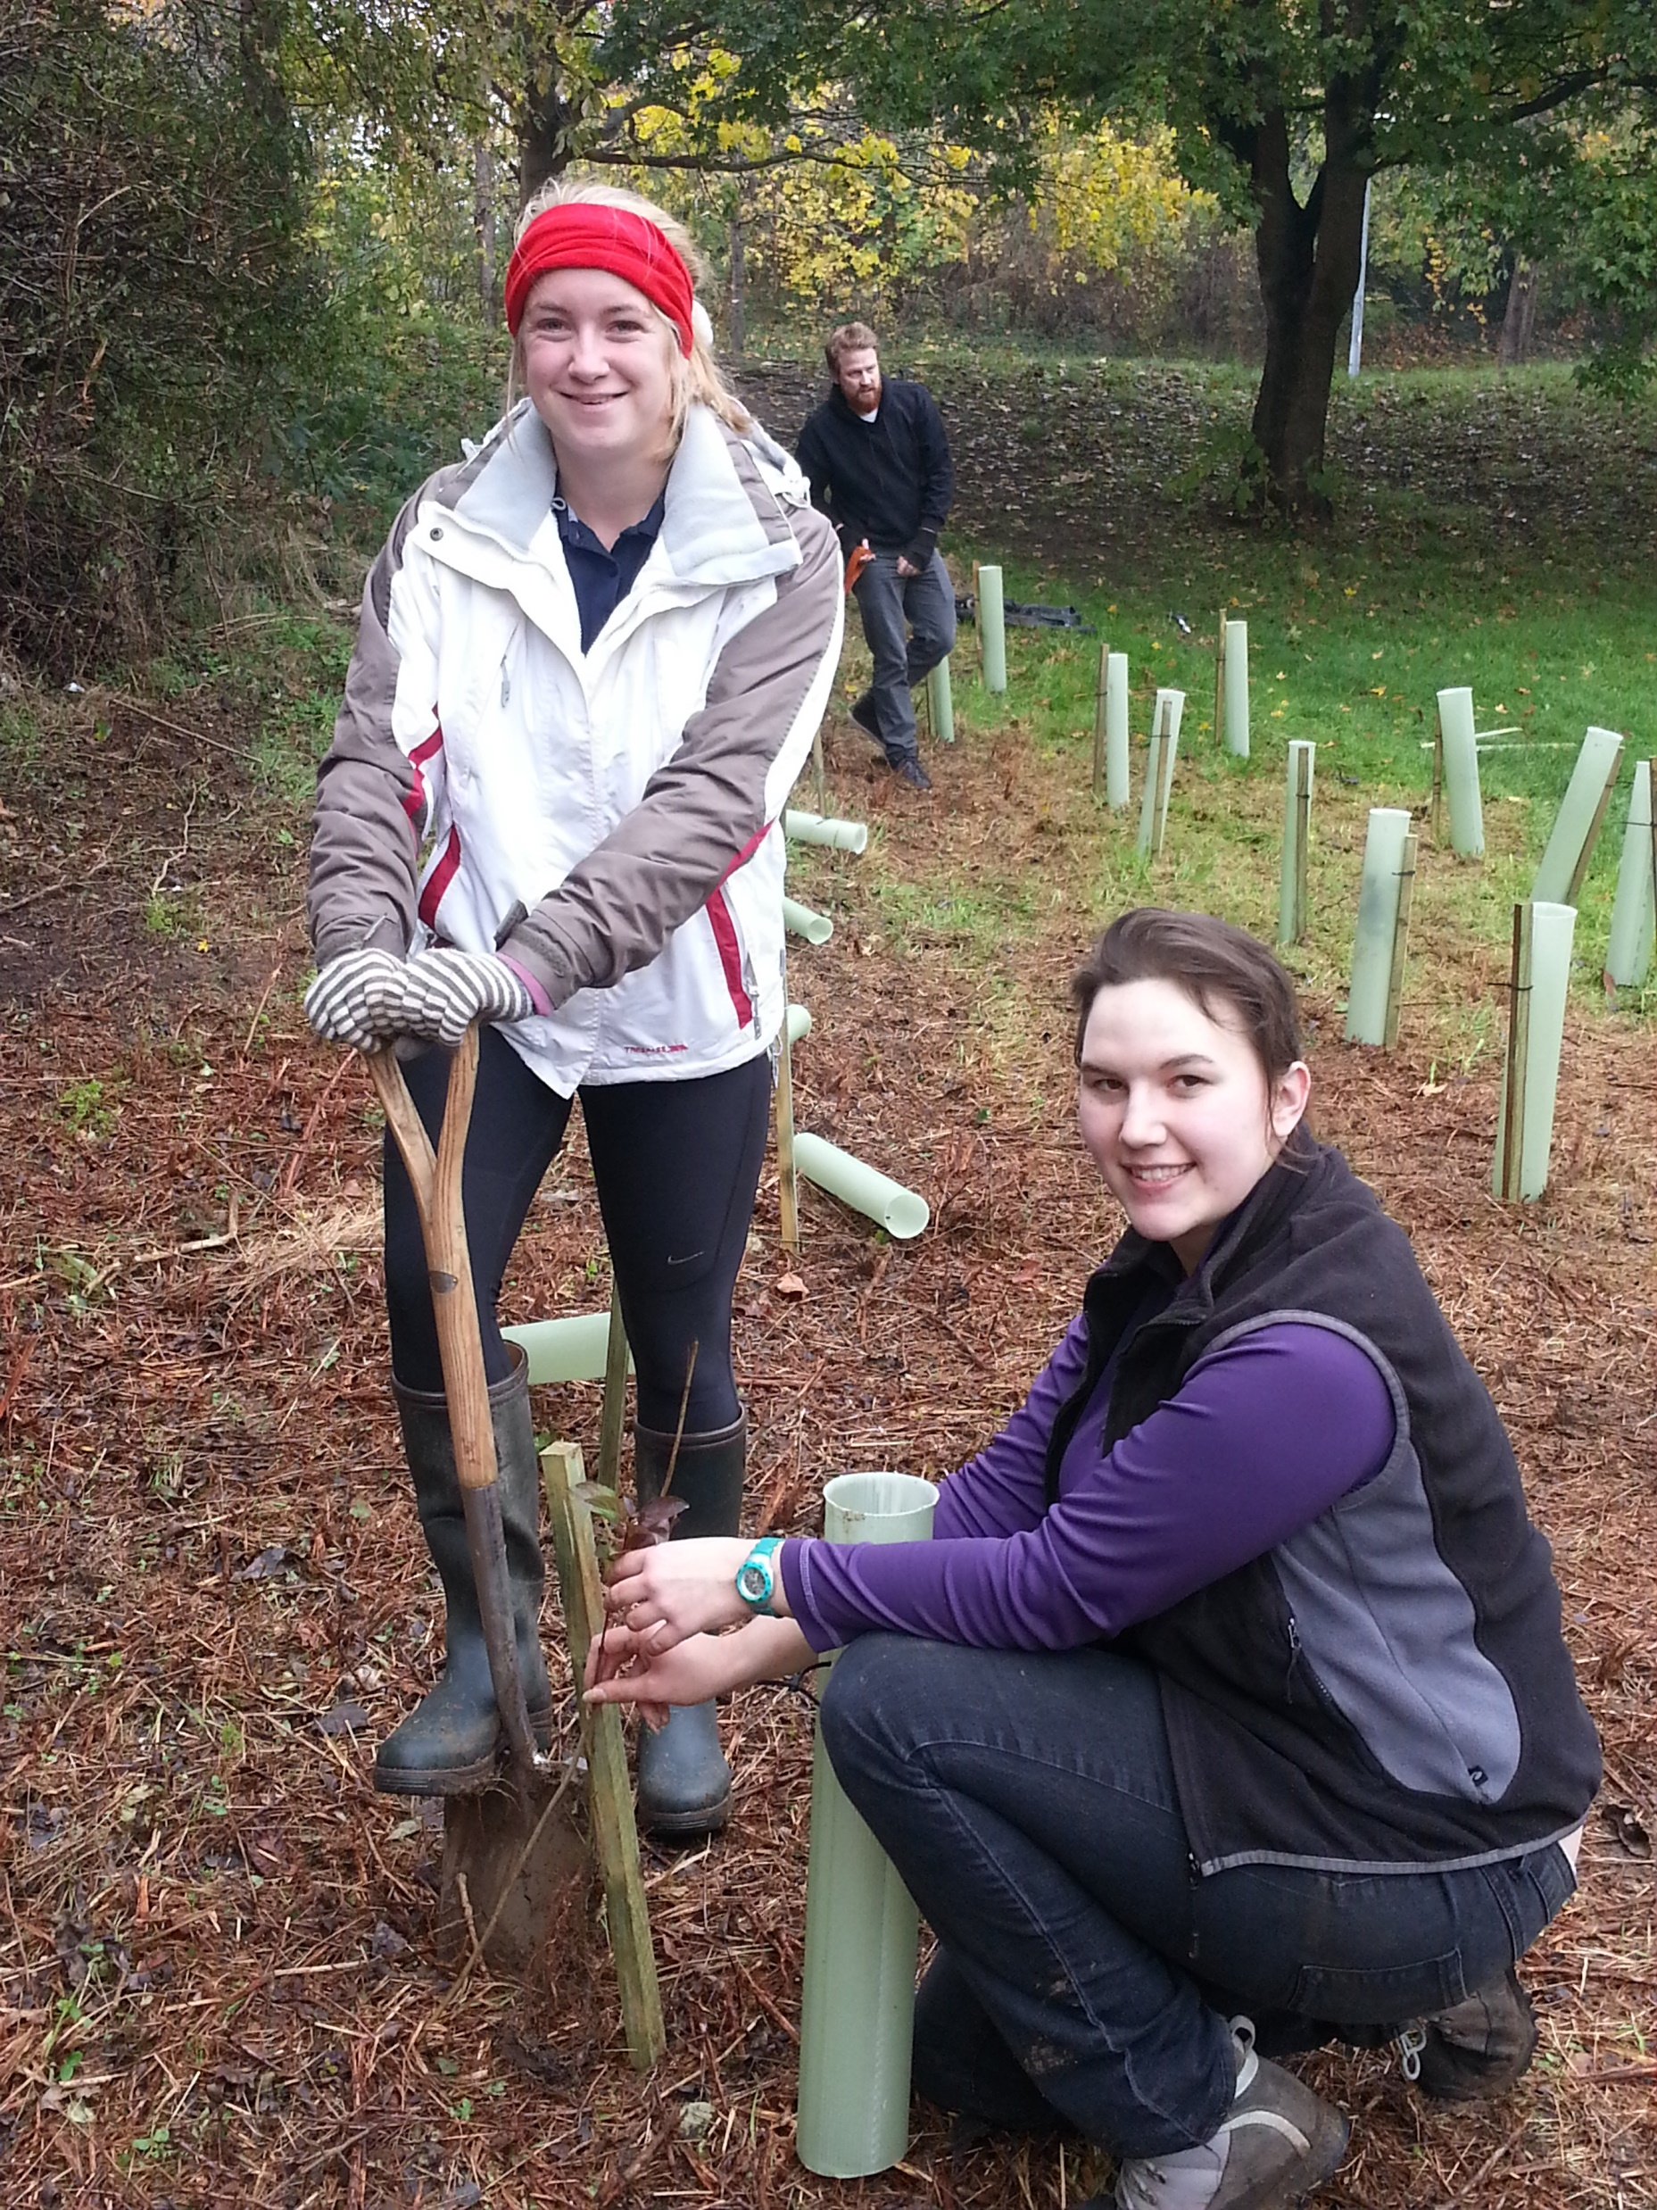
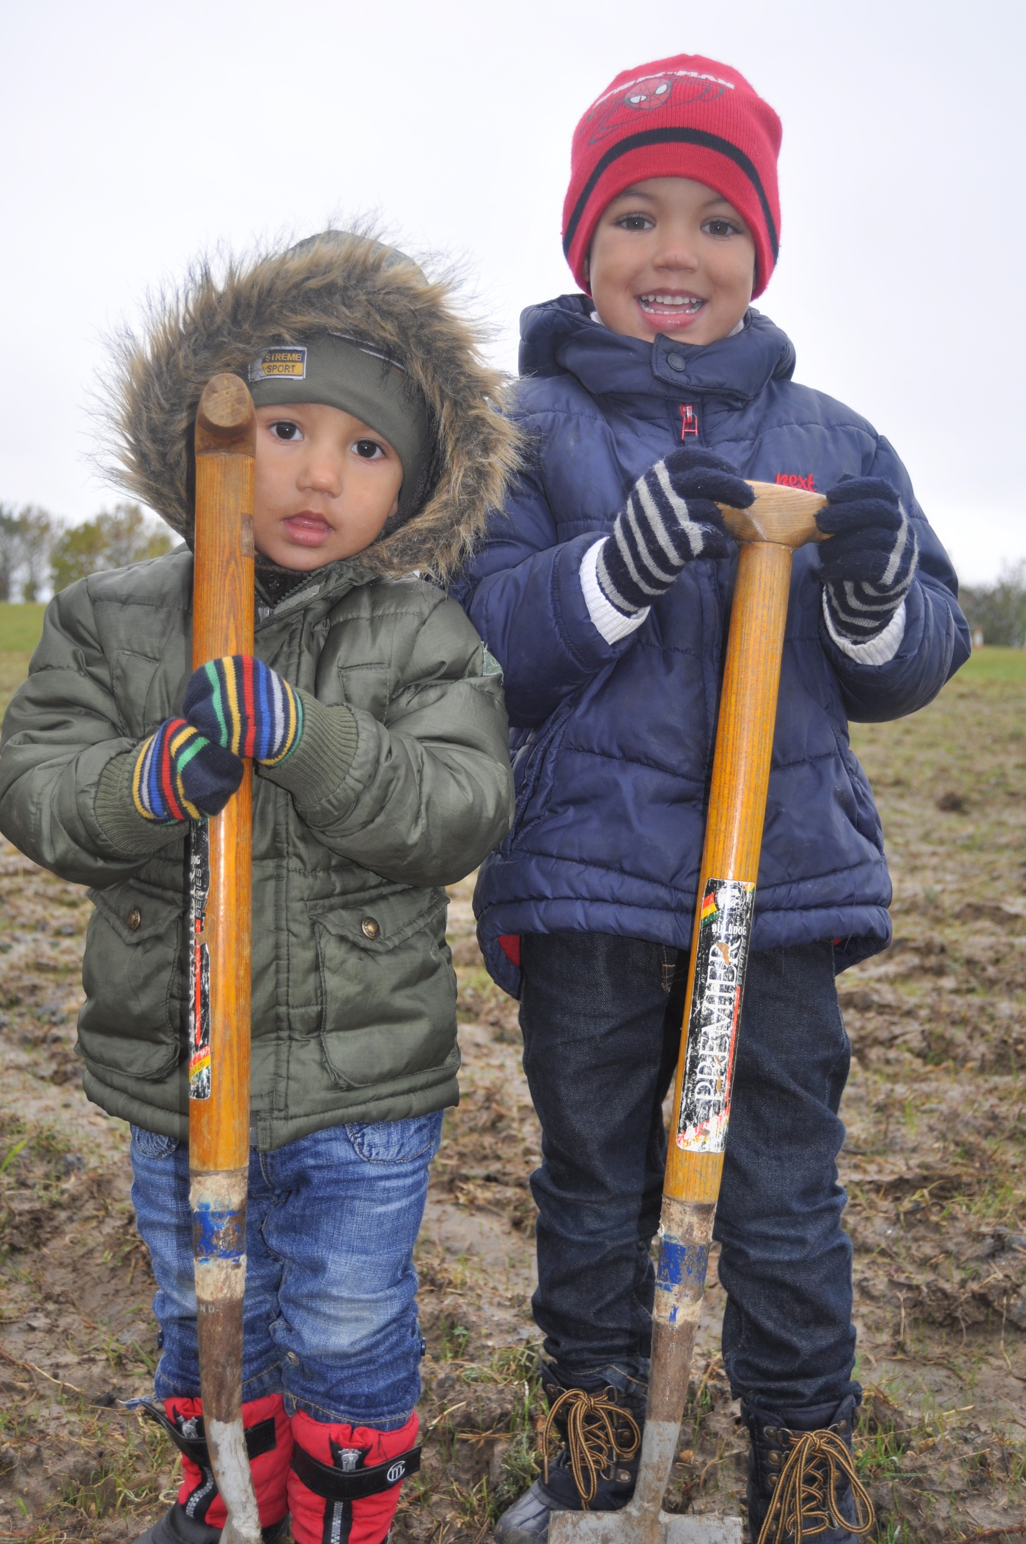
Working together

Slide 42
Areas of expertise
Site clearance
Maintenance and formative pruning
Re-planting
Restoration and natural regeneration
Biodiversity improvements
Species protection

Slide 43
Contacts
General inquiries
Kari-ann.whitbread@pect.org.uk
Natural Environment inquiries
Tony.cook@pect.org.uk
Energy efficiency inquiries
Antony.gough@pect.org.uk

Slide 45
How to apply and what happens next
Emma Dyer

Slide 46
Grant Information
Min/max grant: £1,000 - £15,000
Grant scheme open:
Wednesday 1st July
Application deadline:
  5pm Wednesday 30 September
  Results: by the end of the year

Slide 47
Who can apply?
Any non-profit group or organisation based in South Cambridgeshire or benefiting South Cambridgeshire residents, OR a South Cambridgeshire parish council.
Non-profit organisations could include:
registered charities
companies limited by guarantee
unincorporated associations or clubs
community interest companies
charitable incorporated organisations
community benefit societies
social enterprises
established voluntary sector organisations
community shops which are non-profit making

Slide 48
How to apply:
via our online webpage:
www.scambs.gov.uk/zerocarbongrant

Slide 49
Application process
We have made the application process easier
You can choose one of our options or devise your own project
You can apply for more than one project
All projects need to meet the objectives as stated on the application form

Slide 50
Please take your time and read the guidance notes next to the questions on the application form
Part-funding looked upon favourably
Applicants seeking less than £1,000 are encouraged to apply to the Community Chest

Slide 51
Support and guidance:
Further Information on webpage including a FAQ’s and useful links section.
Please email zcc@scambs.gov.uk with your query or to schedule a call

Slide 52
Q&A’s

