Slide 1
Template header
Northstowe Community Forum
Wednesday 24 January 2024
David Parke
Assistant Director Sustainability & Infrastructure (South)

Slide 2

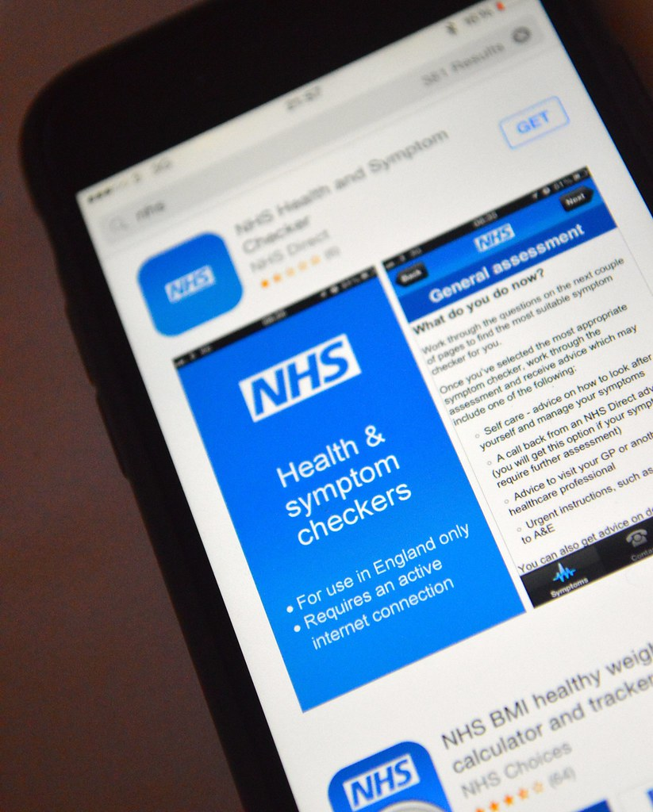
Health Care for Northstowe
General Practice
The following practices cover all or parts of the Northstowe Development as it is built out in phases: Phase 1: 1,353 occupations to date, target 1,500 homes by end of calendar year Phase 2&3: 2028 (Civic Hub due to open) c. 2,500 homes built Cottenham Surgery 1, 2 & parts of 3 Firs House Surgery (Histon) part of 3 Maple (Bar Hill) all phases Over Surgery 1, 2 & parts of 3 Swavesey Surgery part of 3 Waterbeach Surgery 1, 2 & parts of 3 Willingham and Longstanton Medical Practice 1, 2 & parts of 3 Cambridge Northern Villages PCN: (8 Practices, pts: c.50,250 Cottenham, Firs House, Maple Surgery, Milton Surgery, Over Surgery, Swavesey Surgery, Waterbeach Surgery and Willingham MP).
Health Access Now
This Photo by Unknown Author is licensed under CC BY

Slide 3
Health Care for Northstowe
Longstanton & Willingham (nearest practice)
Capacity to take a further c. 5,500 patients. Workforce and operational hours to increase, as necessary. Interim Community Space: location for Pathfinder Way, opposite the Green (to include assembly rooms, offices, food bank with café/kitchen facilities, NHS room). NHS room: delivering mental health support, health visiting and midwifery services from our Community NHS Trusts. Working on procurement and contracting options for newly commissioned permanent facility. Health and Wellbeing services to be co-located from both statutory and non-statutory services, working with System Partners from CUH, CPFT, CCS, LA, EEAST etc.
Future Health Care
Interim Healthcare

Slide 4
Health Care for Northstowe
Northstowe Civic Hub (library and health)
Working with SCDC to design a schedule of accommodation. Working with Contracting & Enabling Team to commission GP and health contractors from Civic Hub to operate from Spring/Summer 2028. Plans to deliver a total of 1,740 sqm for a Civic Hub (1,300 GMS, Community Trusts 200, Pharmacy 120 and Dentistry 120). PCNs and INs to collaborate and use the new Civic Hub for wider services. The Civic Hub needs to be flexible to accommodate both traditional healthcare and services that address the wider determinants of health (e.g. CAB, housing, social care, family hub, social prescribing, Public Health initiatives, social groups, leisure and active pursuits etc). More integration to deliver services closer to where people live (diagnostics, OPA, minor surgery, specialist treatments etc.).
Future Healthcare

Slide 5
Questions

