Slide 1
Stagecoach East Update
Charlton Thornhill
Head Of Commercial
Stagecoach East

Slide 2
Current Position
Passengers on Cambridge Services are currently around 88% of pre Covid 19 levels.
PR5 has around 116 passengers per day using the service from Waterbeach, this makes up around 10% of the total borders on the route.
Reliability of services is good we are currently delivering 98% of journeys, however punctuality is suffering with services struggling with severe congestion in Cambridge City, continual road works, active travel schemes all have seen a negative impact to bus services with ever increasing delays.
Currently we are in a healthy driver position bucking the trend nationally, which is still seeing major shortages across the industry

Slide 3
Milton Park and Ride Passenger Levels

Slide 4


Slide 5
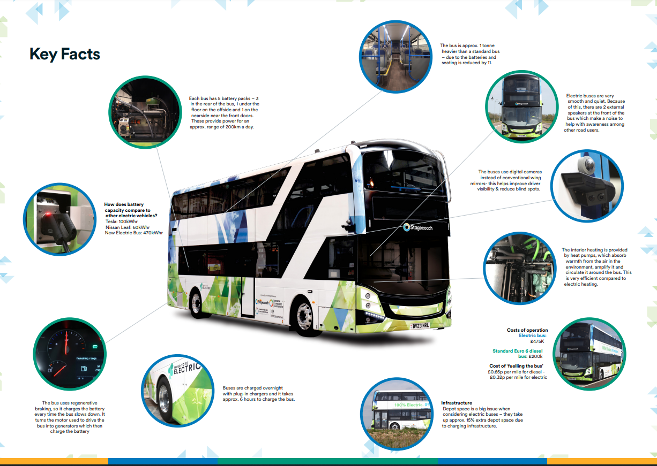

Slide 6
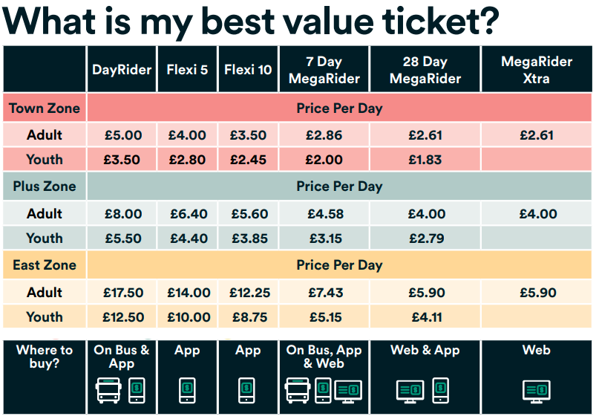

Slide 7

Flexi Tickets
With travel patterns changing and hybrid working becoming more popular, we introduced new Flexi tickets to cater to commuters.
Flexi Tickets are bundles of DayRiders that can be purchased on the app and used at any time over a 12 month period.
Plus, with Flexi you can travel from just £3 a day!

Slide 8
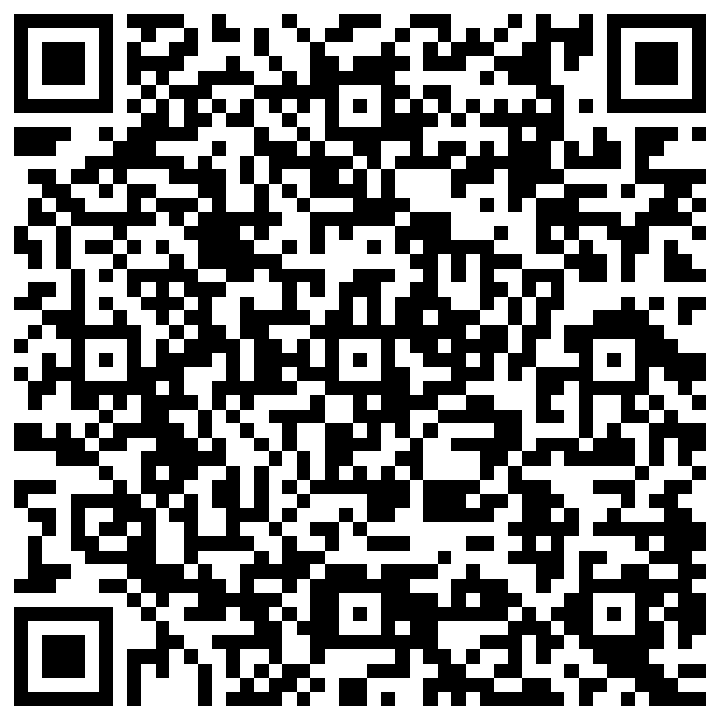
Stagecoach Bus App
Check out our mobile app! It has everything you need to travel with ease. Download and you can:
Plan your journey
Save your favourite routes & stops
Track your bus, live!
Check for quieter travel times
Purchase tickets
And so much more …

