Slide 1
Waterbeach Community Forum
1st November 2023
Notes:
Atkins have been asked to further assess the feasibility of the Waterbeach alignment. We will discuss this approach and outline some key consideration below.
If the original route is no longer feasible, we may need to reconsider
Atkins have also been commissioned to simultaneously consider other alignment options (and their feasability)

Slide 2
Waterbeach Greenway

Slide 3
Greater Cambridge Greenways
Greenways are new and or improved walking, cycling and, where appropriate, horse riding routes.
Provide better, safer and greener cycling and walking and, where appropriate, horse-riding routes, to and from Cambridge and the surrounding villages and other settlements.
Improve access to jobs and opportunities, education, healthcare, leisure and other services.
Help to reduce the impact of traffic congestion and growing traffic levels.
Improve our health by enabling more active travel and helping to reduce air pollution.
Provide safe active travel routes that all ages and abilities can use.
Notes:
Will make it easier both to travel in a pleasant and sustainable way into and out of Cambridge and to enjoy our countryside for leisure purposes.
Will also help to make local journeys such as school and nursery runs safer and easier. In some cases these are new routes, or routes with new sections, whilst others will be based on existing paths.

Slide 4
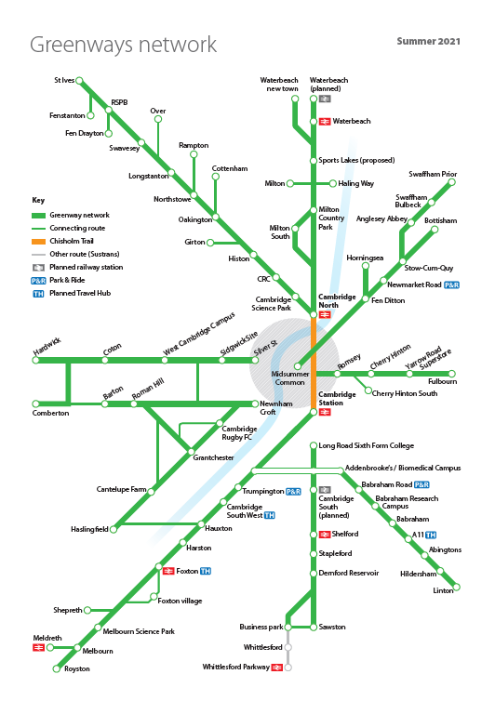

Slide 5
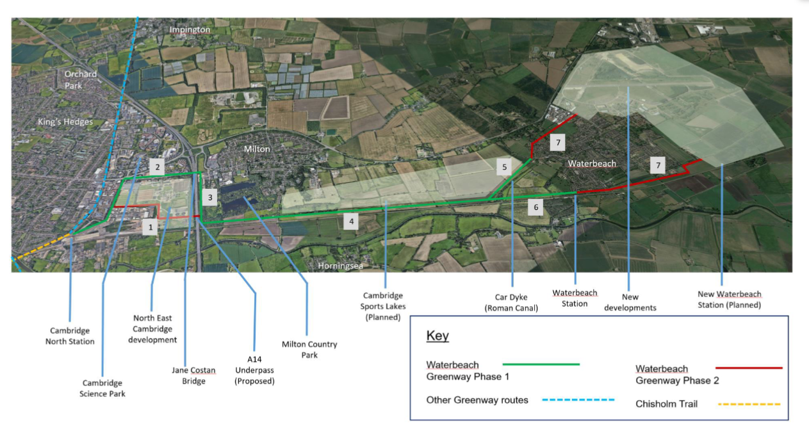
Waterbeach Greenway: Original Alignment
Notes:
Alignment following 2018 consultation
Note this is the line to Kings Lynn
In 2021-22, a feasibility study was undertaken of the Waterbeach Greenway proposed alignment, which includes a proposed underpass under the A14 adjacent to the Network Rail underbridge, and an offline route alongside the railway lines from Cambridge to Waterbeach, alongside the existing rail station and up to the relocated station (see plan). This was considered in 2 phases; phase 1 budget was approved by the GCP Executive Board, but phase 2 was always subject to funding.
A number of challenges were uncovered as part of this, including the cost and feasibility of the proposed A14 underpass and the presence of a Flood Zone 3.
Further investigation of the original offline alignment is being undertaken, including a better understanding of the flood risk and impact on other infrastructure including the railway lines and underbridge as well as the A14 itself.
A further optioneering exercise was undertaken and a potential alternative alignment identified, for which a feasibility study is currently ongoing.

Slide 6
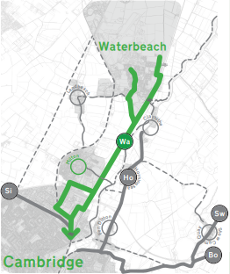
Risks to delivery
Since the 2018 public consultation on the Waterbeach Greenway railway alignment, design investigations have identified a number of key risks.
These key risks include:
Flooding & Drainage
Proximity to railway infrastructure
Construction feasibility
Access via Milton Country Park
Feasibility and cost of A14 underpass
Overall cost of offline alignment
Programme for delivery
There are also other risks including:
Isolation of route
Maintenance of route and of railway infrastructure
Scheduled monument consent for works alongside Car Dyke Road
Business case and value for money

Slide 7
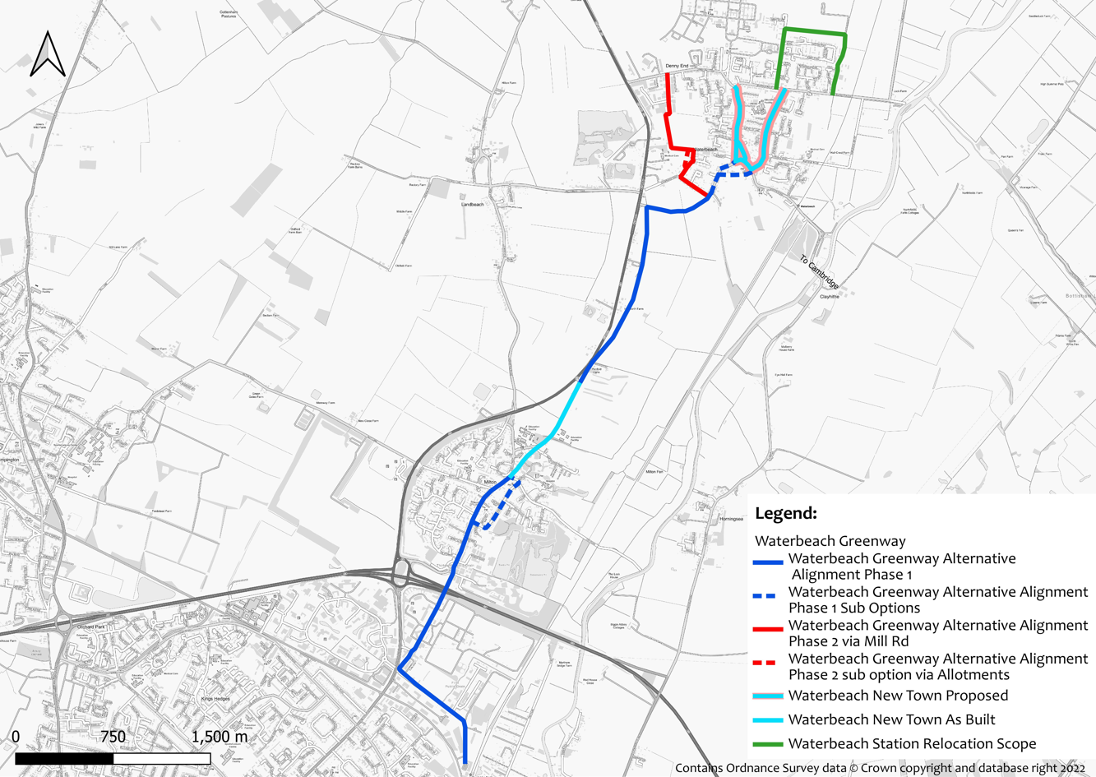
Waterbeach Greenway New Alignment
3 options for Ely Road slip:
1) Widen shared use path into slip lane
2) Close slip lane
3) Close junction and slip
Off-road bridleway (3m paved, 3m grass strip, 2m verge)
2 options for High Street at shops:
1) Parking relocated to west, wider shared path
2) Parking retained on east side, shared path
Traffic calming and public realm enhancements for both options
2 options for Coles Road:
1) Light-touch with cycle symbols
2) Double yellow lines, raised tables
Notes:
Proposed route 6.5km
40m on A10
Link along railway lines – issues

Slide 8
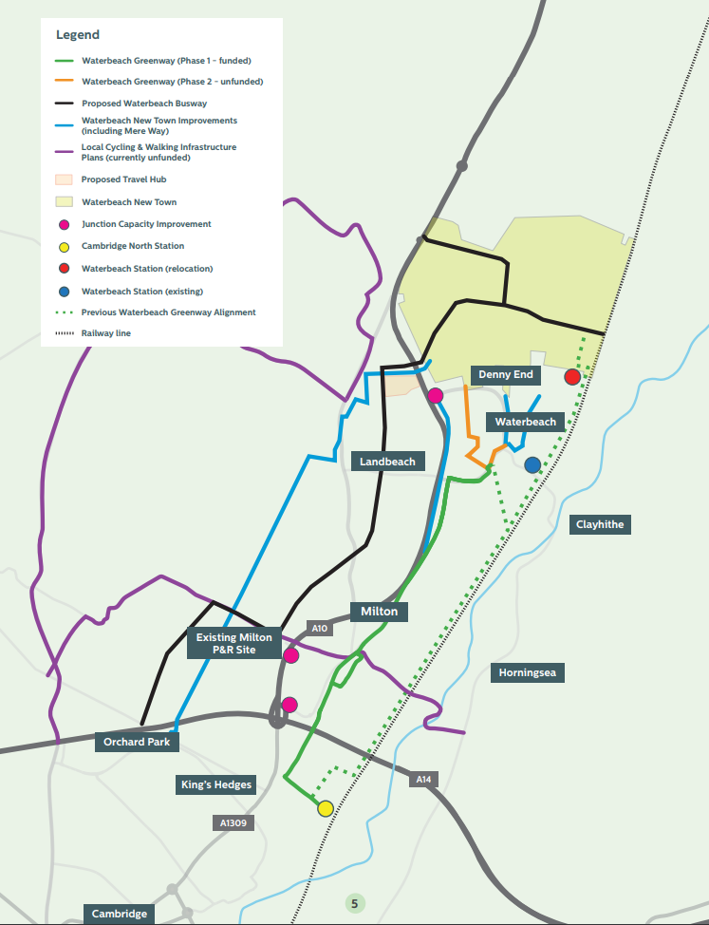

Slide 9
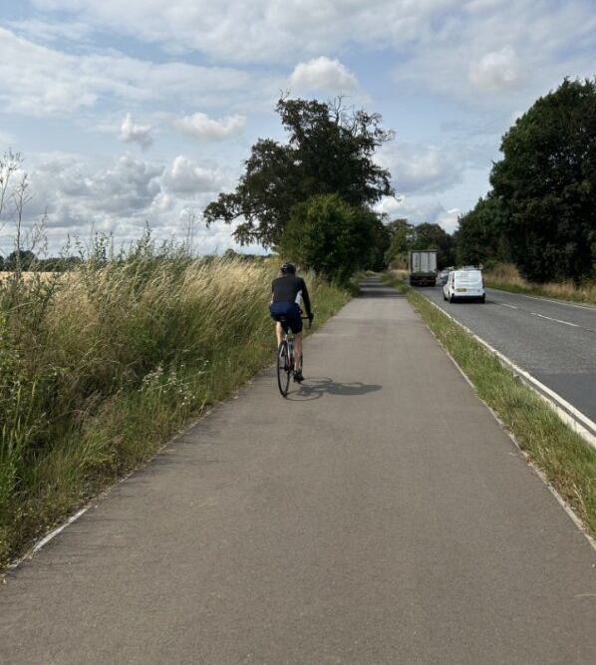
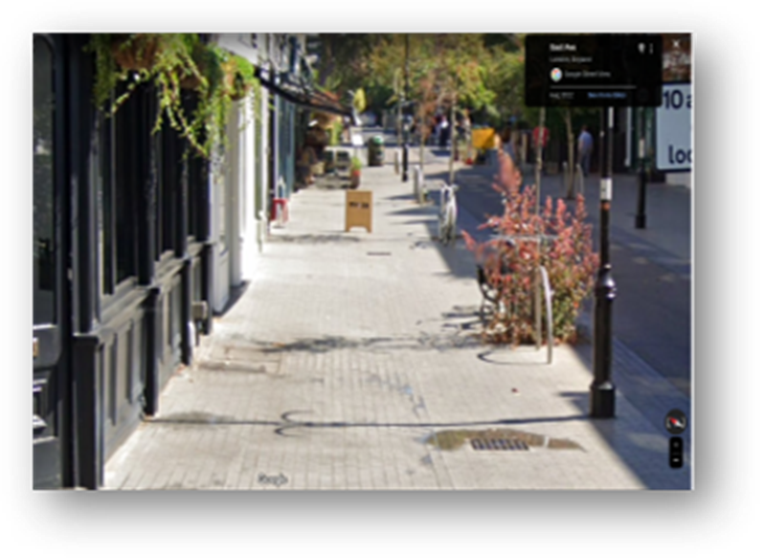
Greenway Benefits
Safe and direct walking and cycling connectivity between residential areas and key facilities such as employment, education, health, recreation and transport hubs.
Improves access to jobs and education
Better, more inclusive environments for walking and cycling.
Investment towards improving the attractiveness of local centres.
Reduced carbon emissions
Provides an opportunity for more people to change travel behaviour
and adopt a healthier lifestyle.
Futureproofs local areas and provides
a platform for further investment.

Slide 10
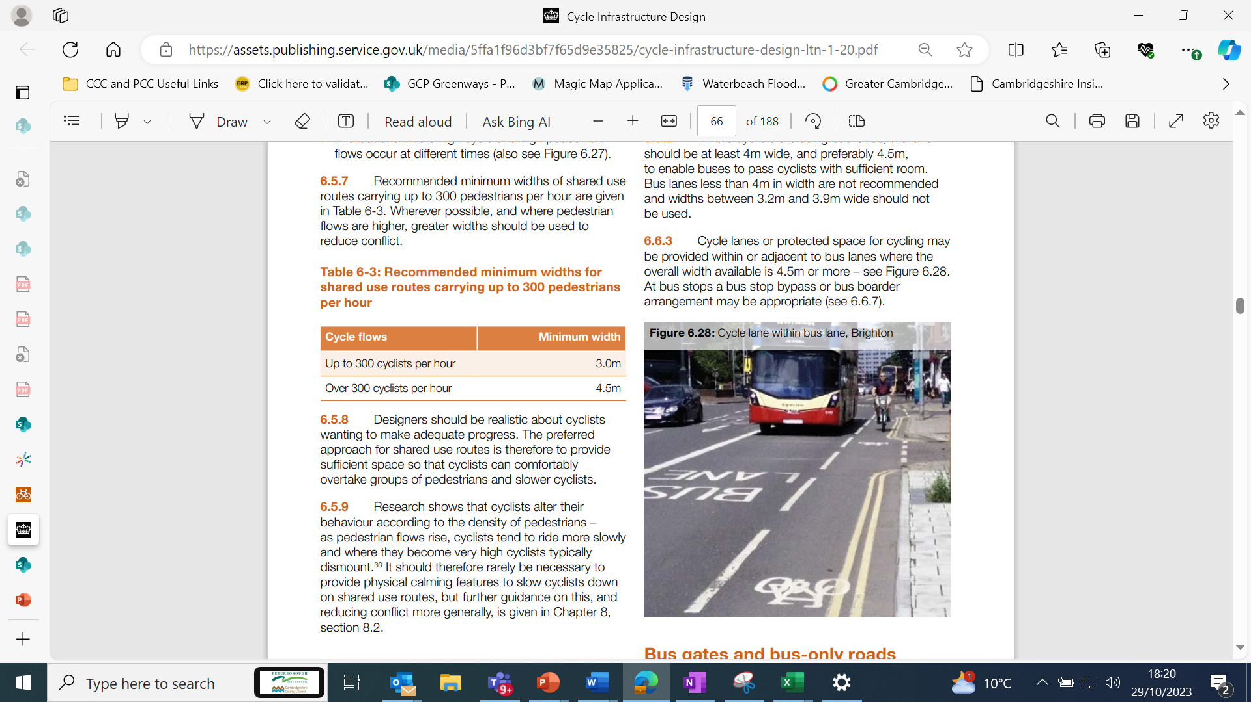
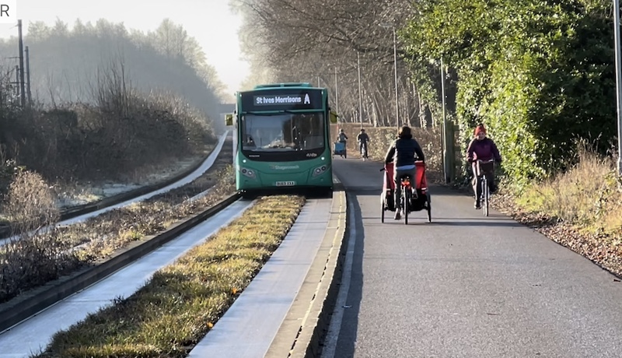
Shared use Paths
Standards set in the Local Transport Note 1/20 - states that 3m shared use provision is acceptable for 300 pedestrians and 300 cyclists an hour.
Shared use paths ensures cyclists alter behaviour to take account of other road users.
Propensity to Cycle Tool predicts that 200 cyclists in the peak hour will use the Waterbeach Greenway in 2031.

Slide 11
Consultation Approach/Actions and Next Steps
On the 28th September, the Greater Cambridge Partnership Executive Board gave approval to consult on a new alignment for the Waterbeach Greenway.
An 8-week consultation period on the new alignment is now underway which began on the 16th October.
ACTION | DATE
Executive Board | 28th September
Pre-engagement | September/October
Launch of 8 wk Public consultation | 16th October to 8th December
Virtual event | 30th October
SCDC Waterbeach Forum | 1st November
In-person event | 7th November

Slide 12
Waterbeach to Cambridge busway

Slide 13
Better Public Transport – Waterbeach to Cambridge
The Waterbeach to Cambridge (W2C) project aims to provide a new high quality, segregated public transport route between the new town at Waterbeach and Cambridge along with associated active travel infrastructure.
The scheme also looks to include a new park and ride facility on the A10 near to the new town at Waterbeach.
The Strategic Outline Case, approved by the Executive Board in July 2021 demonstrated that this new infrastructure is essential for the continued development of the new town as it will create and enhance the required network links that enable people to make trips by public transport, cycle or on foot, thus reducing pressure on the already congested highway network.
Notes:
Will make it easier both to travel in a pleasant and sustainable way into and out of Cambridge and to enjoy our countryside for leisure purposes.
Will also help to make local journeys such as school and nursery runs safer and easier. In some cases these are new routes, or routes with new sections, whilst others will be based on existing paths.

Slide 14
Better Public Transport – Waterbeach to Cambridge
Following Public Consultation in early 2023 on two route options and 3 locations for a new Park & Ride near Waterbeach, further technical work was undertaken, alongside detailed analysis of the consultation responses
Based on this work, it was recommended to take forward the Revised Central Route option and the Park and Ride Option C.
Notes:
Will make it easier both to travel in a pleasant and sustainable way into and out of Cambridge and to enjoy our countryside for leisure purposes.
Will also help to make local journeys such as school and nursery runs safer and easier. In some cases these are new routes, or routes with new sections, whilst others will be based on existing paths.

Slide 15
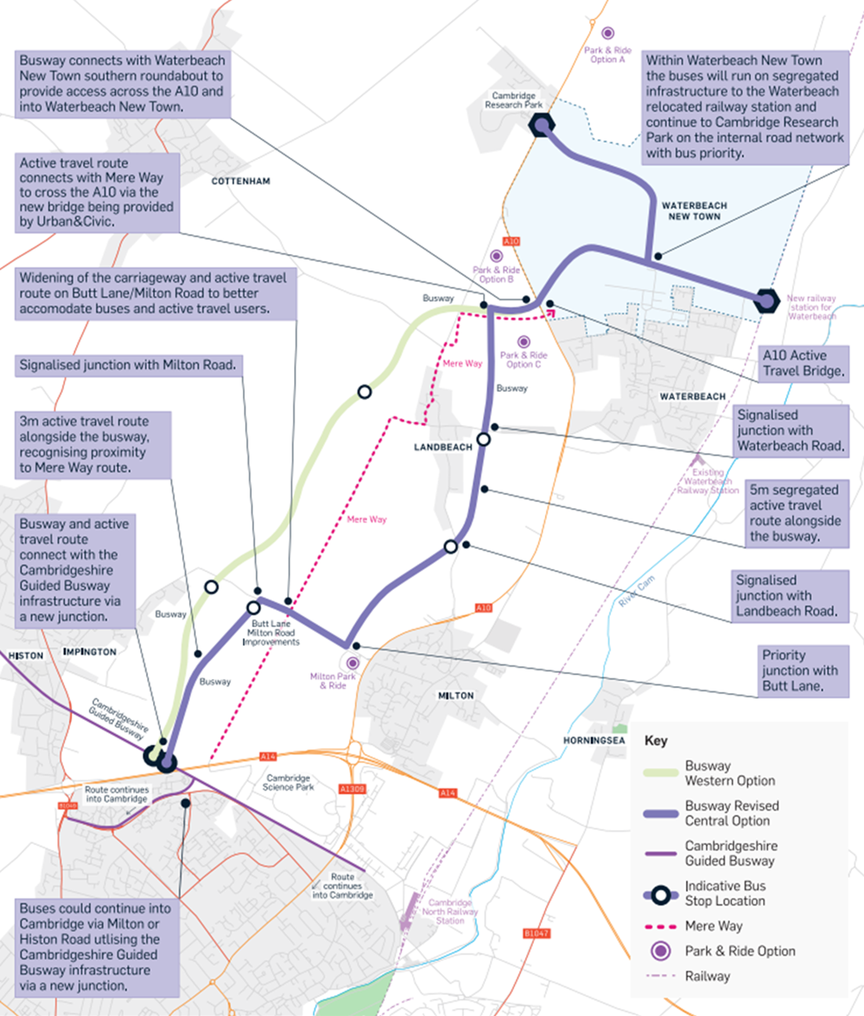

Slide 16
Better Public Transport – Waterbeach to Cambridge
In September 2023, the GCP Executive Board approved the recommendations along with revised budget of £110 Million to take the scheme forward to the next stage which will include:
Detailed three-dimensional design of the busway and park and ride, including junction designs, bus stop specifications and integration with Milton Park and Ride.
Detailed work to understand any requirements for utility diversions, and also to develop the detailed drainage strategy for the scheme which will identify any flood mitigation requirements.
Work to further integrate the proposed scheme with other developments that are proposed in the corridor including Waterbeach Greenway, Mere Way active travel route, the A10, Waterbeach new town, North East Cambridge development (including Cambridge Science Park), and Cambridge Research Park.
Notes:
Will make it easier both to travel in a pleasant and sustainable way into and out of Cambridge and to enjoy our countryside for leisure purposes.
Will also help to make local journeys such as school and nursery runs safer and easier. In some cases these are new routes, or routes with new sections, whilst others will be based on existing paths.

Slide 17
Better Public Transport – Waterbeach to Cambridge
Environmental Impact Assessment, including surveys and associated statutory consultation. It is aimed to hold this consultation in the spring/summer of 2024.
Preparation of the Transport and Works Act Planning Application and Consents.
It is anticipated that the scheme will next be presented to the Executive Board for approval in late 2024.
All going well, it is planned to open the scheme in late 2028.
Notes:
Will make it easier both to travel in a pleasant and sustainable way into and out of Cambridge and to enjoy our countryside for leisure purposes.
Will also help to make local journeys such as school and nursery runs safer and easier. In some cases these are new routes, or routes with new sections, whilst others will be based on existing paths.

Slide 18
Waterbeach Station
Katrina Cajevskaja 01/11/2023

Slide 19
Design
Gap analysis and survey strategy have been completed. Surveys are being completed, such ground investigation, telecoms, ecology, arboriculture and topographic.
Ongoing discussion with Network Rail to ensure that the design is accessible, fit for purpose and is developed to the safety standards.
A meeting was held with the Network Rail’s Built Environment Accessibility Panel (BEAP) team with positive feedback received on the accessible design to and from the railway station.
Car park and highway schematic design is currently being developed to ensure that design is fit for purpose and suits the future development plans.
Options for the new Transport Hub building have been developed to provide a solution that integrates all the transport options in the area.

Slide 20
Stakeholder Engagement
C3R Cambridge Re-Signalling Project
Greenway Cycle Scheme
Guided Busway Project
Housing Developers
Anglian Water
Great Northern & Greater Anglia

Slide 21
Programme Update
Ongoing engagement with the contractor to identify available railway possessions and develop integrated construction strategy.
Ongoing discussion with Network Rail to finalise the design for the new station with aspiration to issue the design for Network Rail’s approval early next year.
Car park and bus interchange schematic layout is currently being finalised to ensure that design assurance timescales are aligned with the railway design.

Slide 22
Any Questions?

