Slide 1
Northstowe Community Forum
24 January 2024
Education Update

Slide 2
Building Work Update
Good progress is being made to all four buildings
All foundation work has been completed
Cross laminated timber structure is being installed to Secondary and Post-16 buildings
Steel frame has been completed to Nursery building and is ongoing to Primary School
Fencing works to perimeter of sports pitches is underway
Foul water drainage connection for Primary School is being made in Stirling Road. This will require 3 weeks of traffic management while works are ongoing.

Slide 3
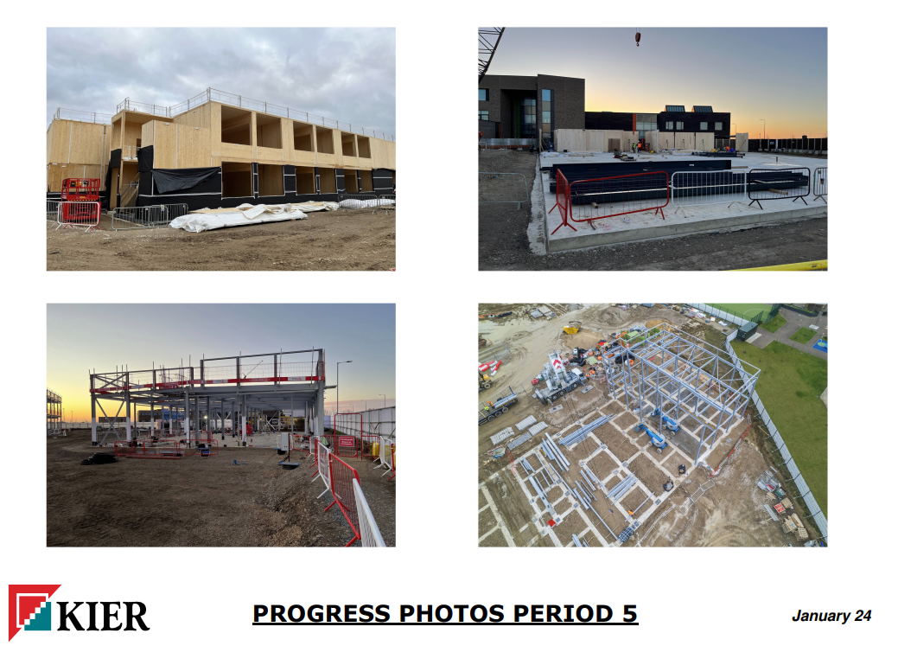
Notes:
Top left – Secondary School extension CLT
Top right – Post-16 CLT underway
Bottom right – Primary School steel frame
Bottom left – Nursery block steel frame

Slide 4
Early Years
A new facility will be provided on the Northstowe Education Campus with facilities to offer up to 78 early years places.
It will be commissioned through the Council’s Pseudo Dynamic Purchasing System (PDPS). The recent survey indicated a strong preference for full day care provision.
The setting will offer the full range of funded entitlements, including both the universal (15 hours) and extended entitlement (30 hours) and funded places for 9 months - 2 year olds, who meet the government’s eligibility criteria.
Likely to begin in one room in Autumn 2024 before all three rooms become available from January 2025.

Slide 5
The first primary school in Northstowe, Pathfinder CE Primary School is managed by the Diocese of Ely Multi-Academy Trust Board of Education. The school has 630 primary places, offers 60 pre-school places and an out-of-school club.
From September 2024, Northstowe Secondary College will extend its age range to offer up to 630 primary places.
It will open with one class in Reception (Age 4+).
The Council will work in collaboration with the Trust to monitor growth in its first few years.
Primary
Notes:
This will help to minimise the impact on surrounding schools and ensure that there is sufficient capacity for residents on the new development.

Slide 6
Northstowe Secondary College, is run by the Meridian Trust. The school opened for 600 pupils aged 11-16 in phase 1.
It is being extended in phase 2 to 1,200 places from September 2024 and finally to 1,800 pupils
From September 2024, it will extend its age range to offer up to 400 sixth form places
The published admission number for entry into Year 7 will be to 150 in September 2024 and increase to 180 in September 2025 and is expected to increase in line with local demand
Secondary

Slide 7
The Martin Bacon Academy also run by the Meridian Trust provides 120 places for children aged 3-19 with SEND. An extension is underway to provide 20 post-16 places
Special
Notes:
Another 40 places on SVC campus

Slide 8
Further schools will be built as the housing development progresses.
Forecasts currently suggest a total of six primary schools and one secondary school will be required but this will be kept under review.
Future

Slide 9
Childminder development visits to Stay and Play sessions Oct/Nov 23
Sunday market 26 Nov – recruitment table in Cabin
28th November:
Radio Cambs interview – Cllr Thompson, Graham Arnold, and local childcare provider
Recruitment Stand in Cabin
Conversations with parents at Stay and Play sessions
Recruitment and Childminding Careers leaflets in Cabin
Recruitment campaign

