Slide 1
Greater Cambridge Shared Planning
Luke Mills (Principal Planner, Strategic Sites)

Slide 2
Northstowe Community Forum 24 January 2024
Luke Mills (Principal Planner, Strategic Sites)

Slide 3



Slide 4
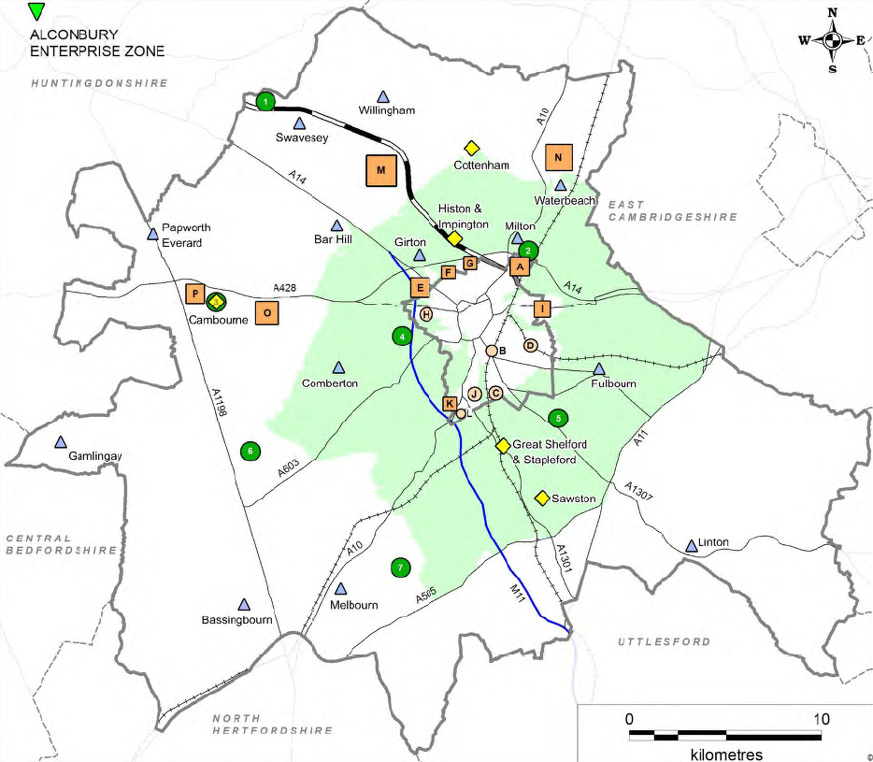
Plan making

Slide 5
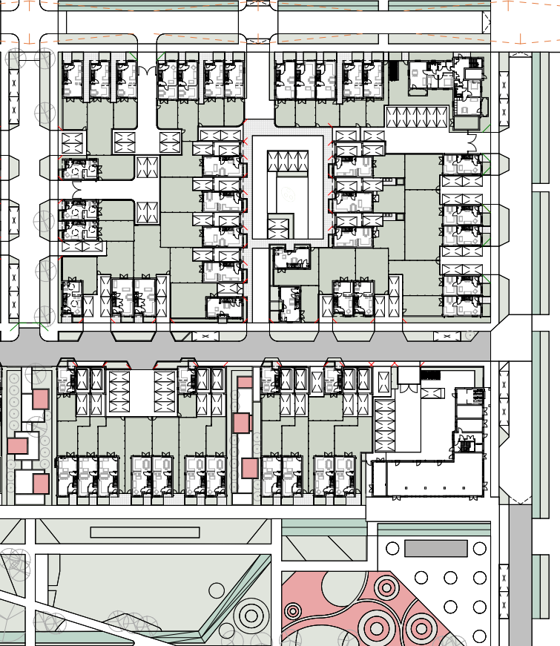
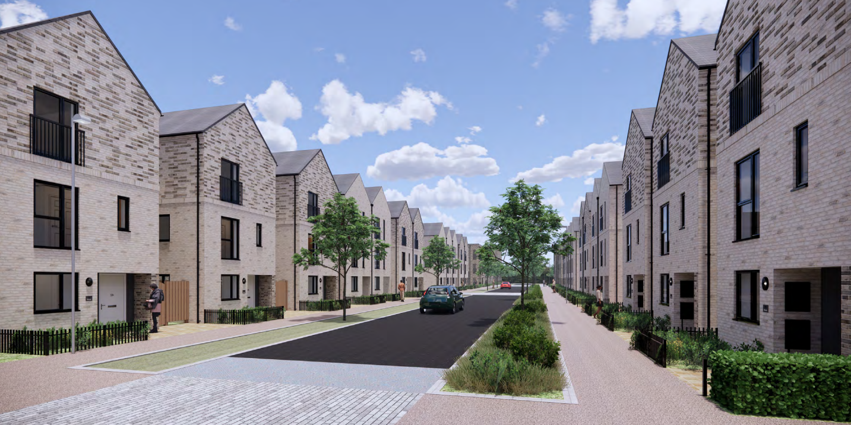
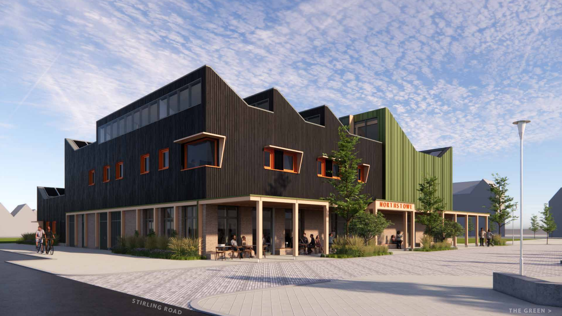
Decision taking

Slide 6
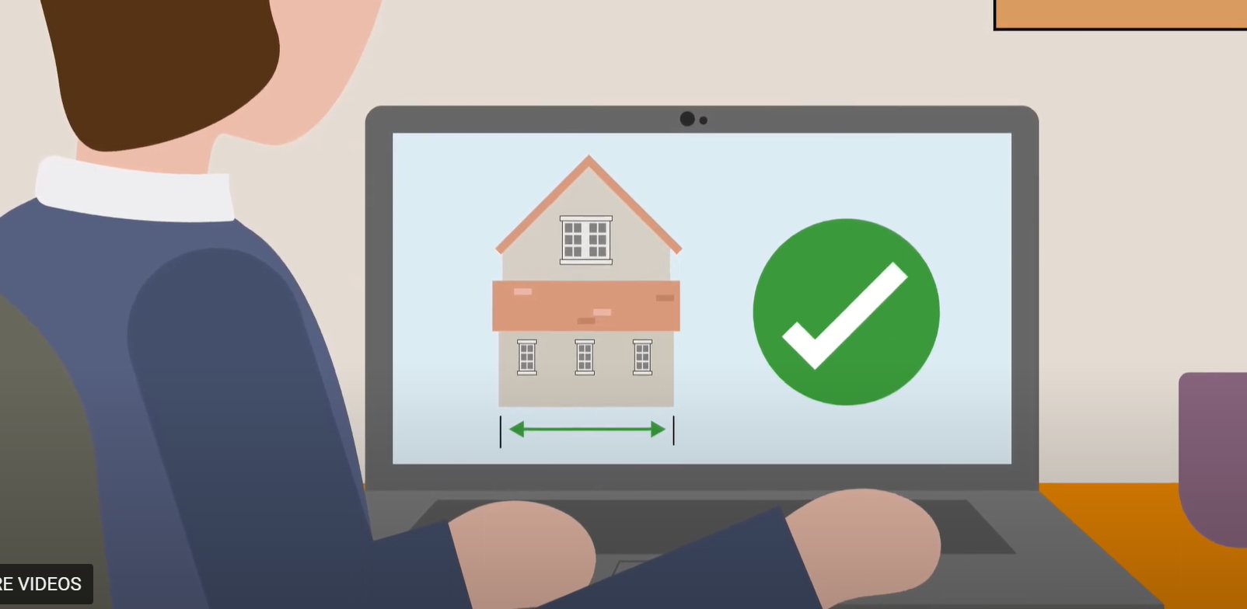
Compliance

Slide 7
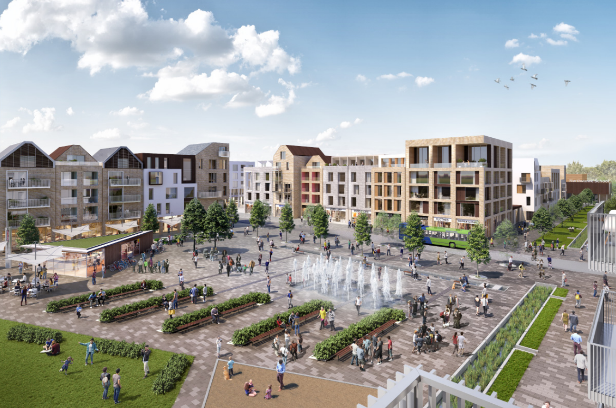
What’s it all for?

Slide 8
Contacts
Website
www.greatercambridgeplanning.org
Planning Compliance
www.greatercambridgeplanning.org/planning-applications/planning-compliance
Planning (Northstowe)
Luke Mills (Principal Planner, Strategic Sites)
luke.mills@greatercambridgeplanning.org

