Slide 1
Northstowe Phase 2 Update
Dean Harris
Notes:
Hello there – I’m Dean Harris with a quick update from the Homes England perspective . . .
I’m joined by a couple of colleagues Catherine O’Toole who is relatively new in post and supporting me on the planning side,
And Chris Standish from our Community Engagement Team – Chris will say a few words later . . . .

Slide 2
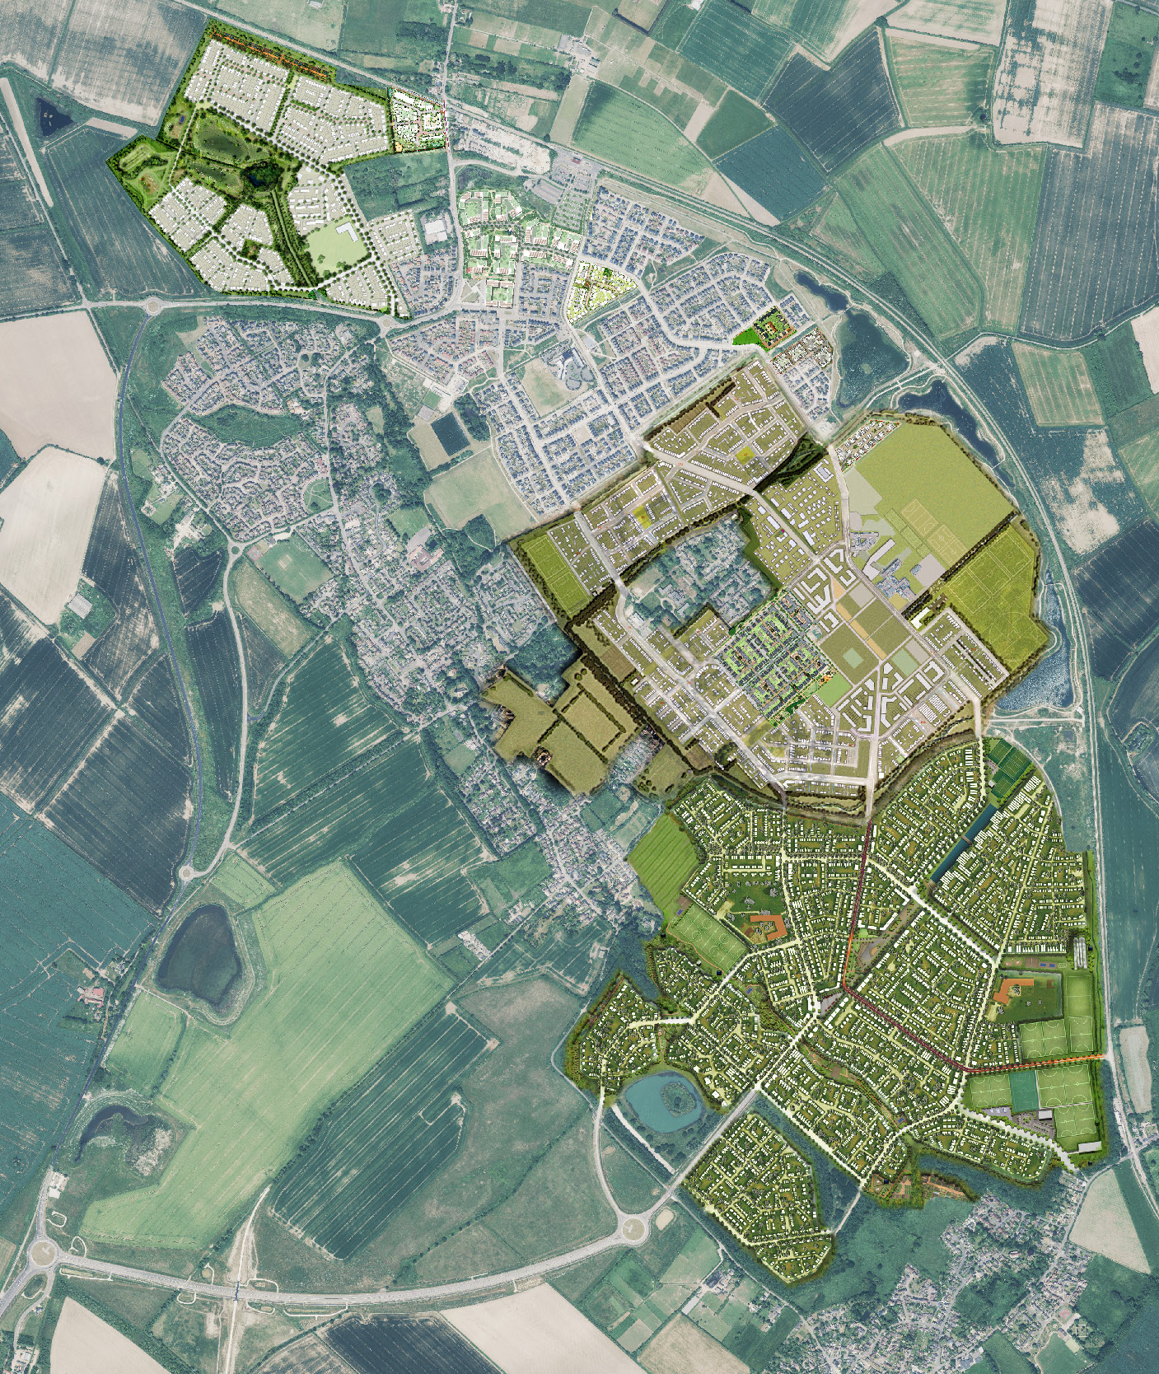
The Cabin
Homes England is the Government’s Housing & Regeneration Agency
Responsible for Delivering Northstowe Phases 2 and 3
Phase 2 – 3500 homes, education campus and infrastructure for the future town centre and related amenities, water parks
Phase 3 – Infrastructure to build 5000 homes and three primary schools and related amenities
Education
Campus
Town
Centre
Notes:
I just thought it might be useful to clarify who Homes England are and what we are doing at Northstowe – for any new residents.
Homes England is the Government’s Housing and Regeneration Agency. At Northstowe We are acting as the public sector master developer responsible for Phases 2 and 3.
Being public sector, we act in the public interest and do not have a profit motive. As master developer we obtain outline planning permission and implement the strategic infrastructure (roads/cycleways/open space/drainage). We then find housebuilding partners (like Keepmoat) to develop the homes themselves.
At Northstowe we are responsible for Phase 2, which is underway around the education campus, and Phase 3 which is the area to the south and very north of the town. 8,500 homes in total.

Slide 3
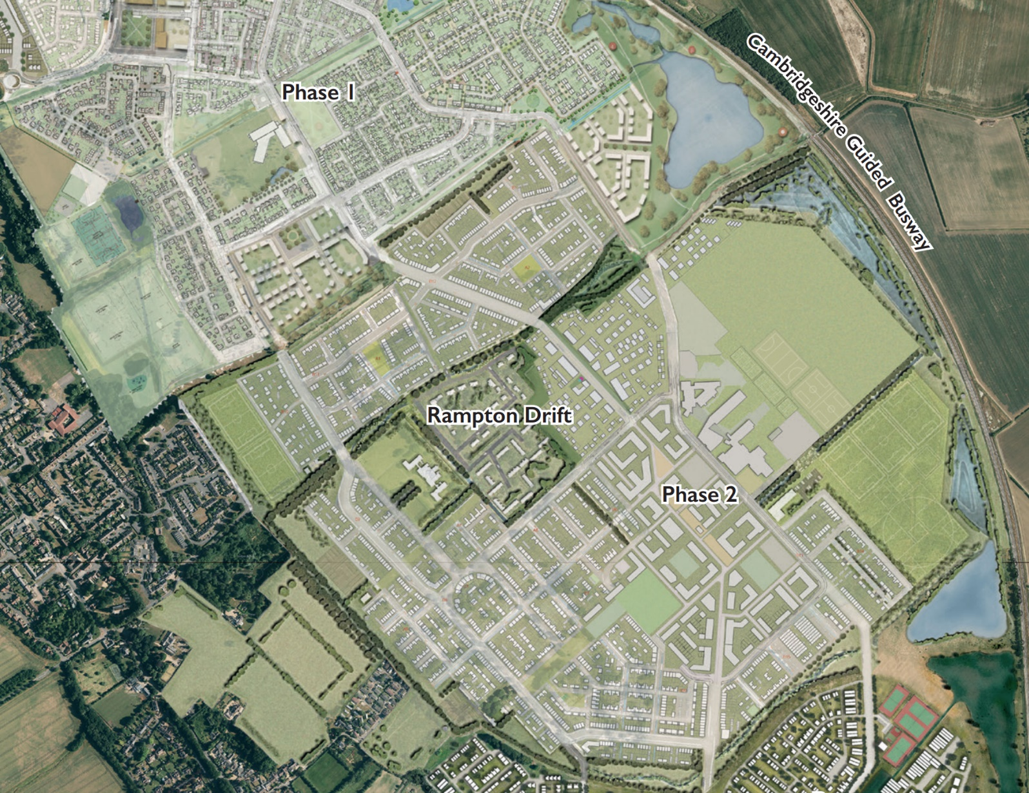
Works
Cabin
Parcel 2C
Greenfisher are the contractor currently undertaking preparatory work for the Eastern Sports Hub. Major earthworks throughout the Spring within Phase 2
Some temporary impact on access around Halcyon Mere
Ongoing landscape improvements in the strategic green areas
Secondary
College
Eastern sports hub
Stirling
Fields
Halcyon Mere
New
lake
Notes:
We’ve got a lot going on in the next few months . . . . .
In particular Earthworks – We’ve appointed Greenfisher to prepare the Eastern Sports Hub (raising levels).
We’re also planning to dig the next lake (blue) and using material to raise the levels of parcel 2C (orange)
There will be some impact on access around Halcyon Mere – we’ll do our best to limit this and give notice via social media. The main restriction will be that the path between Halcyon Mere and the Southern greenway will be closed for a while – potentially up to 9 months (see red box on plan)
You’ll also notice landscape improvements taking place – particularly around the lakes with new and replacement planting
If you spot any issues with our estate please dial our helpdesk on 0845 603 1485
One further point to mention is that we’ve been notified by Kier of works proposed within Stirling Road near the new primary school (which will require Traffic Control In Place)
Note: Eastern sports hub complete Summer 25 > 18 month settling period.
2C / pond 5 complete Winter 25

Slide 4
Planning
Applications to be submitted shortly for site clearance, remediation and earthworks on Phase 2 West (former MoD land)
Secondary
College
Eastern sports hub
Northstowe House
Stirling
Fields
Phase 2 West
Notes:
We are also to submit a planning application in the near future to prepare the west of Phase 2 (the old barracks area).
This involve clearance, remediation and earthworks.
Note: Existing buildings and most important (cat A) trees are proposed to remain.

Slide 5
Other updates
Seeking a housebuilder partner to deliver 190 homes on 2A1 (balance of Phase 2A) and one to build 130 homes and a neighbourhood play area on C2.
Keepmoat (2B) – currently building 300 homes, a commercial unit and play area at Stirling Fields, some occupations already
Community engagement ongoing
2A1
Secondary
College
2B
C2
Notes:
By way of general update. . . .
We are seeking a development partner for the balance of Inholm/Phase 2A (2A1 shown green) and will shortly be seeking a partner for C2 (purple). Arouns 320 homes combined.
[2A1 AND C2 - Planning Spring 25 / Start on site early 2026]
Keepmoat are on site with Stirling Fields which features a mix of tenures, a commercial unit and an initial phase of the town park featuring an equipped play area. Area shown blue on plan.
We are also looking to establish an area within the future town centre for temporary or ‘pop up’ uses and event – more to follow.
Behind the scenes we’re working on a community engagement strategy which we want to develop with partners. I’m going to hand over to Chris to say a few words about community engagement . . . .

Slide 6
dean.harris@homesengland.gov.uk
Notes:
Any questions?

