Slide 1
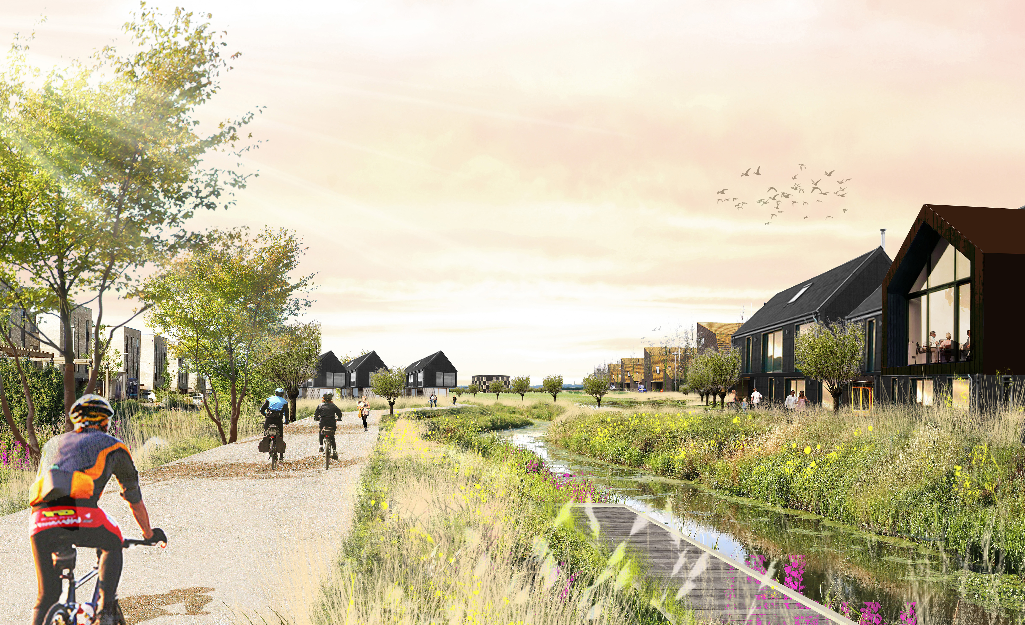
Waterbeach
New Town East

Slide 2
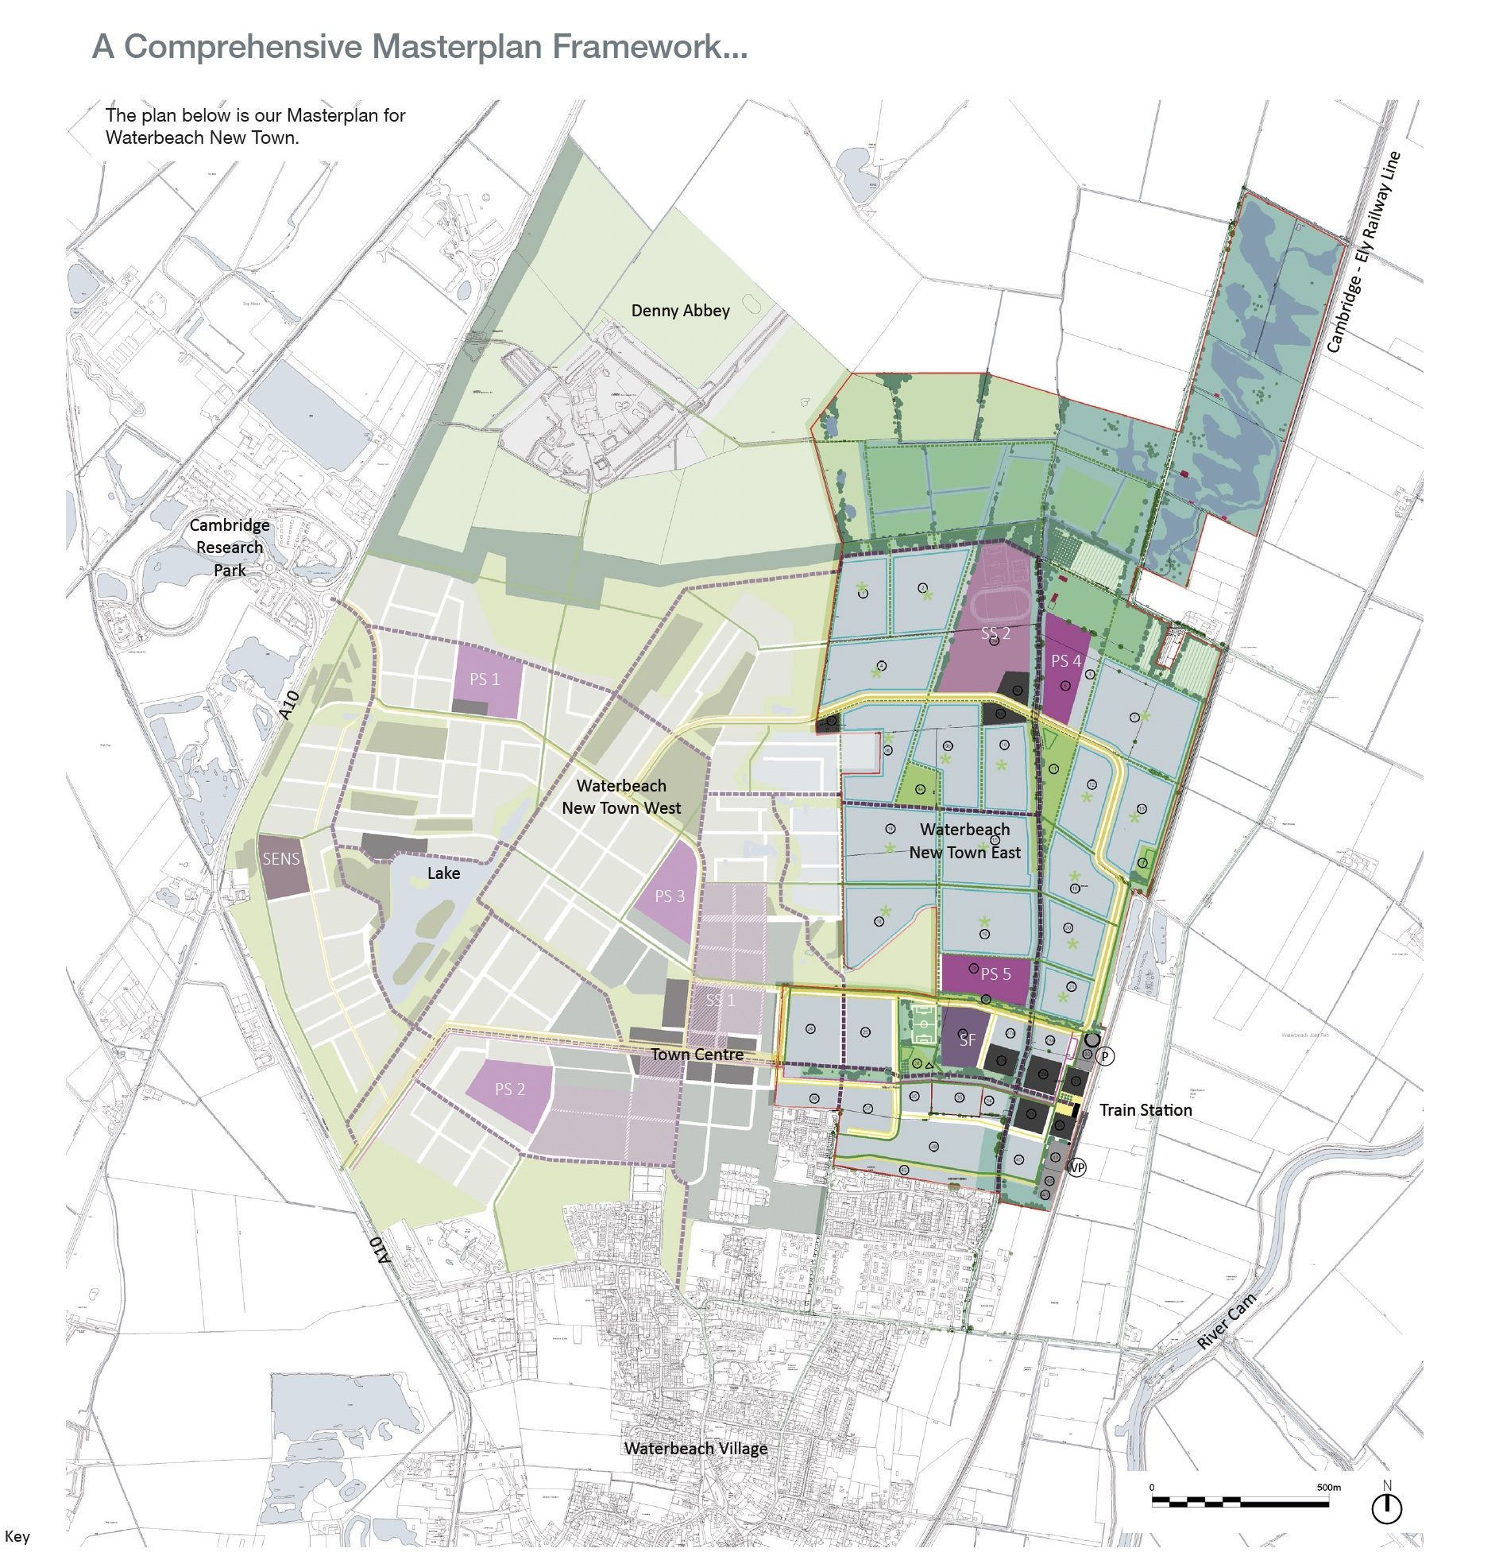
Masterplan

Slide 3
Actions since the last
Community Forum
Website launched
www.waterbeach.co.uk
S.106 and planning permission
Design Codes
Reserved Matters Applications
Clearing Conditions
Hand-over of Station Project to GCP

