Slide 1
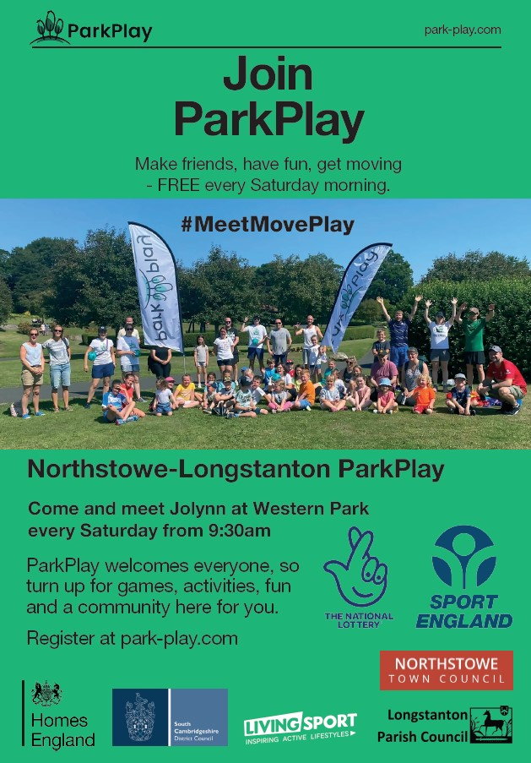

Slide 2
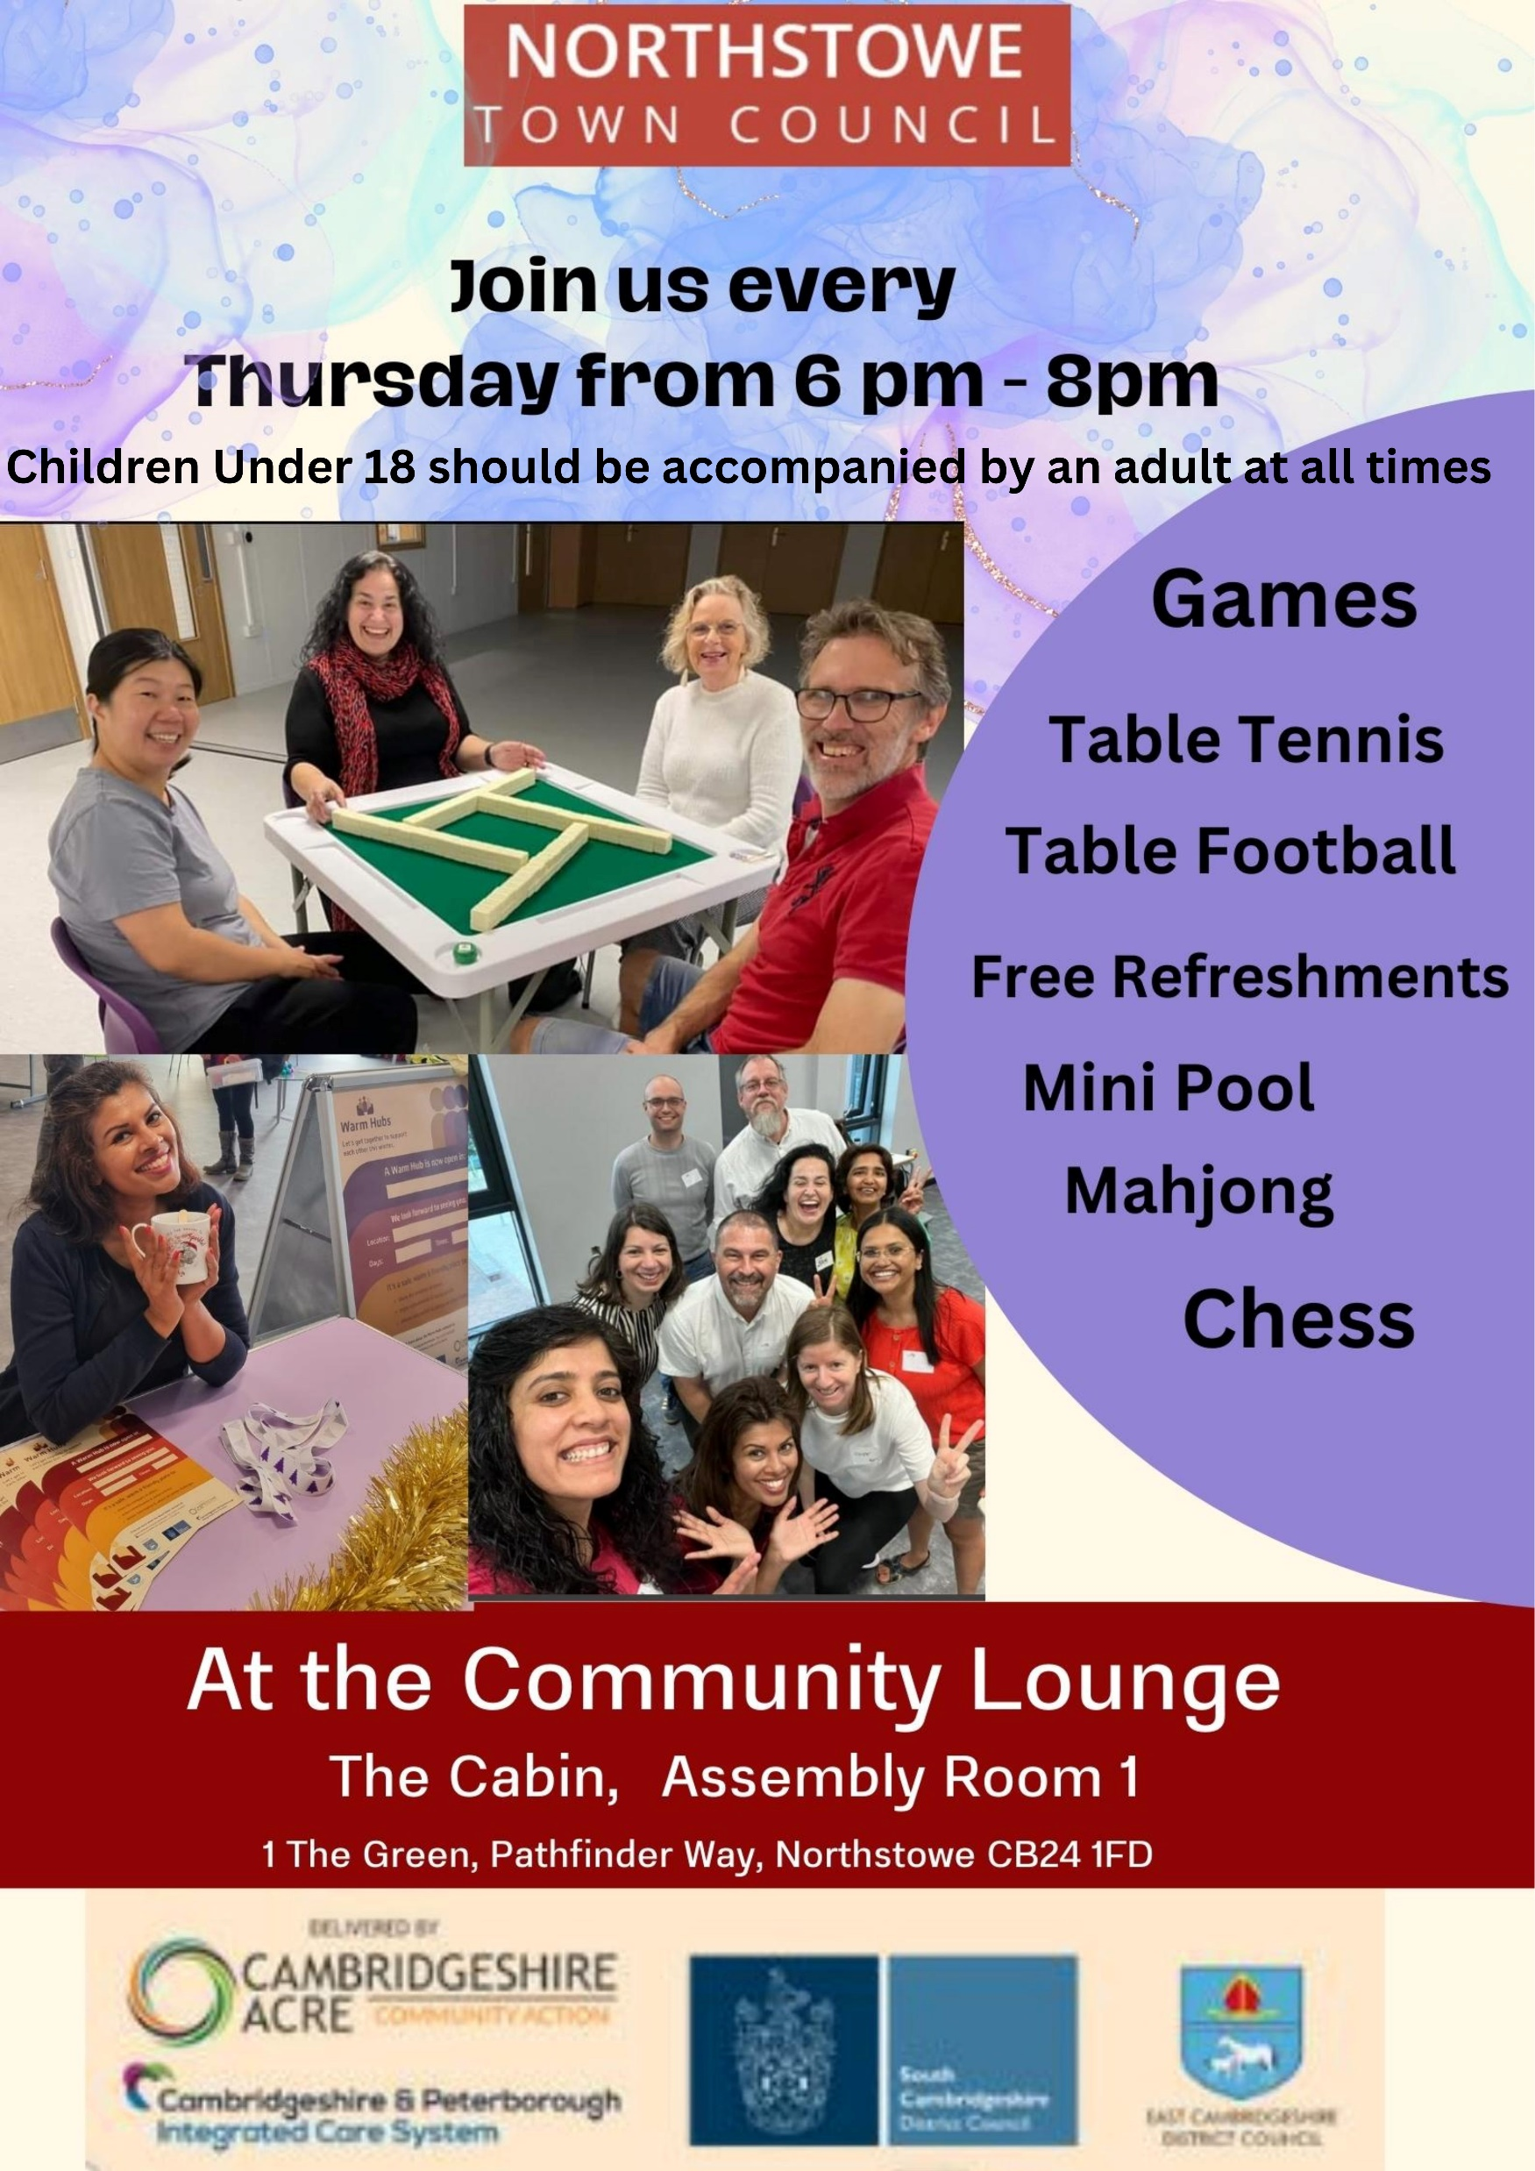
Community Lounge Updates
Successful year of Community Lounge in 2023
Received funding to continue for another year
Every Thursday evenings from 6pm – 8 pm
Regular activities over free refreshments and pastries from the community ladder
Activities suggested by residents.
Chinese new year - Feb 8th
Volunteers needed!

Slide 3
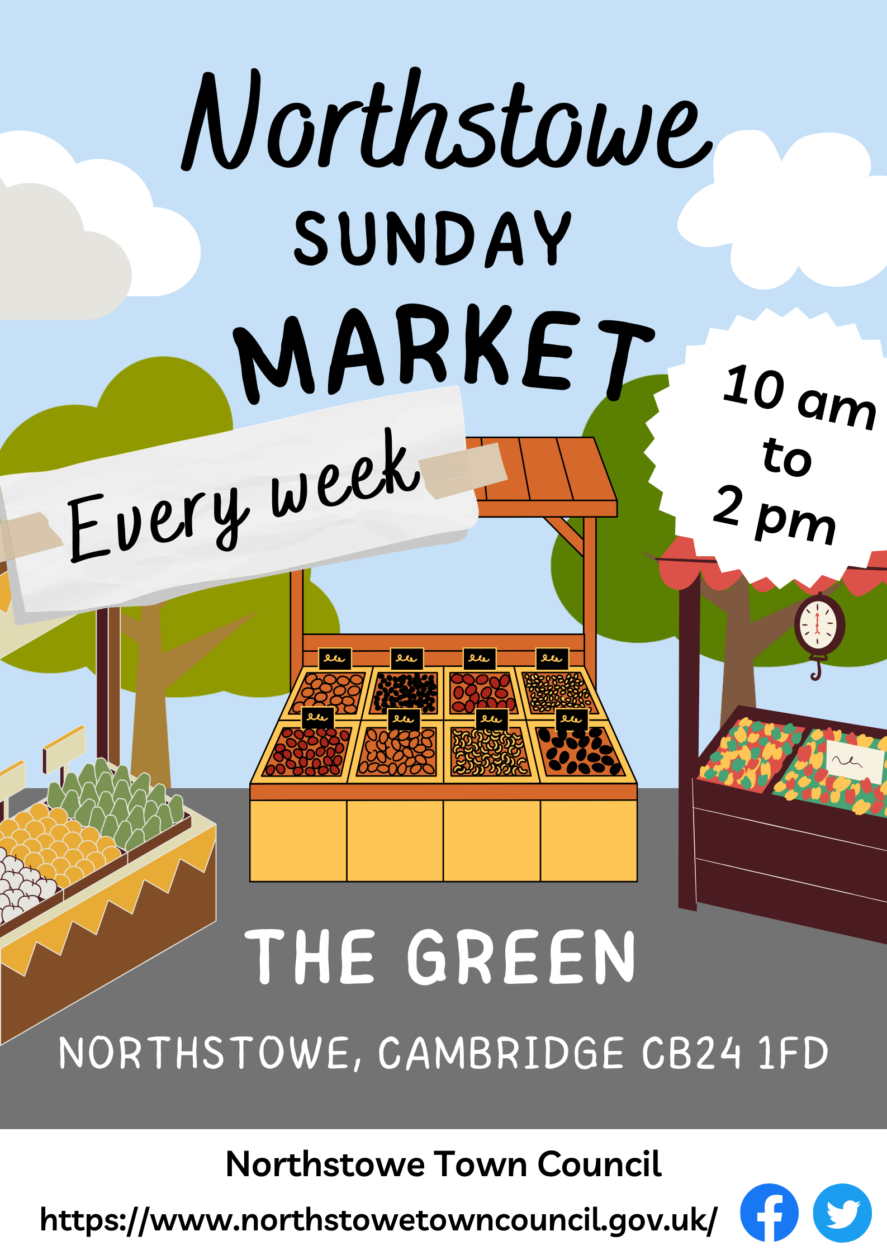
Market updates
Market to continue in Northstowe after 6 months pilot Apr to Oct.
Every Sunday 10-2pm
Weekly: small number of stalls (food and daily basics) – indoors November to March
Monthly: Greater variety of food and non-food and craft stalls (volunteers on the day welcome!)
Also at the market: Community Café, Community Pantry, bike repairs (2nd Sunday of month only), and possibly more – stay tunned
New position: market manager

Slide 4
