Slide 1
Northstowe Phase 2 Update

Slide 2
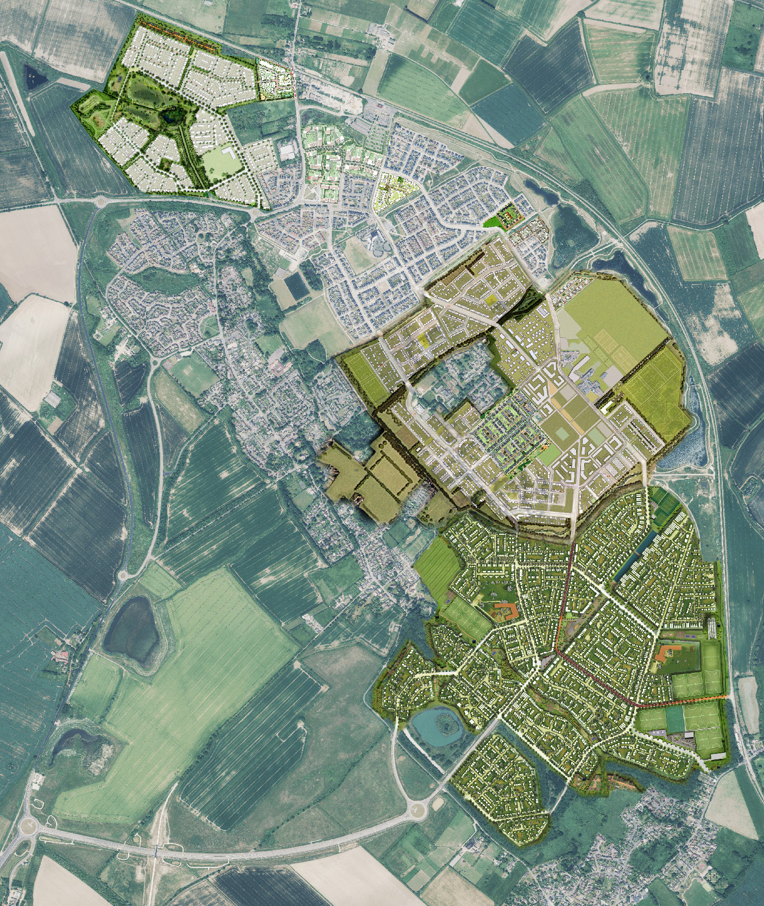

The Cabin
Homes England is responsible for delivering Northstowe Phases 2 and 3
Education
Campus
Town
Centre
Notes:
As most of you will know, HE are responsible for delivering Phases 2 and 3 of Northstowe – Phase 2 outlined in red and Phase 3 outlined in blue. The location of the Cabin is highlighted so you can see where these sit relative to where we are now.

Slide 3
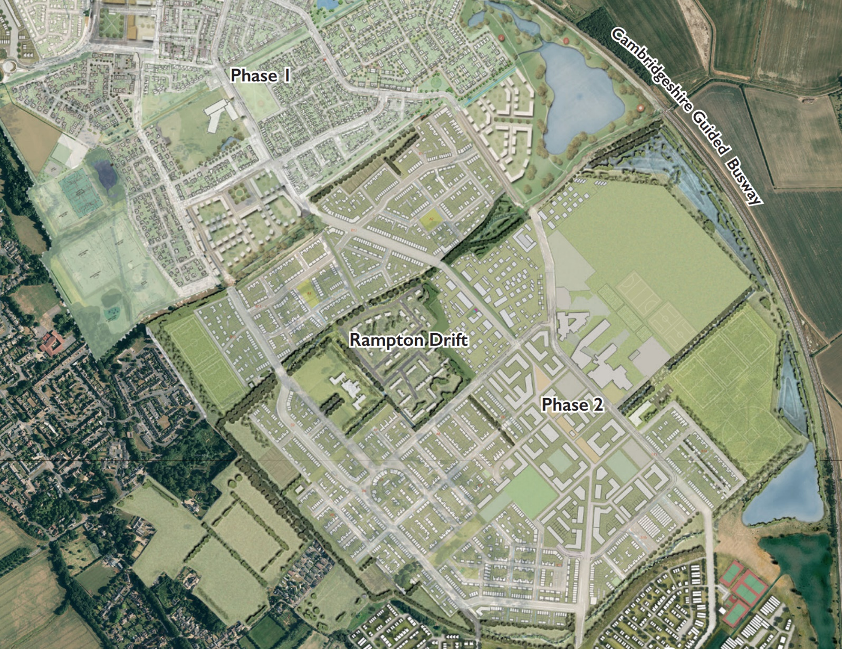
Works Update
Cabin
Greenfisher are currently on site and are responsible for upgrading the haul road and forming the pitches at the Eastern Sports Hub.
Works are progressing well and on time – expected completion of these works is Summer 2025 (followed by a settlement period).
Secondary
College
Eastern sports hub
Stirling
Fields

Slide 4
The next works we will be undertaking on site is to dig ‘Pond 5’ and raise the land levels of Phase 2C.
This is expected to start in June 2024 and last for 10 months (Complete Winter 2025).
There will be some closures of the crossing between the greenway and Halcyon Mere (highlighted in red) which is due to commence shortly.
Phase 2C
Secondary
College
Pond 5
Notes:
If you spot any issues with our estate please dial our helpdesk on 0845 603 1485

Slide 5
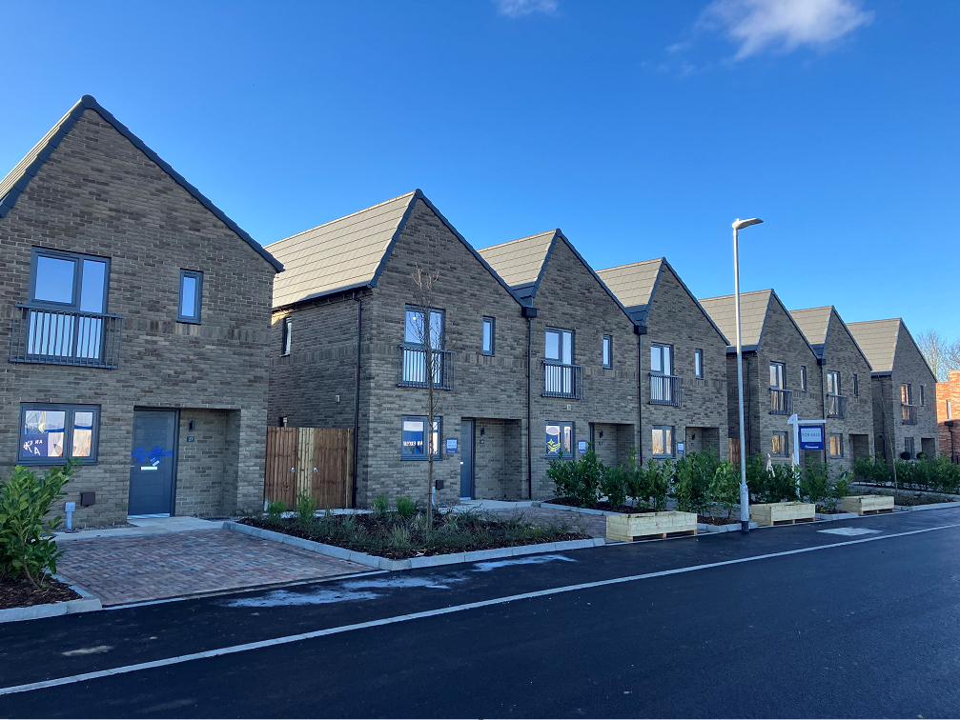
Keepmoat Update
House completions: 33 houses
Events supported:
  Interim Community Centre Raised Beds
  Northstowe Arts Cinema
  Secondary College Green Power Challenge
  Careers Event at Northstowe Secondary School
Notes:
Events supported through social value requirements – required by HE when disposing of land.
Final figures awaited from Keepmoat

Slide 6
Planning
Applications to be submitted shortly for site clearance, remediation and earthworks on Phase 2 West (former MoD land)
Updated Town Centre Strategy – input from town centre and market hall specialists.
Secondary
College
Eastern sports hub
Northstowe House
Stirling
Fields
Phase 2 West
Notes:
We are also to submit a planning application in the near future to prepare the west of Phase 2 (the old barracks area).
This involve clearance, remediation and earthworks.
Note: Existing buildings and most important (cat A) trees are proposed to remain.
We’re looking to submit an updated town centre strategy in June – new location for civic hub, a new market piazza and more support for meanwhile use.
We have appointed CBRE and Next Phase as specialists in town centre placemaking and market halls to inform this work. This will involve community engagement which fill feed into the strategy and action plan to help with some early deliverables in the town centre.

Slide 7
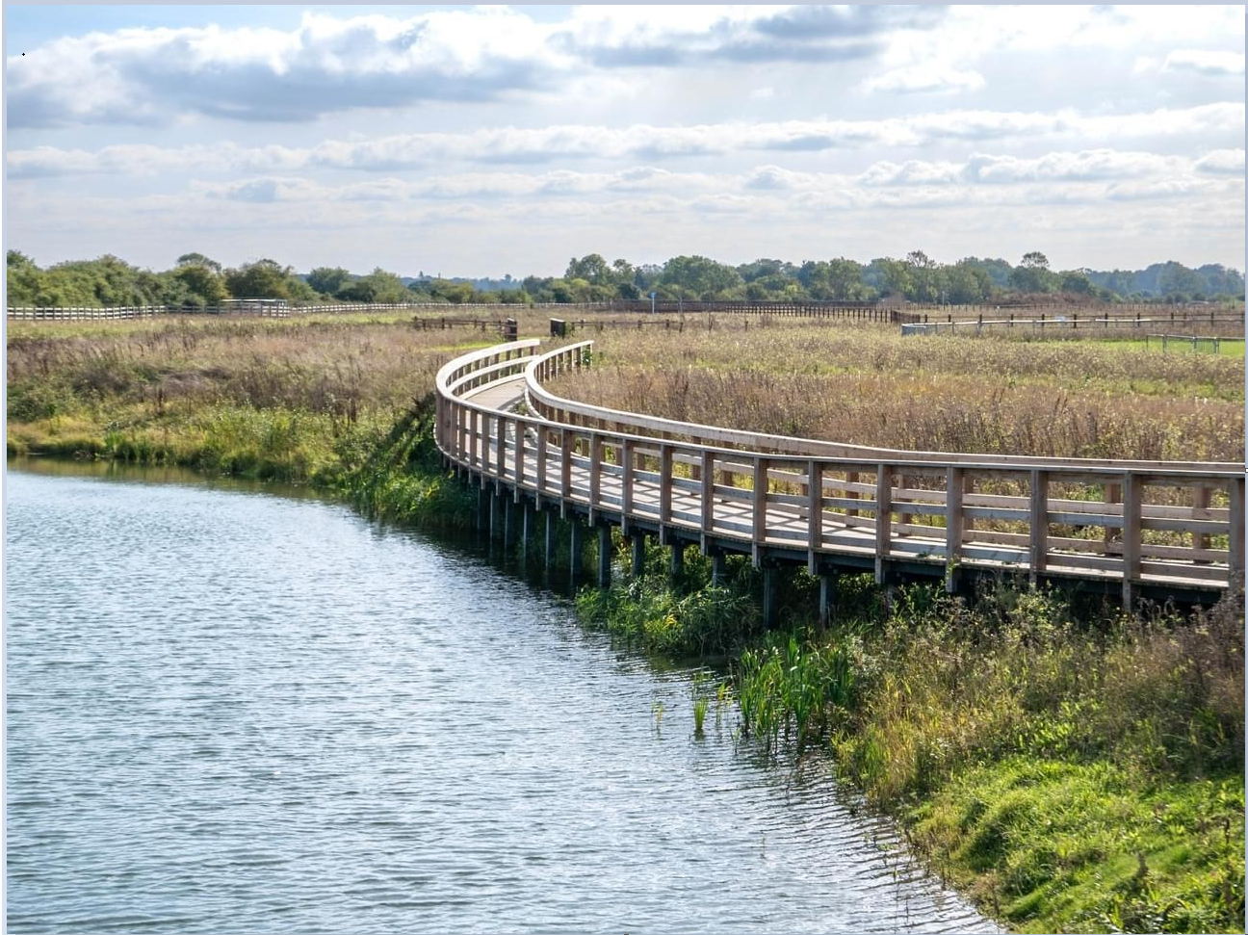
Events & Activity
Northstowe Neighbours film
Lakeside public art
Road naming competition
Notes:
Some of you may have been involved in the Northstowe Neighbours film, to capture and celebrate the local community at Northstowe. We are looking at various opportunities for it to be shown at community events across the summer. The film will also be available for online viewing.
Some of you may also have been involved with Chloe Leaper who has been commissioned to create two sculptures to recognise the names of the lakes – Unity Lake and Halcyon Mere. We are looking to install the sculptures this summer and will have an event to unveil the sculptures, we hope to see you all there.
The road naming competition for the southern access road closed yesterday – hopefully some of you made suggestions and we’re grateful to everyone that did. We will be looking through all entries and will shortly announce the winner.

Slide 8
Northstowe Neighbours Survey
We have recently launched a quality of life survey, this is intended to help us understand the experience of living in Northstowe, what works well and what we could improve.
https://bit.ly/Northstowe-resident-24
Notes:
This will also help us establish a baseline so we can understand how experiences/perceptions change as the town continues to grow. We hope as many of you as possible will participate. We will look to feedback results to the community – including at a future Forum. The quality of life survey includes some questions that will inform the town centre work we referenced earlier – so please do get involved.
Emma here to answer questions?

Slide 9
Northstowe Community Activation Fund
HOLD – website URL and screengrab of landing page – Ellen to add.
We are very pleased to launch this grant with SCDC.
The Fund has a total value of £120,000 and will run from 2024-2029.
Local organisations will be able to apply for up to £10,000 for projects to further improve quality of life in Northstowe
Notes:
Ellen to join – HE are the grant provider and the Fund will be administered by SCDC.
We are excited by this opportunity to help support the community to deliver more and bigger projects to benefit Northstowe residents.
Hand over to Ellen to give a summary on how to apply, CDOs available to assist.

Slide 10
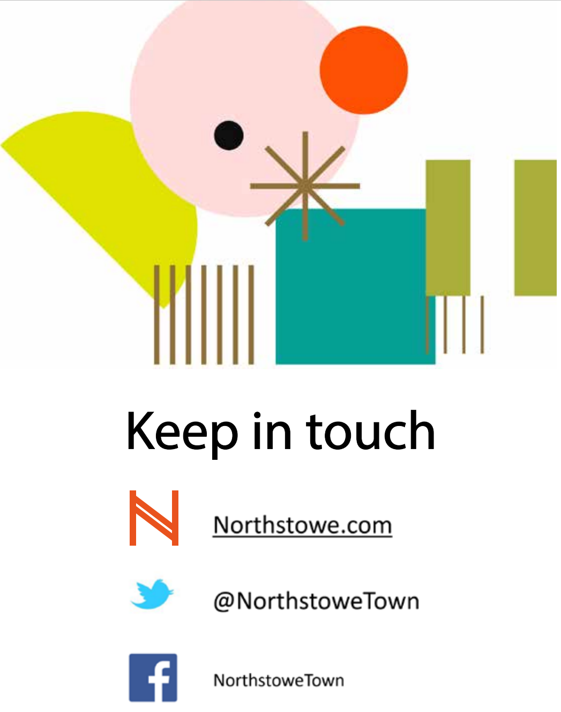
northstowe2@homesengland.gov.uk
Estates 24/7 help desk: 0845 603 1485
Notes:
Any questions?

