Slide 1
Smart Journeys and Waterbeach New Town
Wednesday, 20th March 2024

Slide 2
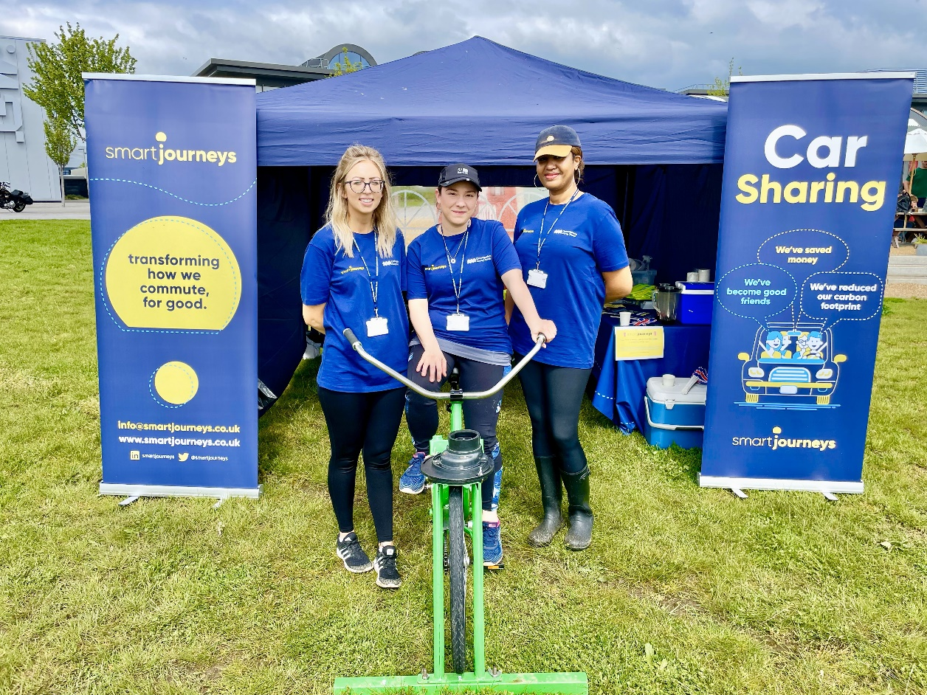
About Us
smart journeys is an organisation of travel planners, who is hosted by Cambridgeshire County Council, that advises and supports clients on how to implement and promote sustainable and active travel.
With strategic plans, innovative solutions, and behavioural change initiatives, smart journeys aim to create a smarter commuter culture, for good.

Slide 3


SCHOOL
TRAVEL PLANNING

Slide 4
Develop a Strategy for Each Academic Year
smart journeys, working in partnership with CCC’s Road Safety Team, will develop a co-ordinated and bespoke strategy of measures and work with schools to promote safe sustainable travel to and from school, for the whole community and aim to achieve at least a 7% reduction in single occupancy car journeys by the end of Year 5.
This will include:
Appointing a member of staff to act as the school travel advisor lead.
Liaising with parent volunteers to coordinate and agree on initiatives to improve parking issues and reduce congestion around schools.
Appoint a team of Junior Road Safety Officers and/or School Travel Champions to develop activities that promote safe sustainable transport modes.
Steer schools towards joining Modeshift STARS in order to gain accreditation and fully support their membership of the scheme with our resources, staff, and time.
Support and coordinate school events to promote sustainable travel.

Slide 5
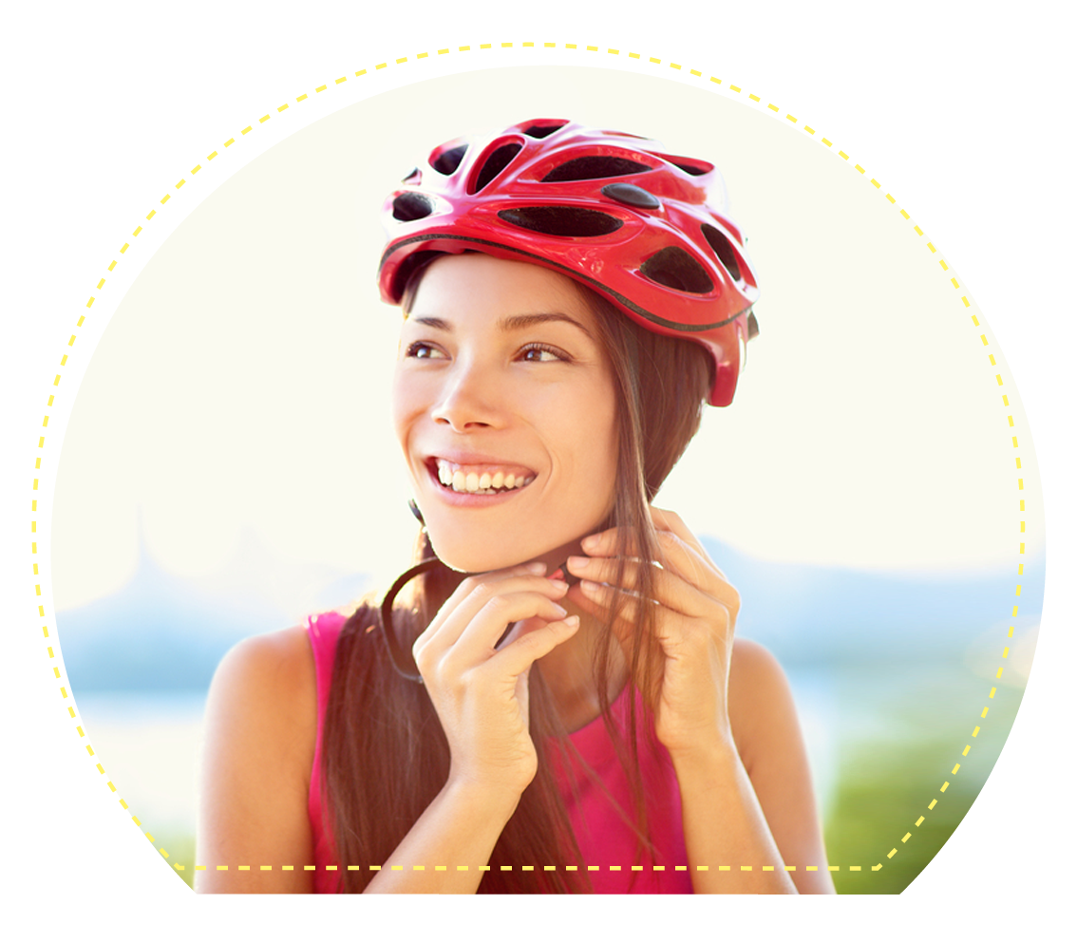
Sustainable Travel Events
Each year the smart journeys team will work with the schools to deliver sustainable travel campaigns, to coincide with National Awareness dates as below, and/or other bespoke events:
The Big Walk and Wheel
Walk to School Week
Scoot to School Week
Bike to School Day
Clean Air Day
Car Free Day
Walk to School Month
Be Bright Be Seen
Road Safety Week

Slide 6

RESIDENTIAL
TRAVEL
PLANNING

Slide 7
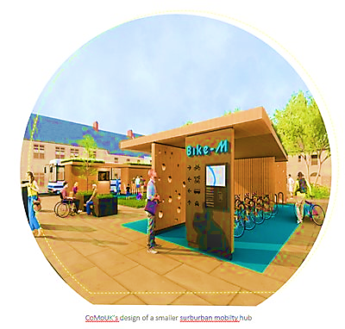
Mobility Hubs
smart journeys will support and collaborate with the Community Development Officer to deliver the services located at the mobility hub. The team are proactively engaging with other Local Authorities and organisations to increase their knowledge in best practice for mobility hubs, which can be applied to Waterbeach.
Our previous combined experience will enable us to assist in the successful management of the mobility hub, to maximise its usage and impact. We will promote the hub across several media channels (community Facebook pages, community website, residential newsletters) to encourage active travel throughout the development. We will also host several events from the hub promoting its services and incorporate modern technology such as interactive bus schedules. We will also promote placement of permanent cabins to attract users to the hub, for example, a coffee stand and/or other local business stands.

Slide 8

Walking
smart journeys are keen to promote the many physical benefits of walking to residents. We have hosted community led walks for staff at New Shire Hall (Alconbury Weald), to promote wellbeing and encourage active travel around the development.
The team are working with Living Sport and have undergone training for leading these community walks.
We are currently running community walking trails and Nordic walking taster sessions at our Alconbury Weald and Northstowe sites. To help create a community feel across the development, we are encouraging residents and workers to take part in these, to explore their local surroundings on foot.
We are planning to North Stowe set up similar led walks around the Waterbeach development and offer training for community walk leaders to steer and manage the events. We will promote routes which incorporate specific areas with information points to explain the history of the barracks.

Slide 9
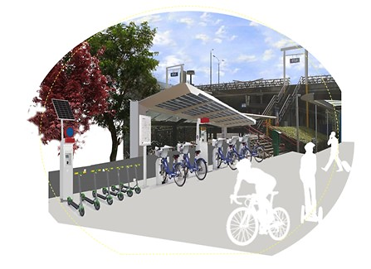
Cycling
smart journeys are committed to ensuring cycling is safe and accessible for all, including those with special accessibility requirements for example: parents and those with disabilities. Our excellent working relationships with other CCC departments, including Transport Assessment and Highways, ensures we have specialised knowledge of the local area and can apply this to our bespoke cycle schemes for Waterbeach.
We will host monthly bike servicing sessions, cycle safety training and offer route planning to remove barriers associated with cycling.
We are currently looking to provide ‘Hire Bikes’ that can be used to travel from the new development to Waterbeach Station with additional cycle racks being provided as the station car park for this purpose.

Slide 10
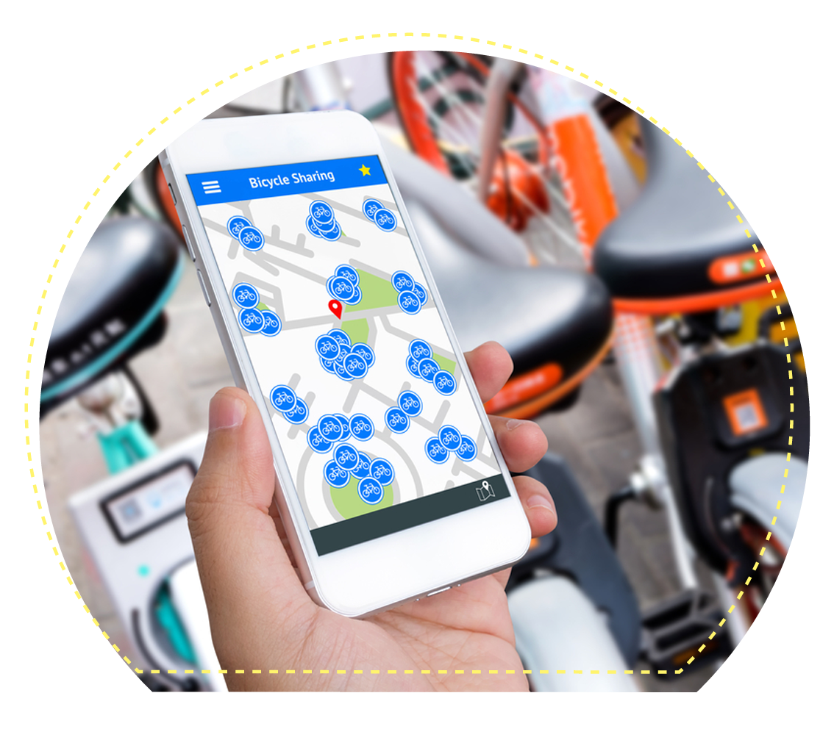
E-Car & E-Bike Hire Schemes
smart journeys have already set up discounted E-car clubs (Enterprise) for residents and employees at sites such as Northstowe and Alconbury Weald. These E-car clubs have the potential to remove the need for a second car in a household and encourages employers to promote E-car sharing for work journeys.
smart journeys are in discussions with E-bike companies to look at providing a E-bike hire schemes for Waterbeach residents, which can be located at the mobility hub. The expansion of the area under which the existing Voi bikes can operate would be extremely beneficial in this respect.
Any E-bike scheme will be monitored to assess the impact of the scheme and how carbon emissions are being reduced in the local area through their usage.
We will provide regular monitoring reports on E-car and E-bike hire usage to ensure we are working towards carbon zero living in line with Urban & Civic’s Travel Plan.

Slide 11

Car Sharing
Car sharing has the potential to reduce the number of cars owned per household and solve wider pollution and congestion problems. On average, there are only 1.2 people in each car during peak hours, this means that everyday there are millions of empty seats not being utilised.
smart journeys have partnered with ‘Mobility Ways’ to identify car sharing opportunities within residential and workplace communities. The Mobility Ways platform supports residents in finding neighbouring occupiers, willing to share their journeys. In turn, this reduces single occupancy car trips, reduces commuter emissions and creates a community culture.
We have already implemented a Mobility Ways domain for Urban & Civic, which includes Waterbeach, Alconbury Weald and Wintringham.

Slide 12
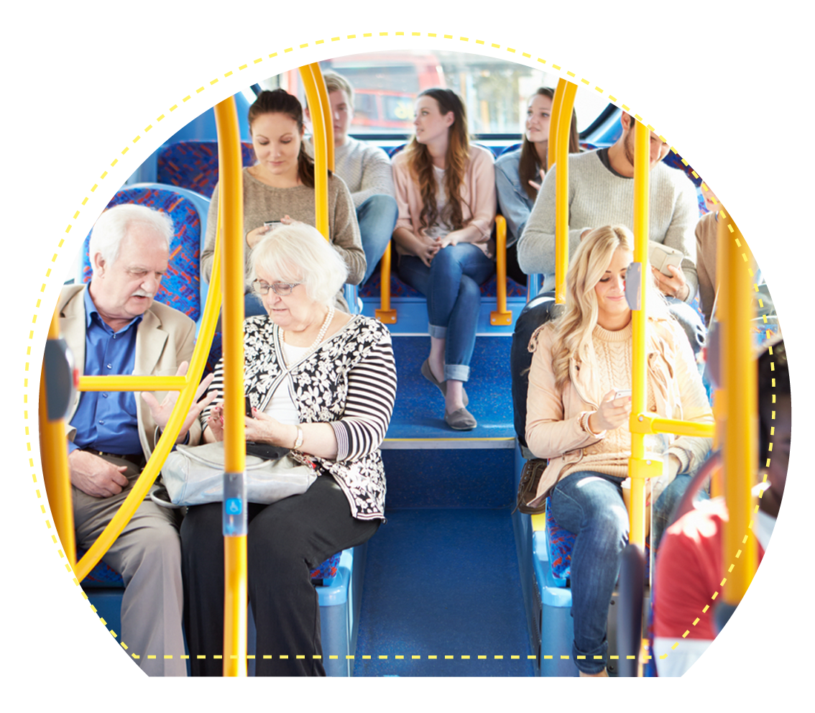
Public Transport
Travelling sustainably can seem expensive, with passengers having to pay for monthly and annual season tickets up front. We are looking to improve the experience and reliability for onward journeys and have negotiated discounts for residents and employees to cut commuting costs.
smart journeys are liaising with bus and rail providers to secure discounted rail tickets and bus tickets.
Furthermore, our team has previous experience working for Sustrans and Rail Delivery Group, focusing on inclusivity within public transport. We will use our expertise to tailor our approach to the needs of Waterbeach residents, to ensure public transport is affordable and accessible for all.

Slide 13

Personal Travel Planning
We will promote and implement personalised travel planning to enable residents to consider their travel habits, choices, and the impact this has on their surroundings.
smart journeys are skilled at encouraging residents to think about their own travel habits. Through one-to-one support we will speak with individuals and provide them personalised travel information, enabling them to voluntarily make more informed travel choices. Our aim is to encourage residents to explore different ways to travel for leisure and work.

Slide 14
Residential Travel Plan Forum
To shape the residential Travel Plan and to understand stakeholders' priorities, smart journeys will actively encourage participation, representation and engagement from residents.
smart journeys will manage and implement a Residential Travel/Transport Forum which will address residents’ travel needs, and create an on-going conversation, with emphasis on actively working together to create a better and more sustainable community.
Our team are keen to work with both the existing and future residents of Waterbeach by actively engaging with them. This forum is vital in our understanding as to how to tailor our services to all residents and ensure we are offering bespoke and impactful incentives for residents and employees alike.
We will host quarterly online sessions where residents and local transport service representatives will have an opportunity to offer updates, discuss transport issues within the development and ask questions.

Slide 15
Marketing, Communications & Brand Awareness
smart journeys will develop an effective marketing plan, that will connect us with the local community and establish positive, long-term relationships. We will deliver a range of direct marketing communications, that are relevant and related to sustainable travel and transport.
We will deliver digital newsletters and promotional e-mail campaigns, to engage with residents on upcoming sustainable travel events.
We will deliver two-way communications and information sharing, through various social media channels e.g. Facebook community groups and Instagram.
We will setup a travel section on the community website for residents to visit and provide information about relevant travel initiatives.
We will encourage residents to write articles, share their experiences and deliver feedback on transport initiatives and experiences to help us tailor our services at Waterbeach.

Slide 16
Sustainable Travel Incentives
The smart journeys team are skilled at promoting healthier and sustainable lifestyles for all. We have specific experience of behavioural change success, and this will be applied to Waterbeach. To inspire residents to walk, cycle and use shared modes of transport smart journeys will engage with key stakeholders and local businesses to secure discounted sustainable travel opportunities for residents of Waterbeach.
Our team currently offer a variety of incentives across our sites including:
Vouchers towards the purchase of a new or second-hand bike including bicycle accessories such as; helmets, locks and lights.
1-2-1 cycle confidence training.
Flexi bus tickets which cater for hybrid working travel patterns.
Bike Servicing.
In turn, these incentives will help to reduce congestion, create social engagement and promote a greener environment. We will regularly ask residents for feedback on our offers so we can tailor these to their requirements. If we find that an incentive is not achieving the results expect, we will seek to change it to deliver the greatest impact we can on sustainable travel at Waterbeach.

Slide 17
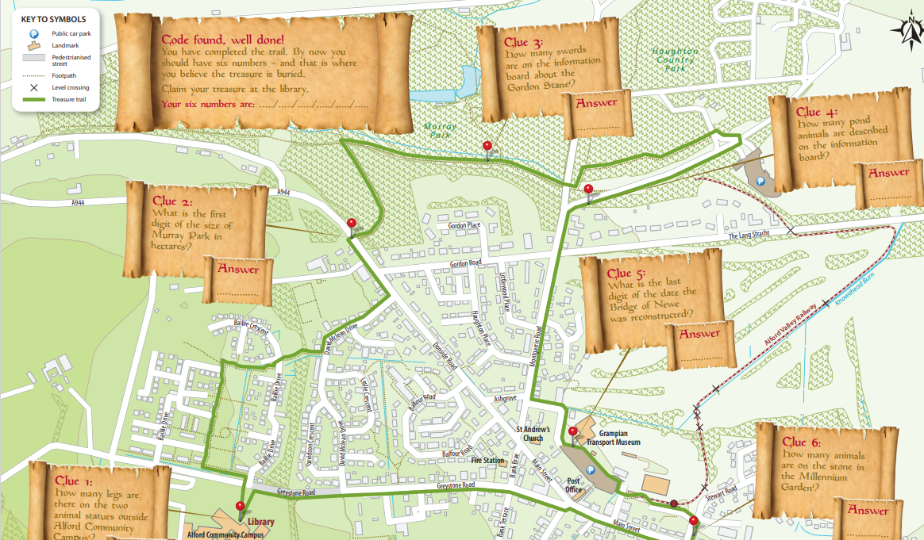
Community Trail & Treasure Hunt
This summer smart journeys will be setting up a community trail at Waterbeach as we have already done at Alconbury Weald
The trail will promote walking, cycling and scooting within the development, with an aim to show residents lots of different landmarks and locations within walking, scooting or cycling distance from their homes. Participants will be entered into a prize draw where they could win prizes such as:
£50 bike voucher.​
Master bike lock.​
Bike lights.​
Cycling accessories.
Map example ‘Pindar Creative’ for Alford

Slide 18
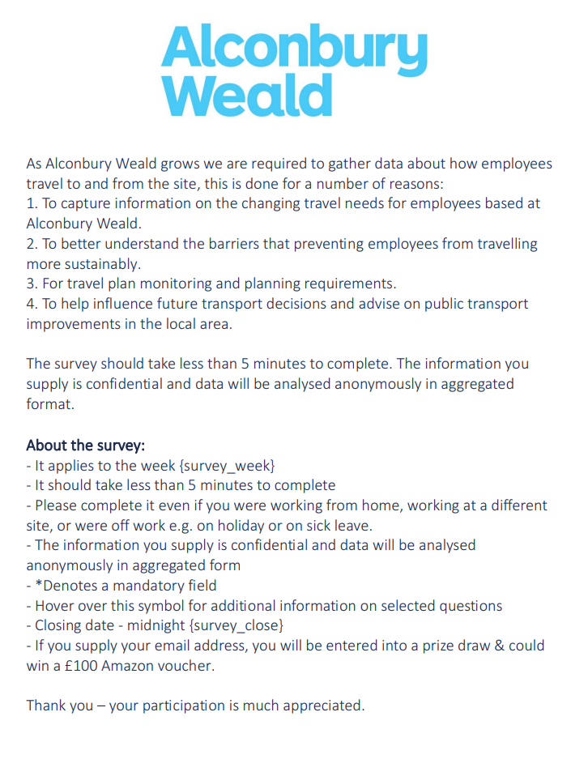
Annual Travel Survey
smart journeys will deliver an annual travel survey, designed to help us understand how residents get to, and from work from the development. We are experienced in asking leading questions, that enable us a to gauge a clear understanding of barriers that prevent them travelling sustainably.
smart journeys will design a comprehensive plan, that outlines our approach and provides a clear timeline to deliver the survey. We will use a mix of methodologies for collecting survey results, to include: an on-line platform and a paper-based survey to capture as much feedback as possible.
The travel survey will also allow us to plan, monitor and evaluate the impact of our Travel Plan initiatives and will aid us in reaching your objectives. We can use the data that has been collected from thousands of employees across Cambridgeshire to make sure our data is the most valuable in our geographic area.

Slide 19
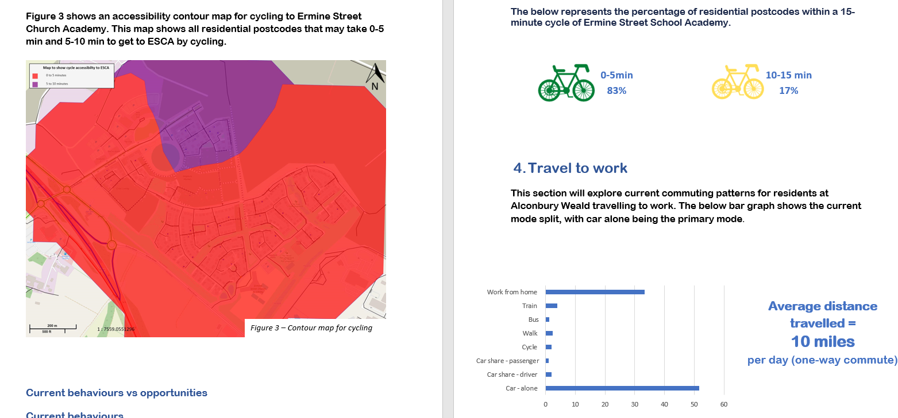
Submit Monitoring Report and Travel Plan Revisions
Each year smart journeys will analyse data and feedback collected from the travel survey and provide an advanced statistical analysis of the results. Using GIS and statistical software, our comprehensive report will identify trends, provide actionable insights and drive new ideas.
smart journeys will create a yearly Monitoring Report and submit this data to the Local Authority, detailing how objectives within the Travel Plan have been met, as part of the planning condition.
Furthermore, we will use the results of the survey to understand which schemes and initiatives enable behavioural change and update these accordingly, to continually improve our offer. We can also use these reports to help celebrate your successes.
Alconbury Weald 2023 Scoping Report

Slide 20

Resident Travel Welcome Packs
smart journeys are developing residential travel packs for new residents, which will include details on sustainable travel to and from the development. Through the information provided, residents will have the ability to make informed choices about how they choose to travel. These travel packs will include:
An overview of the objectives and structure of the Residential Travel Plan.
Details of incentives being offered to residents to encourage sustainable travel and how to apply for discounts/voucher codes.
Current bus and rail timetables.
Pedestrian and cycle route maps to and from the development.
smart journeys’ contact details.
Our team are experts in behavioural change and understand that travel habits are formed within 3 months of moving to a new area; therefore, it is vital to encourage positive behaviours from day one and provide residents with the tools to make sustainable choices.

Slide 21
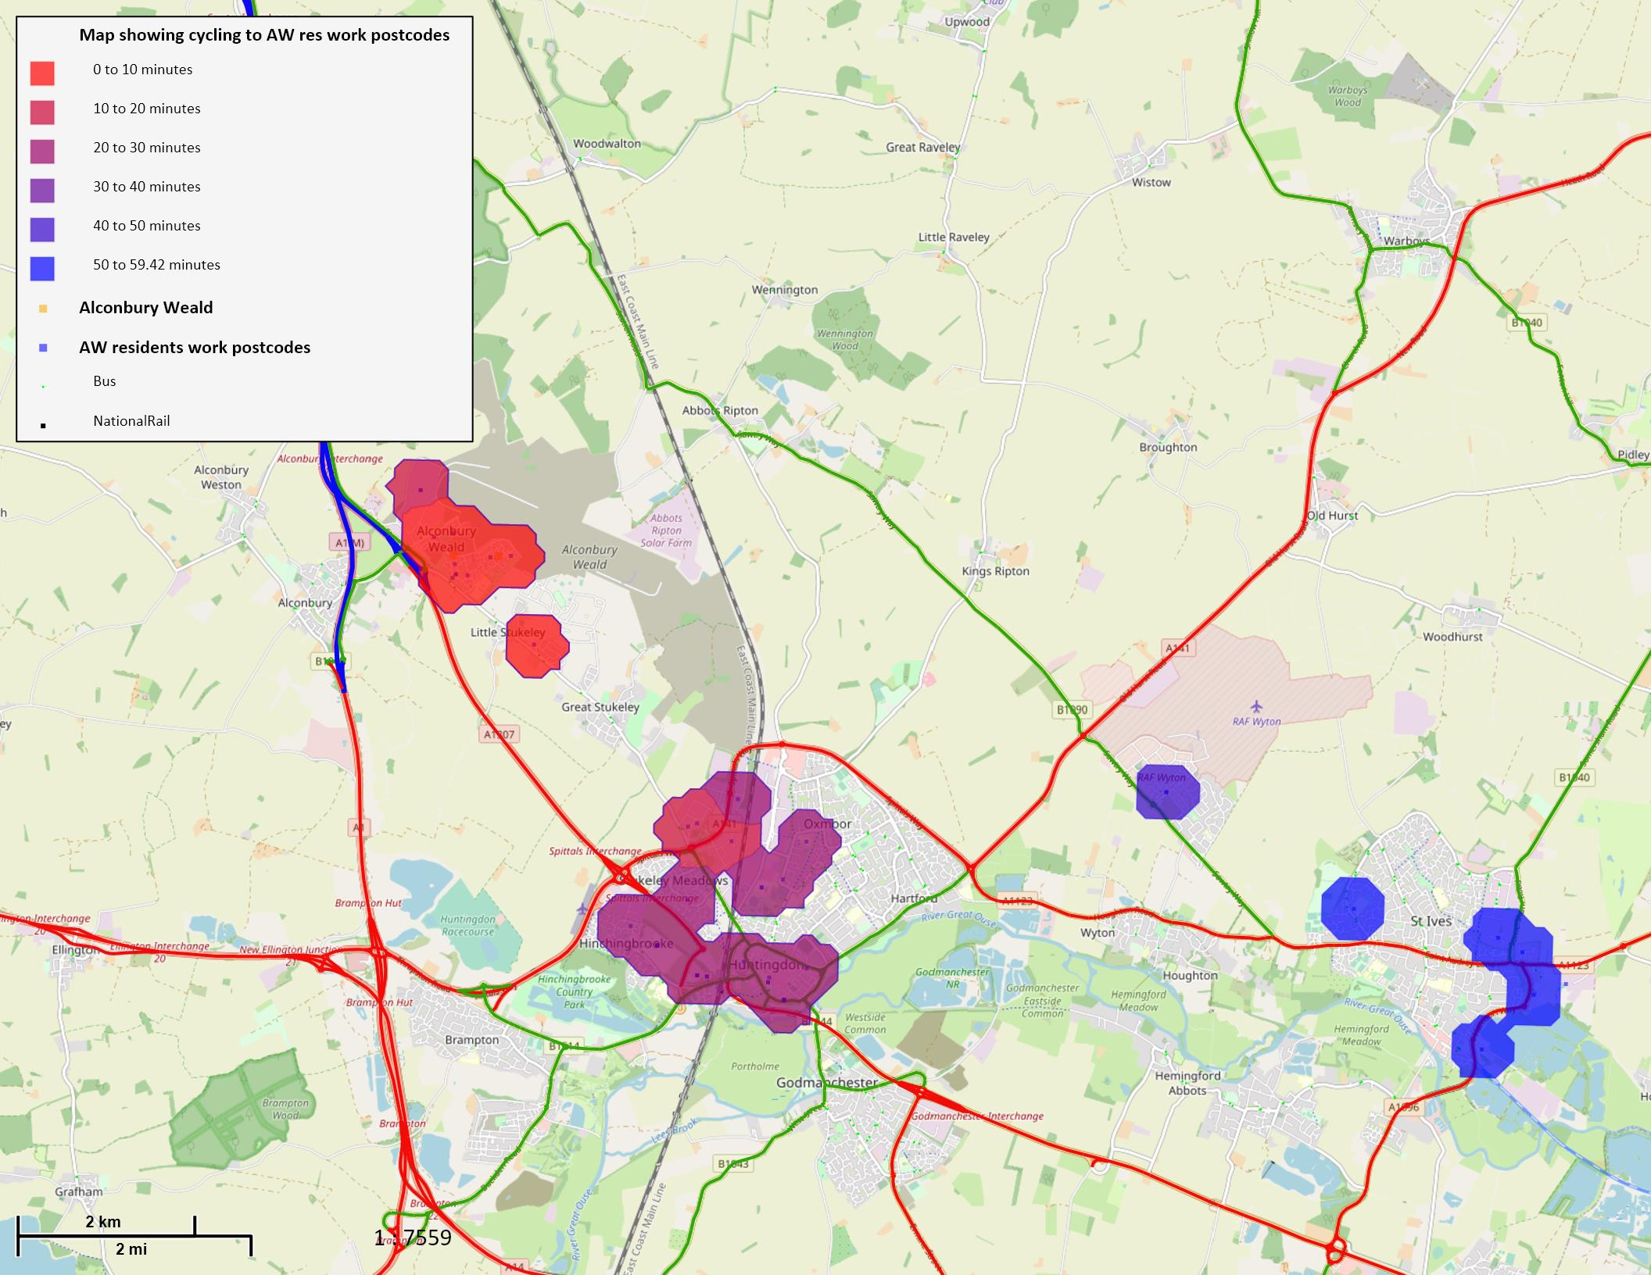
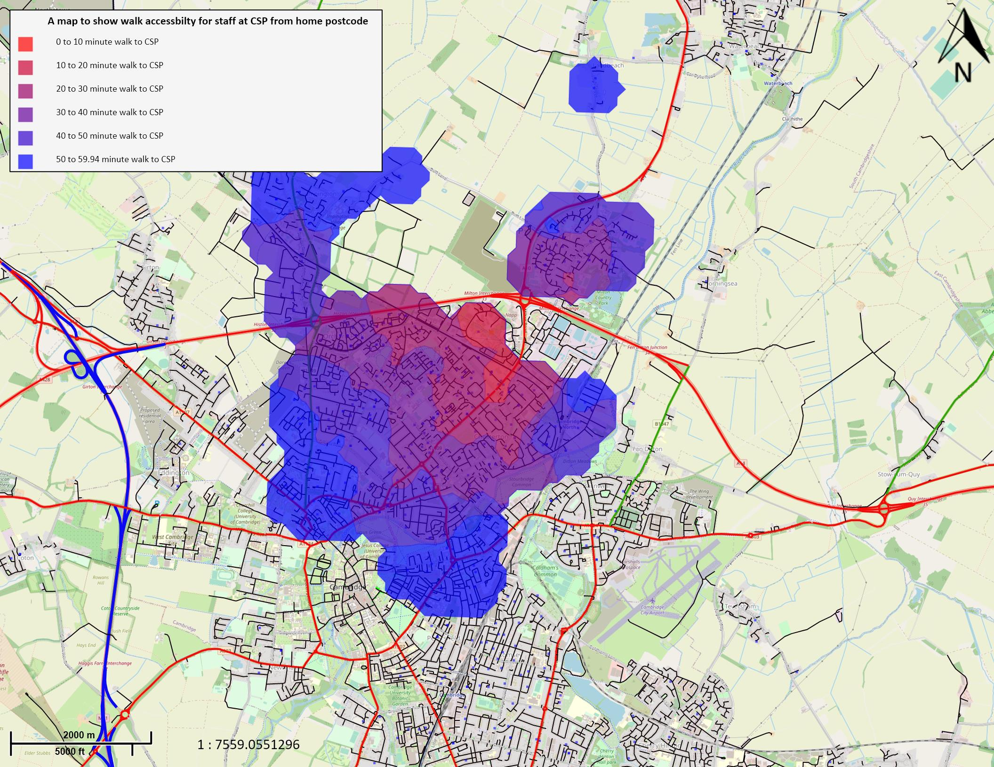
Postcode Mapping
Using geographical information software (GIS), smart journeys can present geospatial data on residents’ travel options. Working with individuals we can map home postcodes to work postcodes or points of interest and use this data to visually identify the modes of transport available to them. This will enable us to support residents in establishing which travel campaigns would have the greatest impact, as illustrated by figures below.
Figure 1 - map showing workplaces of Alconbury Weald residents within 60 min cycle of Alconbury Weald
Figure 2 - map showing employee home postcodes within a 60 min walk of Cambridge Science Park

Slide 22



Inclusivity
Inclusivity is at the heart of smart journeys sustainable travel plan initiatives. With experience in accessibility and inclusion, smart journeys will aim to incorporate inclusivity in all their workstreams to ensure sustainable travel is accessible for all.
Oftentimes, people with special accessibility requirements are excluded in sustainable travel plans and various travel schemes. As a result, we have proudly partnered with key charities and organisations such as ‘Wheels for Wellbeing’, an award-winning charity supporting disabled people of all ages and abilities to enjoy the benefits of cycling. This ensures our initiatives are appropriately structured and incorporated in our workstreams. Combining their specialist knowledge and skills will influence our work, enabling us to empower Waterbeach in becoming sustainable travel trailblazers, pioneering accessible travel in other local communities around Cambridgeshire.
We have also partnered with ‘TAG Bikes’ who offer training for adults with learning disabilities to enable them to find future employment. We currently use their services at Alconbury Weald and are in the process of securing vouchers for new residents at Northstowe to include in our ‘Welcome Pack’. This provides an opportunity to purchase a refurbished bicycle, a new lock and helmet. All funds received are returned to Huntingdon Day Care Social Fund.

Slide 23
5-year plan
Incentives
Welcome packs, bus tickets, bike servicing, cycle training, continuing Mobility Ways lift sharing app, personalised travel planning, promotional events, community trail, set-up sustainable transport forum, introducing e-bikes, establishing the Mobility Hub.
Welcome packs, bus tickets, bike servicing, cycle training, setting up Mobility Ways lift sharing app, personalised travel planning, and promotional events.
Welcome packs, bus tickets, bike servicing, cycle training, continuing Mobility Ways lift sharing app, personalised travel planning, promotional events, community trail, run sustainable transport forum, setting up e-car, e-bikes, Mobility Hub management.
Welcome packs, bus tickets, bike servicing, cycle training, continuing Mobility Ways lift sharing app, personalised travel planning, promotional events, community trail, run sustainable transport forum, e-car, e-bikes, Mobility Hub management.
Welcome packs, bus tickets, bike servicing, cycle training, continuing Mobility Ways lift sharing app, personalised travel planning, promotional events, community trail, run sustainable transport forum, second e-car, e-bikes, Mobility Hub management.
Year 1
  Travel Planning Services - £15,000
  Travel Planning Initiatives - £15,000
Year 2
  Travel Planning Services - £16,000
  Travel Planning Initiatives - £20,000
Year 3
  Travel Planning Services - £18,000
  Travel Planning Initiatives - £22,000
Year 4
  Travel Planning Services - £18,000
  Travel Planning Initiatives - £22,000
Year 5
  Travel Planning Services - £18,000
  Travel Planning Initiatives - £22,000

Slide 24
Q&A

Slide 25
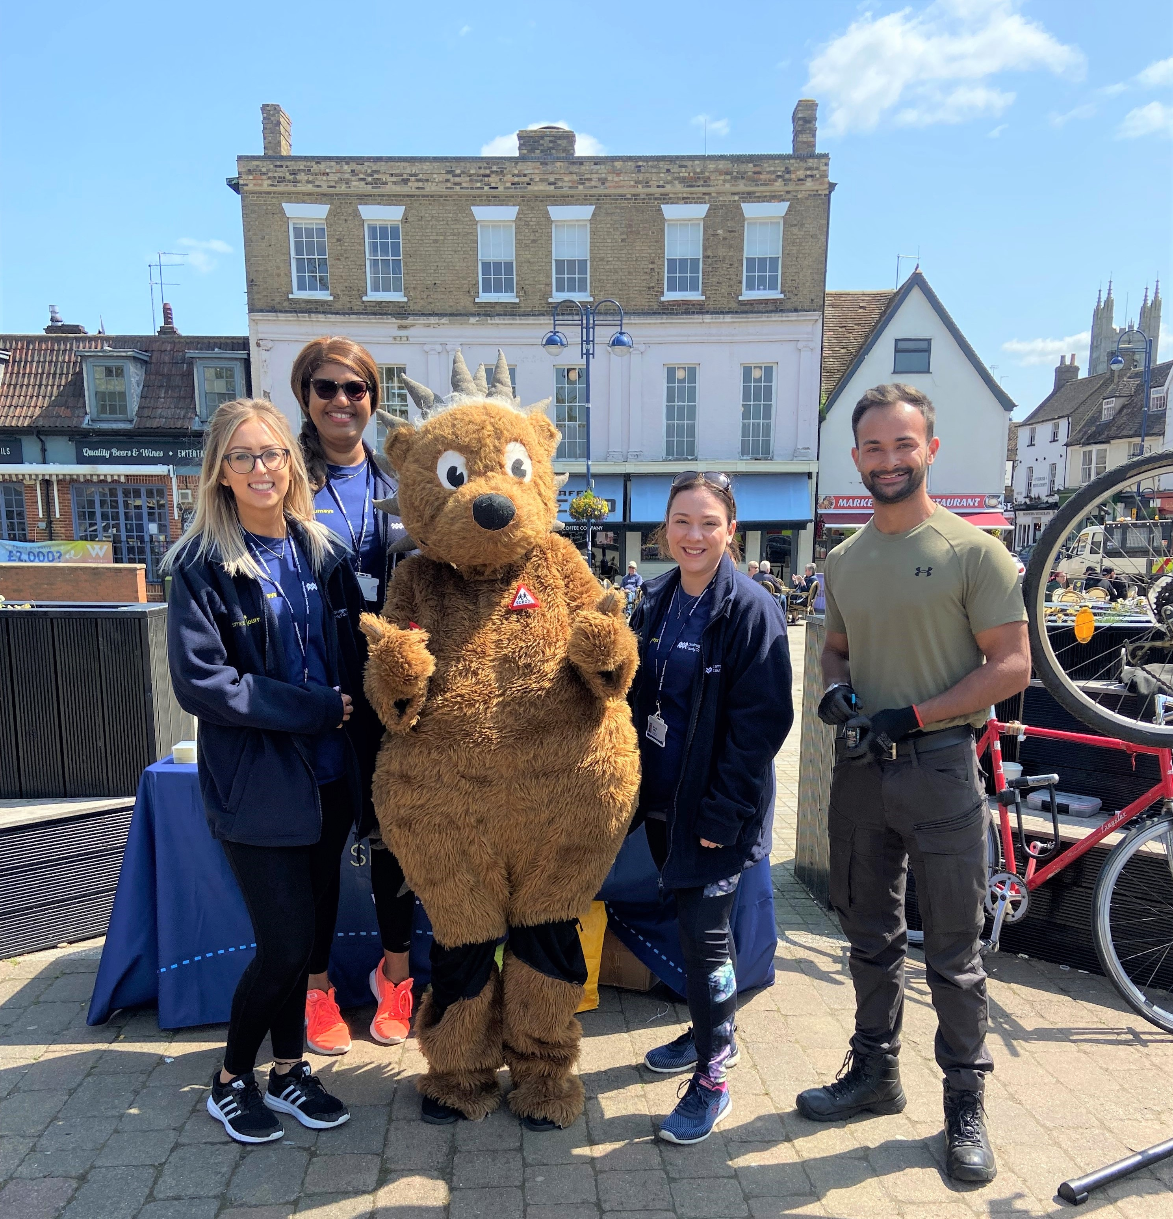
Contact Us
info@smartjourneys.co.uk
Day of Action in St Neots for Project-EDWARD
16th May 2023
www.smartjourneys.co.uk

