Slide 1

Cambourne West
James Truett, Senior Planning Officer
e: james.truett@greatercambridgeplanning.org
Notes:
Introduce:
James Truett, Senior Planning Officer in the Strategic sites team GCSP
I am the case officer and supporting on 2 outstanding reserved matters applications and handling the remaining outstanding planning conditions and minor applications across this site, and I have previously dealt and assisted with numerous planning applications across Cambourne West.
The two developers, Taylor Wimpey and Vistry are unable to present at this meeting so I am stepping in to provide an overview of the site.

Slide 2
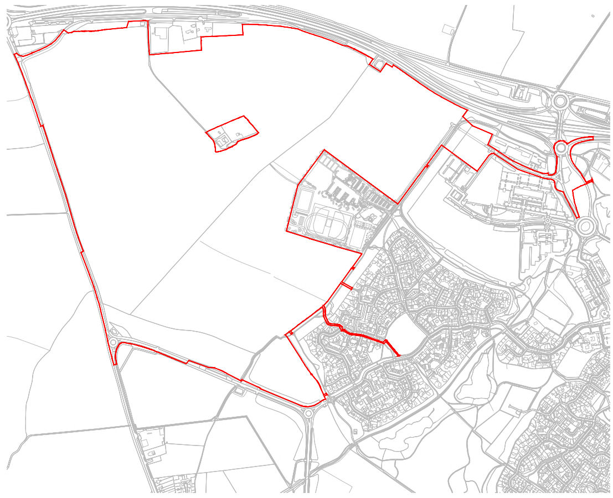
S/2903/14/OL – Outline Planning Permission
Outline planning permission granted December 2017 (as amended by S/1775/19/NM)
2,350 residential units
Notes:
Outline permission was granted in December 2017 (denoted by the RLB) which includes 2,350 dwellings, retail, offices/light industry, community and leisure facilities and schools.
For each development parcel or strategic engineering and landscaping element a reserved matters application must be submitted and approved by the local planning authority.
Applications for the approval of reserved matter shall be made to the local authority before the expiration of 16 years from December 2017 (December 2033)

Slide 3
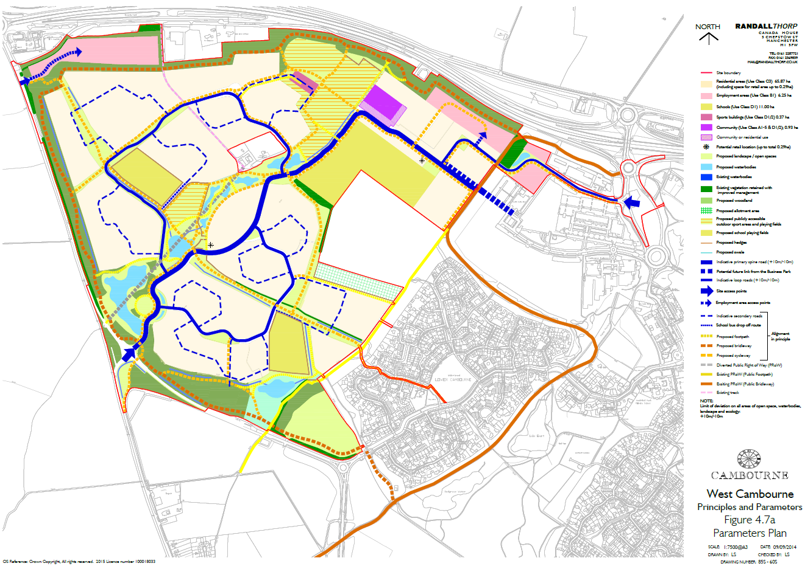
Notes:
This shows the approved parameter plan for the Cambourne West development.
This shows some of the key principles which guides the development including the general layout, the movement strategy, and points of interest (i.e. schools, shops, and community centres).

Slide 4
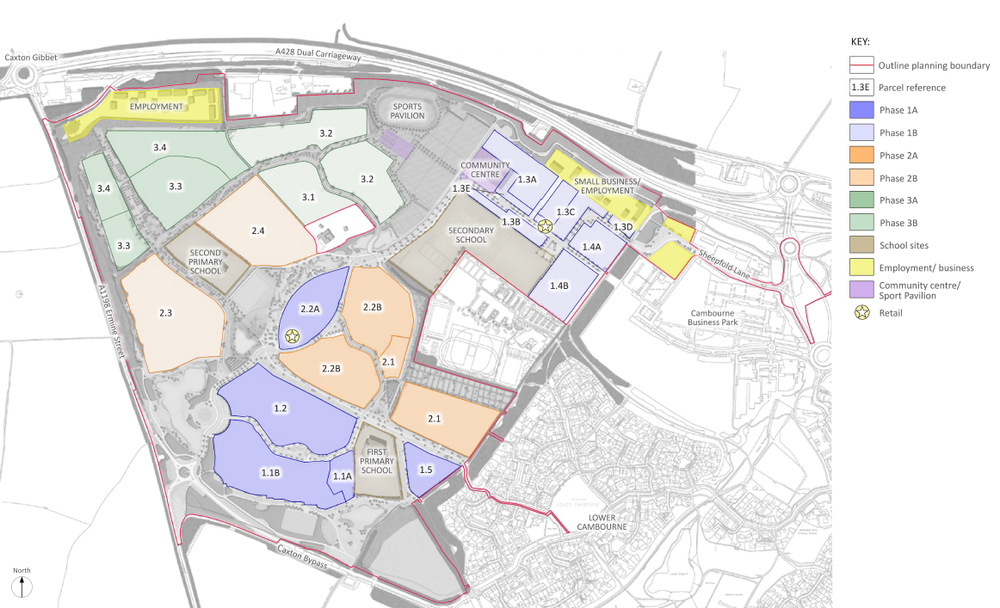
Layout and development phases
Parcels 1.1, 1.2, 1.3, and 1.4 - received reserved matters approval
Notes:
Phasing plan for development (Swansley Park, Sheepfold, Woodfields)
Parcel 1.1 (S/4537/19/RM) – Approval June 2020 for 200 Dwellings
Parcel 1.2 (20/01536/REM) – June 2020 for 190 Dwellings
Parcel 1.3a and 1.3d (20/02543/REM) – Approved May 2021 for 150 Dwellings
Parcels 1.3b, 1.3c, 1.3e, 1.4a & 1.4b (20/01640/REM) – Approved June 2020 for 286 Dwellings
Parcel 1.5 (22/04745/REM) – Approved May 2023 for 41 Dwellings
Parcel 2.1 (22/04785/REM) – Approved July 2023 for 118 Dwellings
985 dwellings have reserved matters permission. Over 373 occupied, reaching this mark at the start of the year.
Final slide showing the layout as a whole.
Planning obligations are achieved through a section 106 agreement between the county council, district council and the land owners, this include community related facilities.
37 LAPs, 5 LEAPs, 2 NEAPs and 6 SIP.
Local Area of play is primarily for under 6s
Locally equipped area of play is for children beginning to go out and play independently
Neighbourhood Equipped Area of Play is for older children but with play opportunities for younger children too.
Space for imaginative play
Over 10ha of land is allocated for sports provision including buildings, parking, sports pitches and running track.
New community building is proposed
Allotments (2.63ha) proposed
Burial ground

