Slide 1
Waterbeach Community Forum
Wednesday 15 March 2023
Agenda
19:00 | Welcome | Councillor Anna Bradnam – Milton & Waterbeach Ward | 5
19:05 | Planning Update | Mike Huntington – Principal Planner, Greater Cambridge Planning Service | 10 (all times incl questions)
19:15 | Urban&Civic – Development Update + Strategic Presentation on Ecology, Biodiversity and Open Space | Rebecca Britton, Regional Director – Communications, Communities and Partnerships ; Paul Mumford, Project Director | 25
19:40 | General Q&A | All | 20
20:00 | Close - Next meeting 7 June 2023 |  | 5

Slide 2

Waterbeach New Town
15th March 2023
Planning update
Mike Huntington
Principal Planner – Strategic Sites
Mike.Huntington@greatercambridgeplanning.org
or 0770 4018477

Slide 3
Vision for the new town
2 developers
Western half – U&C with MoD
Eastern half - RLW

Slide 4
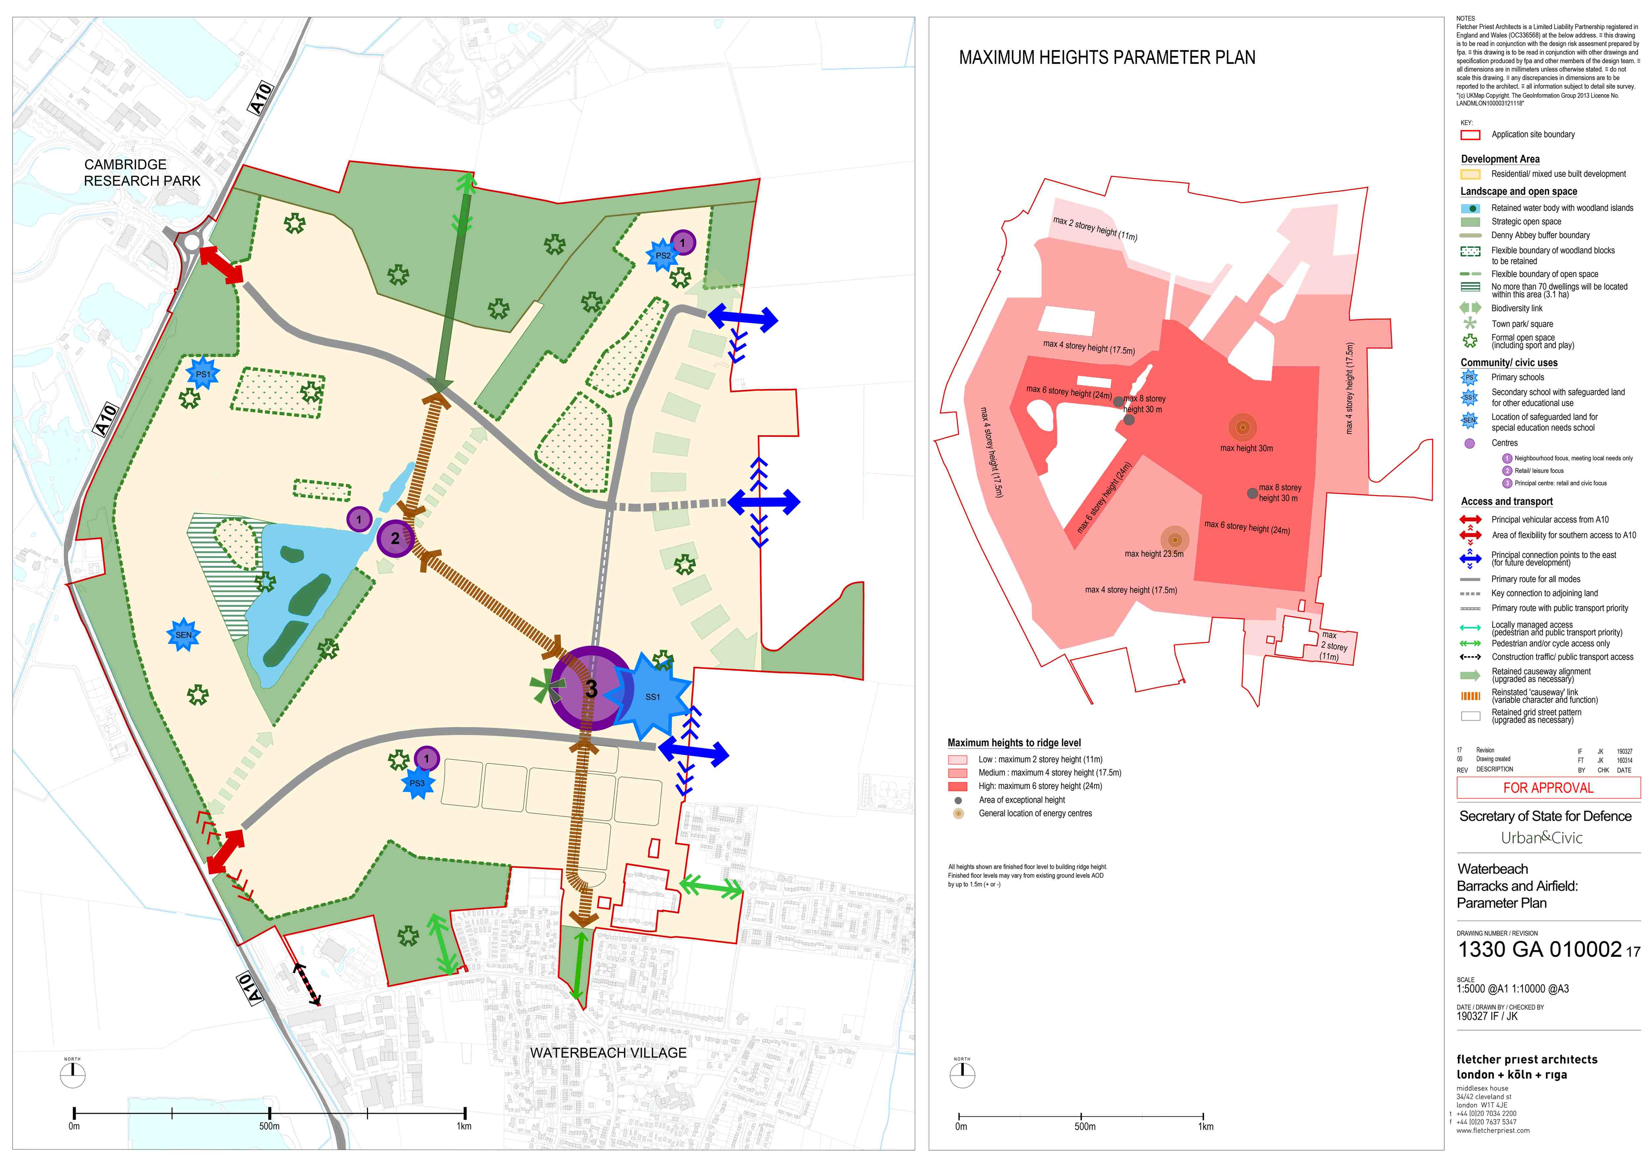

Slide 5
Indicative masterplan for the western half

Slide 6
First phase – known as Key Phase 1, and divided into key phase 1 north and key phase 1 east
Covered by relevant Conditions and s106 triggers monitored by SCDC
E.g. early delivery of community space and transport infrastructure

Slide 7
Regulatory plan to guide development for key phase 1
Shows where houses, schools, commercial uses, roads, open space, will go.

Slide 8
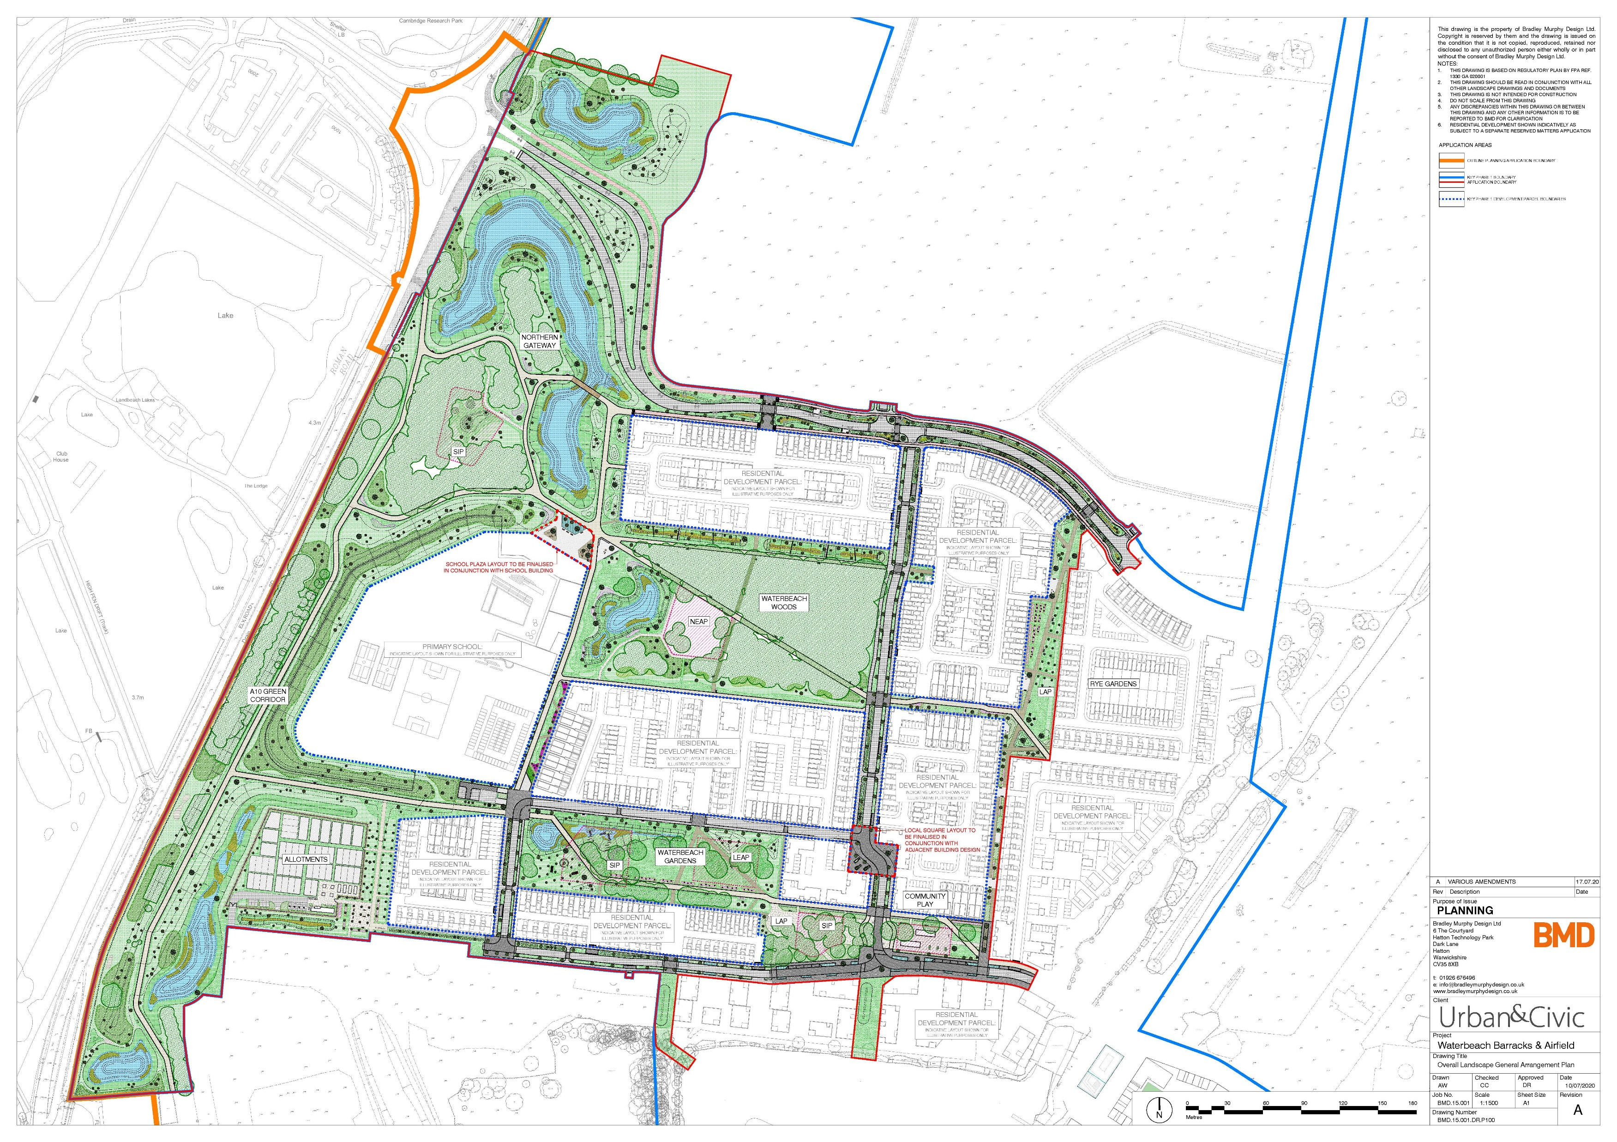
Development currently taking place on site includes
1) infrastructure and housing parcels 1 and 2.1.
2) Lake spur
3) Lake path
4) 1st Play area
Planning applications in at the moment –
First primary school – with County Council
Plaza in front of the school

Slide 9
Eastern half
RLW planning application
Finalising the s106 legal agreement with County Council colleagues at the moment
Various conditions to approve before development takes place on site
Relocated railway station – lawful development certificate application

Slide 10
Thank you for listening

Slide 11
Waterbeach Community Forum
Wednesday 15 March 2023
Agenda
19:00 | Welcome | Councillor Anna Bradnam – Milton & Waterbeach Ward | 5
19:05 | Planning Update | Mike Huntington – Principal Planner, Greater Cambridge Planning Service | 10 (all times incl questions)
19:15 | Urban&Civic – Development Update + Strategic Presentation on Ecology, Biodiversity and Open Space | Rebecca Britton, Regional Director – Communications, Communities and Partnerships ; Paul Mumford, Project Director | 25
19:40 | General Q&A | All | 20
20:00 | Close - Next meeting 7 June 2023 |  | 5

Slide 12
Contact Information
Email –
Waterbeach.community@scambs.gov.uk
Webpage –
www.scambs.gov.uk/waterbeach-community-forum
Telephone – 01954 71 3070

