Slide 1

Community Forum
20th March 2024
Urban&Civic Update

Slide 2

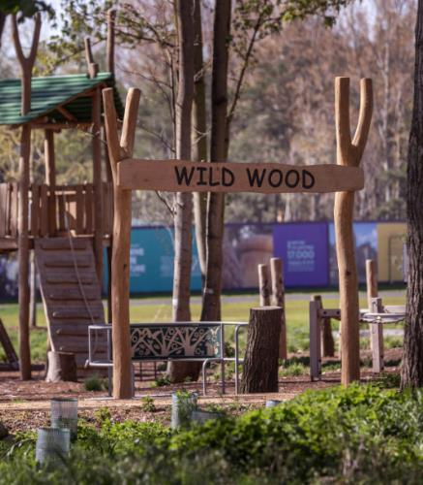
Development Update
First residents welcomed, including affordable housing homes
Tree maintenance work undertaken. Woodland and play area due to re-open April 2024
Lake Activation including Paddleboarding and Wild Swimming with Milton Country Park and exploring café
Working with health partners to understand the requirements for first health space
PPG Public Meeting next Tuesday 26th March
Conversations ongoing re: next homes
Working with Cambridgeshire County Council to understand how the pause in planning permission impacts school delivery

Slide 3
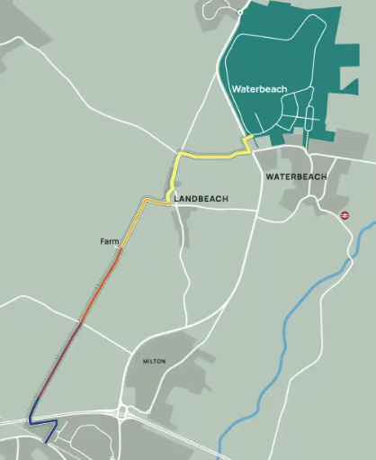
Connections
Walking and Cycling route open through site (village to A10)
A10 Cycle Works Completed
Lake Loop Open
Working with GCP to connect development to Park & Ride and Greenway
Working with GCP and RLW to support train station move
Phase 1 of Mere Way complete through Landbeach
Bridge over A10 will be installed as part of Phase 2 Works

Slide 4
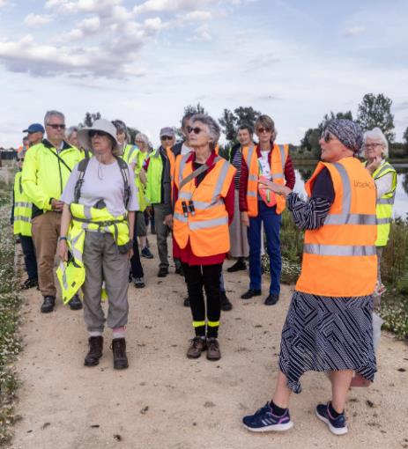
Community Update:
What’s happened
Tours for prospective residents and community groups
Community Market moved to bigger, covered Terraces space with increased footfall – last Sunday’s was the busiest yet!
Monthly art exhibitions and workshops at Community Market
Over 45 monthly community groups
Free bike repairs at October & November Community Market
Free Shuttle Bus for Community Market

Slide 5
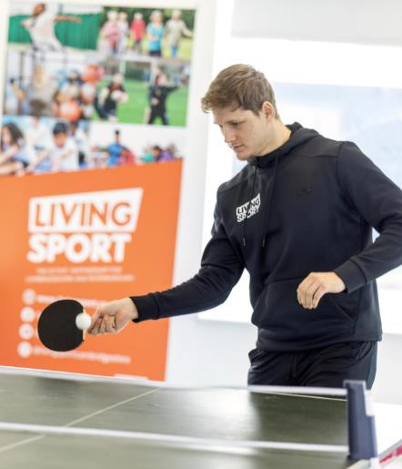
Community Update:
What’s happened
Working with Living Sport to activate community sport including taster sessions at community market and Feb half term
Increased daytime provision including Walking Football and Wellness Walks
Activation of Squash Club
Interim library space launched in the Studio – a book exchange with dedicated time for access
Introducing the community to walking and cycling route through site
Partnership with smart journeys to launch lift share

Slide 6
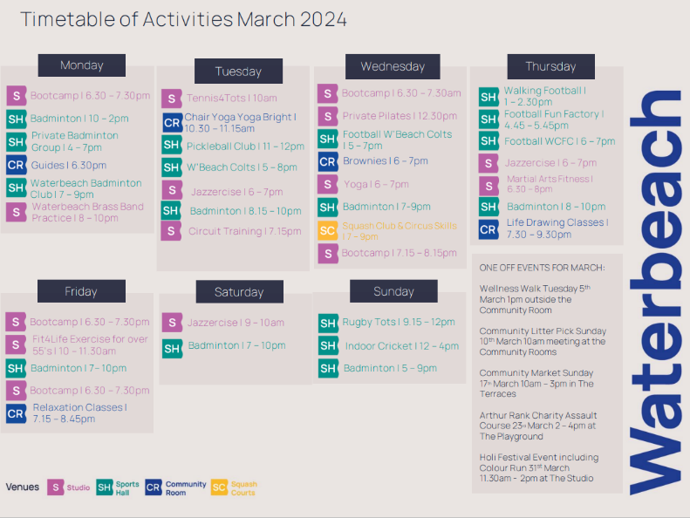

Slide 7
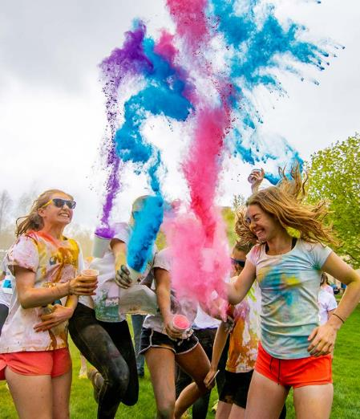
Community Update:
March 2024
Full timetable of events and activities in the community spaces
Holi Festival and Colour Run in association with Waterbeach Indian Association – all tickets sold out within 48 hours
Easter Trail – pick up a sheet from the housebuilders, and answer the questions to win an Easter prize!
‘Meet Your Neighbours’ Event for new and future residents of the development

Slide 8
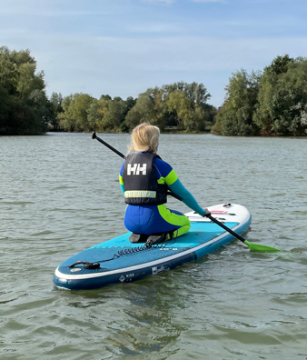
Community Update:
Lake Activation
Working with Cambridge Sports Lake Trust to deliver paddleboarding and wild swimming
Installation of beach huts to act as storage and changing space for watersports, as well as a focal point by the lake to get people talking
Talking to café providers about lakeside unit
Working with New Meaning Foundation to deliver the beach huts as part of jobs and skills work

Slide 9
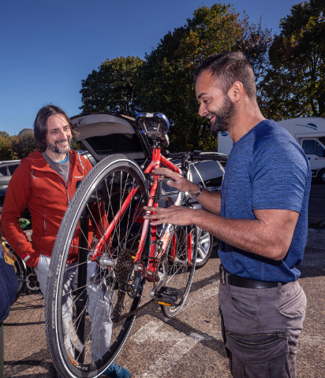
Community Update:
2024 and Beyond
Welcome packs and welcoming more residents
Working with smart journeys to launch bike hire and activate Sustainable Transport Hub
Working with Living Sport to activate more sports and activities
Emerging New Communities conference
Community Market continuing – themes for each month to encourage wider range of market stalls and to attract different people

Slide 10
Thank you
Rebecca Britton
Regional Director Communications, Communities & Partnerships
rbritton@urbanandcivic.com
Paul Mumford
Project Director
paul.mumford@urbanandcivic.com
Fiona Reardon-Rose
Communications & Partnerships Manager
fiona.reardon-rose@urbanandcivic.com

