Slide 1


Phase 1 Faith/Voluntary Land
Clare Gibbons
Growth Manager
Trovine Monteiro
Built Environment Team Leader
South Cambridgeshire District Council

Slide 2
Secured under policy SC4 (Meeting Community Needs) of the Local Plan:
Phase 1
0.25 hectares of land, adjacent to Parcel H13 and Bughunter Waters
Phase 2
An area of serviced land in the town centre, capable of providing between 1000-1050 sq.m gross internal area (could be land or floorspace within a building)
Phase 3A (Faith land)
0.15 hectares of serviced land within the site, adjacent to the Local Centre, or within a secondary mixed-use zone (additional to a community garden for remembrance and reflection to be brought forward by Homes England)
Phase 3B
0.1675 hectares of serviced land within the site, within or adjacent to the secondary mixed-use zone or adjacent to the primary school

Slide 3
Eligibility criteria:
The faith/community group has an association with Northstowe.
The organisation has charitable status.
The applicant organisation has the financial resources and organisational capacity to deliver.
Any building delivered on the faith/voluntary land should accommodate, in addition to any dedicated worship space, shared space to be made available, with staff to support the provision of a range of community activities open to all. Such shared space must also be made available to other community and faith groups without restriction.

Slide 4

Community & Faith Land: Development Brief
Aim & Purpose
The brief is prepared to assist the council to articulate its strategic vision, expectation for the site, buildings and landscape,
Assess bids, proposals coming forward.
Objectives
Establish some parameters for building footprint, open space, parking, height and massing of building.
Develop design principles to articulate the vision including sustainability.
Assumptions
The brief is not a planning document- incorporates comments from Planning GCSP and Highways.
Provides a starting point to develop detailed requirements, inform concepts, test ideas, develop detailed designs.
Plans, sketches and images are illustrative used to set the design and quality ambitions: not meant to restrict imagination and creativity of design teams
Further pre-application discussions will be required with Local planning authority. Detail engagement with the community will be required.
The sketches and images are illustrative and does not represent the final design and layout of buildings.

Slide 5
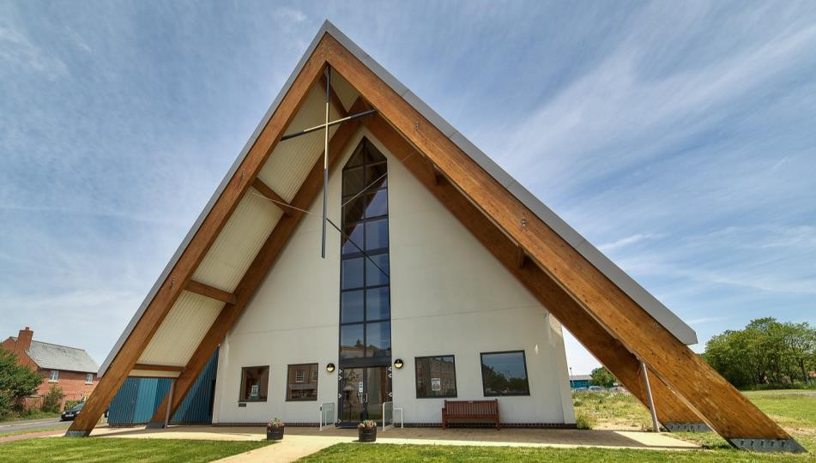
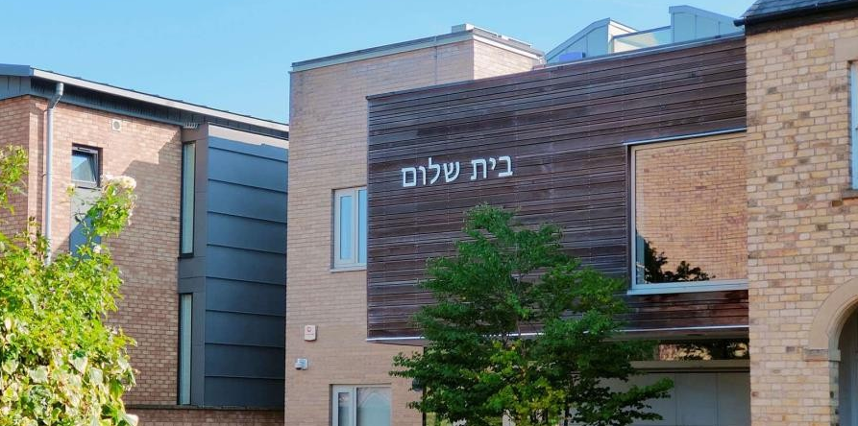
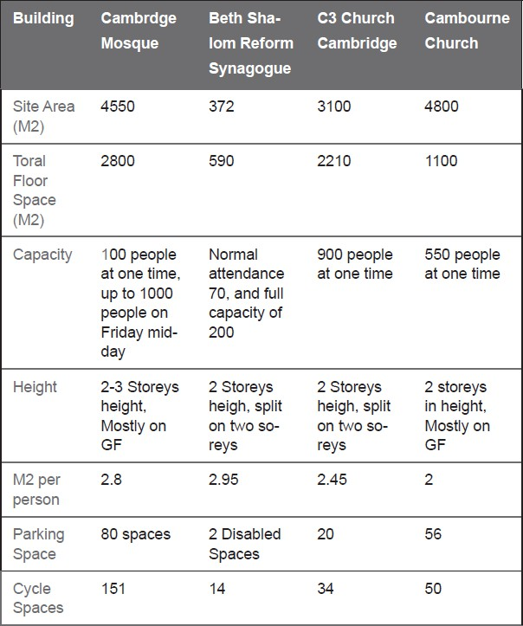
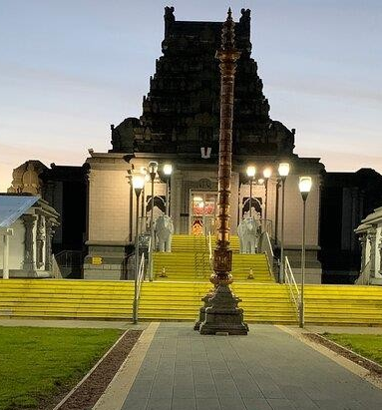
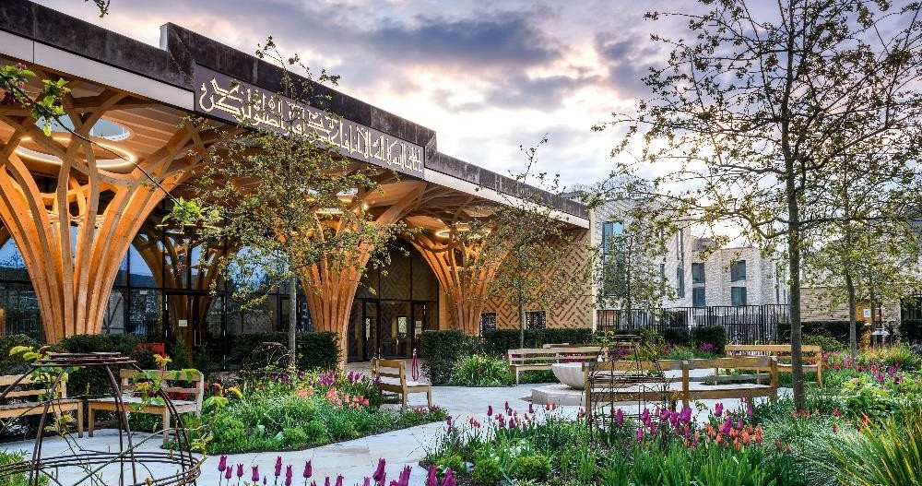
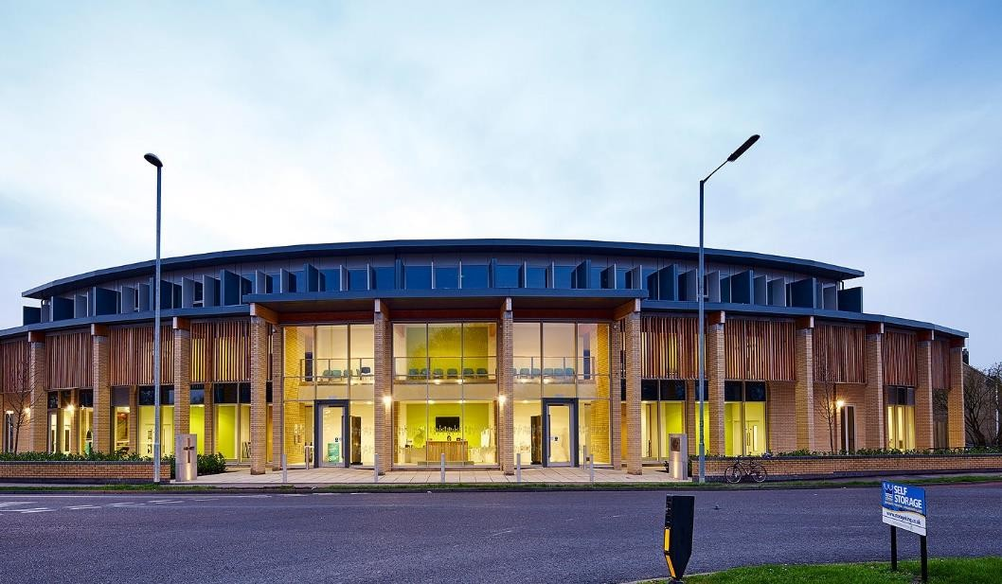
Case Studies
Cambourne Church
Beth Shalom Reform Synagogue
Cambridge Mosque
Shri Venkateswara Balaji Temple, Birmingham
C3 Church Cambridge

Slide 6
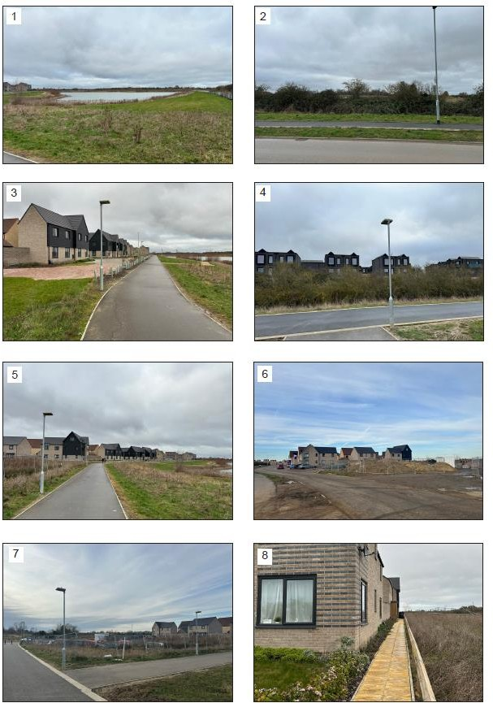
Context: Site
As part of S106 Northstowe phase 1 - Land identified for Faith and Volunteer groups: Appx 2500 sq.m.
Location
The site lies adjacent to and south-east of Northstowe phase 1, north of Northstowe phase 2 which includes the town centre, primary and secondary education uses.
The site is bounded by water park to east, Stirling road to the west, Residential parcel H13 to the north and the Strategic landscape corridor to the south.
Connectivity
Footpaths and cycleway connects the site to the park and ride busway to Cambridge, town centre and educational uses.

Slide 7
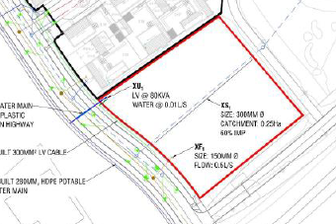
Constraints & Opportunities
Services
Surface water drainage pipe that runs under the site to be moved by L&Q before site transfer
Landscape and setting
Located in a prominent position within the strategic landscape corridor with fantastic views of the lake
Car Parking Provision
Local Plan Parking Standards 1 space per 8 sq.m or per 4 seats. Site is in an accessible location with adjacent parking infrastructure and good connections to the park and ride to Cambridge, town centre and educational uses
Should provide minimum parking infrastructure as possible on site with justification of catchment, size of congregation and a sustainable travel plan.
Relationship to houses on Parcel H13
Narrow Pedestrian access way leads to the front doors of properties on parcel H13 facing the site .
Quality Drivers for the building
Building expressing its religious/communal significance, designed as a pavilion block, opportunity to sensitively integrate height, internal design express external form, distictive design and landmark qualities.
Notes:
Relationship to houses: Building set back from residential edge for privacy, permeable landscape buffer, no harsh boundaries or narrow enclosures

Slide 8
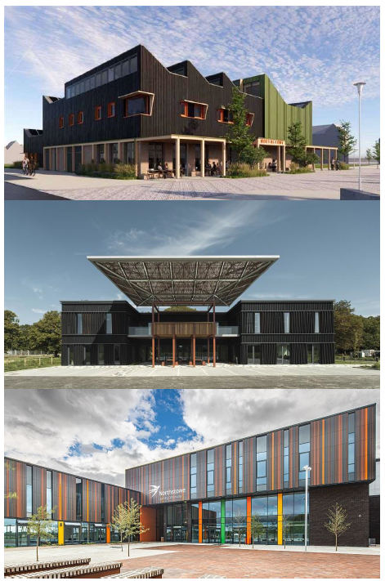
Vision for Northstowe
The vision for Northstowe is to create a 21st Century Town, with a strong local identity that combines the best historic characteristics with sustainable pattern of living and lifestyle choice……................................Northstowe Design Code Phase 1
It has excellent cycling, pedestrian connectivity, public transport and green infrastructure: lakes, greenways, parks, that draws its inspiration from the Fen Landscape: (network of waterbodies, drains and ditches)
Some of the buildings built or granted permission that exemplify the character, image and identity of 21st Century Town and vision
Vision for Community & Faith Land
To reflect its communal, religious, voluntary function to create a building with a distinctive identity,
To take advantage of, but sensitive to its landscape context,
Builds on the vision of Northstowe as a 21st Century town,
Address the challenges of our time on climate change through sustainable design
Northstowe Community Building, CZWG Architects
Northstowe House, Proctor & Matthews Architects
Northstowe Educational Campus, Frank Shaw Architects

Slide 9
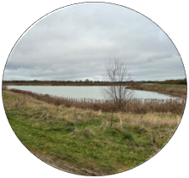
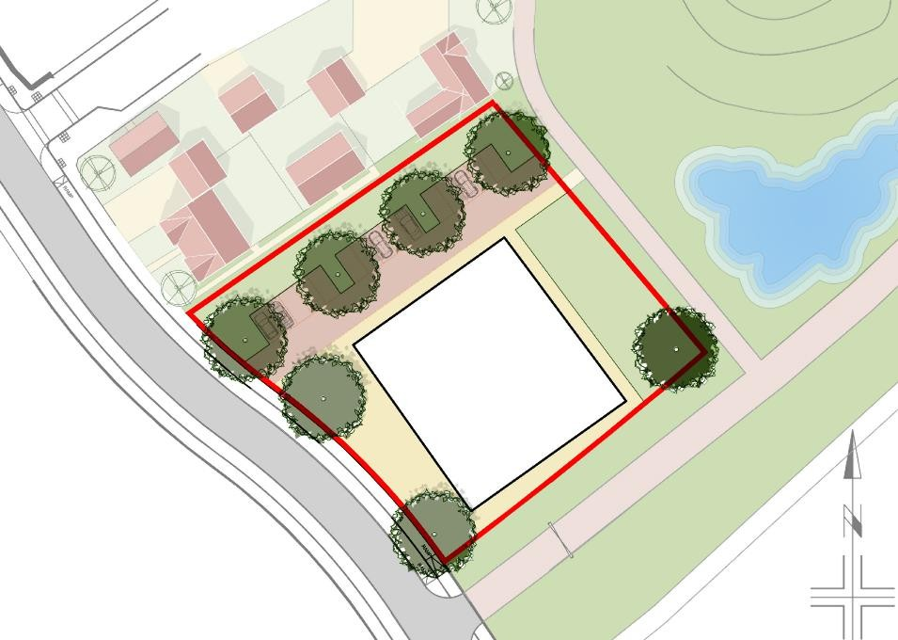


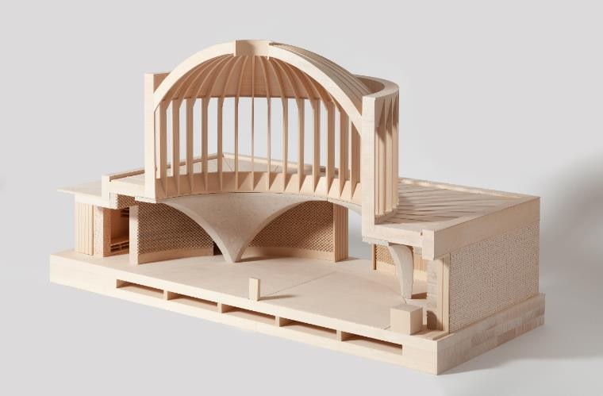
Design Principles
Design Principles
1. Respecting its landscape and Setting
2. Being a good neighbour
5. Sustainable Design
3. Promoting active travel
(minimum onsite car parking)
4. Building with a distinct identity

Slide 10
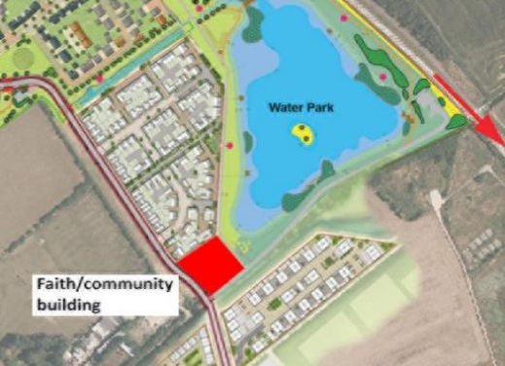
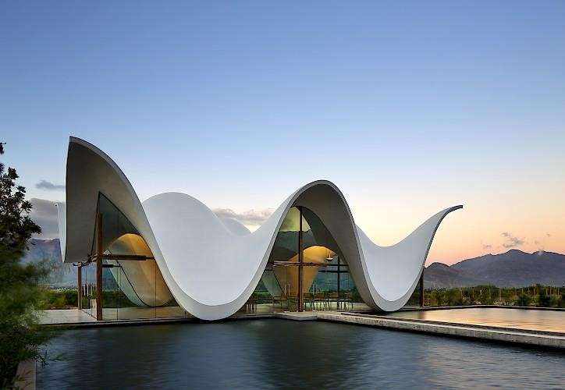
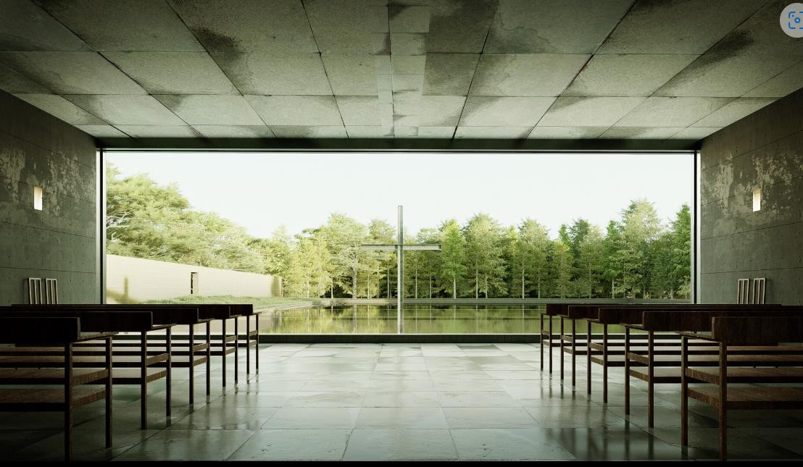
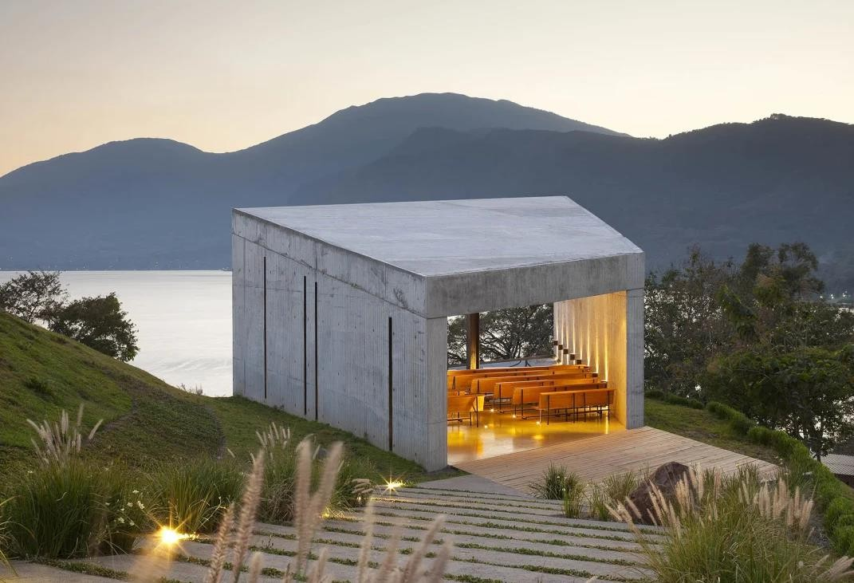
Design Principles
1. Respecting its landscape and Setting
Site is located in a prominent location within the strategic landscape corridor
Highly visible, sensitive design, elegant object, sculpture in the landscape
Sit gently within and transition gracefully into the landscape.
Strong thematic and conceptual rationale complementing its architectural design
Take advantage of views of the lake and landscape corridor
Sensitively incorporate a degree of greater height
Apropriate balance between building, landscape and parking
Create a high quality public realm that considers the use of water and creates a vantage point
Bosjes Chapel , South Africa Steyn Studio
Church on the Water, Tadao Ando
Chardedeu Chapel, El Salvador EMC Arquitectura

Slide 11
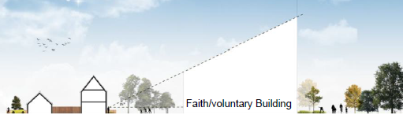
Design Principles
2. Being a good neighbour
Building should be positioned away from the residential edge. A minimum distance of 18m separation with residential units is suggested.
It should have an active edge on all four sides and not have a back
It should provide permeable, buffer planting of atleast 5 mts between along the entire edge facing the residential parcel H13 that allows filtered views and natural surveillance.
Avoid a gated development, but through good design ensure that it is safe and secure with clear definition of public and private spaces
Sensitively modulate its height and built form so that taller elements are located away from the residential parcel, mitigating its impact, including avoiding overshadowing and provide adequate access to sunlight/daylight

Slide 12
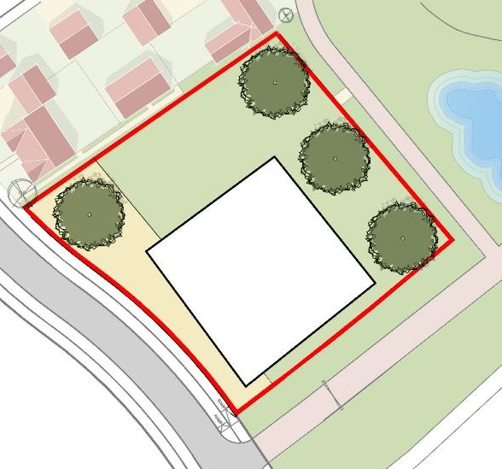
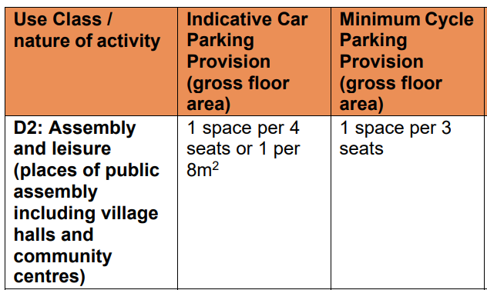
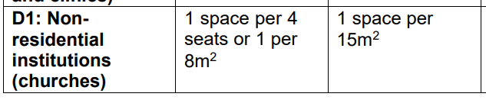
Design Principles
3. Promoting active travel whilst providing minimum onsite car parking
Promoting active travel encouraging people to walk, cycle or use public transport to access the site.
Provide links to adjacent cycleways and pedestrian footway network connecting the shortest route to the entrance and exits, through the site
Reduce the demand for onsite car parking provision by developing a sustainable travel plan
Making use of adjacent facilities such as the park and ride, education and future town centre car parks to manage peak in demand.
Provide policy compliant cycle parking as a minimum that should be easy to access at grade and safe to park with good natural surveillance.
Option 1: 13- 15 Car Spaces
Option 2: 26- 30 Car Spaces
Option 3: Zero or 60 Car Spaces
Extract from table – scdc local plan 2018

Slide 13
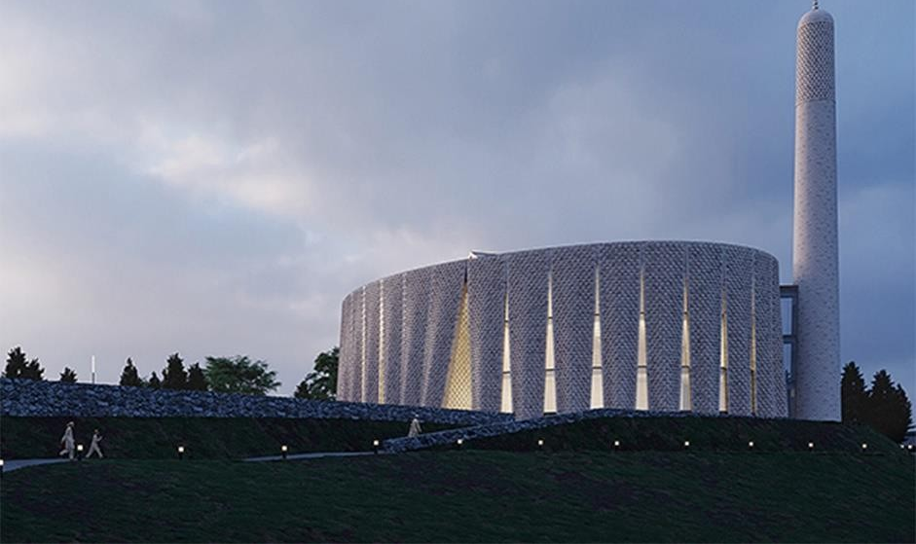
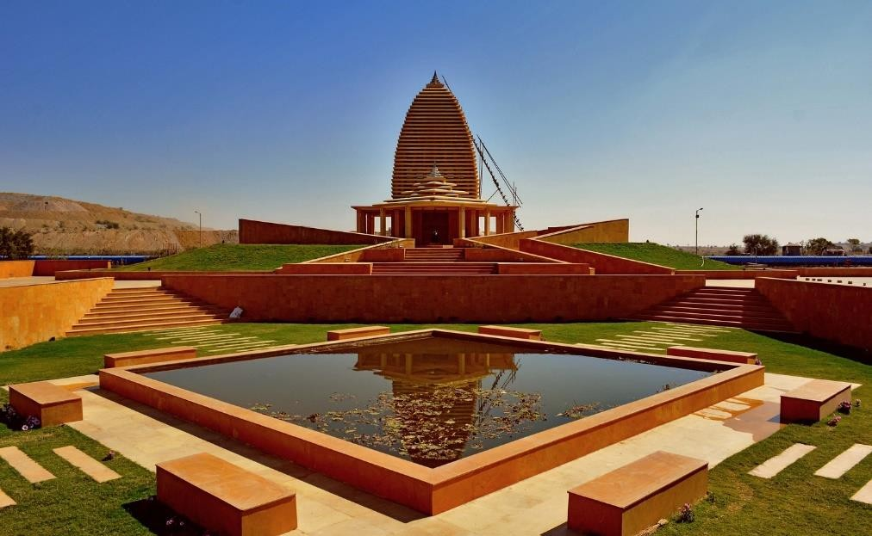
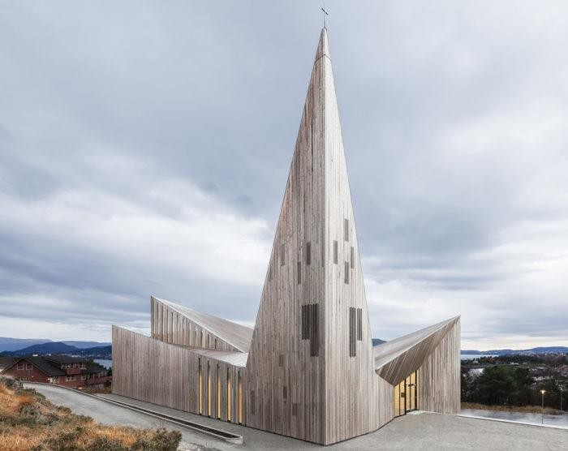
Design Principles
4. A place with a distinct identity
Church on the Water, Tadao Ando
Bosjes Chapel , South Africa, Steyn Studio
The design of building should consider its unique communal, religious, and voluntary uses, its role and status in the community through:
the expression of its internal design to serve the uses and functions,
Responding sensitively to its landscape context and
addressing sustainability
The building can make a substantial contribution to the place as a ‘landmark’, helping legibility, wayfinding, and giving identity to Northstowe.
Builds on the vision of Northstowe as a 21st Century town.
Mosque in Preston, Luca Poian Forms
Barmer Temple, Rajasthan India Space Matters
Community Church of Knarvik, Norway
Chardedeu Chapel, El Salvador EMC Arquitectura

Slide 14
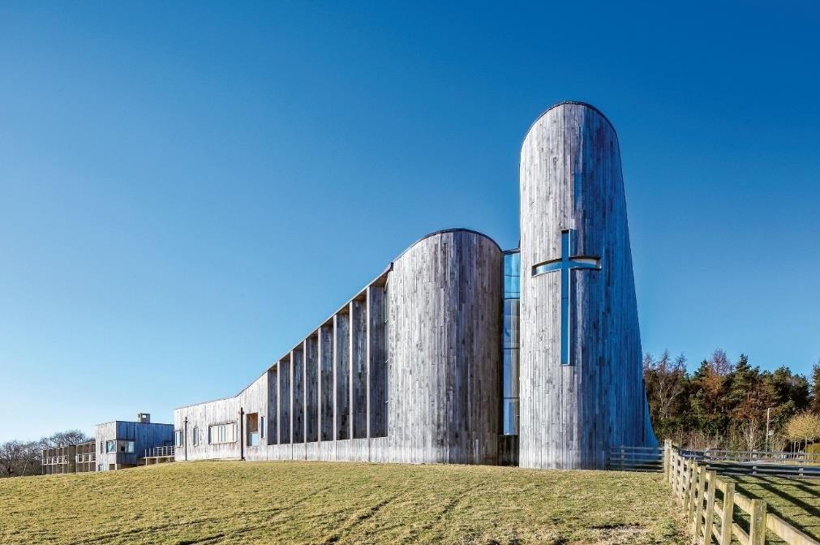
Design Principles
Stanbrook Abbey Church, Yorkshire FCB Studios
5. Sustainable Design
The building should take a design led approach in responding to the twin challenges of climate change mitigation and adaptation.
The design should prioritise the development of a low energy building that supports the transition to net zero carbon through passive design principles and the use of on-site renewable energy.
Achieving BREEAM Excellent/Outstanding or Passivhaus standard or similar
Improve water efficiency
Design led approach to prevent overheating
Opportunities should be utilised to incorporate features such as SUDs, Green/Blue roofs and Rainwater harvesting
Use materials with low embodied energy

Slide 15
Option 1
Site Area: 2500 sqm.
Cycle Spaces (Min) – 54 spaces
Parking: 13-15 spaces
Open Space: 300 - 500 sqm.
Building Footprint: 800 sqm.
Height: 6 - 7.5m predominant eaves height
2-2.5 residential storeys
Elements rising above subject to LVA
Separation from H13 – 18 mts
Buffer planting: 5 m
Option 1a: Parking/Landscape buffer separation to parcel H13
Option 1b: Green Open space separation to parcel H13

Slide 16
Option 2
Site Area: 2500 sqm.
Cycle Spaces (Min) – 54 spaces
Parking: 0-60 spaces (Ground /basement)
Open Space: 1300 sqm. (Ground/podium)
Building Footprint: 800 sqm.
Height: 6 - 7.5m predominant eaves height
2-2.5 residential storeys
Elements rising above subject to LVA
Separation from H13 – 18 mts
Buffer planting: 5 m
Option 2a: Zero Parking on site
Option 2b: 60 Car Parking Spaces – Part basement*
* Subject to feasibility due to high water table

Slide 17
Comments from planning and highways
Planning Comments
Highway Comments
Servicing
The site is not expected to accommodate a turning head with refuse vehicles requiring to reverse into the site to service the Faith building. This should be discussed with the refuse department but the Local Highway Authority would have no, in-principle, objection to this arrangement.
Car Parking
The Local Highway Authority would seek that the site provides car parking commensurate to its proposed use but acknowledge that it would be difficult to achieve anywhere close to the LPAs parking standard.
A range of parking provision between 15-35 spaces was discussed. Any reduction to this level would need to be justified in the context of the site location, alternative parking opportunities and sustainable travel choices, and any plans to be proposed by an end user on how they will restrict parking at the site.
The Local Highway Authority would only be in a position to support such as reduction if it was satisfied that it would not result in inappropriate or unsafe car parking on surrounding streets, and particularly on Stirling Road itself which has cycle lanes.
Notwithstanding this, it is acknowledged, much like school sites, that it is not possible or desirable to provide a parking provision to meet infrequent occasions that result in very large, but short-lived peak parking demands.
It is therefore important that any future planning application is accompanied by a Transport Statement into the likely use of the site, the transport strategy for the likely use, and the resulting parking demand, along with measures as to how the impact of any offsite parking will be controlled to a satisfactory degree.
Overall brief
The comments are generally supportive of the brief with any of the three options refined, subject to transport justification and mitigation
Surface water drainage
It highlights surface water drainage pipe and easement that severely inhibits the building layout but is understood to be moved
Car parking
Most challenging aspect of the scheme will be to address the provision of car parking spaces. This will be based on
  actual capacity,
  catchment,
  assessment of local need,
  realistic walking, cycling and public transport routes/infrastructure,
  option to provide additional spaces, and
  detailed arrangements of the use of nearby parking facilities.
Open spaces
The generous opens space is welcome with detail on its function to be clarified but states the pressure it may face from any increase in parking.
Detail Matters
It sets out detail submission requirements that would be required for future pre app advice as detail proposals come forward.

Slide 18
Option 3
Site Area: 2500 sqm.
Cycle Spaces (Min) – 40 spaces
Parking: 26-30 spaces
Open Space: 200sqm.
Building Footprint: 600 sqm.
Height: 6 - 7.5m predominant eaves height
2-2.5 residential storeys
Elements rising above subject to LVA
Separation from H13 – 24 mts
Buffer planting: 5 m
Option 3a: 30 spaces Parking/Landscape buffer separation to parcel H13
Option 3b: 26 spaces, Parking/Landscape buffer separation to parcel H13 & frontage

Slide 19
Summary
Bosjes Chapel , South Africa, Steyn Studio
Vision:
To reflect its communal, religious, voluntary function to create a building with a distinctive identity, building on the vision of Northstowe as a 21st Century town.
Principles
1. Respecting its landscape and Setting
2. Be a good neighbour
3. Promoting active travel providing minimum onsite carparking
4. Create Building with a distinct identity
5. Sustainable Design
Options
Option 1 - 800 sq m building footprint, 13-15 car parking spaces & 300-500 sqm open space
Option 2 - 800 sq. m. building footprint, zero or 60 spaces (part basement) & 1300 sqm open space
Option 3 – 600 sqm. building footprint 26- 30 car parking spaces & 200 sq.m. open space
Balance
Balance of provision of building, open space and parking will depend on the capacity requirements,
catchment, assessment of local need, realistic walking, cycling and public transport routes/infrastructure and detailed arrangements of the use of nearby parking facilities.
Barmer Temple, Rajasthan India Space Matters
Mosque in Preston, Luca Poian Forms

Slide 20
Next steps:
Receive feedback on the development brief
clare.gibbons@scambs.gov.uk
GCSP reviews the service corridor proposed by L&Q
SCDC takes land transfer from L&Q
SCDC activates the faith land allocation, in accordance with the Allocation Policy for the distribution of faith / community land approved on the 4th March 2020
Bidding window will remain open for 12 months minimum

