Slide 1
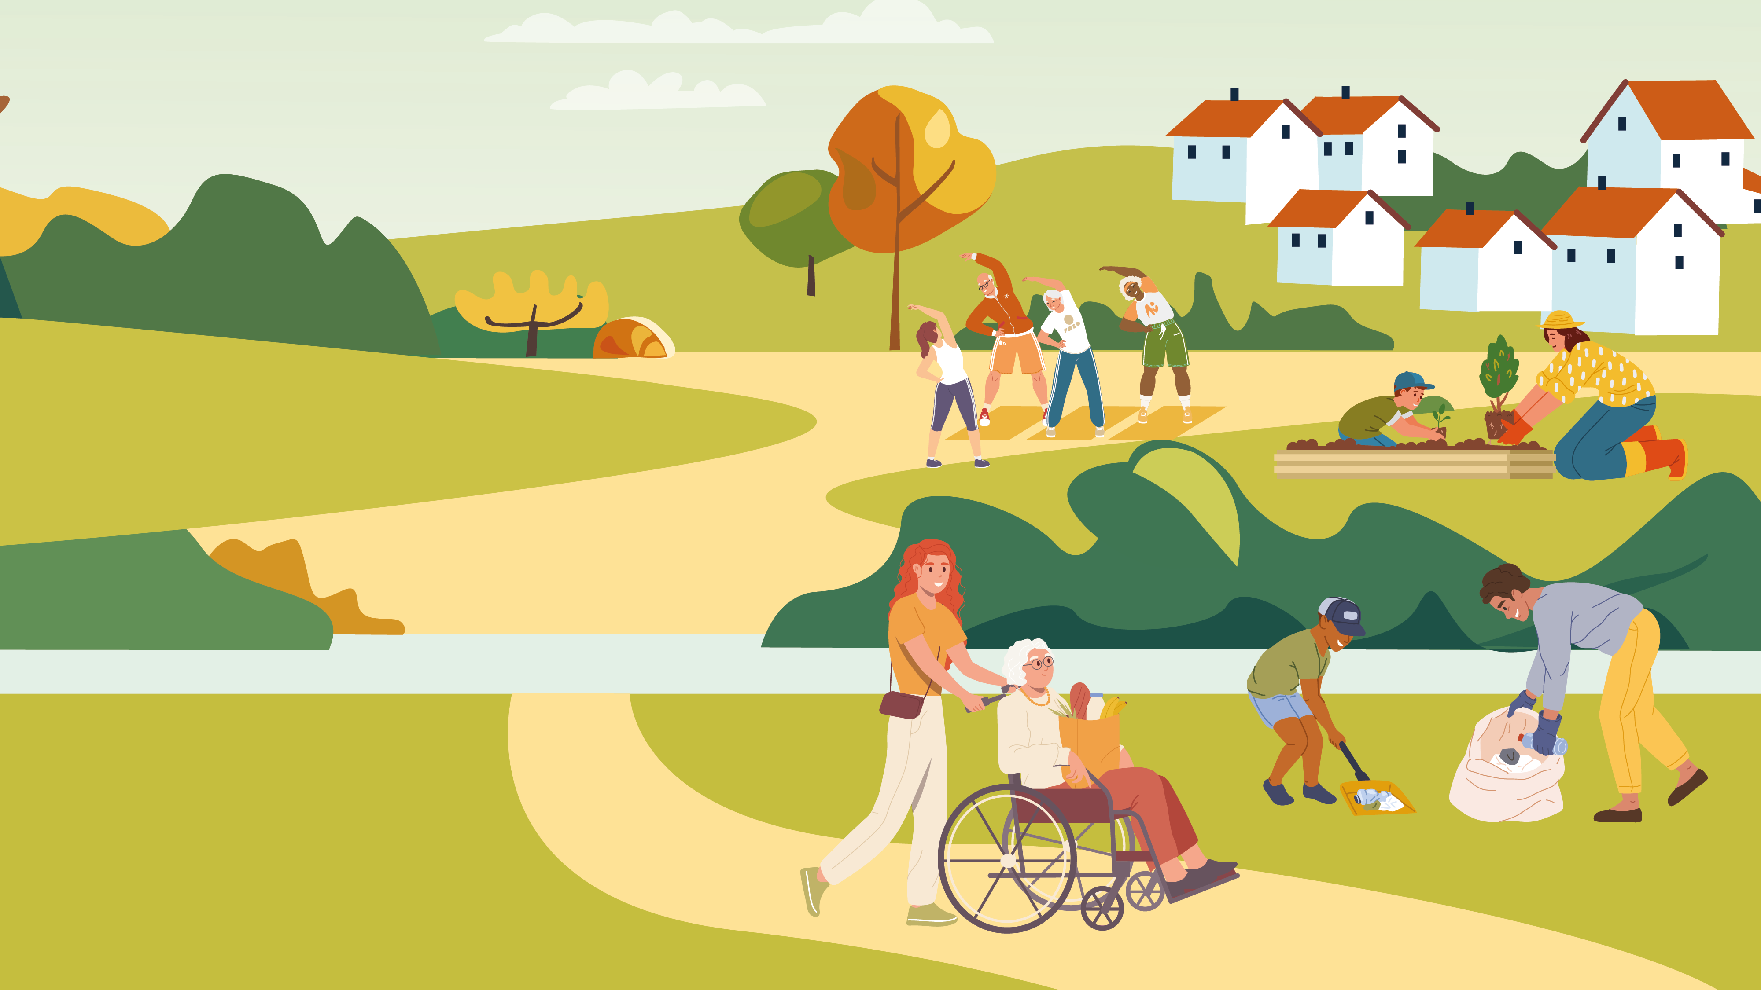

How we can support your community projects
Notes:
Good evening, thanks for allowing me some time on your agenda.
I am here to talk to you about the many and varied ways in which the Council provides support to the communities of S Cambs – be they Town or Parish Councils, Community Groups and Charities or emerging groups – people who have an idea for a project, but are unsure of how to make it happen. We have pulled a very high-level document together that aims to outline examples of the ways in which we offer support and we’re calling this our Communities Offer.

Slide 2
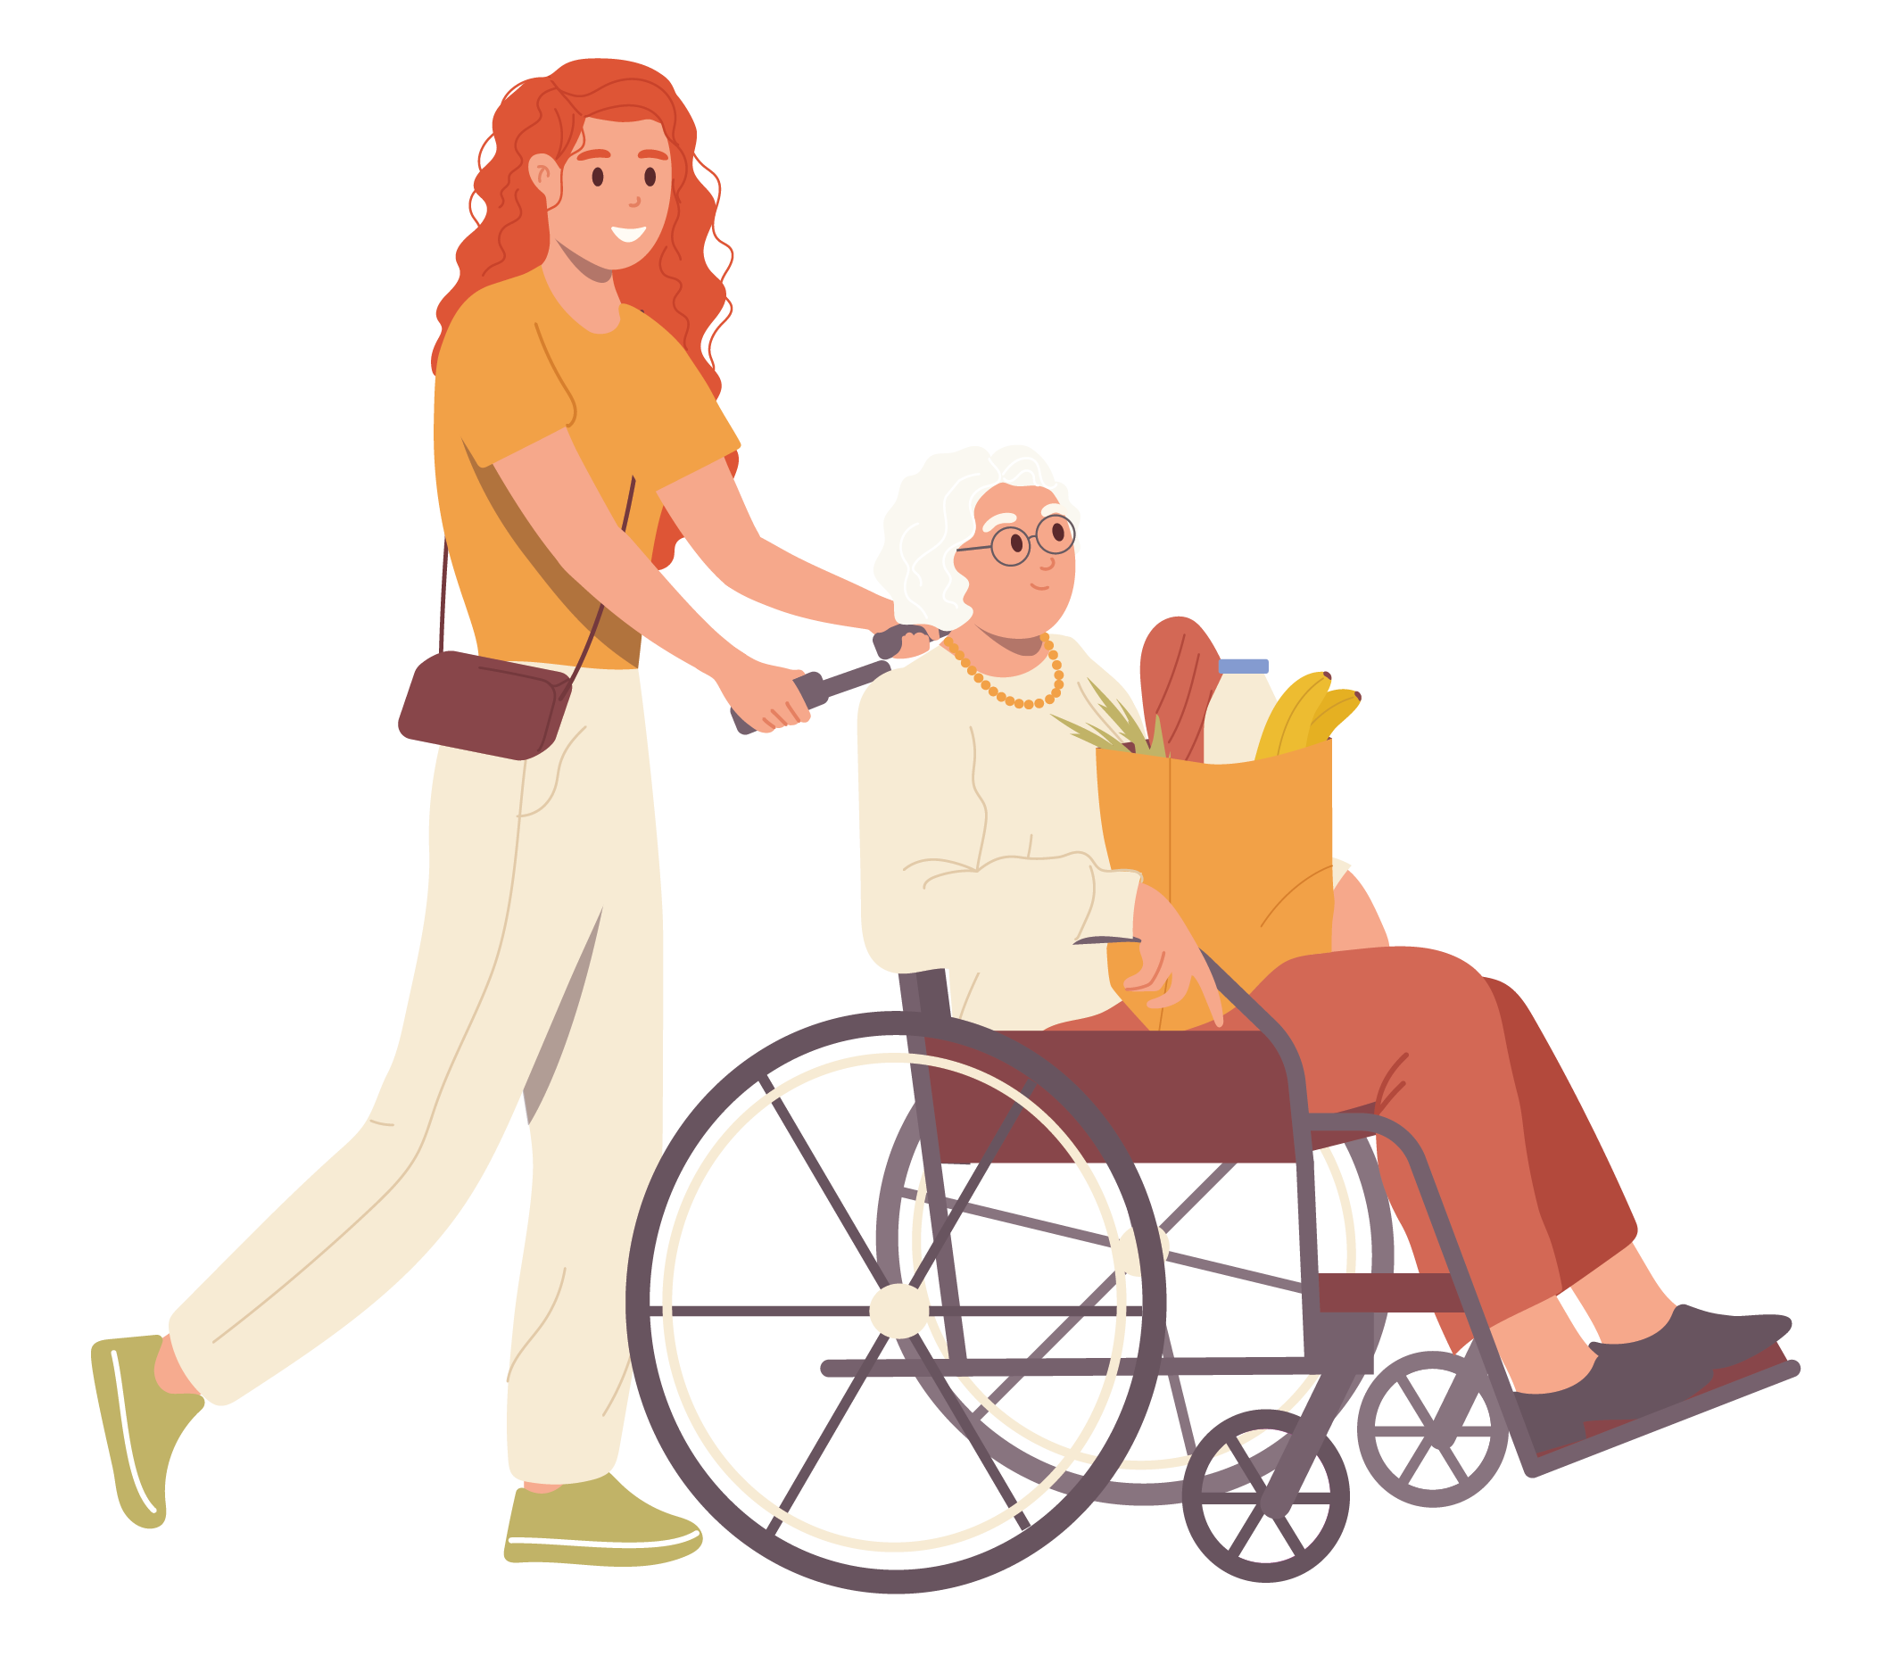
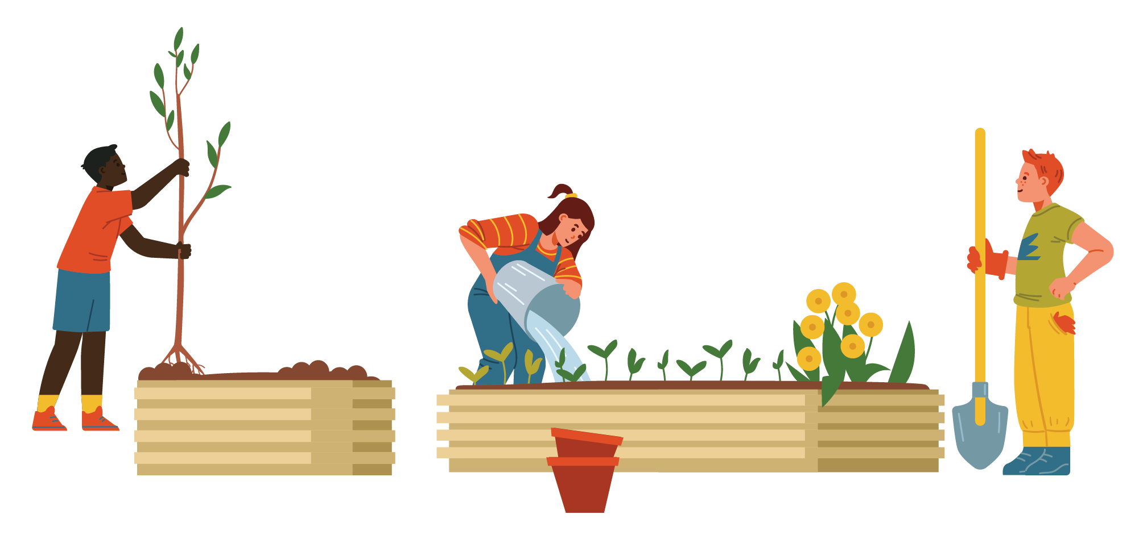
Introduction
How we can support your community projects
Support
Facilitate
Enable
Parish / Town Councils and community groups to create vibrant communities, promote community action,
and support community growth.
The Communities Team at South Cambridgeshire District Council is here to support projects across the district that help improve people’s lives. This is done in a number of ways.
Notes:
There are a number of ways we do this. Our key words are facilitate – support – enable: we want to build your community resilience and your capacity to deliver projects and solutions; we will never do to you – but we’re on hand to support in the early stages or when you hit a bump in the road, and smooth the way with some advice / guidance / signposting to funding or to another group who has done the same and can share their experience.

Slide 3
Vibrant Communities
Community Hubs
Cost of Living Support
Welcoming spaces in the heart of the community
Offering social connection and refreshments
Providing links into wider health and advice services
Led by volunteers, funded by grants and overseen by Cambridgeshire Acre
19 hubs so far
Each hub tailored to meet local need
Warm and inclusive, welcoming people of all ages
Direct support from the Council
Guiding communities to existing resources
Helping established schemes to reach those most in need
Supporting community groups to start new support projects
Notes:
Community Hubs
In partnership with Cambridgeshire ACRE, 19 Community Hubs have been established across the district – funded by health.
Community Hubs are welcoming spaces for residents to relax, engage in social activities, and connect with others in a safe environment.
These hubs serve as central points for gathering information, receiving advice, and fostering a sense of community among neighbours.
Each hub is designed to meet local needs, providing an inclusive space where people of all ages can come together, build relationships, and support each other.
Cost of Living Support
We are trying to help residents navigate the rising cost of living.
Support Methods:
Providing direct support from the council through, as an example, through Food vouchers and Emergency Food Parcels, providing slow cookers / electric blankets and free period products to those in need.
Working in partnership with Hope CIC to sustain existing foodbanks and set up new one in the district to support vulnerable residents who are struggling with the cost-of-living crisis. And have developed a network
Providing grants up to £500 for community growing projects where the produce is shared amongst the community.

Slide 4

Vibrant Communities
continued
Health and Wellbeing
Community Safety
Understanding local health needs
Engaging with partners, residents and health professionals to understand the need of the communities
Development of physical activity and nutritional programmes
Support community-led activity sessions to be established
Supporting actions taken by residents (e.g. Speedwatch groups)
Resources available to Town/Parish Councils in response to issues (hate crime, DA)
Organise and arrange community meetings to listen to concerns and provide suggestions for action
Help address anti-social behaviour
Regularly work with police, fire, and other partners to address issues through multi-agency meetings (e.g. problem-solving groups)
Notes:
Health and Wellbeing strategy – everything we do as a council impacts positively on the mental and physical health of residents:
The activity coordinator seeks to develop sessions and ensure that there are opportunities for residents to engage in, and sustain, a healthy active lifestyle.
The support could be taster sessions, payment for venue hire, signposting to grant funding or activity sessions already in place, finding instructors to deliver, venue hire, equipment purchases or delivering an engagement talk.
Activities developed so far include walking football, walking rugby, walking cricket, strength and balance classes at Hubs, training well-being walk leaders, new age Kurling, pickleball, nutrition workshops. The activity co-ordinator is always open to new ideas and opportunities for new initiatives and projects that could be delivered in local communities so, please do contact us.
Community Safety: We work closely with the other Community Safety Partnership agencies (including neighbourhood policing team, fire service, health, County Council and the Voluntary Sector). We commission a strategic assessment to give us a data profile of crime and ASB across the district, which tells us where, and against which themes, we should focus our attention. Our key question: where can we add value to the work of individual agencies?
Some work is statutory, e.g. Domestic Homicide Reviews. Some is ‘responsive’ – where we aim to increase community safety by helping residents take action themselves:
reporting incidents / concerns appropriately and through the right channels
then beyond the immediate issue, setting up projects, sharing social media and providing information to address the source of the problem.
We can support with such things as:
Setting up a Speedwatch group; investigating options to target activities for young people, particularly to address Anti-Social Behaviour - such as - boxing, detached youth work, targeted SVD sessions, County Lines information sessions for parents. And we work closely with churches, youth workers, schools and charitable / community groups to achieve this.
3) Where appropriate, we feed details of challenging individuals or problem locations into ‘problem-solving groups’ – partners as above - that come together to try to resolve the issues, including referring them for additional support / resource where needed – this has resulted in mental health support for example. Or additional patrols in a given area.
4) We set up ‘Stakeholder meetings’ – Cambourne, OP, Northstowe, Milton just starting – interested parties, not public, come together in these priority areas and problem solve and work on some of the things that go beyond crime and ASB which contribute to prevention – e.g. speedwatch / parking / diversionary activities for YP.
5) We have created a resource bank on the SCDC website for Parish/Town Councils – posters and information about a range of issues including inconsiderate parking, hate crime, modern day slavery, safeguarding, exploitation and County Lines, online safety, Prevent (radicalisation) and so on. If you want us to look at other issues, give us feedback.
6) And we support the Police with their ongoing ‘Survey’ – advertise as per the slide – and engagement events – the police review survey responses and explain the trends they’re seeing, and how they may need to re-direct resources if there is a concentration of concerns / reports in a particular area / theme.

Slide 5

Community Action
Community Grants
Responding to communities
Community Chest Grant - funding of up to £2,000 for community projects.
Mobile & Community Warden Scheme Grant - to support older people to live independently at home.
Tenant Community Grant - funding of up to £1,000 for those living in Council owned homes
Long Term Health Conditions Grant – funding of up to £2,000 for physical activity programmes
Service Support Grants -funding for Voluntary and Community Sector organisations
Improving the High Street - Grants of £5-20,000 to promote rejuvenation of High Streets
Setting up a Community Group or ‘CIC’
Recruiting volunteers
Organising a litter pick
Setting up a local food hub or foodbank
Nominating an Asset of Community Value
Running a community survey
Supporting a Community Governance Review
Finding funding and in-kind resources
Creating a Community-Led Plan
Notes:
The Council provides a wide range of grants to help improve your community, These include our:
• Community Chest Grant - funding of up to £2,000 per financial year for a wide range of community projects.
• Mobile and Community Warden Scheme Grant - funding to start up and run a scheme to support older people to live independently in
their homes. Schemes will be able to apply this Autumn
• Tenant Community Grant - funding of up to £1,000 for tenants living in South Cambridgeshire District Council homes wanting to improve
their local community, e.g. Benches, planters, seeds and gardening supplies for a community garden; New blinds and equipment for communal rooms; Funding for a monthly film night; Equipment and supplies to start a weekly games club (including badminton, indoor carpet bowls and table tennis).
• Long Term Health Conditions Grant – funding of up to £2,000 for physical activity programmes that support people with specific
long-term health conditions.
• Service Support Grants – funding for Voluntary and Community Sector organisations who support residents to live and travel
independently, and get the support, advice, and advocacy that they need. This is a 3-year grant scheme. We will be accepting applications next year for the 2026-2029 funding round
Improving the High Street grants of £5k-20k to local businesses, charities, community groups and Parish Councils within the district.
The scheme aims to improve the look of our high streets, promote rejuvenation, encourage residents to shop locally and attract more local businesses to the area.
We also signpost to other organisations who can provide funding and support.
Responding to communities
We can provide support and advice on how to address a range of different social, economic, environmental, and cultural issues within
your community. This could include:
• Advice on setting up a Community Group.
• Help with recruiting volunteers.
• Support with organising a litter pick.
• Setting up a local food hub or foodbank.
• Support for nominating an Asset of Community Value.
• Guidance on how to run a community survey.
• Supporting the shaping or reshaping of Parish and Town Council
membership and boundaries, known as a Community
Governance Review.
• Signposting to sources of information or funding.
We can also support you to create a Community Led Plan. Your Plan could aim to achieve anything from organising regular litter picks, or
buying a defibrillator for a community building, through to setting up an environmental group. The important thing to remember is that it is led,
driven, and resourced through action taken by people who live in your community.

Slide 6

Community Action
continued
Electric Vehicle Chargepoint Grant offers up to £5,000 to install a community EV chargepoint
Six Free Trees - In winter, every parish and town council is offered six whips or one larger tree
Zero Carbon Communities grant funds projects up to £15,000 to reduce carbon emissions or create wider community engagement on climate change
Community Chest Biodiversity pot offers up to £2,000 for habitat improvement or creation.
Get in touch: climateandenvironment@Scambs.gov.uk
Climate and environment
If your community would like to take on a project to reduce carbon emissions or promote nature recovery, the Climate and Environment team can help with advice or signposting to funding. The Council also offers several grants for environmental projects:
Action on Energy provides support, advice and funding to improve energy efficiency in private housing
Notes:
The Climate and Environment team aims to support community-led climate action – whether that’s projects to reduce carbon emissions, to promote biodiversity in your local area, or to achieve wider community engagement on these issues and promote sustainable behaviour change
You can email climateandenvironment@scambs.gov.uk for ad hoc advice – on home or community building retrofit, nature recovery, greenhouse gas emissions and carbon footprints
The team can also help signpost to funding sources for your project – you can sign up for a quarterly newsletter to get updates into your inbox
The council also has a number of grants to fund environmental projects (listed on slide)
Action on Energy is a partnership between Cambridgeshire councils that provides information about home energy efficiency and offers grant-funded home improvements to eligible households. Google Action on Energy Cambridgeshire

Slide 7
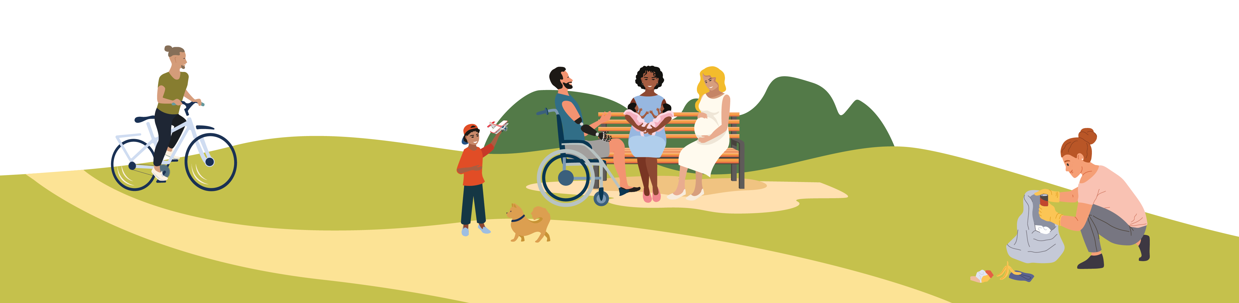
Community Growth
Supporting community growth
Can help secure community infrastructure as new housing developments are planned, at major sites.
Ensure meaningful engagement in the planning processes
Support through ‘section 106’ agreements
Organise Community Forums serving each development
Can work with existing and emerging communities to conduct community governance reviews.
Notes:
This is an area of work some of you may know about if you live in or near one of the larger scale developments in S Cambs.
We have a team of Development Officers and Community Development Workers who focus on particular sites.
Predominantly working within large-scale housing sites – generally 1000+ homes
Team ensures communities are engaged with the planning process from pre-app through to delivery
We support the delivery of essential community and sports facilities, play, open space, allotments and community orchards etc
We actively engage with the ‘section 106’ [of the Town and Country Planning Act] negotiation process to secure funding for community development, and they can work with external partners to help make this happen
We deliver community forums that serve each major development to keep residents informed of proposals and progress, and address concerns related to delivery
We deliver Community Governance reviews that arise because of new housing growth. This can look at the creation of new parishes, redrawing of existing parish boundaries and the number of parish councillors to name a few.
Liaison meetings for some of the smaller sites – generally where there is a less complicated build out – maybe the expansion of an existing village e.g. Swavesey – meetings are not public but for key partners like Parish Council and Developers to come together and iron out delivery issues. E.g. noise / muddy roads etc.

Slide 8
Q&A
We welcome any questions you may have.
Please remember to place these into the chat or raise your hand (virtually).
Notes:
There are a number of ways we do this. Our key words are facilitate – support – enable: we want to build your community resilience and your capacity to deliver projects and solutions; we will never do to you – but we’re on hand to support in the early stages or when you hit a bump in the road, and smooth the way with some advice / guidance / signposting to funding or to another group who has done the same and can share their experience.

Slide 9

How to contact us
To talk to us in more detail about how we can support you and your community, get in touch on duty.communities@scambs.gov.uk or call 01954 713070.
Watch out for the Communities Offer- Supporting your community projects - South Cambs District Council

