Slide 1

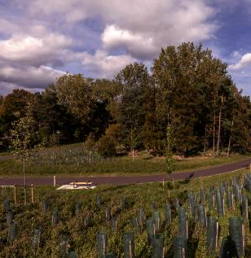



Waterbeach
Development Update
Waterbeach Community Forum: 1st November 2023
Waterbeach

Slide 2
Contents
Development Update
Mere Way
Community Development & Events

Slide 3
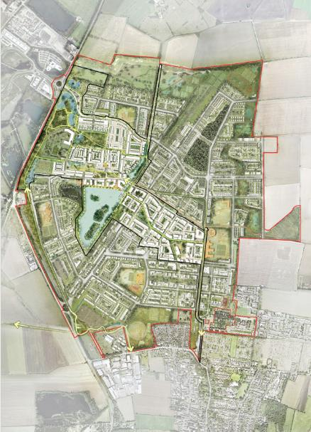
Development Update: Masterplan

Slide 4
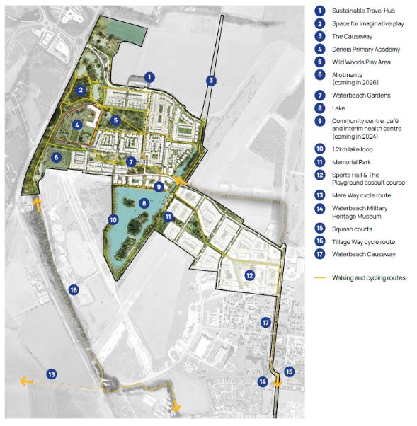
Development Update: Key Phase 1

Slide 5
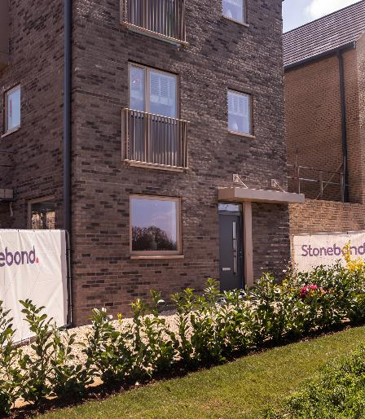
Development Update
We welcomed our first residents yesterday – a big milestone for the development
Two Stonebond properties exchanged, establishing the first residents to the new community
Preparing an update for Waterbeach Parish Council to update on S106 and planning conditions in line with first occupation triggers

Slide 6
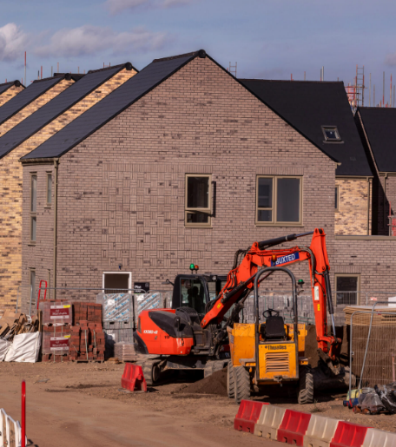
Development Update
Stonebond and Cala progressing
Walking and cycling route through development completed
Negotiating contracts with housebuilders for next parcels
Confirming partners for lake activation and lakeside café unit

Slide 7
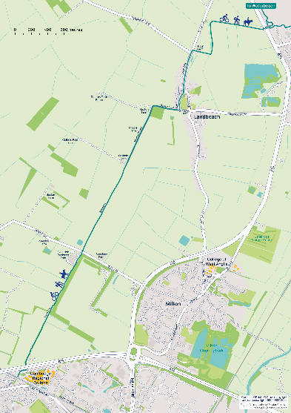
Mere Way
Mere Way is one of the key active travel routes linking Waterbeach and Landbeach to Cambridge Science Park and beyond
Works include refurbishment of the route to provide a 3-4m hard surface alongside a 2-3m soft surface
Upgrades will create a more accessible and inclusive route for wheelchairs and pushchairs
Listening to public feedback and media discussion, ensuring all user groups are considered
The first phase of the route is nearly complete, with works continuing in Landbeach at Green End
The second phase of work will begin next year, including installation of the A10 bridge

Slide 8
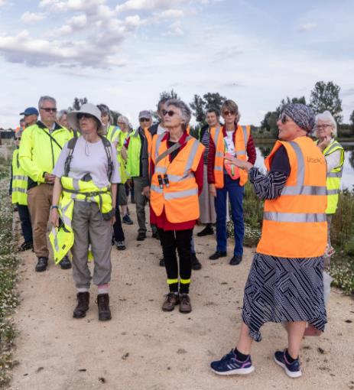
Community Development Update:
What’s happened
Summer at the Beach
Ecology and archaeology tours for Gardening Group, Brownies and Guides
Community Grants and Support in Kind for existing community groups
Community Market moved to bigger, covered Terraces space with increased footfall
Monthly art exhibitions and workshops at Community Market
Over 40 monthly community groups
Heron’s Pre-School thriving – they now have a ‘forest school’ in their outdoor area. Some spaces available

Slide 9
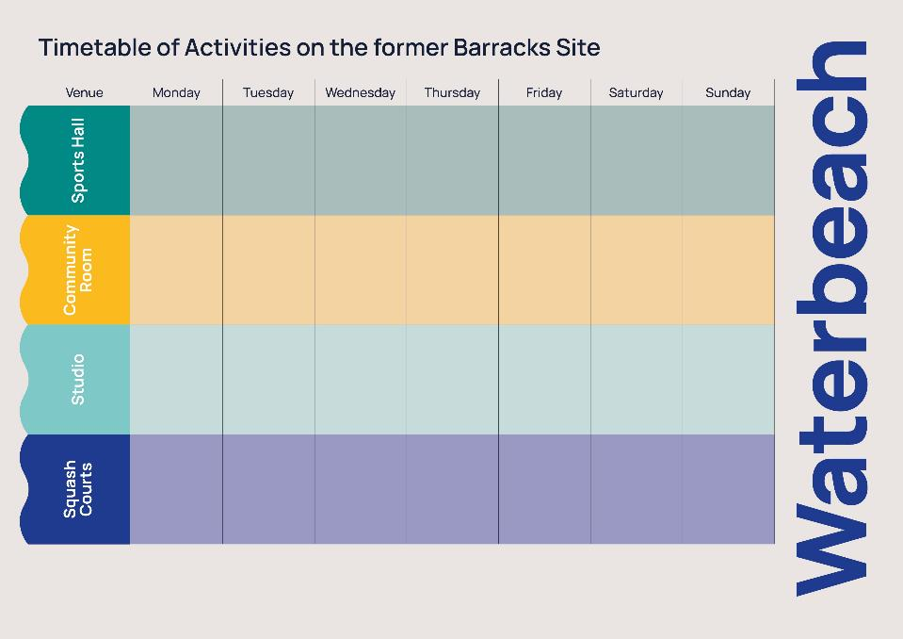

Timetable of Activities November 2023
10am - 2pm
Club Dan Badminton https://www.teamdanbadminton.co.uk
7pm – 9pm Waterbeach Badminton Club
10am Tennis4Tots www.tennis4tots.co.uk
5.15pm - 6.16pm Football Practice
Milton Colts
6.15 - 8.15pm
Football Practice Waterbeach Colts
8.15-10pm Badminton, https://www.teamdanbadminton.co.uk
5pm – 7pm
Football, Waterbeach Colts
7pm-9pm
Badminton https://www.teamdanbadminton.co.uk
6-7pm
Football, Waterbeach Colts
7-10pm
Badminton https://www.teamdanbadminton.co.uk
4pm - 8pm
Badminton https://www.teamdanbadminton.co.uk
Some Availability for events hello@waterbeachwb.co.uk
9.15-12pm
Rugby Tots
meg@rugbytots.co.uk
5pm - 9pm
Badminton https://www.teamdanbadminton.co.uk
6.30pm
Guides
1stwaterbeachguides@gmail.com
6pm
Brownies
1stwaterbeachbrownies@gmail.com
7.30pm - 9.30pm
Life Drawing Classes petersuttonartist@gmail.com
6pm - 7pm
Yoga
https://karen-norris.co.uk
8-10pm
Waterbeach Brass Band Practice
Richard Dean
07801 677288
6pm -7pm
Jazzercise
nikki.murphy2@hotmail.co.uk
7.15pm
Circuits Training
Jamie Leonard info@jlfit.co.uk
12.30pm
Private Pilates
Cam Vac
6pm - 8pm
Yoga
Lisa Broad
lisa@yoga-bright.com
6pm -7pm,
Jazzercise
nikki.murphy2@hotmail.co.uk
10am - 11.30am
Fit 4 Life
Exercise for over 55's vanessa@summerhill.myzen.co.uk
9am - 10pm
Available for private bookings on request hello@waterbeachwb.co.uk
4pm -5pm
Jazzercise
nikki.murphy2@hotmail.co.uk
Open for bookings
7am - 10pm hello@waterbeachwb.co.uk
Open for bookings
7am - 10pm hello@waterbeachwb.co.uk
Open for bookings
7am - 10pm hello@waterbeachwb.co.uk
Open for bookings
7am - 10pm hello@waterbeachwb.co.uk
6.30 - 8pm
Martial Arts Fitness info@cbtandemdr-cambridge.co.uk
Open for bookings
7am - 10pm hello@waterbeachwb.co.uk
Open for bookings
7am - 10pm hello@waterbeachwb.co.uk
Open for bookings
7am - 10pm hello@waterbeachwb.co.uk
10.30am
Tuesday mornings at the Studio
Chair Yoga, Lisa Broad
lisa@yoga-bright.com

Slide 10
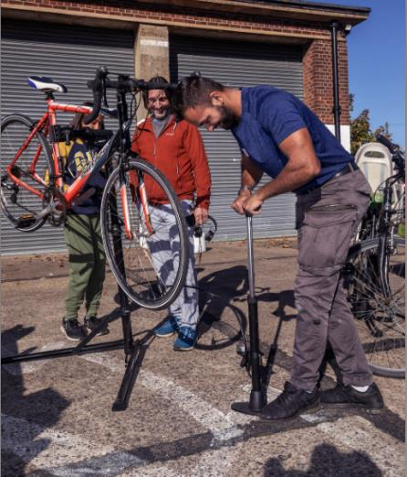
Community Development Update:
What’s happening
Welcome packs and welcoming first residents
Christmas Community Market
Free bike repairs at October & November Community Market
Working with smart journeys to launch car share app
Working with Living Sport to activate more sports and activities
Community Mural on Squash Courts
Interim library space launching in the Studio – a book exchange with dedicated time for access
Introducing the community to walking and cycling route through site
Lake activation including water sports

Slide 11
Paul Mumford
paul.mumford@urbanandcivic.com
Rebecca Britton
rbritton@urbanandcivic.com
Fiona Reardon-Rose
fiona.reardon-rose@urbanandcivic.com
Caroline Ward
hello@waterbeachwb.co.uk
Urban&Civic
November 2023

