Slide 1
Building | Tenant | Area (sq ft) NIA | Revised Area (sq ft) NIA | Vacant Space | Vacated | Lease Expired | Basis of Measurement
Granary House | Vacant | 3,917 | 3,917 | 3,917 | Aug-20 | Dec-20 | Bidwells marketing report - 2015
Link House | Vacant | 997 | 997 | 997 | Feb-21 | Mar-21 | Bidwells marketing report - 2015
The Maltings | Adcock Refrigeration & Air Conditioning Ltd | 4,281 | 4,281 |  | Feb-21 | Apr-21 | Bidwells marketing report - 2015
Stables A | Vacant | 1,229 | 1,392 | 1,392 | Prior to May 17 | Prior to May 17 | Cheffins marketing to let
Stables B | Vacant | 1,436 | 1,436 | 1,436 | May-17 | May-17 | Cheffins marketing to let / Bidwells marketing report - 2015
 |  | 11,860 | 12,023 | 7,742
% of Total |  |  | 100% | 64%
Basis of measurement is NIA and excludes those areas shaded white in plans. Actual GIA and GEA's therefore expected to be c.15 - 25% larger.

Slide 2
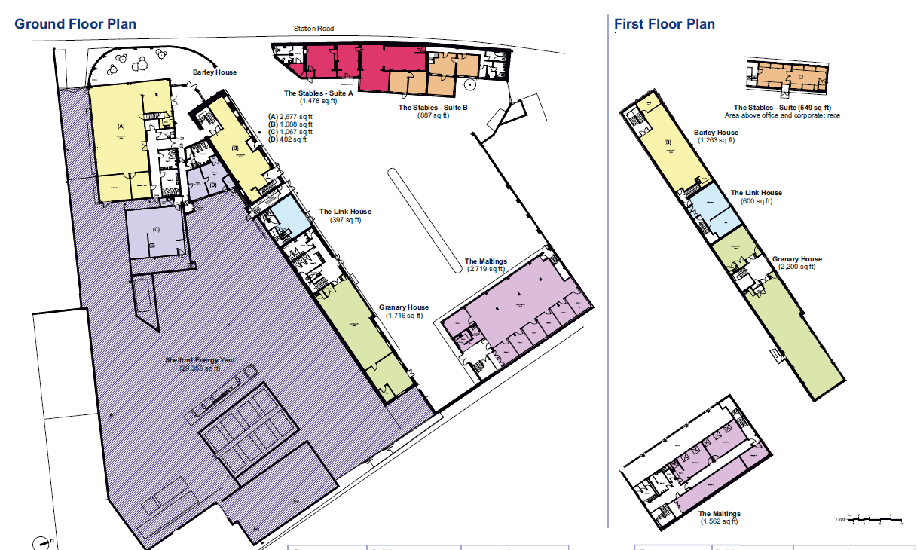
Care home site – works commenced and buildings have been demolished.

