Slide 1


Slide 2

Welcome and Introduction
Cllr Pippa Heylings, Chair of Climate & Environment Advisory Committee

Slide 3

We are facing a Climate and Health and Ecological Emergency!
Pippa Heylings
Chair, Climate Change and Environment Advisory Committee

Slide 4
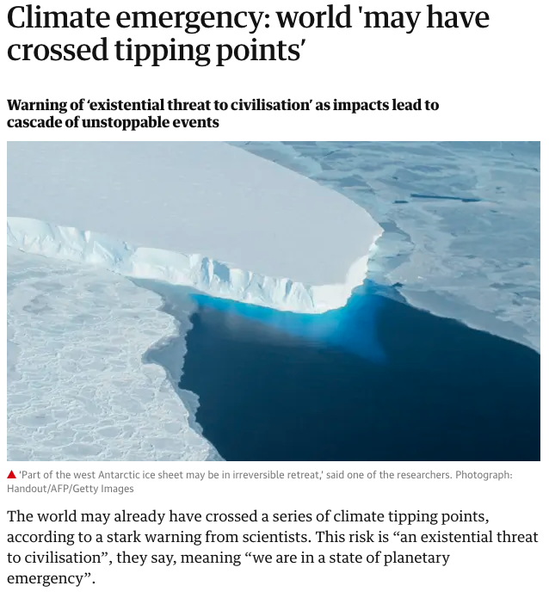
Nov 2019: Ahead of projections, we have crossed a series of climate tipping points before even reaching 1.5 degrees of global warming
We are now experiencing a series of unstoppable destructive feedback loops with a ‘domino effect’ unleashing “a cascade of unstoppable and irreversible events” where the planet self-amplifies global warming:
- Melting of ice-sheets in Antartica and Greenland and melting of permafrost in the Arctic (and the methane that this will also release) happening earlier and faster than predicted
- Amazon forest dieback and North American and Australian fires turning carbon sinks into carbon source.
…..we are in a state of planetary emergency

Slide 5

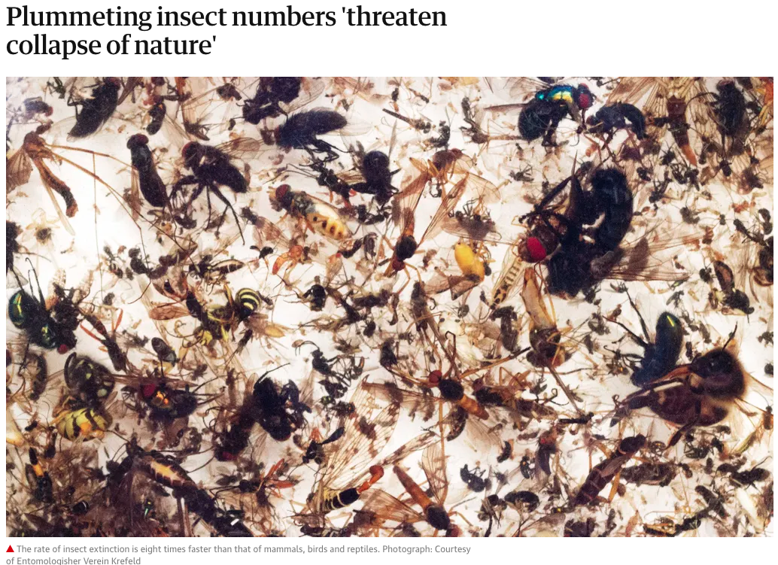
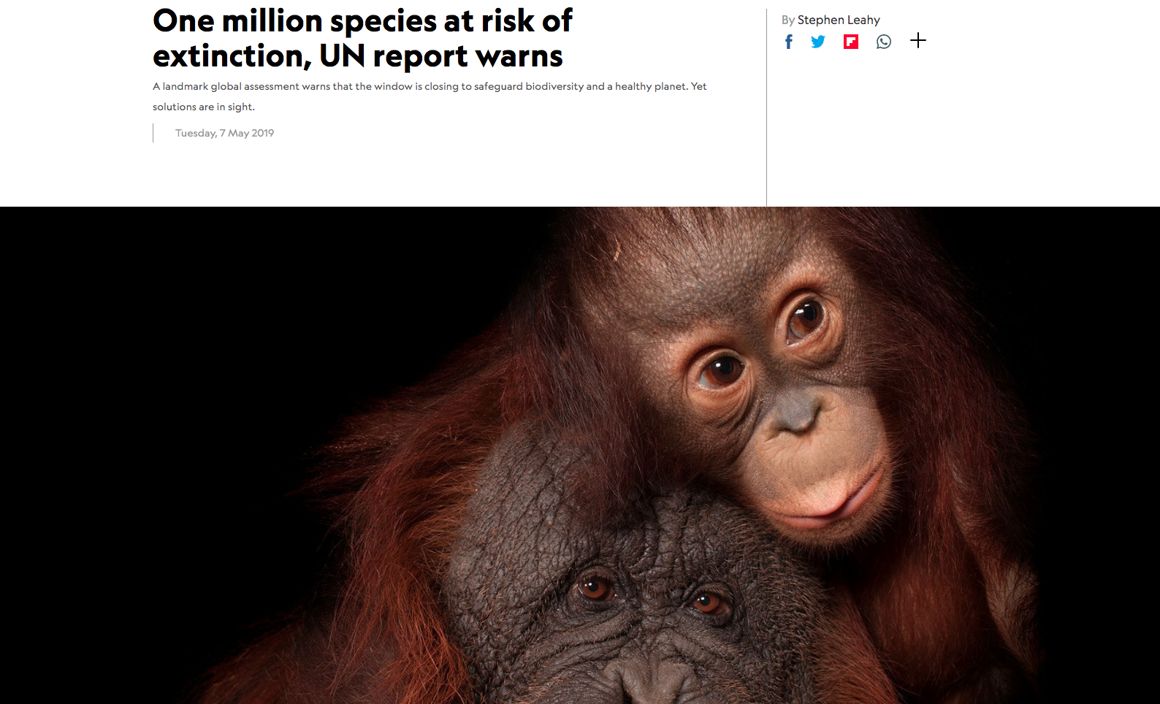

Slide 6
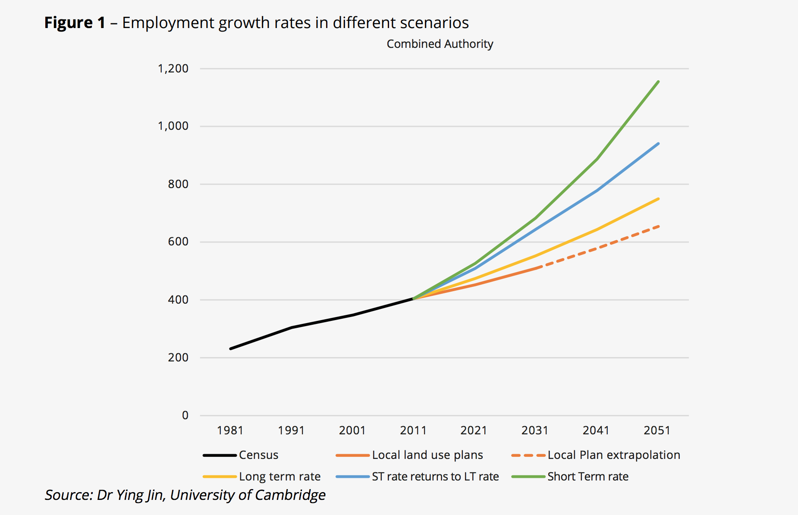
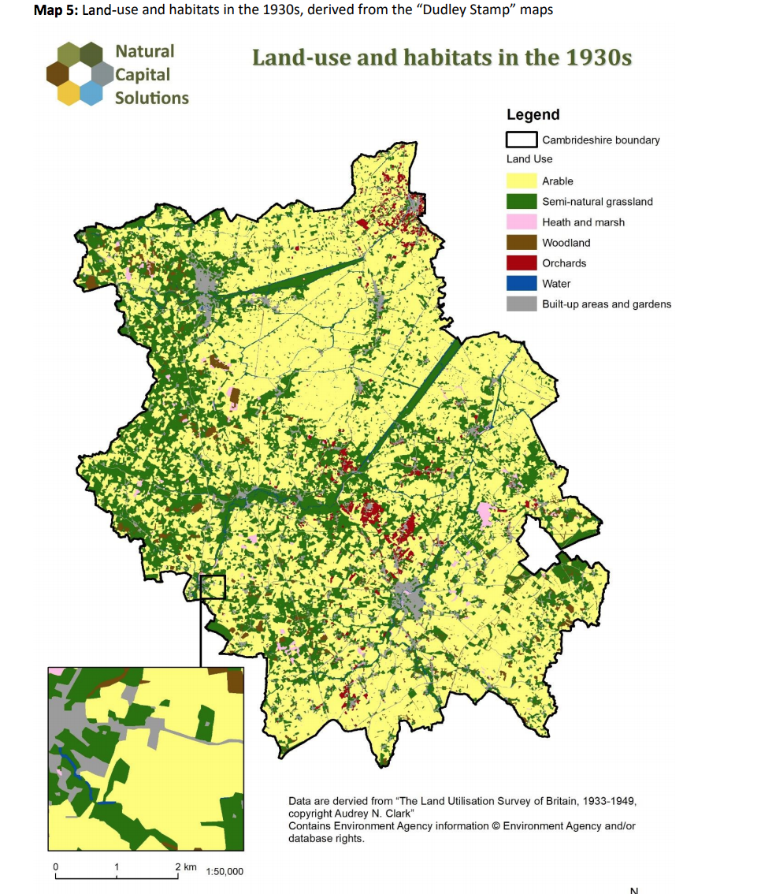
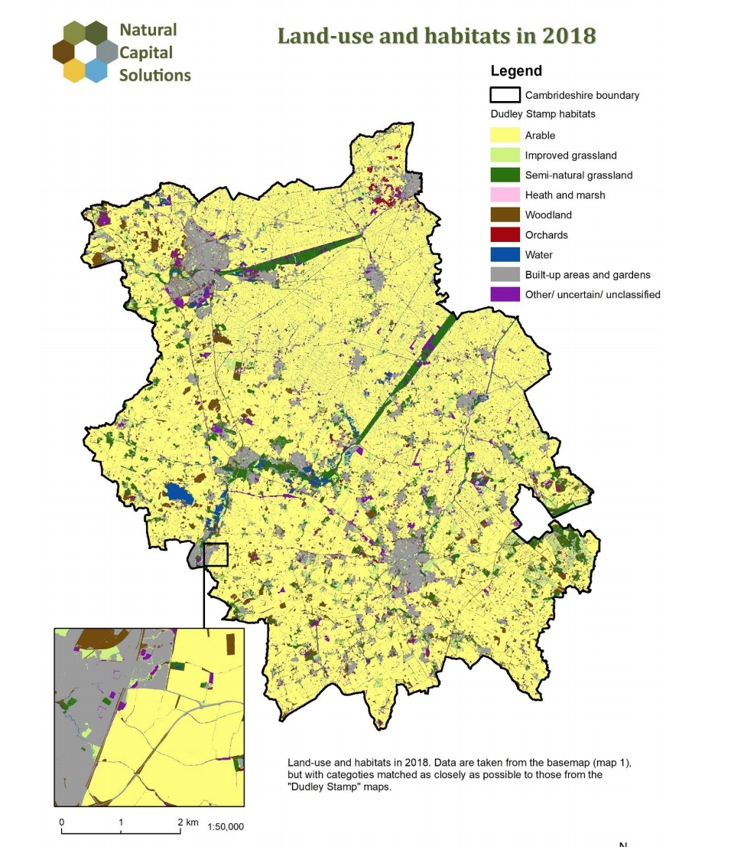
Future Growth Scenarios
Impact of Growth and Land-Use Change 1930s - 2018

Slide 7
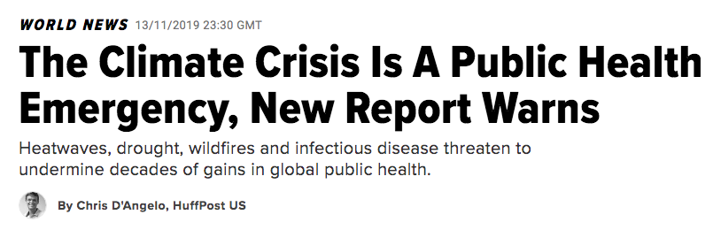
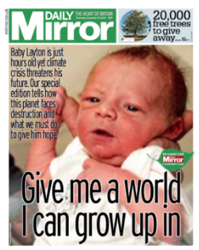
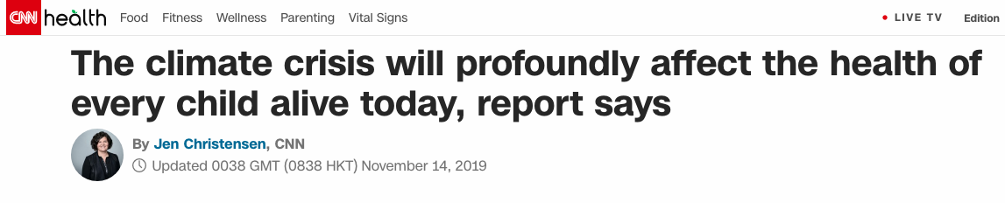
2019 Lancet Climate and Health Report
Or it could be
“the greatest global health opportunity of the 21st century”.

Slide 8
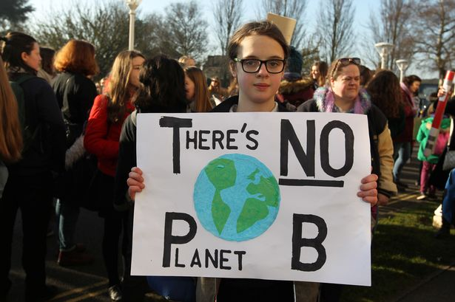
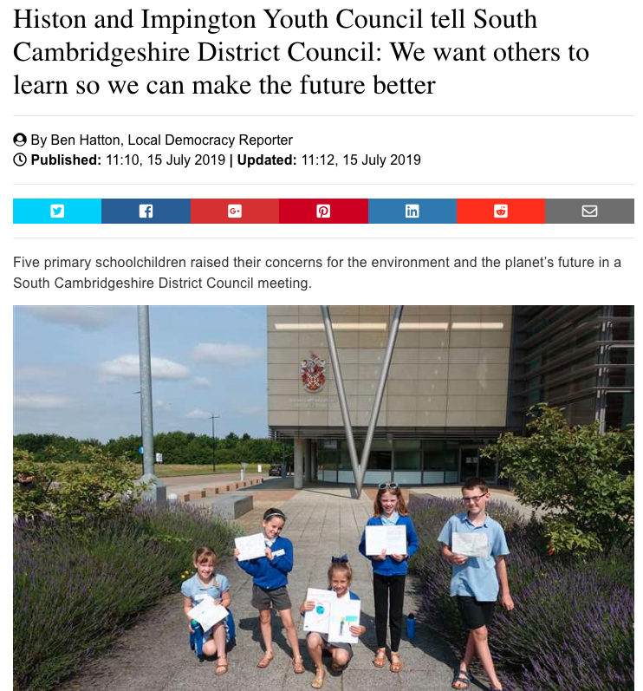
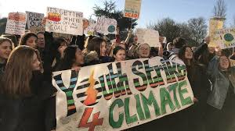

Slide 9
We do have a choice. We can choose Stubborn Optimism!
In the words of Christiana Figueres
The year is 2050. The world is on fire. The air is suffocating and deadly. Most of our coastline and inland communities are under water whilst the rest of the country is suffering terrible drought.
OR
The year is 2050. The world is breathing. The air is fresh. Nature is thriving. Entire populations have a better quality of life.

Slide 10
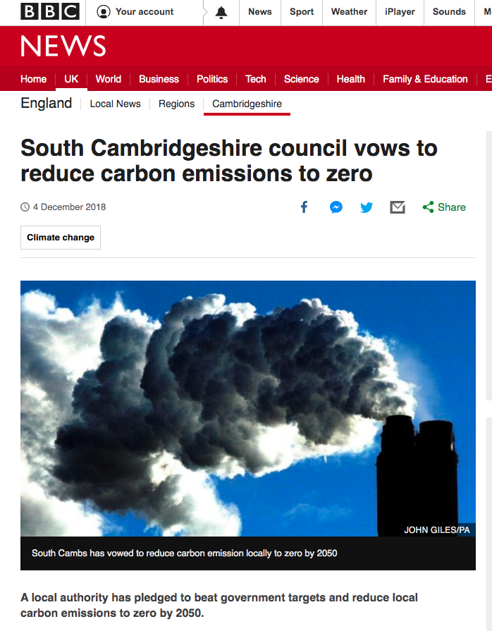
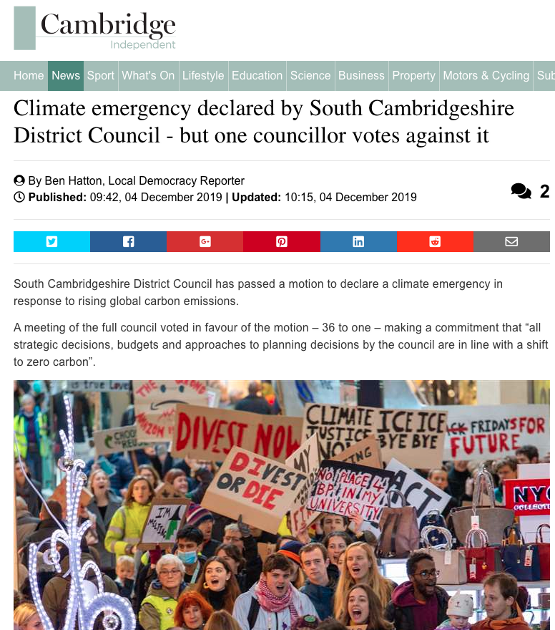
One of first District Councils to set a Zero Carbon target.
Motion passed unanimously with cross-party support in December 2018. Key focus on Local Plan, our “teeth”

Slide 11

Currently being drafted

Slide 12
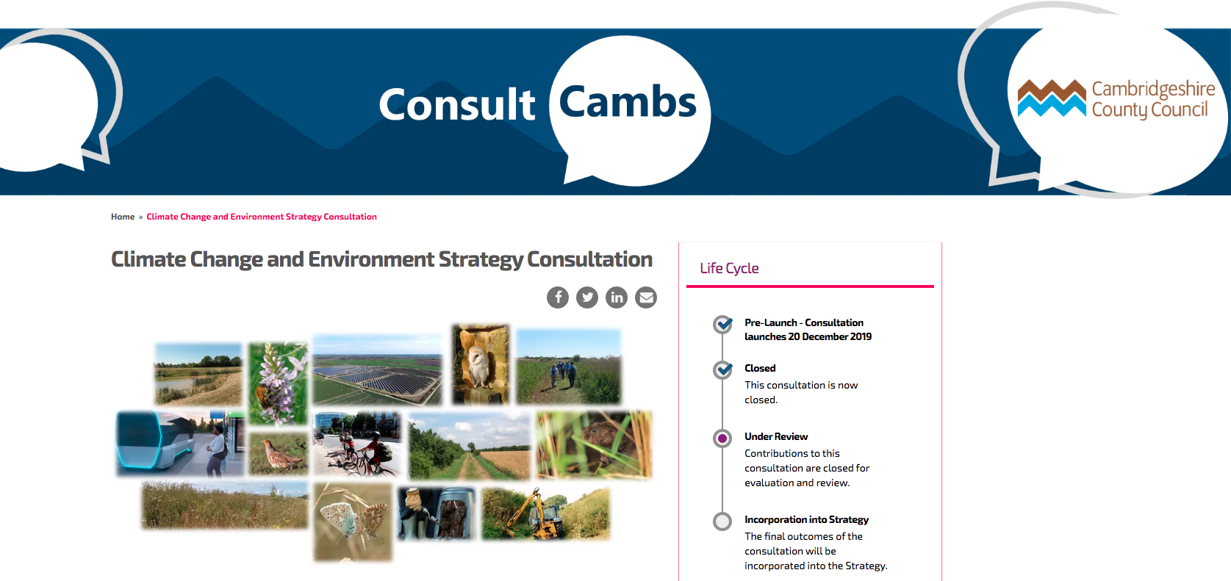
Carbon Footprint for Cambridgeshire County
https://consultcambs.uk.engagementhq.com/3017/widgets/9927/documents/3607

Slide 13
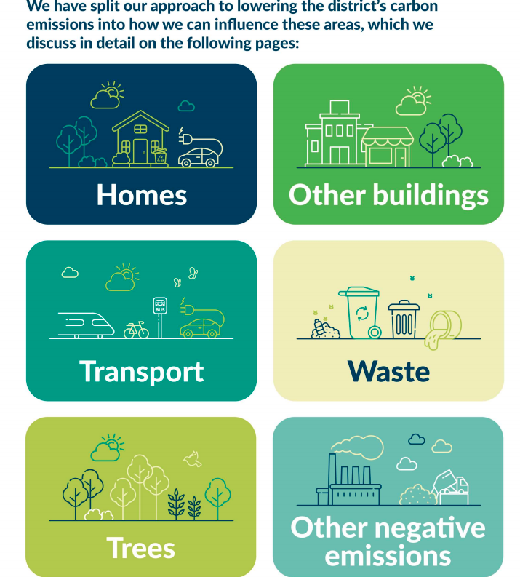
South Cambs District Footprint
HOMES
We have around 64,000 homes in South Cambridgeshire. Providing heating and power for them gives rise to close to a quarter of a million tonnes of CO2 - around 20% of the district’s carbon footprint.
WORKPLACES
We have around 8,500 enterprises in South Cambridgeshire employing 87,400 people in a broad range of industries, big and small. Providing heat and power for these enterprises gives rise to 326 thousand tonnes of CO2 – around 30% of the district’s carbon footprint.
TRANSPORT
Transport accounts for over 50% of the district’s carbon footprint, around 679 tonnes of CO2 per year. 98% of these emissions are from road traffic, mainly from the M11 and major A roads running through the district. Cars and vans account for 77% of emissions, with HGVs accounting for most of the remainder.
WASTE
tbc
LAND AND TREES
Plants naturally capture carbon from the atmosphere. It is stored in leaves, stems and roots and eventually accumulates in the soil. However, agriculture can cause it to be released from the soil at a faster rate than it is replaced, and in South Cambridgeshire there is a net loss from the land of 5.4 k tonnes of CO2 – not including peatlands

Slide 14


Slide 15
We are hearing that you want this kind of support:
You want to know which villages have declared a Climate Emergency – and what they have done since
What examples of climate action groups are out there and how did they start
Lessons learned for different types of zero carbon projects (stop wasting time reinventing the wheel)
List of contacts and expertise
Continuation of Zero Carbon Communities Grant
List of potential funding sources
Guidance on planning permission process
Urgency and seriousness communicated through website, South Cambs magazine
And….????

Slide 16
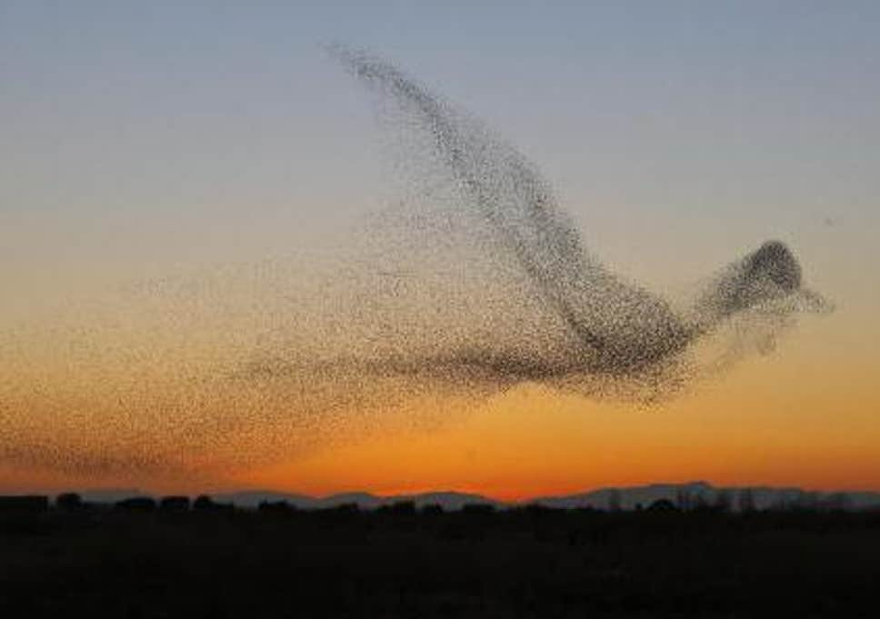
With the beat and turn of a single wing, we can each have the power to shift and switch the direction and swoop of the whole flock..

Slide 17
The Zero Carbon Communities Programme
Siobhan Mellon, Climate & Environment Development Officer

Slide 18
Programme
12.30 | Lunch
13:30 | Welcome and Introduction Cllr Pippa Heylings, Chair of Climate & Environment Advisory Committee
13:40 | The Zero Carbon Communities Programme Siobhan Mellon, Climate & Environment Development Officer
 | Zero Carbon Communities grant-funded projects
13:50 | Net Zero Now Alana Sinclair, Cambridge Carbon Footprint
14:00 | Food, our Future Sam Dyer, Cambridge Sustainable food
14:10 | Orchard Park Shared Electric Cargo Trike Project Frances Wright, Cambridge Cohousing
14:20 | Wilbraham Woodlands Stephen Bartlett, Chair of Gt Wilbraham Parish Council
 | Setting up a Climate Action Group
14:30 | Sean Hughes, Hardwick Climate Action Group
14:35 | Mark Freeman, Cambridge Council for Voluntary service (CCVS)
 | Discussion
14:45 | Part 1: Responding locally to the climate emergency: what do you see as the challenges?
15:15 | Tea Break
15:30 | Part 2: What do you see as the solutions and what support would help you move towards them?
16:00 | Networking
16:30 | End
Notes:
Signpost plan for the day

Slide 19

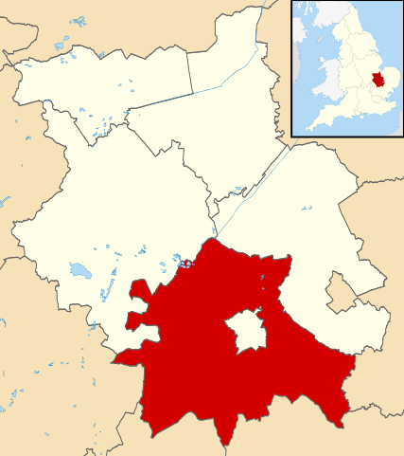
The impact of our area on climate change
1255,000 t CO₂ (BEIS, 2017)
Land Use & Forestry <1%
Industry and commerce
Commerce & Industry 26%
Transport 54%
Domestic 19%
By Contains Ordnance Survey data © Crown copyright and database right, CC BY-SA 3.0, https://commons.wikimedia.org/w/index.php?curid=15990257
Notes:
Incomplete picture:
Shows only CO2
Doesn’t show imported emissions
--
These are taken from the most recent BEIS local authority data set.
Transport is the big one in South Cambs because of the major roads running through the district.
The small sector at the top shows emissions from Land Use and Forestry. This includes carbon sinks as well as sources, and in most districts is negative emissions. In South Cambs emissions from this sector total 5.4 kt. It varies from -892 kt in Dumfries & Galloway to 132 in East Cambs.
It is an incomplete picture because it is CO2 only. CO2 accounts for 81% of global warming potential on average in the UK. (Other GHGs are methane, nitrous oxides and fluorinated gases from waste management and agriculture mainly.)
It is also incomplete in that, in line with standard accounting practice, it shows CO2 emitted in the district (direct emissions, Scope 1), and CO2 emitted in the production of energy, (principally electricity), consumed in the district, (indirect emissions from energy, Scope 2). It does not include emissions from the production of goods and services consumed in the district but produced out of the district. There is no data on these, but to give an indication, the Committee on Climate Change estimate that on average in the UK, this increases emissions by 70%

Slide 20
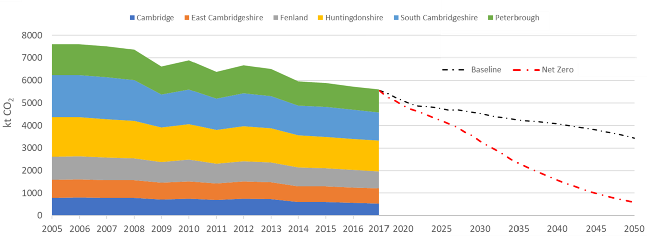
What needs to happen
CUSPE report, Net Zero Cambridgeshire, 2019
Notes:
This chart was produced by the CUSPE team for the county council. Each band shows total historical and projected CO2 emissions of one of the Cambridgeshire and Peterborough local authorities from 2005 to 2050. Sth Cambs is the blue band near the top.
The historical decline is despite increases in population; and is due to increased energy efficiency and decarbonisation of the electricity grid.
Two projections are shown. The upper line takes projected increases in population into account, using projections from ONS, and shows the expected decline in emissions based on current and expected government policies which are planned.
The steeper lower line in red shows the necessary pathway for net zero by 2050.

Slide 21
Lifestyles need to change…
Committee on Climate Change, 2019

Slide 22
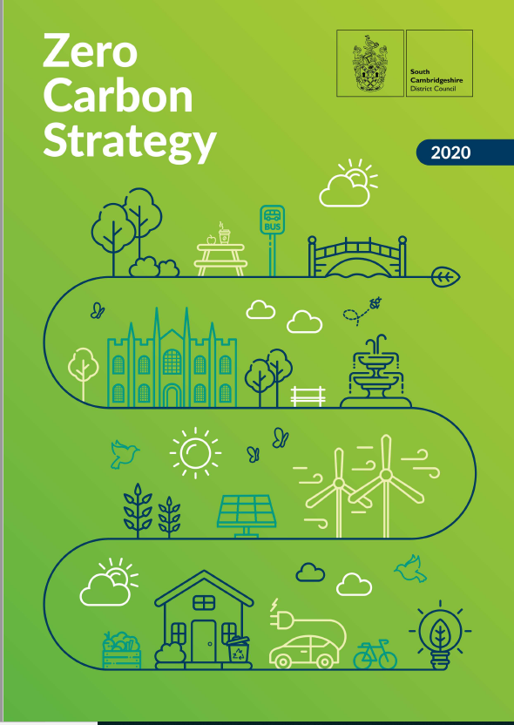
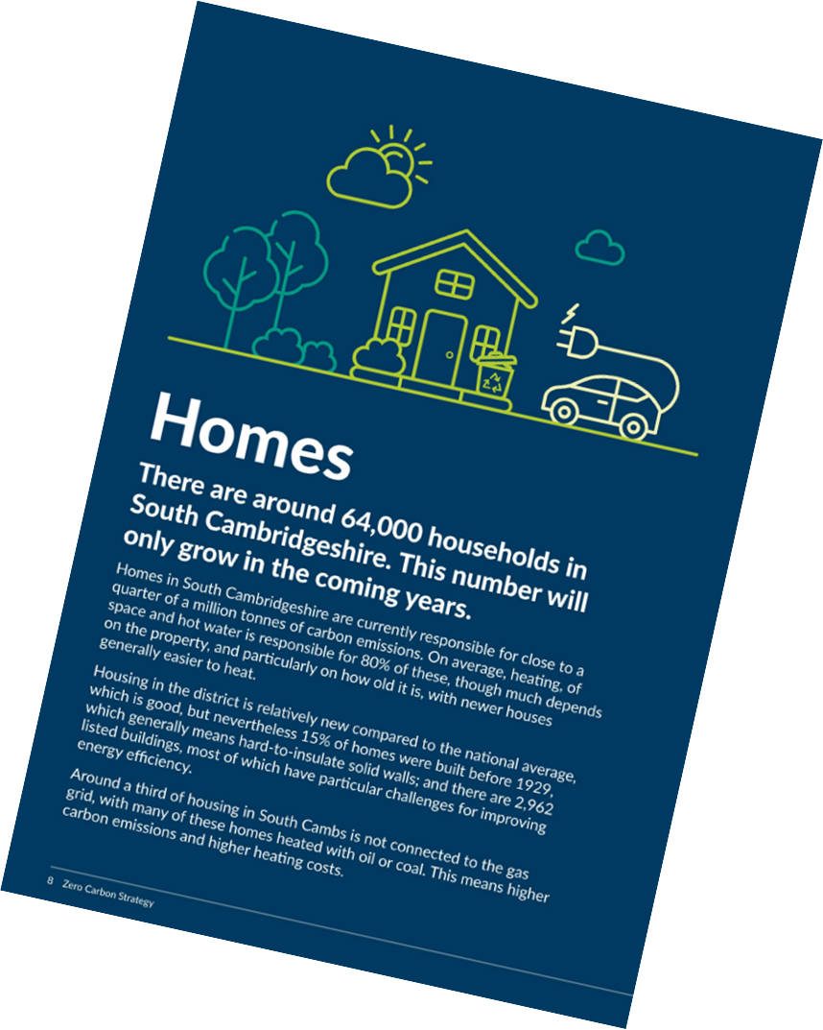
The Council’s approach
Use our wider influence
Use our direct influence through policies
Put our own house in order
Notes:
This chart was produced by the CUSPE team for the county council. Each band shows total historical and projected CO2 emissions of one of the Cambridgeshire and Peterborough local authorities from 2005 to 2050. Sth Cambs is the blue band near the top.
The historical decline is despite increases in population; and is due to increased energy efficiency and decarbonisation of the electricity grid.
Two projections are shown. The upper line takes projected increases in population into account, using projections from ONS, and shows the expected decline in emissions based on current and expected government policies which are planned.
The steeper lower line in red shows the necessary pathway for net zero by 2050.

Slide 23

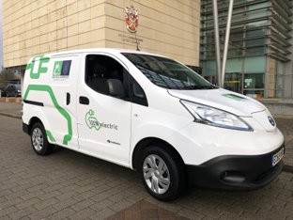
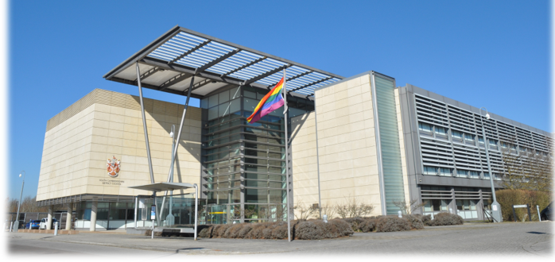
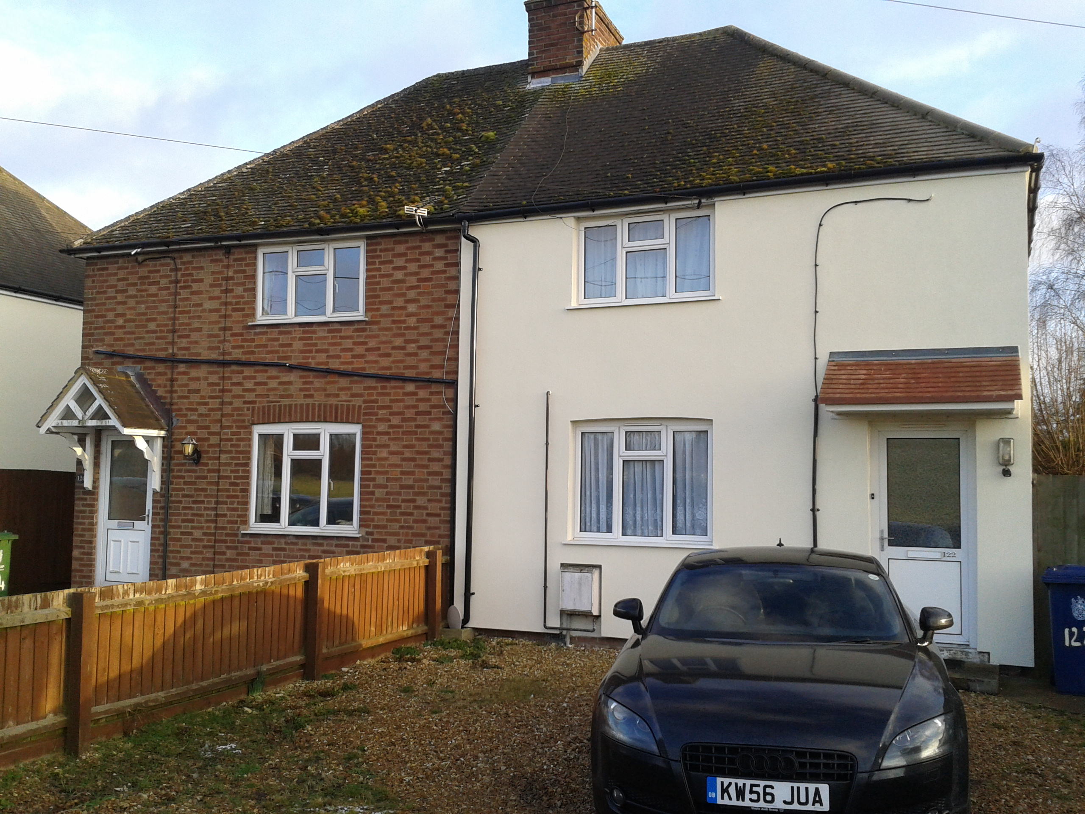
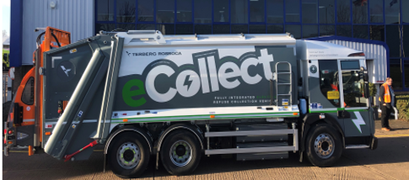
Putting our own house in order
Notes:
Council approach is to
lead by example on our own Estate and Operations and
use our direct influence from policies, procurement and investment
Use our wider influence through partnerships, grants and our channels of communication

Slide 24

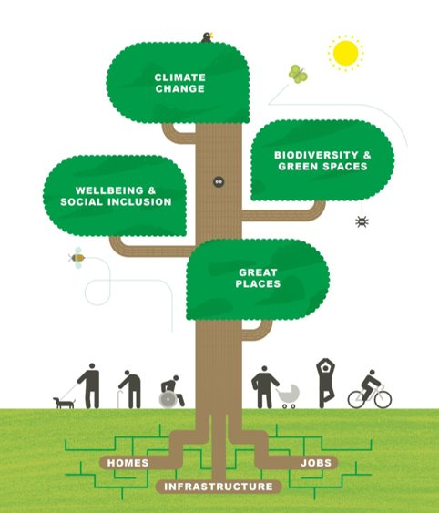
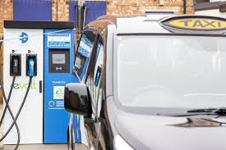
Using our direct influence through policies
Notes:
Council approach is to
lead by example on our own Estate and Operations and
use our direct influence from policies, procurement and investment
Use our wider influence through partnerships, grants and our channels of communication

Slide 25




Using our wider influence through partnerships etc
Notes:
So I hope this puts the ZCC programme in context, next slide

Slide 26


Grants ✓
E-newsletter ✓
Workshops ✓
Net Zero Now, coming soon
Food our Future, coming soon
Online toolkit, coming soon
Notes:
Support our communities to play their part, talk a bit about the grants

Slide 27
Zero Carbon Community grants, Round 1
40 applications received
19 successful applications
£120,000 allocated
2 x awareness-raising projects each received £15k
3 x projects to encourage cycling each received £10k-15k
Smaller projects funded were:
5 x projects which promote cycling, purchasing electric bikes, installing cycle racks and/or establishing bicycle repair cafés
4 x projects to plant trees or hedges
2 x projects will continue the theme of tackling food production, distribution and waste as contributors to carbon emissions
1 x village hall LED lighting replacement
1 x pop-up plastic free shop
1 x project to install water refill stations

Slide 28
Zero Carbon Community grants, Round 2
Details to be finalised by Grants Committee later this month
Proposal to run in broadly similar way to Round 1, ie
  Bids would be invited for up to £15k for projects which help move to net zero carbon and engage the community
  Would be open to parish councils and constituted community groups operating in South Cambs
Proposal to be open for applications early June – end of September

Slide 29
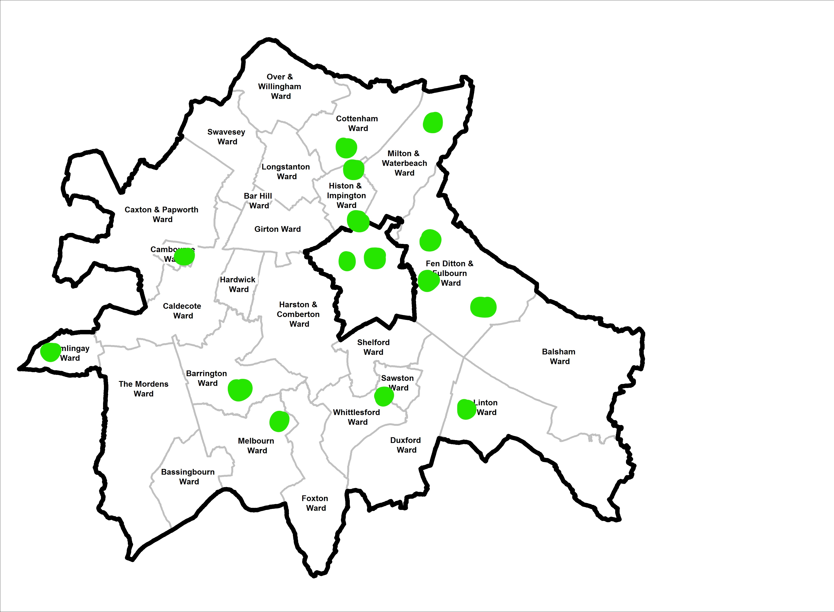

Lots of things happening in the area
Notes:
Lots of things happening around the area
Green dots are where grants awarded
I’ve added a few blue dots where I know there are active groups.
No doubt much much more

Slide 30
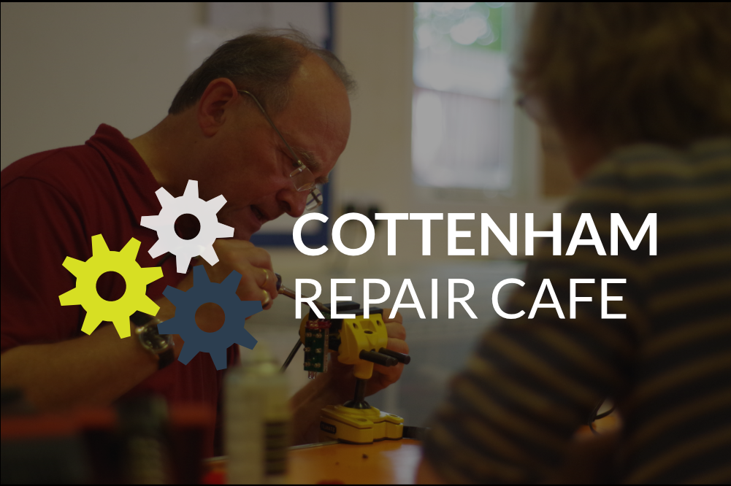
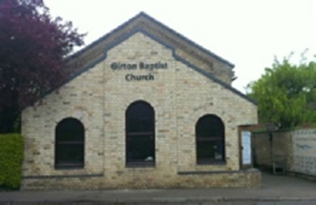



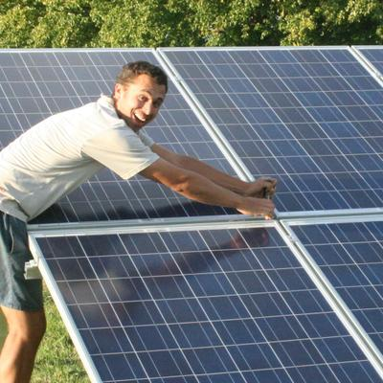

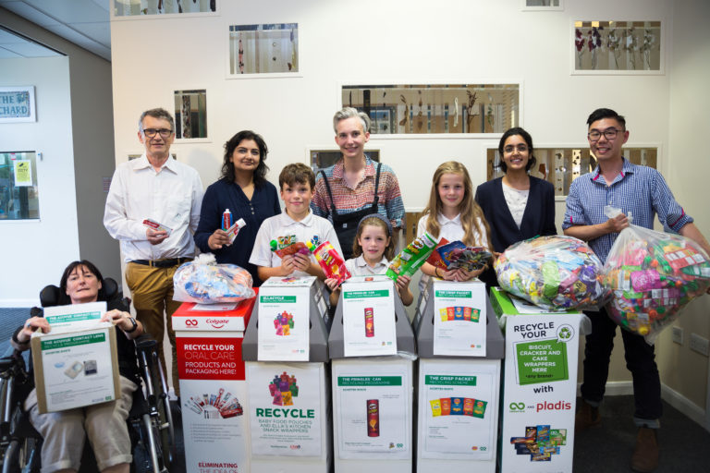

Energy Retrofit to Community Building
Notes:
Lots of great projects – just a few here, lots to learn from other’s experiences

Slide 31
Please tell us how we can best help…
Siobhan Mellon
Development Officer, Climate and Environment
Siobhan.mellon@scambs.gov.uk
01954 3195
Emma Dyer
Project Officer, Climate and Environment
Emma.dyer@scambs.gov.uk
01954 3344

Slide 32
Zero Carbon Communities grant-funded projects

Slide 33
Net Zero Now
Alana Sinclair, Cambridge Carbon Footprint

Slide 34


Slide 35
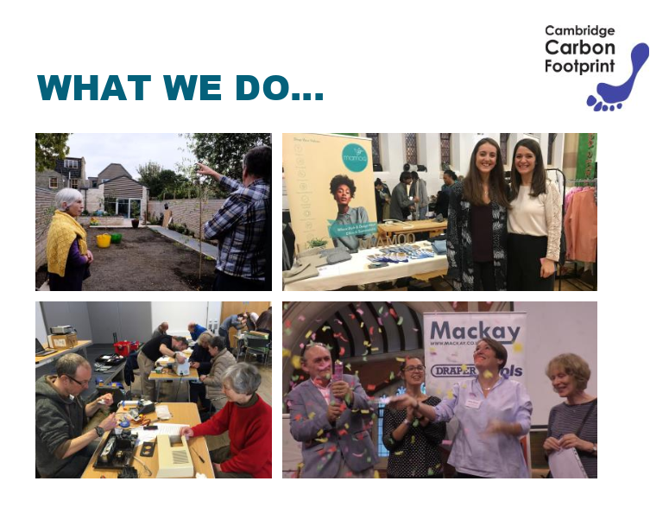

Slide 36
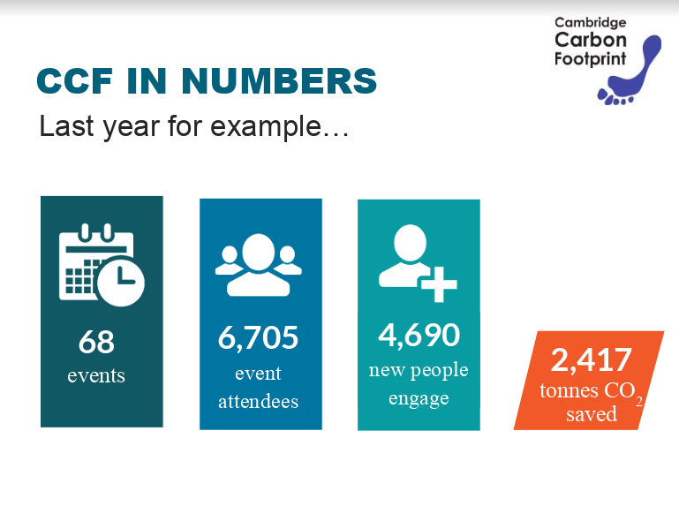

Slide 37
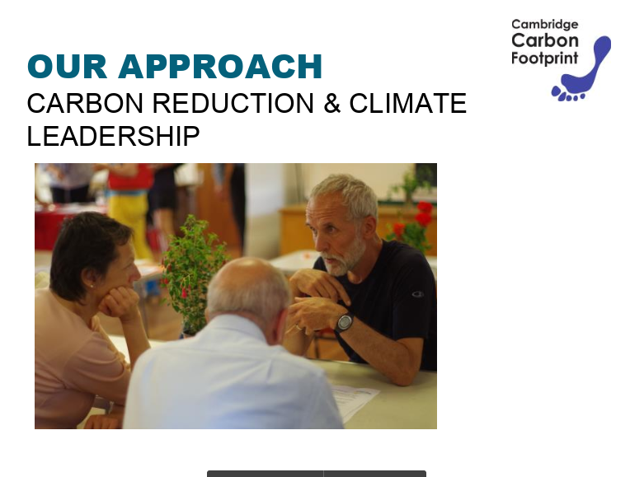

Slide 38
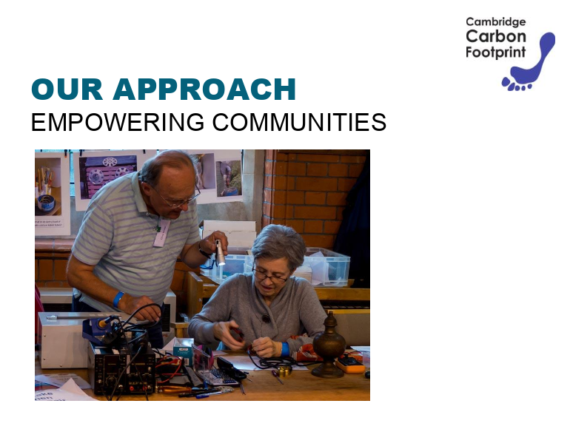

Slide 39


Slide 40
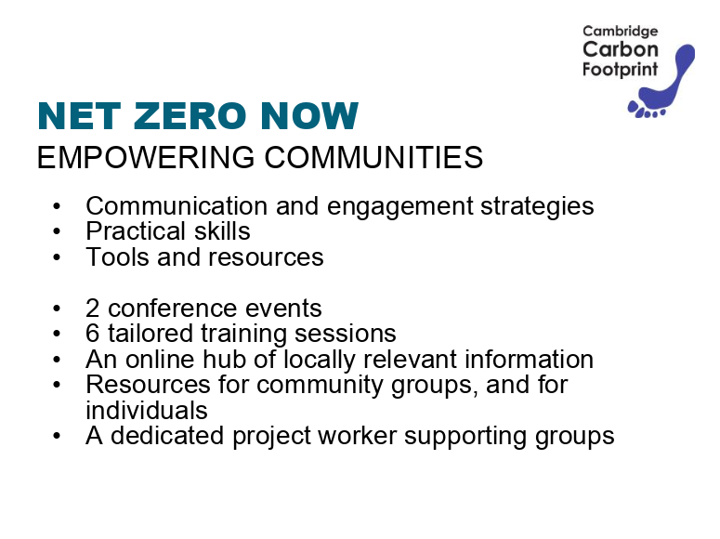

Slide 41


Slide 42
Orchard Park Shared Electric Cargo Trike Project
Frances Wright, Cambridge Cohousing

Slide 43
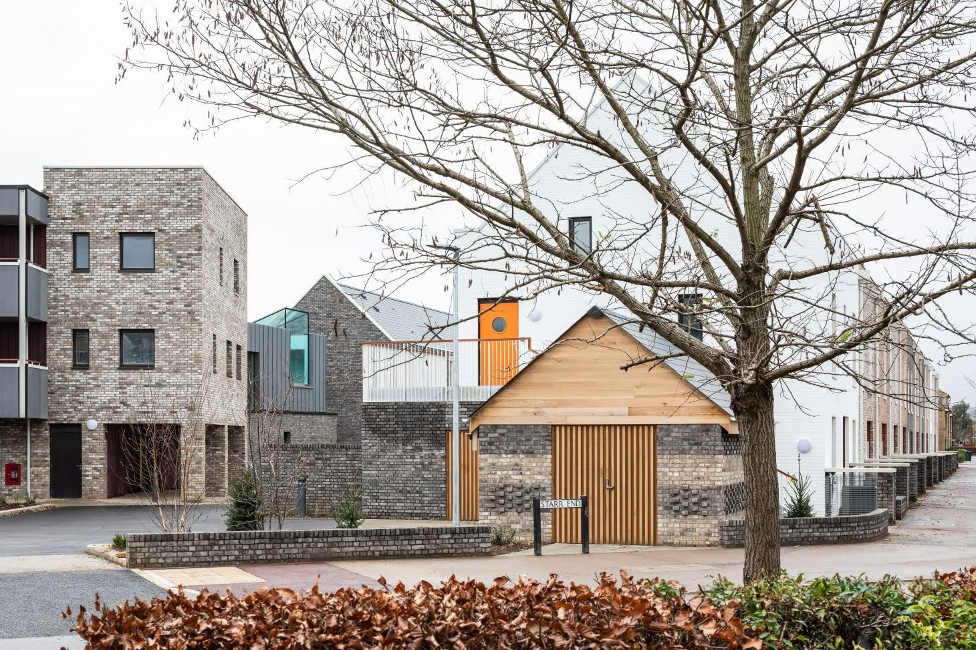
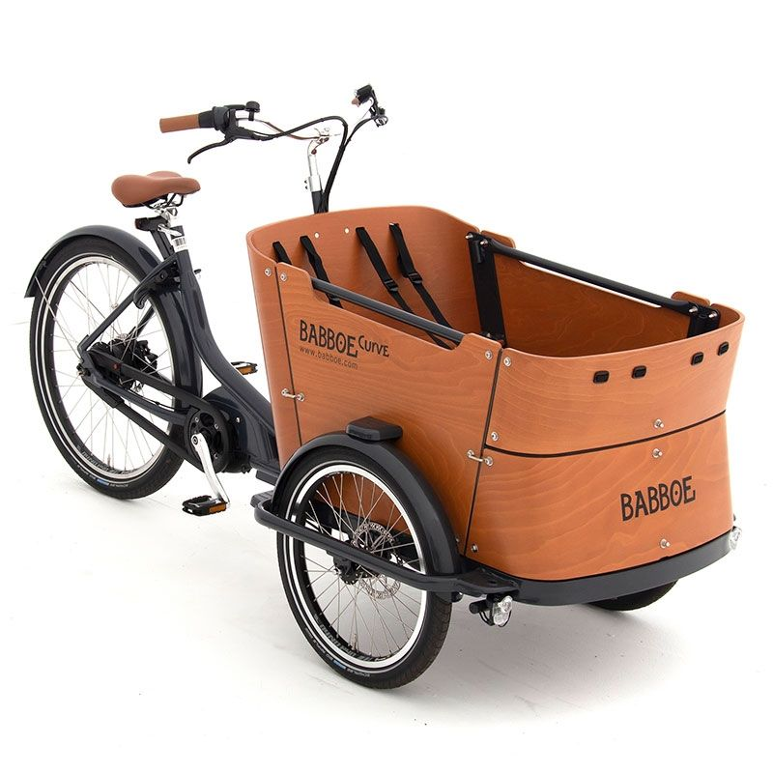

Orchard Park Shared Electric Trike Project
Notes:
This initiative came out of the experience of the Cambridge cohousing community in Marmalade Lane.
This is a year old housing development formed of 42 households in Orchard Park built by an enabling developer for a cohousing group. It is a form of community led housing where everyone has their own home and outside space but also share what is called a common house and a shared garden. Car parking is at the side of the development enabling Marmalade Lane itself to be car free and some of the car parking is along the southern boundary of the shared garden and so there is a real incentive for the group to try to reduce car ownership.

Slide 44
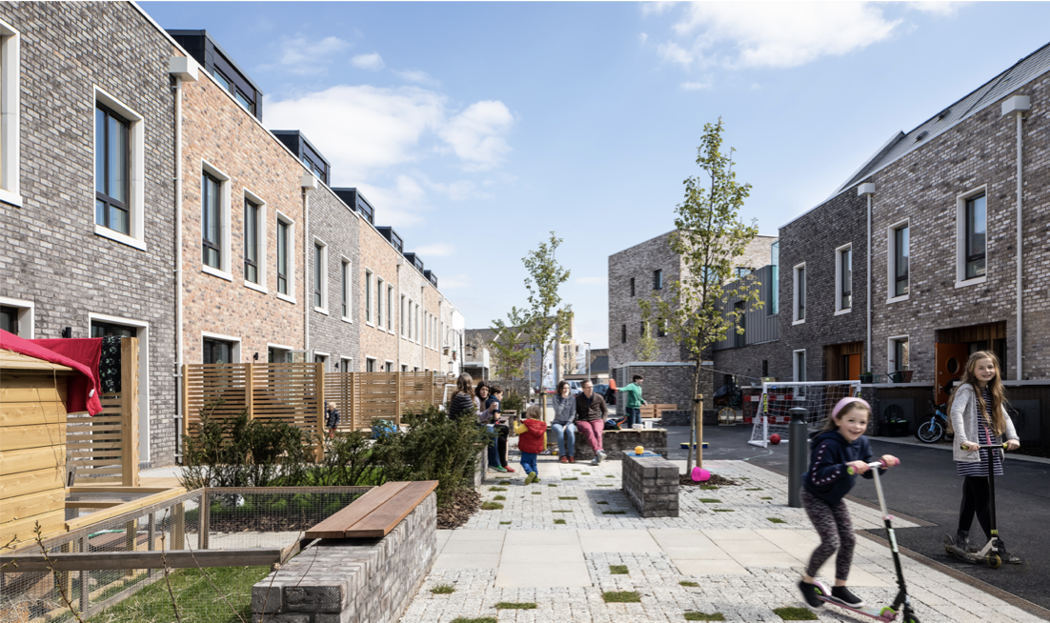
Notes:
This is Marmalade Lane, at the heart of an 18 month old cohousing development formed of 42 households in Orchard Park built by an enabling developer for a Cambridge Cohousing Group.
It is a form of community led housing where everyone has their own home and outside space but also share what is called a common house and a shared garden.
Car parking is at the side of the development enabling Marmalade Lane itself to be car free and a great place for children to play and parents to meet. Some of the car parking is along the southern boundary of the shared garden and so there is a real incentive for the group to try to reduce car ownership.

Slide 45
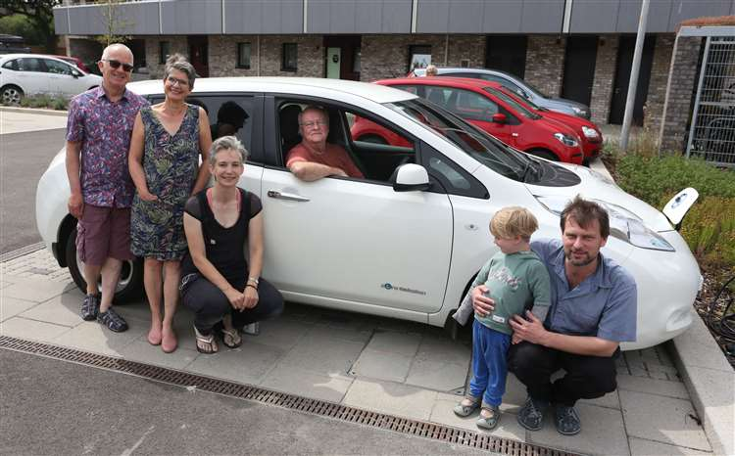
Cambridge Cohousing
Shared Electric Car
Notes:
Last summer we purchased an electric car - purchased and shared by 10 households for whom 4 it was to become their only car and 6 for whom it would be their second car but used in preference whenever possible.
With the records we kept it became obvious that it was used for many short journeys of 5 miles or less as a round trip - often to the shops despite there being a multitude of bikes and cargo bikes within families within the community.
So when the grant came along we had the seeds of the idea for an electric cargo bike... and we were up for doing something in the wider Orchard Park context because it supported our longer term objective of become integrated into Orchard Park and making a contribution to our local area.
Today going to briefly set out the climate context to our project and then cover some of the practicalities and the challenges.
But before I do so we were asked to also share details of the shared electric car scheme. I should emphasis this is not all we are experimenting with sharing - we share a printer, a small library of things - for household items, we share tools and equipment.
Second hand Nissan leaf - 10 households sharing it - 1/7th and 1/14th contribution to purchase (£1500 and £750).
We had a charging point as it is a new development. We are also hoping to connect it to the National Grid along with 1000 other Nissan Leafs so that they can supply power back to the Grid at times of peak demand.
We set up a legal entity - an unincorporated association to own it and to open a bank account.
We then had to insure it. That was where the challenge came. Innovation and insurers do not readily go together and we came to learn that electric was already enough innovation let alone adding sharing to it. We also had no claims history.
So the insurance cost was very high but split over the 10 households manageable. We have got involved with a national organisation called co-mobility to try to improve the insurance available for community car shares and car clubs.
Mileage works out at 4pm a mile.
Ongoing costs will be shared depending on the context either on the basis of percentage usage or capital contribution.
People book in the car’s google calendar - the title is what it is for and who is using it. We have a dedicated Slack channel for communication. So people can ask to share a lift to the shops if they see someone going. Where there is conflict - we encourage each other to ask to see if the usage is negotiable - whether it can be moved to a different time or day.
Within the community we also have some private car shares going on between households.

Slide 46
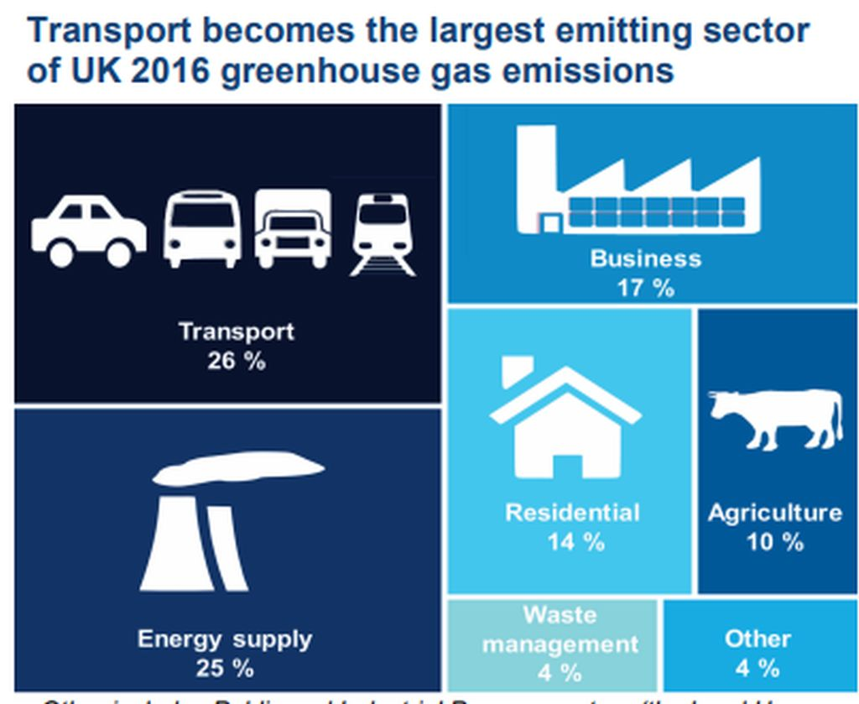
Notes:
Stepping back to the climate context - transport is critical.

Slide 47
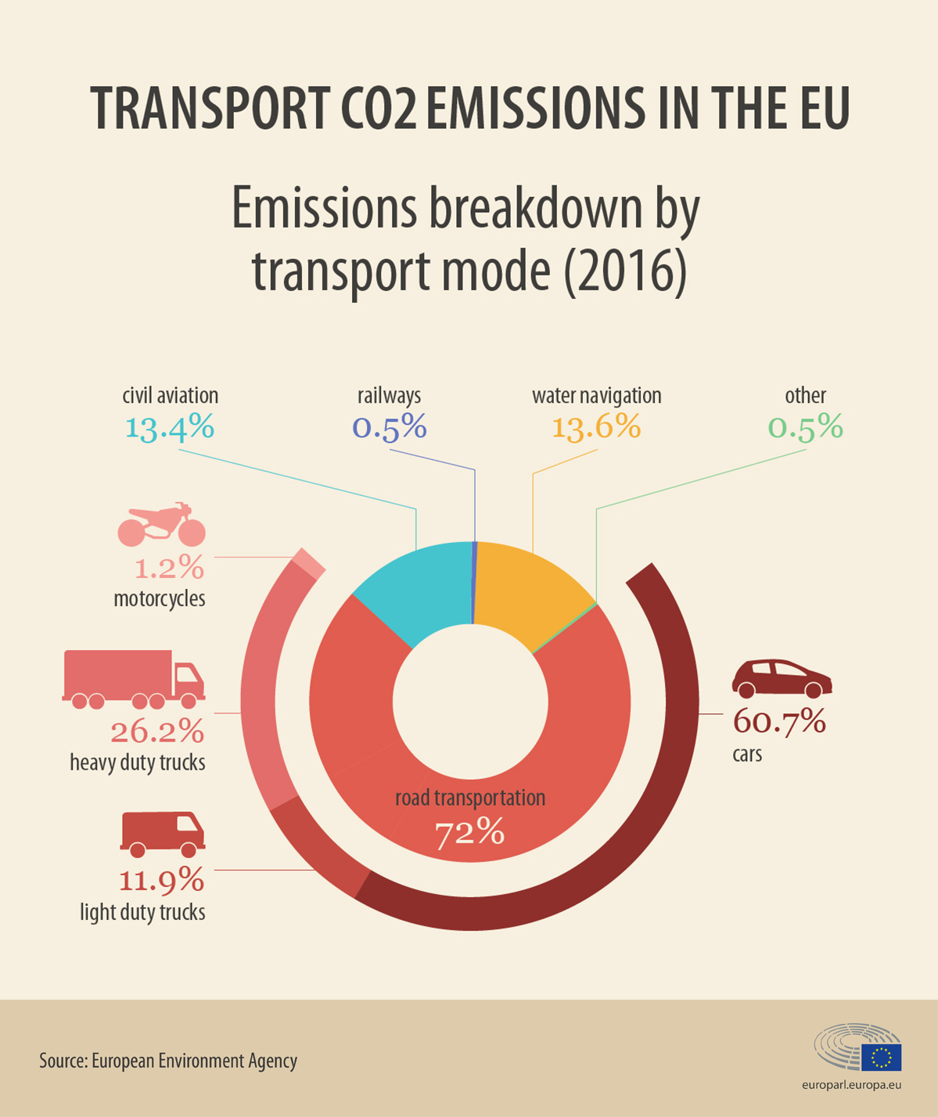
Notes:
Private car use the biggest contributor to C02 emissions in the transport sector. Not airflights or haulage.
Despite increases in efficiency C02 road transport from emissions has risen by 6% since 1990 (Sept 2019, ONS)
What is going on: more cars, used more, critically larger cars are now dominating the market, more recently from impact of turn away from diesel.
Around the corner is electric cars but a like for like replacement isn’t going to be enough by itself because of the forecast continued growth in ownership and use.
Co2 emissions overall, taking into account production, are less for electric cars but when you realise on average a car is unused 96% of the time then sharing is the obvious way to reduce CO2 emissions further.
So the key message is own less cars and use them less.
One way to do that is bikes - CO2 consumption whether electric or not thought to be 10 times less than a car.
It is hoped electric bikes will be the gamechanger in increasing the use of bikes over cars.
What we identified is that there is a gap - for families, for larger shops, that is where a electric cargo bike or trike makes sense.
And as with so much else - it makes sense to share.
______
Reducing emissions from transport is going to require behavioural change.
Simply moving to electric cars is not the solution - not only because that doesn’t help congestion or end air pollution, but also because of the C02 embedded in the production process.
Cars need to be shared more rather than individually owned AND we need to turn away from car use when we can. The key message is share more and use less applies just as much to transport as it does to other areas of our lives.
Bikes - whether electric or not, are believed to account per KM for 10 times less CO2 than a car (taking into account both CO2 in production and use). Electric bikes are thought to be the gamechanger that helps get people out of their cars because longer, hillier, faster journeys become possible for more people. Electric trikes take that advantage further because of their extra capacity.
One of the things we have learned from the shared electric car in the cohousing community is that sharing is practical. The other is that a significant proportion of journeys are low mileage.

Slide 48
Objectives
Promote local awareness of climate emergency and need for individual action, and contribution of transport choices can make.
Reduce use & ownership of cars to reduce C02.
Provide a case study on viability and value of community-led electric bike schemes.
Promote community-led solutions to climate emergency.
Encourage community engagement in Orchard Park.
Notes:
So many ‘sharing solutions’ are corporation-facilitated app-based profit-making products - we think the community-led initiatives are really important. When it comes to bike-sharing and car sharing for instance it is rarely profitable for companies to operate these outside of city centres - so community-led schemes are vital and often have additional benefits.
Engagement with local school - artwork, assemblies, outside gates for families to try it, practically support OP events - rubbish ramble and community centre.
Aim use as a way to connecting people in OP as a basis for future sustainability initiatives.

Slide 49
Funding
Trike & accessories. Spare battery, box cover, rain cover, sun roof, rear carrier rack, baby seat.
Security measures. Padlocks for bin store. Ground anchor. Gold standard chain & padlock. Security marks. Etc.
Promotional activity. Outspoken bikes event. Materials for box decoration. GPS Tracker for research. Covered by grant from Cambridgeshire County Council/EU.
Running costs. Insurance, electricity & repairs - to cover from membership fees.
Notes:
Funding was awarded at level sufficient for bike suitable for hills - don’t have many but we were thinking of the bridges. 100K load capacity - up to 4 children. Trike as easiest and most accessible to ride.
£3500 trike, £1000 accessories - large part cost of spare battery.
C£500 coming from CCC EU City Changer Cargo Bike Fund.
Ongoing costs: insurance, reimbursement to CCL for electricity, repair costs to be covered by membership fees and usage contributions. C£500.
Membership fees £30 & £40 - inclusive of use to minimise admin. We have signed up 16 households and covered that cost so as we add members we can also start to think about can we add to the scheme if we are able to increase membership and build up reserves - a folding electric bike because it supports multi-model travel is on our wish list.

Slide 50
Practicalities
Bookings & communication
Cambridge Cohousing
Administration
Location
Insurance
Storage
Security in use
Sign up, guidance & induction
Tracker
Notes:
Talk through.

Slide 51
Challenges
Replication
Covering running costs
Engaging with Orchard Park
Storage
Security
Insurance
Volunteers for weekly checks/admin/repairs
Managing capacity
Notes:
Talk through.

Slide 52
Wilbraham Woodlands
Stephen Bartlett, Chair of Gt Wilbraham Parish Council

Slide 53
Wilbraham Woodlands
Stephen Bartlett
Chairman, Great Wilbraham Parish Council

Slide 54
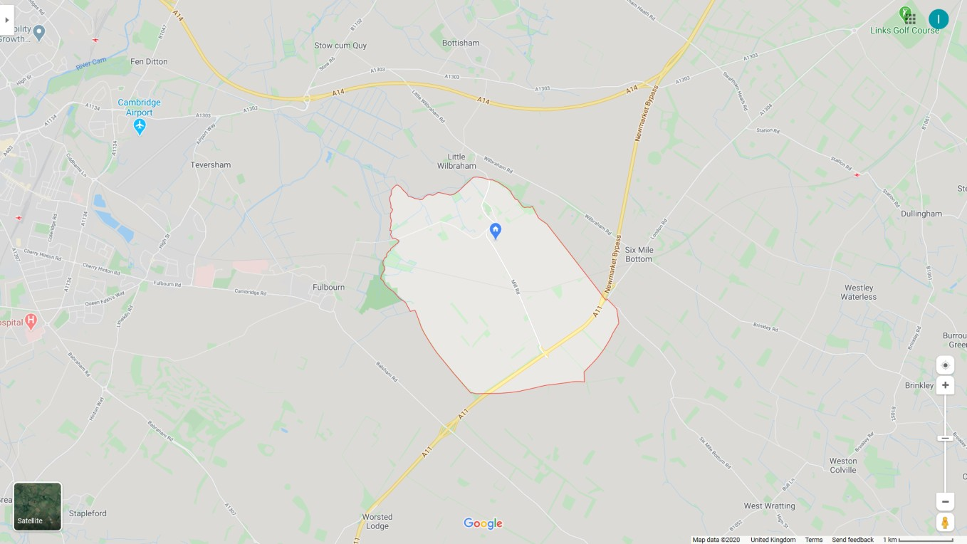

Slide 55
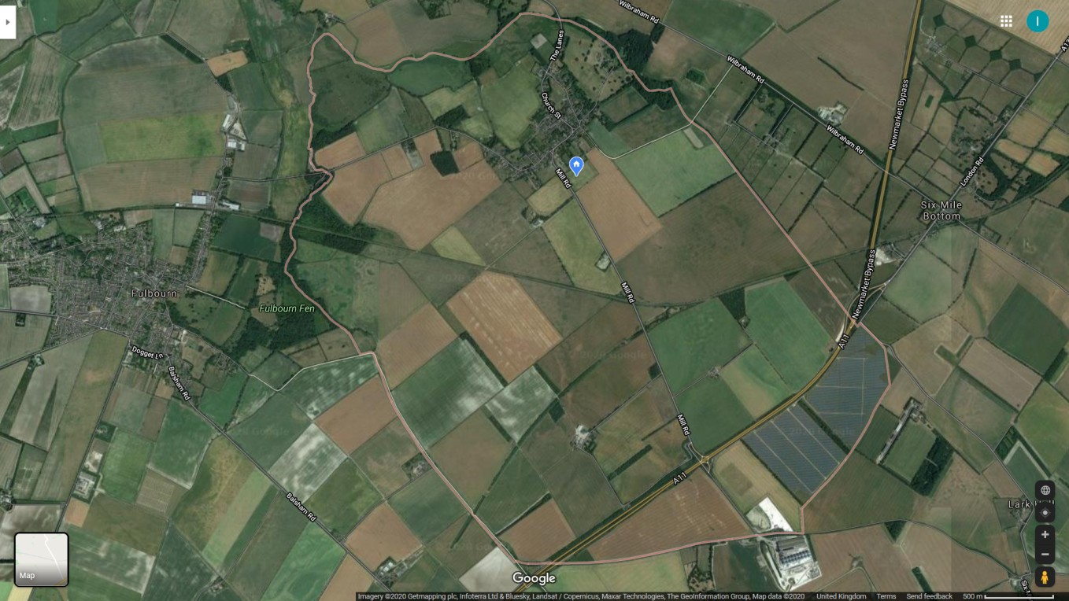

Slide 56
Rough Figures
z
§ 2000 acres
§ c.10% wooded
§ Goal c.30% wooded

Slide 57
Others Involved
z
§ Village Youth Group - supported by the Parish Council
§ Well-brahams - a mental health and well-being initiative in Great and Little Wilbraham, supported by the ParishCouncil
§ Great Wilbraham Common Rights Holders
§ Cambridge Wildlife Trust
§ Natural England
§ Woodland Trust

Slide 58
Project Phases
z
§ Phase 1 Launch - pupils from the school and members of the Youth Group will plant 6 standard oaks at sites around the village.
§ Phase 2 Common - plant one acre of oak at the eastern end of the common to improve the boundary windbreak. (now likely to be on other PC land)
§ Phase 3 - Off-road access to the Common - work with the local Estate - Wilbraham Farms - to create a wooded walkway from the School to the Common, planting up to 40 acres of oak, lime and hazel.
§ Phase 4 - Creating other wooded walkways, again working with the local Estate up to 60 acres.
§ Phase 5 - Expand the woodland to 600 acres - i.e 205 of the parish and at a level which makes the village carbon neutral. ( the village has approx. 600 residents, for their daily life each person creates approx. 10 tons of carbon per annum and 1 acre of tees will also capture 10 tons of carbon per annum - so for a carbon neutral environment one acre of wood per resident.)

Slide 59
z
Wilbraham Woodlands
Questions?

Slide 60
Setting up a Climate Action Group

Slide 61
Shaun Hughes, Hardwick Climate Action Group

Slide 62
Climate Actions

Slide 63
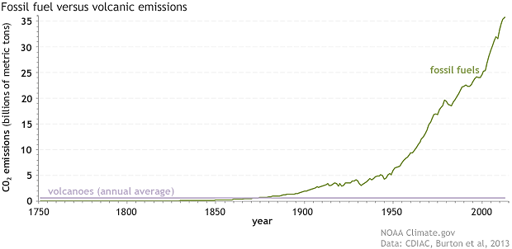
Global CO2 Emissions: humans vs volcanoes
Source: NOAA (climate.gov)

Slide 64
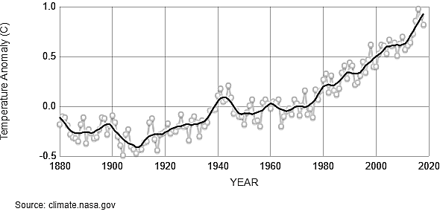
Global Temperature
Source: climate.NASA.gov

Slide 65
Hardwick Climate Action Group
Inaugural meeting 15 Oct 2019:
About 55 attended
Welcome/introduction to Stefan Haselwimmer (Cambs Climate Emergency), Lina Nieto (Cambs County Council)
Climate Quiz
  Sea level change today since 1870? 6, 12 or 24 cm?
  Sea level change by 2100 if 3-6 deg hotter?
CO2 culprits
Identify actions
80-100 cm

Slide 66
Millions of small changes will make a difference
Tonnes of CO2 per person per year | Today | Tomorrow | Savings
Food (Omnivore vs Vegan) | 2.6 | 1.5 | £611
Heating (Gas vs Heat Pump) | 1.5 | 0.5 | £700
Flights vs Calls | 0.9 | 0.1 | £332
Car to Cambridge vs Electric Vehicle | 0.7 | 0.0 | £2,667
Bus to Cambridge vs Electric Vehicle | 0.5 | 0.0 | £700
Electricity (Fossils vs PV or Wind Turbine) | 0.9 | 0.0 | £800
TOTAL | 7.1 | 2.5 | £5,810
One person breathes out 20,000 times/day = 0.4 tonnes CO₂ per year

Slide 67
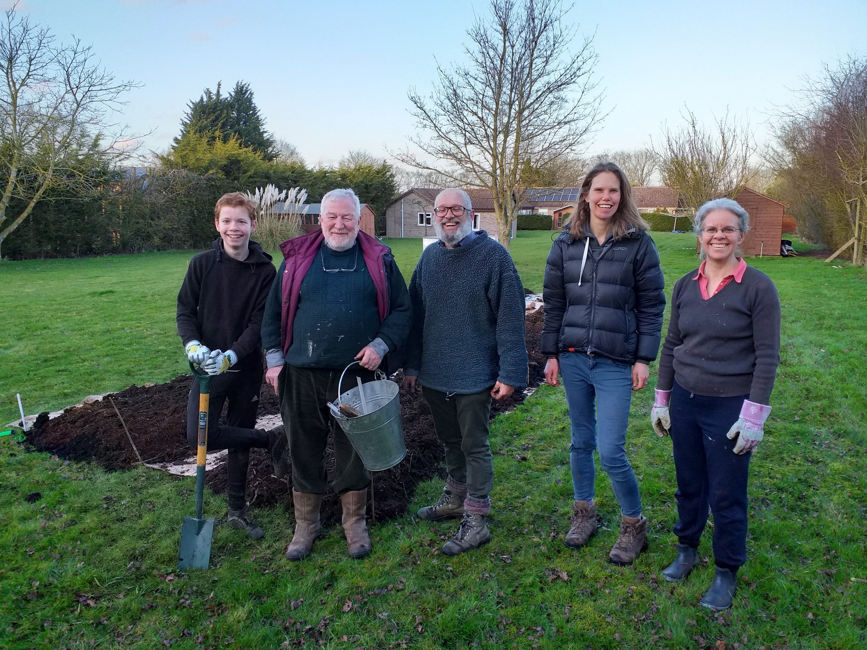
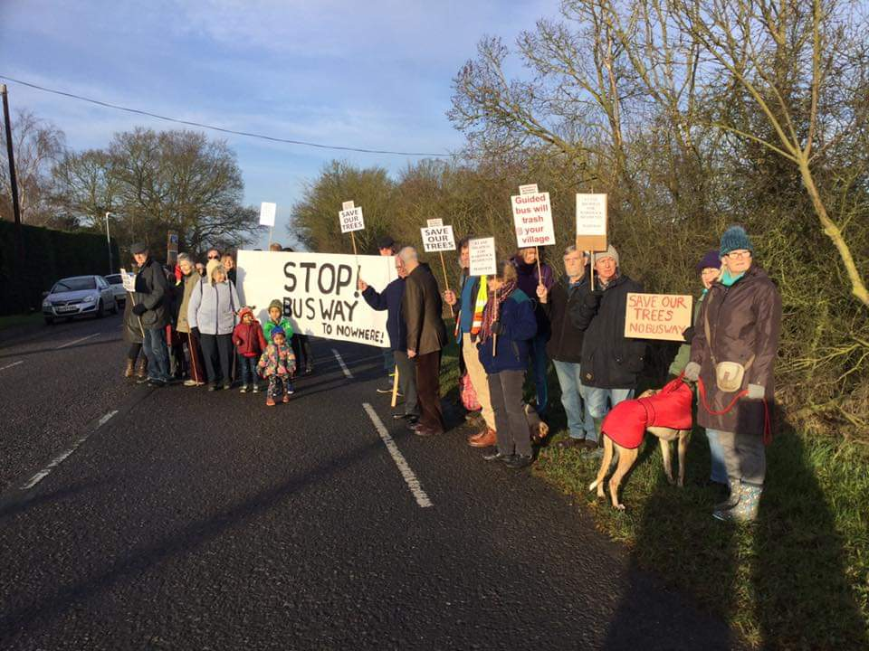
Hardwick Climate Action Group
Actions – commit to three (40 signed up):
Fields of Grace (village farm)
Plant more trees
Recycling
Solar Panels
Wind turbines
Vegan diet
Clothing swap
Heating & Insulation
Cycle parking at bus stops
Eco commuting
Car share
Eco heating

Slide 68
Mark Freeman, Cambridge Council for Voluntary service (CCVS)

Slide 69
Discussion

Slide 70
Responding locally to the climate emergency: What would help you move forwards?

Slide 71
Networking

