Slide 1
Greater Cambridge Sustainable Design and Construction SPD
Agents Forum Briefing
17 July 2019

Slide 2
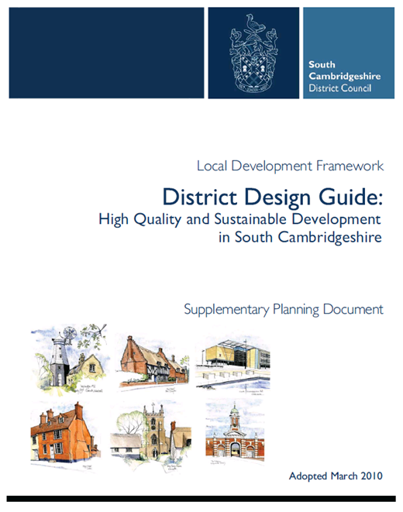
Purpose of the SPD
Policy implementation guidance on policies related to:
Energy and carbon reduction;
Sustainable Drainage (Cambridge);
Climate change adaptation (including links to trees and green infrastructure)
Biodiversity;
Water conservation;
Pollution/Environmental Health
Works to heritage assets to address climate change;
Sustainable Show Homes.
Wider approaches to sustainable design
Updates guidance in existing SPDs;
Aims to ensure that sustainable design and construction is integral in the design process.

Slide 3
Overview of guidance
Section 1: Introduction
Section 2: The importance of urban design
Section 3: Policy implementation
Section 4: Further approaches to sustainable design and construction
Appendices
Notes:
Section 1 provides an introduction to the SPD, what sustainable design and construction is, the policy context and the purpose of the SPD;
Section 2 is a section that covers the importance of urban design, outlining the importance of integrating sustainable design and construction with urban design to ensure the delivery of high quality new development and to maximise the opportunities to enhance the environmental performance of new development;
Section 3 policy implementation (the heart of the SPD) – technical guidance on the information that needs to be submitted alongside planning applications to demonstrate compliance with the policies;
Section 4 covers further approaches to sustainable design and construction. The purpose of this section is to encourage developers to go further than current policy requirements, particularly for strategic sites and new settlements that have policy requirements to demonstrate excellence in sustainable development. This section will give developers pointers towards areas that could be considered as demonstrating excellence, for example health and wellbeing, modern methods of construction and supporting low carbon lifestyles by, for example, integrating food growing opportunities into new developments. These topic areas have been chosen as they have been the focus of negotiations on the new settlements to date.
Appendices – the SPD includes a series of appendices including a sustainability checklist, proformas for the submission of carbon calculations and guidance on environmental health matters such as emissions standards for gas Combined Heat and Power.

Slide 4
Policies covered
Cambridge Local Plan (2018)
Section 4: Responding to climate change and managing resources
Policy 28: Carbon Reduction, Community Energy Networks, Sustainable Design and Construction and Water Use
Policy 30: Energy Efficiency Improvements in Existing Dwellings;
Policy 31: Integrated water management and the water cycle;
Policy 32: Flood Risk
Policy 33: Contaminated land
Policy 34: Light pollution control
Policy 35: Protection of human health from noise and vibration
Policy 36: Air quality, odour and dust
Section 7: Protecting and enhancing the character of Cambridge
Policy 63: Works to a Heritage Asset to Address Climate Change
Policy 69: Protection of sites of biodiversity and geodiversity importance
Policy 70: Protection of priority species and habitats
Policy 71: Trees

Slide 5
Policies covered
South Cambridgeshire Local Plan (2018):
Chapter 4: Climate Change
Policy CC/1: Mitigation and Adaptation to Climate Change
Policy CC/3: Renewable and Low Carbon Energy in New Developments
Policy CC/4: Sustainable Design and Construction
Policy CC/5: Sustainable Show Homes.
Policy CC/6: Construction Methods
Chapter 6: Protecting and enhancing the Natural and Historic Environment
Policy NH/4: Biodiversity
Policy NH/15: Heritage Assets and Adapting to Climate Change
Chapter 9: Promoting successful communities
Policy SC/10: Lighting proposals
Policy SC/11: Noise Pollution
Policy SC/12: Contaminated Land
Policy SC/13: Air Quality
Policy SC/15: Odour and Other Fugitive Emissions to Air

Slide 6
TOPIC | REQUIREMENT | EVIDENCE REQUIRED | SECTION OF SPD
Energy and carbon reduction | Policy 28: All Residential development – 44% reduction on Part L 2006 (19% reduction on Part L 2013) All Non-residential – mandatory requirements for Ene01 associated with BREEAM ‘excellent’ Policy 30: Householder application – home energy questionnaire | Residential development – Carbon Reduction Statement Non-residential development – BREEAM Pre-Assessment Householder applications – home energy questionnaire | Section 3.2, paragraphs 3.2.2 – 3.2.7 plus carbon reduction template in Appendix 2. Section 3.2, paragraph 3.2.8 Section 3.2, paragraphs 3.2.9 – 3.2.13 plus the Home Energy Questionnaire in Appendix 4
Water | Policy 28: All Residential development – 110 litres/person/day All Non-residential development – maximum BREEAM credits for Wat01 | Residential development – Water Conservation Strategy Non-residential development – BREEAM pre-assessment | Section 3.3, paragraphs 3.3.2 – 3.3.3 Section 3.3, paragraphs 3.3.4 – 3.3.6

Slide 7
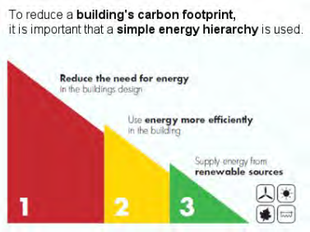
Policy implementation guidance
Carbon reduction;
Climate Change Adaptation;
Biodiversity;
Water efficiency;
Pollution;
Construction standards;
Works to heritage assets
The Cooling Hierarchy
Notes:
Section 3 of the document as I’ve said is the real heart of the document, providing the technical guidance to ensure that developers submit the right sort of information with their applications and to ensure that they are interpreting policy correctly. These are some of the areas included in this section:
Carbon reduction – so meeting our requirements for renewable energy provision or carbon reduction. Details are provided in terms of what needs to be included in carbon calculations, how to apply these to sites (be that on a site wide or building by building basis) and the technologies and approaches that can be used to meet policy requirements. Proformas are also provided in the appendices to ensure we get calculations in the correct format (you would be amazed at the number of ways 10% renewables can be calculated).
Climate change adaptation – a new area of focus in this SPD as it is becoming an ever important aspect to be addressed. This section provides guidance on the role of green infrastructure and trees in enhancing an areas ability to cope with flood risk and heatwaves, guidance on the role of the cooling hierarchy in reducing the risk of overheating in new developments (which is illustrated on this slide), and the role of cool materials.
Biodiversity – providing high level guidance on when ecological surveys are required and the role of new development in delivering biodiversity net gain. It includes links to a number of Biodiversity Toolkits that have been developed including the Natural Cambridgeshire’s Developing with Nature Toolkit.
Water efficiency – so the information that needs to be submitted on water efficiency specifications;
Pollution – this is probably the largest and most technical section of the SPD, covering light pollution, contaminated land, noise and air pollution. The technical guidance in this section does go into a lot of detail, to ensure that we’re getting the right level of information submitted with applications. It’s in the air quality section that consideration is given to issues such as electric vehicle charging requirements.
Construction standards covers the BREEAM requirements contained within policy in Cambridge, and there is also some guidance on the South Cambridgeshire requirement for Sustainable Show Homes.
And we also have a section providing some guidance on proposals that are looking to undertake works to heritage assets to address climate change and environmental performance, to ensure that any such works are sensitive and do not cause harm to heritage assets.

Slide 8
Further approaches
Going beyond baseline requirements;
Health and wellbeing;
Modern Methods of Construction;
Food growing;
Smart technologies;
Responsible sourcing and embodied carbon.
Notes:
Section 4 of the document covers further approaches to sustainable design and construction, and is partly in response to policy requirements, particularly for new settlements, which require developments to go beyond baseline requirements for sustainable design and construction. These areas have been included in response to pre-application discussions with developers on the new settlements, and are typically some of the areas that we are suggesting in terms of what could be considered an ‘exemplar’ or going beyond baseline requirements. So this chapter covers areas of:
Health and wellbeing – so thinking about the design of new developments and buildings themselves can contribute to the health of our residents and those working and visiting the city.
Using modern methods of construction to not only speed up the deliver of houses but to also enhance their environmental performance and reduce construction waste;
Integrating opportunities for food growing into new developments in addition to our formal requirements for allotment provision.
The increasing role of smart city technologies, linking into the smart cities work being led by the Greater Cambridge Partnership.
The responsible sourcing of materials and also the issue of embodied carbon of projects – which is an area that will need to be addressed if we are to achieve net zero carbon.

Slide 9
Consultation arrangements
9 am on Monday 15 July 2019 to 5pm on the 23 September 2019
Letters and emails sent out to consultees and a notice in Cambridge Independent
Documents available to view online and in South Cambridgeshire Hall and Mandela House
Respond online or using our response form
www.scambs.gov.uk/sustainableconstructionspd
www.cambridge.gov.uk/

Slide 10
emma.davies@cambridge.gov.uk
Any questions?

