Slide 1
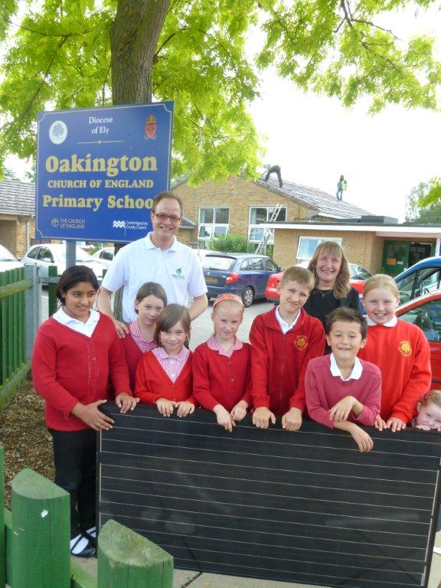
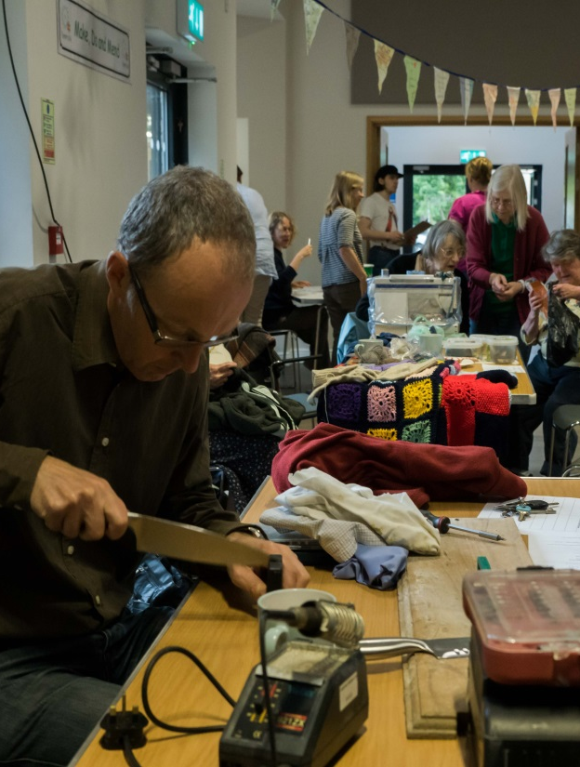
Zero Carbon Communities Grant
Siobhan Mellon, Development Officer – Climate & Environment
Emma Dyer, Project Officer – Climate & Environment

Slide 2
Applications invited for projects which achieve:
Community engagement around climate change and the environment
A shift towards zero carbon emissions…

Slide 3
A shift towards zero carbon thro’:
Reduced
carbon emissions
use of energy
use of resources
waste
Generation of renewable energy or heat
Promotion of sustainable travel

Slide 4
Projects need to achieve:
Community Engagement
Reduce energy use
Generate renewable energy
Promote sustainable travel
Reduce use of resources
Increase recycling
Reduce waste

Slide 5
Applications are invited for between £1k and 15k, can be for:
Capital items
And/or
Project costs including staff time

Slide 6
Applications will be judged on:
How well does the project align with the aims of the grant?
Community engagement
Shift to zero carbon
Value for money
Deliverability
How bold, ambitious and imaginative

Slide 7
A few ideas:
Energy improvements for a community building – tied in with a community event such as a ‘Village Energy Day’ or climate change film & discussion evening

Slide 8
A few ideas:
A project to tackle fuel poverty by providing advice and guidance to people living in cold homes

Slide 9
A few ideas:
A significant-scale Community Energy project such as a wind turbine or solar farm – funding for initial engagement (further project funding could be applied for from the RCEF later)

Slide 10
A few ideas:
New cycle racks or cycle path, tied in with a Cycling Breakfast event or a community cycle ride

Slide 11
A few ideas:
Installation of an electric vehicle charging point in a village hall carpark – joint funded with OLEV grant
Replacement of an existing vehicle for community use with an electric one

Slide 12
A few ideas:
A project to set up regular Repair Cafes, Swapshops and other Reduce, Reuse, Repair, Recycle type initiatives

Slide 13
A few ideas:
Planting of a Community Woodland
A public drinking fountain with an Opening Event

Slide 14
Who can apply?
Parish councils (of all sizes)
Voluntary sector organisations
Must be
Based in South Cambs or benefiting South Cambs residents
Properly constituted with an elected committee
Not-for-profit
Can be
Registered charity
A partnership of two or more organisations – lead applicant must be as above

Slide 15
How to apply?
Read the online Criteria, Guidance and Information documents
Fill out the online application form
Submit application and upload required documents by 5 pm on 31 October.

Slide 16
How will applications be assessed?
Scored independently by officers
Officer panel meets to pool scores and agree recommendations
Report to Grants Advisory Committee with Climate & Environment Committee
GAC makes recommendations to lead Cabinet Member for Finance for decision

Slide 17
Key Dates
Key Dates
Thu 31 October | Deadline (5 pm)
January 2020 | Applicants informed of decisions and funding agreements drafted and signed, including arrangements for payment, staged where appropriate
January 2021 | Funding to be spent within 12 months of the award being made
Within 3 months of project completion | End of project report with photographs to be submitted to the Council

Slide 18
Please help publicise the grant!
Leaflets
Social media – please share Council posts
Village newsletters

Slide 19
Questions?

