Slide 1
Waterbeach New Town SPD
Planning Policy Team
Greater Cambridge Planning Service
September 2018

Slide 2
Contents
What’s happened?
Background
What does the draft SPD say?
What happens now?
Key issues for the SPD
Questions

Slide 3
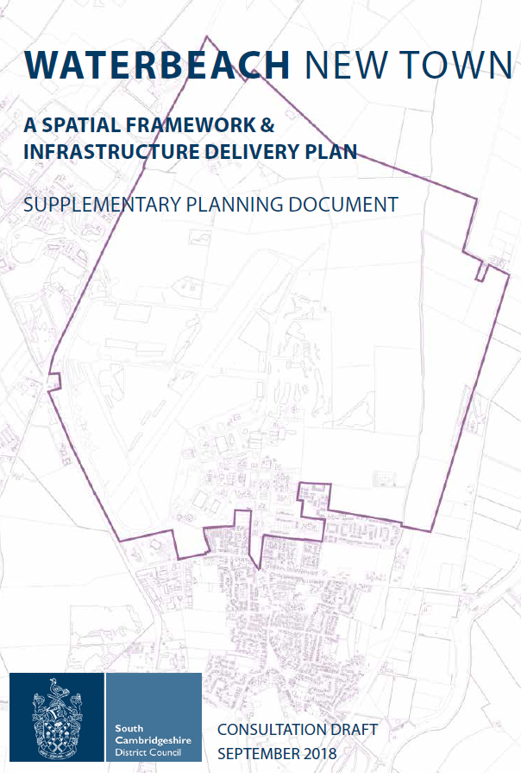
What’s happened?
New Local Plan allocates land for the new town (Policy SS/6)
Local Plan Inspectors Report published 3rd September
SCDC Council meeting 27th September to adopt the Local Plan
Public consultation on the SPD 14th September to 26th October
Notes:
Local Plan prepared over 3 year period to March 2014 when submitted for public examination.
Public consultation on Issues and Options in 2012 (overall support for inclusion of new settlements from across the District).
Waterbeach New Town included in proposed submission Local Plan, consulted on in 2013.
The new town has a long history having been proposed for development 20 years ago and running Northstowe very close when that site was first allocated for development in the 2003 County Structure Plan.

Slide 4
l
Background
Housing need 19,500 homes 2011-2031
No scope for further major Green Belt releases on edge of Cambridge
Limited capacity for long term village growth identified
City Deal (GCP) signed in 2014 to provide funding for key infrastructure like the A10
Notes:
Inspectors’ Reports: The Inspectors have considered responses received during the consultation periods, and all other matters raised throughout the Examination period, and reached their conclusions.

Slide 5
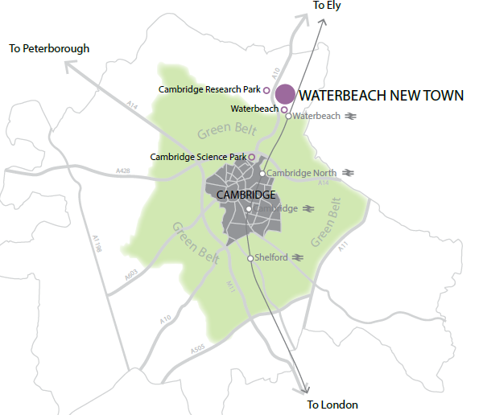

Slide 6
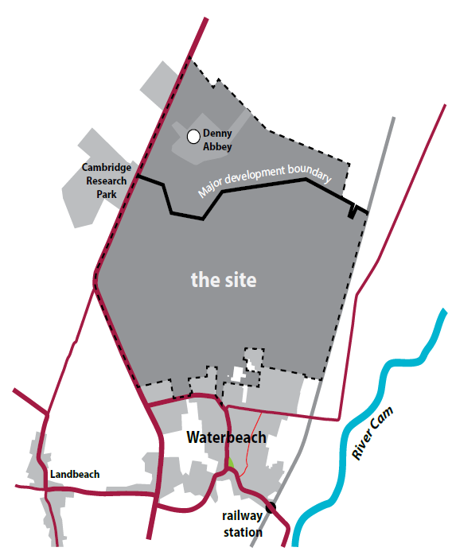
What does the SPD have to say?
Supplements policy SS/6 adding further detail
Must be consistent with the Local plan, cannot create new policy
Allocates land for a new town of approximately 8,000 to 9,000 homes of which around 2,300 by 2031
Including market and affordable homes

Slide 7
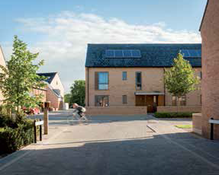
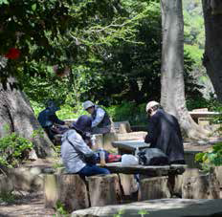
l
Vision and Objectives
Independent
Distinctive
Well-connected
Healthy and safe
Vibrant
Attractive and modern
Inclusive
Sustainable and resilient Prosperous

Slide 8
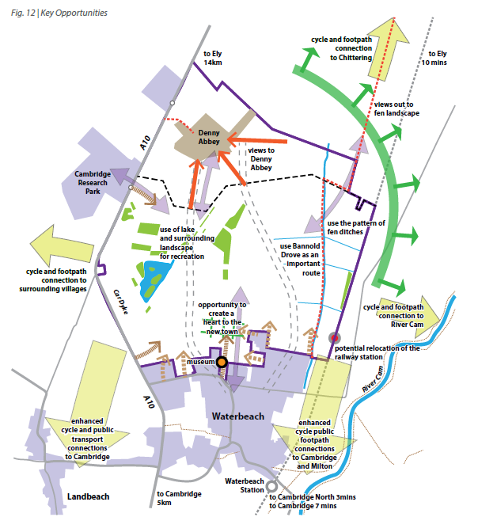
l
Constraints and Opportunities
Denny Abbey setting
Existing village
A10, waste park, railway station
Existing landscape and water features
Keeping links to the history of the airfield and barracks
Links to Cambridge and nearby villages

Slide 9
l
What goes where?
1 town and 3 local centres
Schools
Landscaping and parkland
Relocated and improved station
Denny Abbey setting
Causeways and runway park
Village transition
Notes:
Inspectors’ Reports: The Inspectors have considered responses received during the consultation periods, and all other matters raised throughout the Examination period, and reached their conclusions.

Slide 10
l
Movement
Key to success
Ely to Cambridge Transport Study: GCP/CA
Road improvements
Public transport
Walking and cycling internal and external
Relocated station
Controlled and managed movements between the new town and Waterbeach village
Notes:
Inspectors’ Reports: The Inspectors have considered responses received during the consultation periods, and all other matters raised throughout the Examination period, and reached their conclusions.

Slide 11
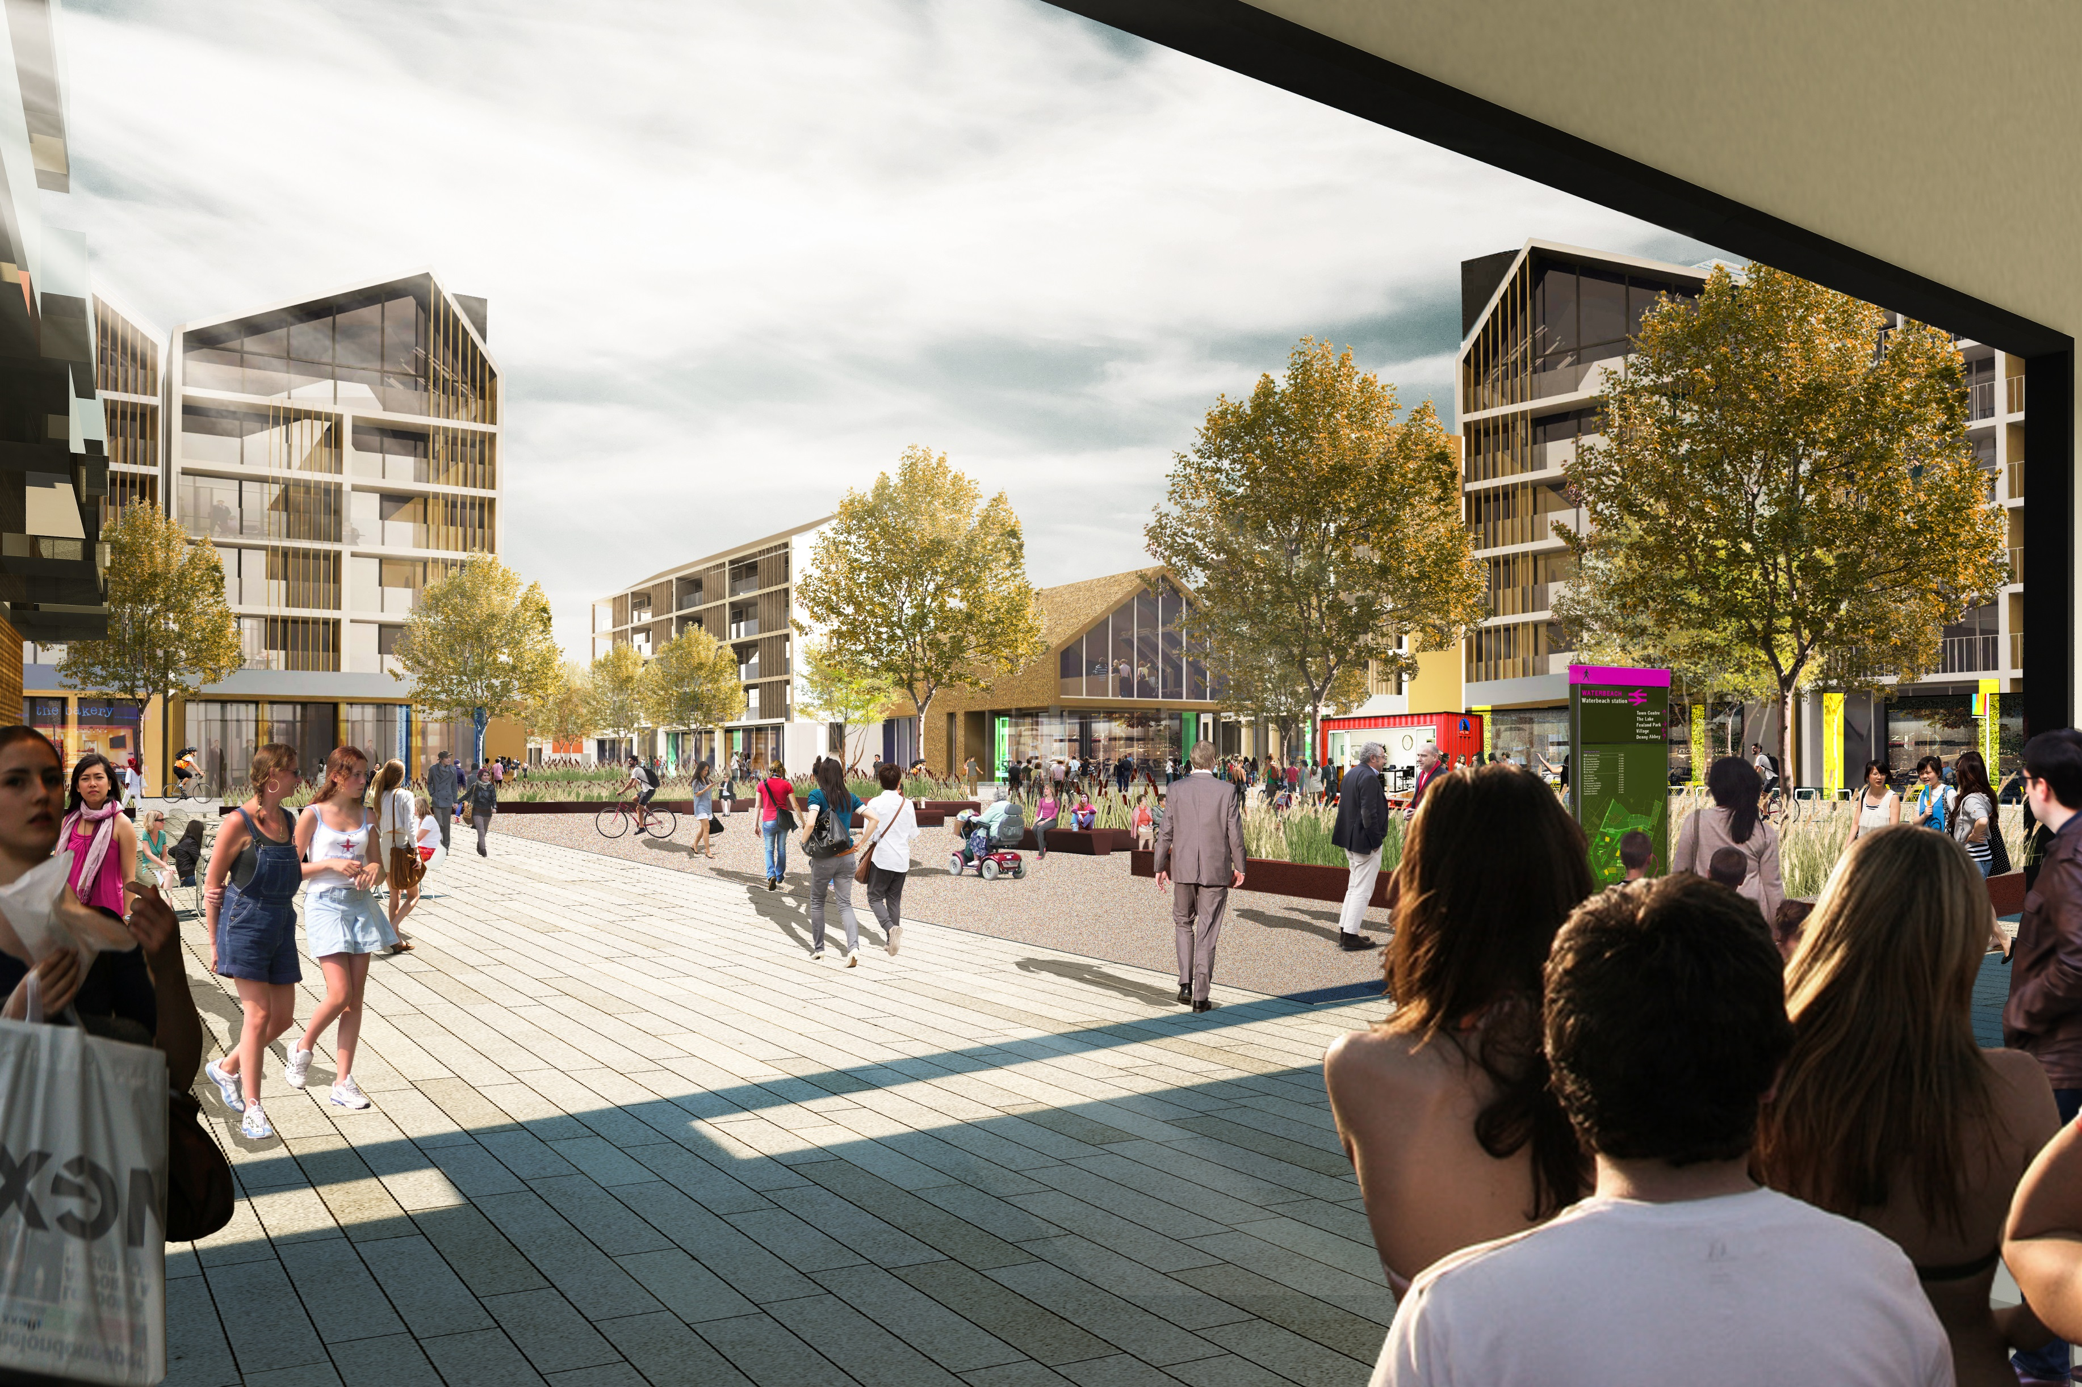
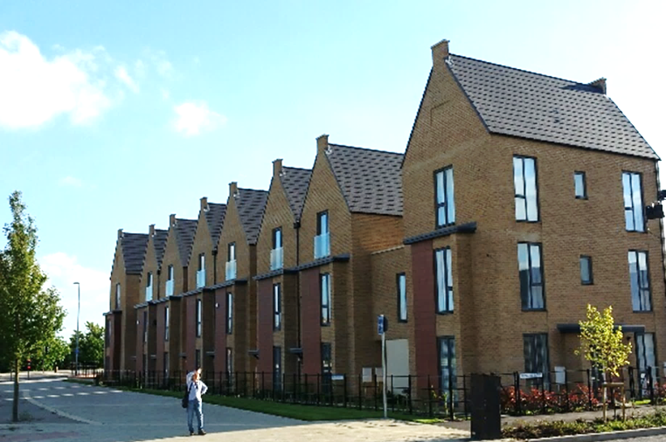
l
Housing and design
To provide housing for all
Capacity to be determined through planning process in context of Local Plan and this SPD
Heights to be controlled, and be lowest close to the existing village, and on the new town edges
Emphasis on design quality
Notes:
Inspectors’ Reports: The Inspectors have considered responses received during the consultation periods, and all other matters raised throughout the Examination period, and reached their conclusions.

Slide 12
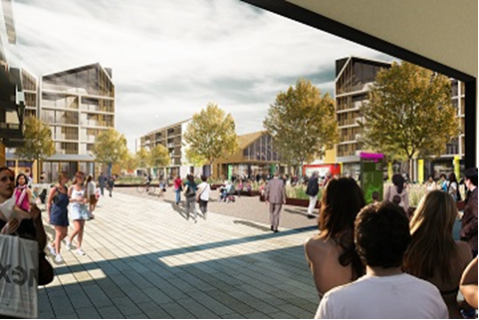
l
Shops and services
Shops, services (inc 9 schools) and health provision to be easily accessible
Job creation opportunities
Provision for leisure, socialising, and recreation
Town centre at the heart and close to existing village
Notes:
Inspectors’ Reports: The Inspectors have considered responses received during the consultation periods, and all other matters raised throughout the Examination period, and reached their conclusions.

Slide 13
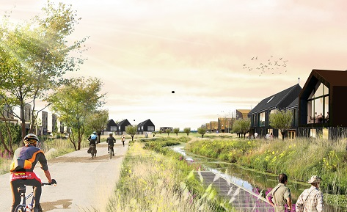
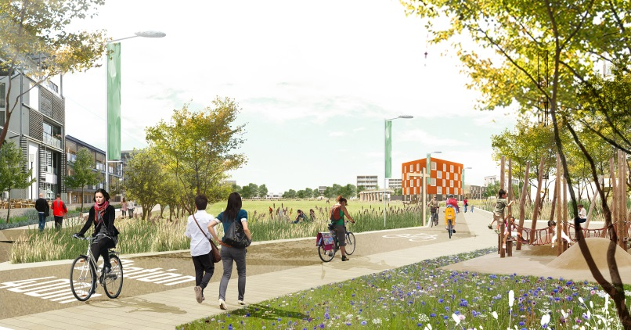
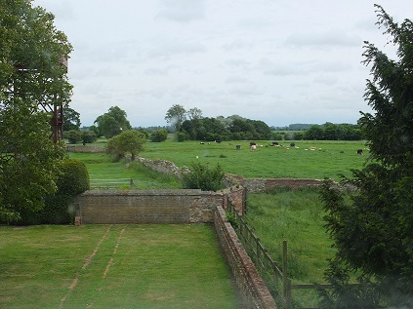
l
Green spaces and water
North Park – Denny Abbey
South Park – Village transition
Runway park- Green heart
Lakes and watercourses
Green droves and causeways
Space for sport and informal use
Flood control and prevention
Notes:
Inspectors’ Reports: The Inspectors have considered responses received during the consultation periods, and all other matters raised throughout the Examination period, and reached their conclusions.

Slide 14
l
Delivery
Comprehensive delivery secured through planning permissions and legal obligations
Phasing – long term
Infrastructure Delivery Plan
Development consistent with the Local Plan and this SPD
Notes:
Inspectors’ Reports: The Inspectors have considered responses received during the consultation periods, and all other matters raised throughout the Examination period, and reached their conclusions.

Slide 15
Responding to the SPD
Location of the town and local centres, schools and open spaces
The relationship between the new town and the village and Denny Abbey
Making sure that the new town is a good neighbour to Waterbeach
The movement network
Ensuring comprehensive development
Please do not comment on the principle of the new town or on matters fixed by Local Plan policy SS/6

Slide 16
Have your say
Help us make the SPD better:
By submitting comments online
By emailing us comments
By writing to us
Send us your comments before 5pm on Friday 26th October
Come along to our exhibition in the village on Monday 8th October at the Salvation Army Hall on Station Road between 12.30 and 19.30

Slide 17
Questions?

