Slide 1


Slide 2
What is a Community Land Trust?
Form of Community-led development
Allows communities to develop genuinely affordable homes and community facilities for local people for the long term
Membership based organisation
Non-profit vehicle led and run by local volunteers
Legal asset lock protects the community benefit for the long term, no private profit
You get to input into how you think the village should develop

Slide 3
Why do we need a CLT?
Housing in the local area is unaffordable
  Housing needs survey 2010 identified we require 168 affordable homes
  Housing Register has 148 households with local connection
  CLT has had over 60 expressions of interest so far
  Median house price is x8.5 median income in Waterbeach
  Affordable is considered x3.5
  Lower quartile house price is x12.5 lower quartile income in Waterbeach
Not just about housing. Develop community facilities too.

Slide 4
Why do we need a CLT?
Gives members of the community opportunity to manage some of the development taking place in the area
Ensures community engagement and a thriving local area
Develop to benefit local people, housing can be allocated to those with a local connection
The Neighbourhood Plan is setting planning policies. It can be used to support community-led development, and we are trying to put in CLT-friendly policies

Slide 5
Why now?
Lots of things happening in the Village, some seen as negative
Opportunity to do something positive
Lots of big decisions being made, we should be involved
Lots of press about community development and housing
Support and grant funding available from ECCH and SCDC
Incorporate into Neighbourhood Plan

Slide 6
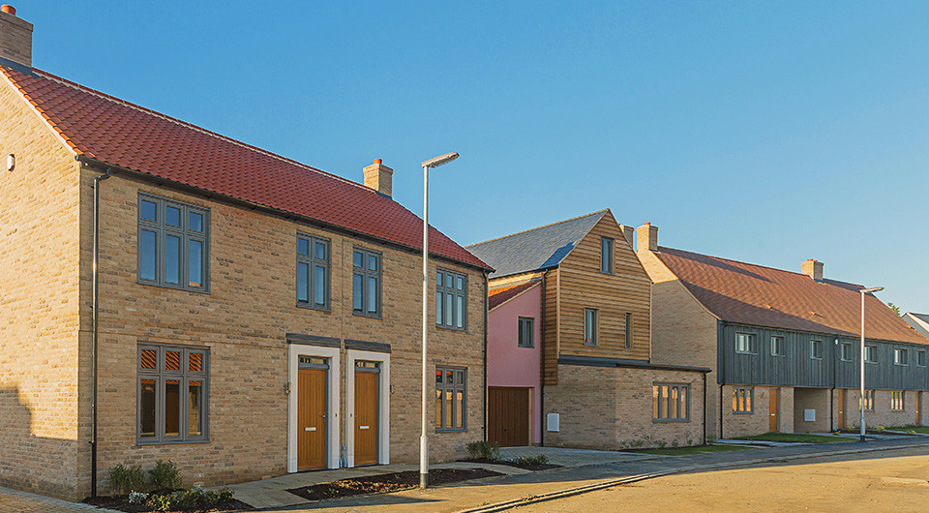
Other CLTs
Stretham and Wilburton
  75 houses, 23 affordable homes
  65% market rate
Haddenham
  54 houses,19 affordable homes
Soham
  13 houses, 8 affordable homes
Swaffham Prior
  20 house, 8 affordable homes
Cambridge
Cottenham
  Sites identified in NP for 90 homes
Manor Farm – S&W CLT

Slide 7
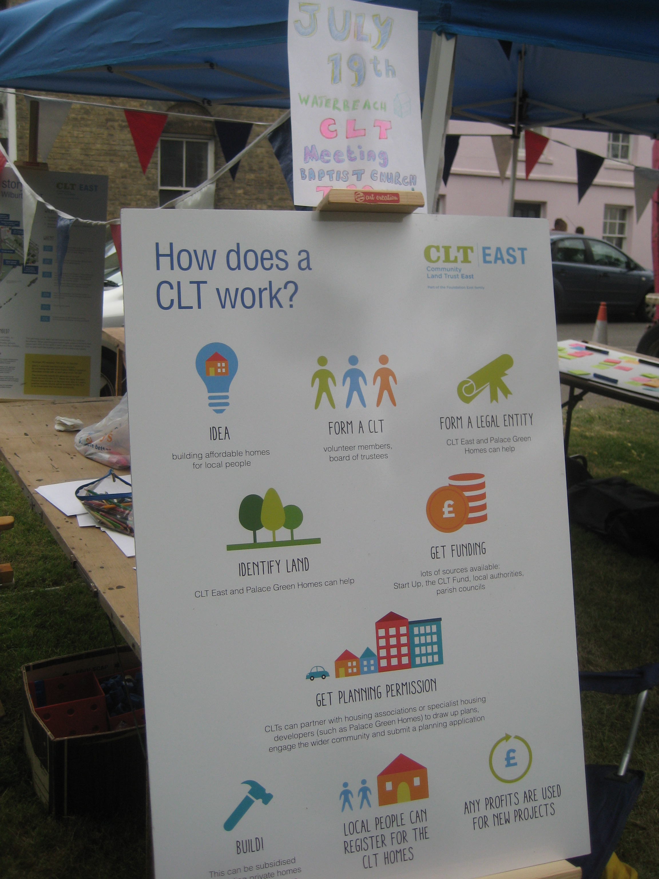
What have we done so far?
Set up steering group
Held scoping event with ECCH
Made a successful grant application to SCDC for start up funding
Started to engage with Council, developers and stakeholders, lots of positive discussions and support
Organised publicity in village
Started to gather members, over 60 so far at Feast
Launched Expression of Interest for those in need of homes, over 60 so far

Slide 8
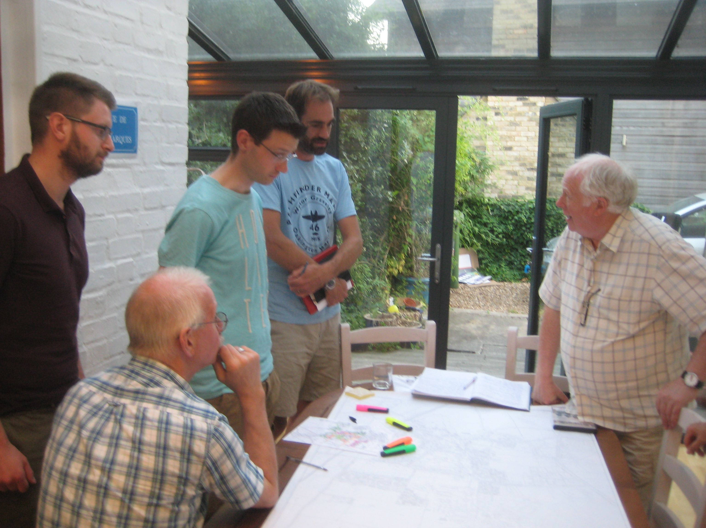
Our Steering Group
Ian Bracey - Born in Waterbeach, Structural Engineer
Robert Jones – Secretary – Long term resident, lecturer, business owner
Robert Bracey – Born in Waterbeach, Architectural Designer
Gideon Pain – Resident, artist, community event organiser
John Cattermole – Resident, Primary School Head
Janie Jones – Long term resident
Anna Jones – Born in Waterbeach, Social Worker
Jonathan Taylor – Resident, Civil Engineer

Slide 9
Our Emerging CLT Values
“Building a vibrant community for the future, where everyone can live, work and play.”
  Affordable housing for local people
  Encouraging better work-life balance, cut down commuting
  Creating great leisure facilities
  Supporting sustainable green infrastructure
  Inclusive community-led development
  We want to know what these mean to you

Slide 10








How do communities set up a CLT?
Idea
Community Engagement
Set rules for CLT
Incorporate as a legal entity
Call for land/assets
Funding secured
Apply for planning permission
Build or renovate
Manage the assets

Slide 11
We need you!
We need you to sign up as a member
  It costs £1 for a membership share
  You get to have your say in what the CLT does, elect the Board of Trustees
Tell us what you want to see in the village
  What facilities would you like to see? swimming pool, support for start-ups, cycle links?
Do you know someone who wants a home? We want to hear from you! www.waterbeachclt.co.uk/looking-for-a-home
Want to start engaging with land owners who want to help the local community

Slide 12
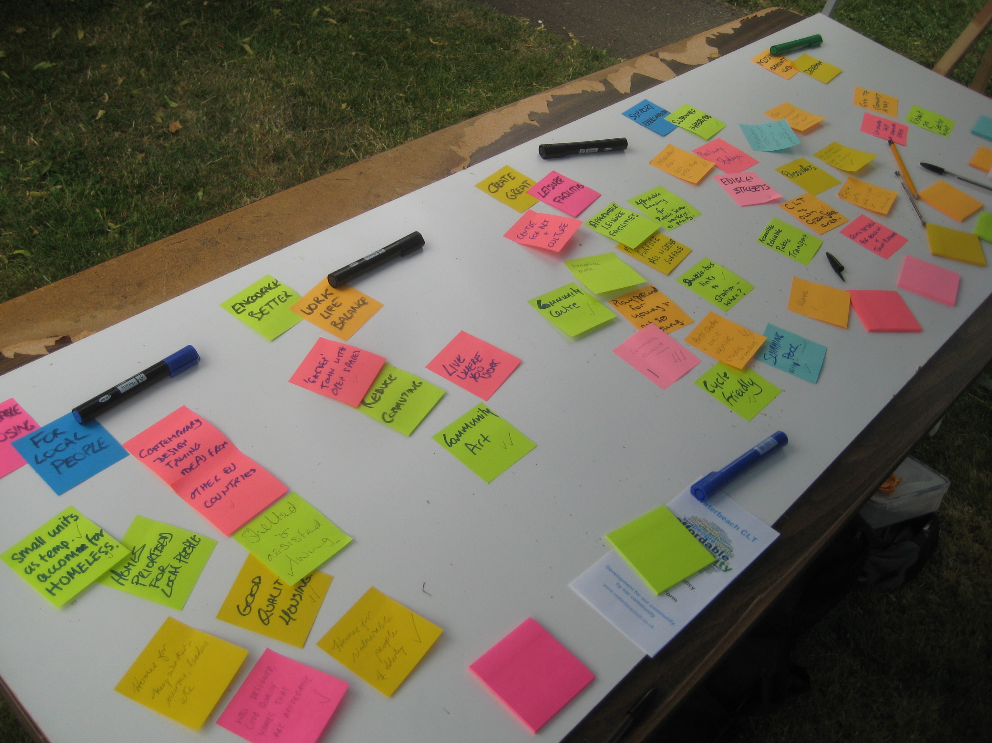
Community Engagement
What does “affordable” mean to you?
What facilities would you like to see?
What styles of housing do you like?
Who should be eligible for homes?
Who should be eligible to be a member?
Tell us what you think.

Slide 13
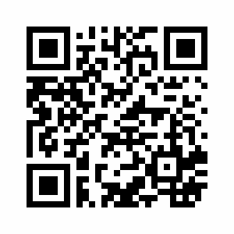
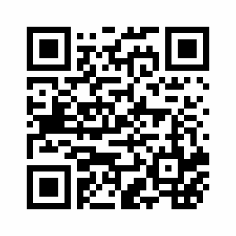
How can you find out more?
Website: www.waterbeachclt.co.uk
Facebook group: Waterbeach Community Land Trust
Twitter: @waterbeachclt
Email: info@waterbeachclt.co.uk
Signup www.waterbeachclt.co.uk/signup Home EoI
www.waterbeachclt.co.uk/looking-for-a-home

