Slide 1
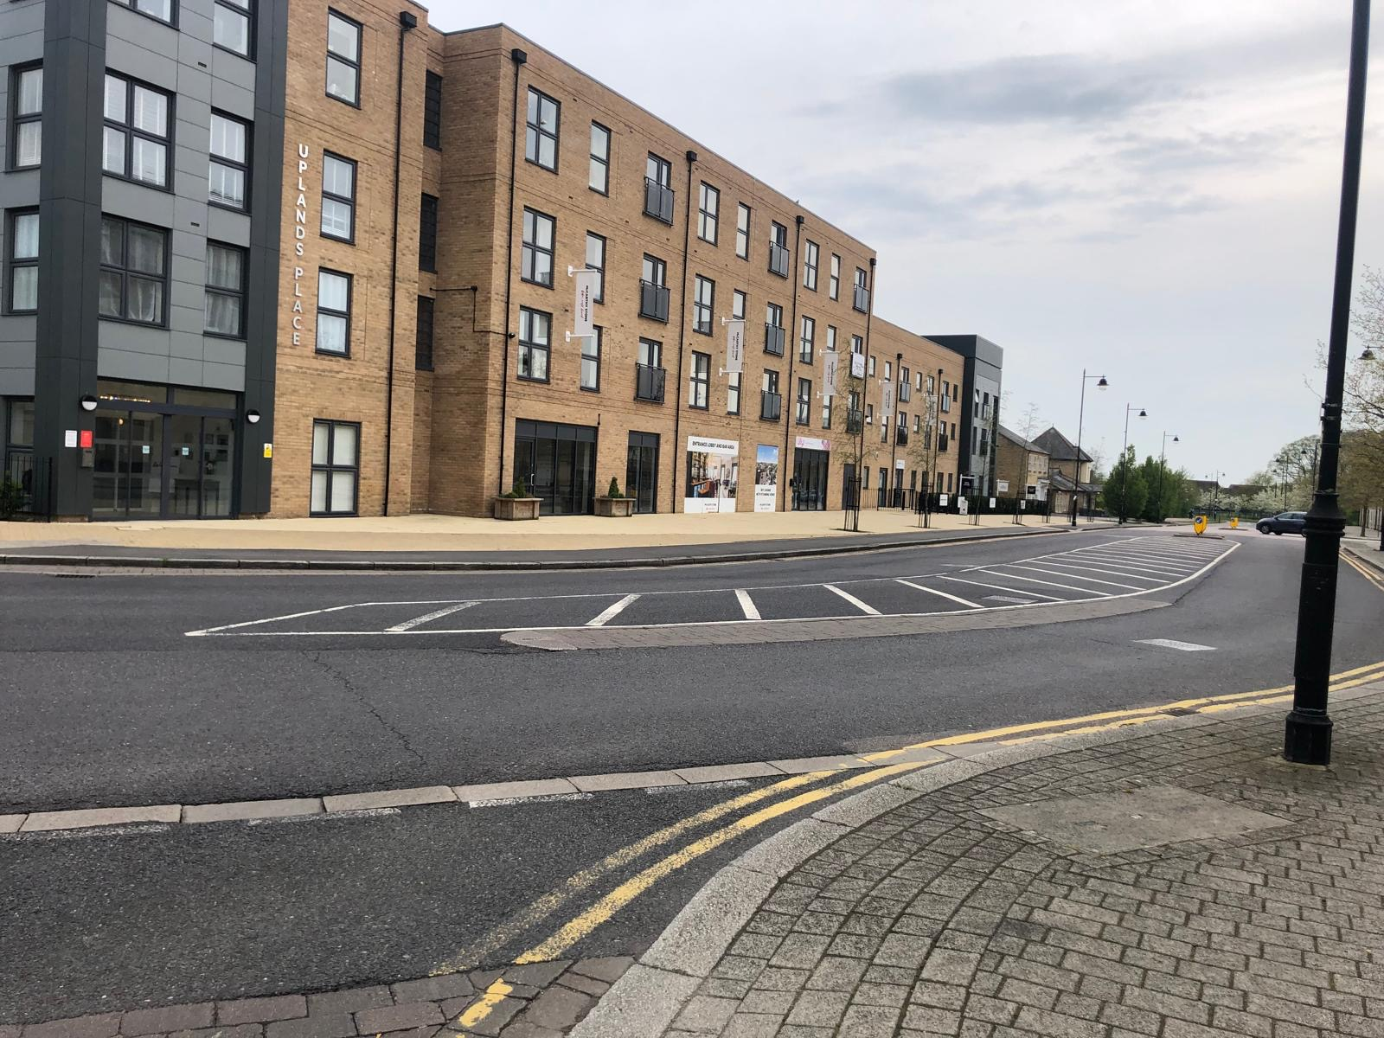
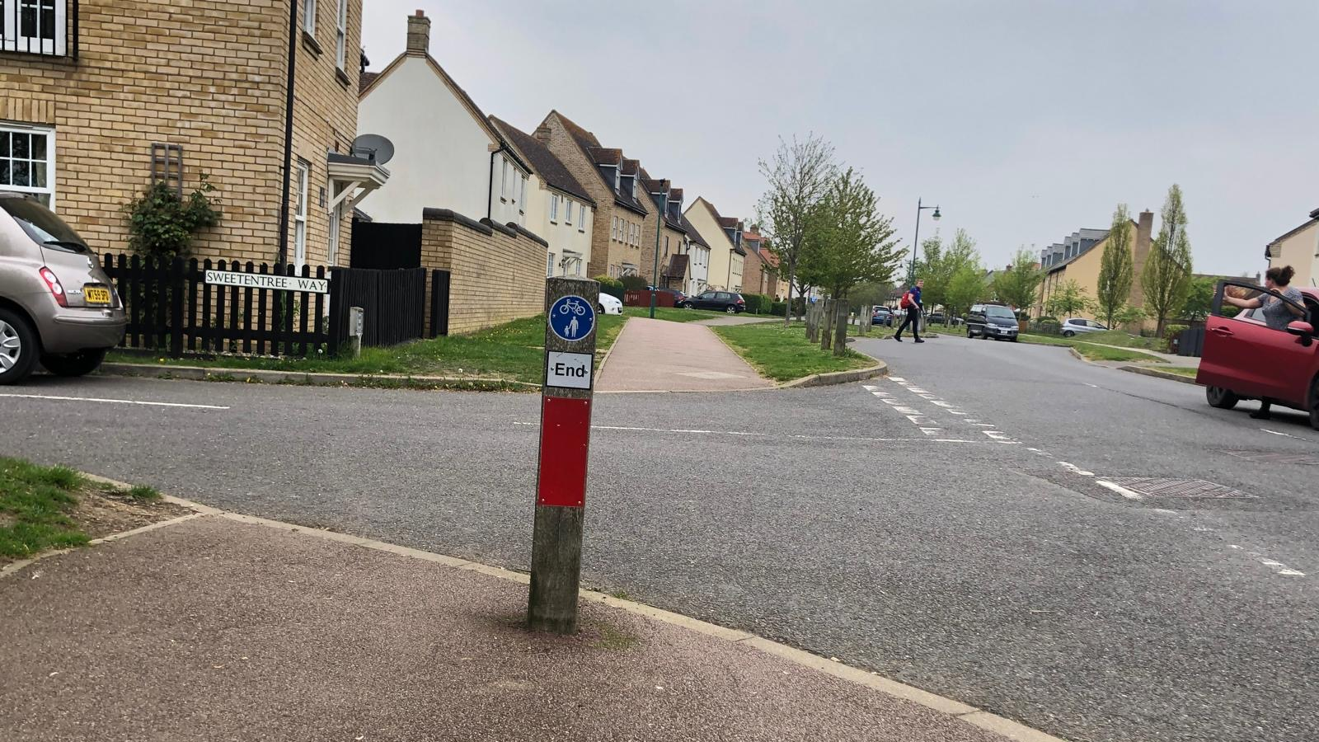
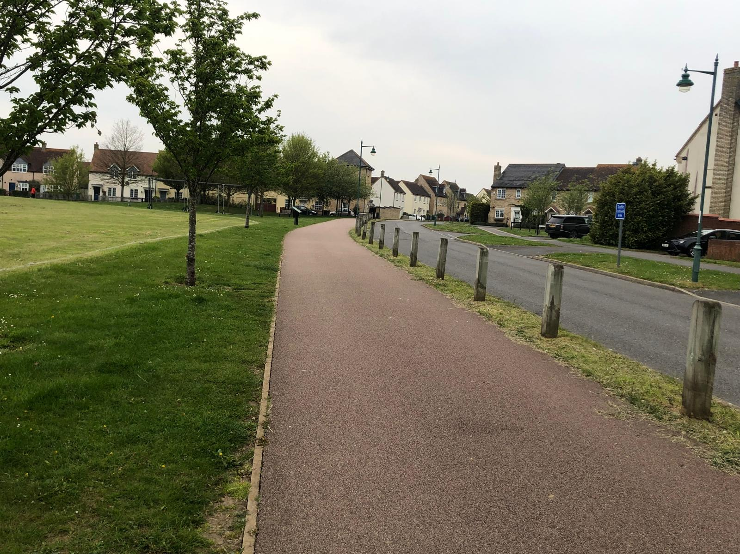
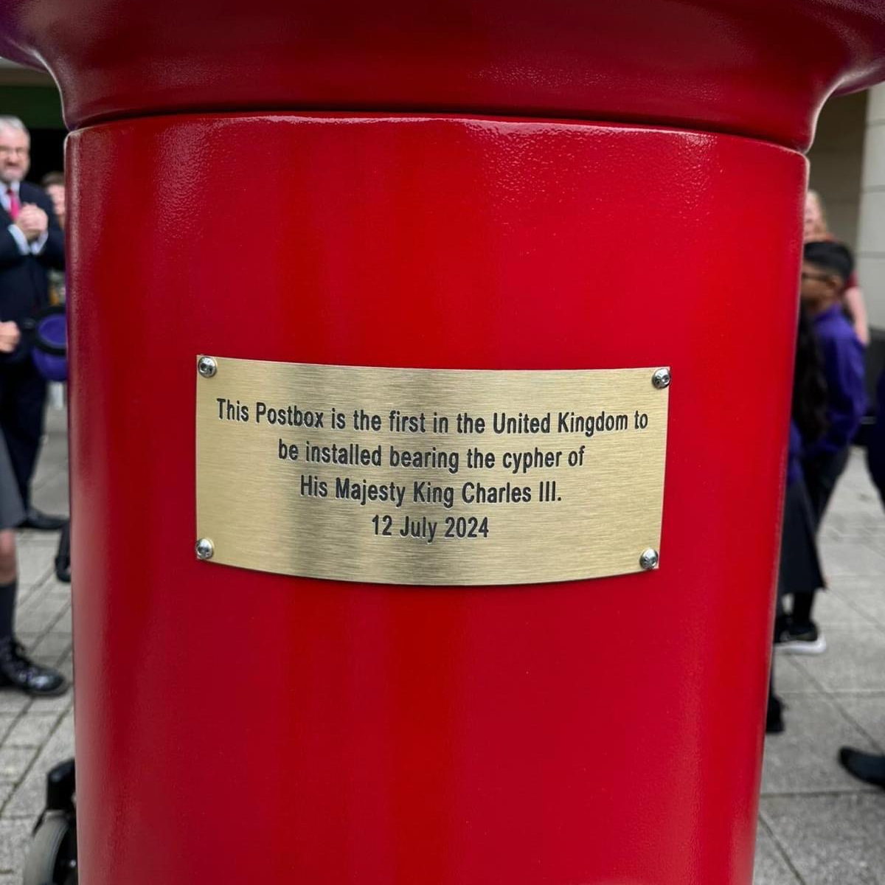
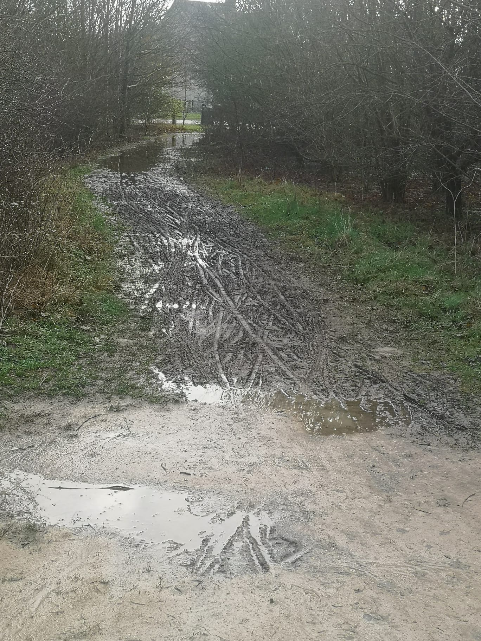
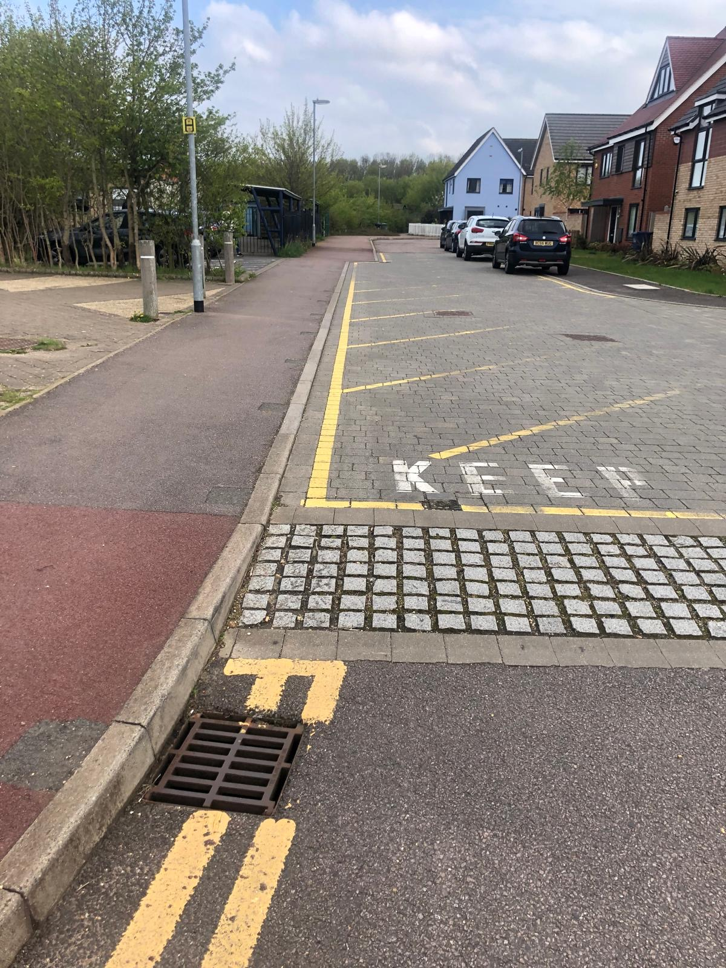
Cambourne25

Slide 2
Cambourne25
Town councillors
District councillors
County councillor
MP
Town council clerk
District council officers
County council officers
Housing developers
Stakeholder representatives (schools, medical practice etc.)

Slide 3
Cambourne25
Meetings held every two months
Chaired by district councillor, Stephen Drew
Brings all responsible into regular meetings and contact
Administrative support provided by SCDC officers
Agenda set by requests from members
Solution focussed
Tasks set between meetings and reported on

Slide 4
Cambourne25
Active travel provisions
Paths surrounding the town
Uplands Place crossing
Vine School safety
Swansley Lane cycle route to CVC

Slide 5
Cambourne25
We aim to work for the residents of Cambourne and ensure that all levels of local government, stakeholders and representatives are coordinating their work in order to serve residents of our town.
We aim to maximise communications and collaborative working between those responsible for serving the people of Cambourne
We aim to overcome legacy issues where decisions made and actions taken in the first 25 years have led to sub-optimal facilities and provisions in the town.

