Slide 1
Planning Updates

Slide 2
Government Changes
General Election/Planning Reforms
- Ministerial Statements “radical and decisive reform”
- 1.5m Homes over 5 years
- National Planning Policy Framework Revised (Grey Belt)
- “Vision” led transport strategy
- Strategic Planning/CPCA
Cambridge 2050/Case for Cambridge
- Cambridge Delivery Company
- Water Scarcity Group
- Defining future delivery vehicles/Development Corporation?
New Towns Task Force

Slide 3

Planning Reform 31 July 2024 – letter from
Deputy Prime Minister…
The Government has been clear that the only route to improving the prosperity of our country and the living standards of working people is through sustained economic growth. We have also been clear that this will not happen without radical and decisive reform to our planning system…
The proposals… speak to concerns… that instead of supporting sustainable growth, the planning system presents a barrier to high-quality development, failing to tackle a housing crisis which is crippling the aspirations of young people and leaves some of the most vulnerable without access to a safe and secure home….
…the Government is determined to do more to support those sectors which will be the engine of the UK’s economy in the years ahead. We will therefore change policy to make it easier to build growth-supporting infrastructure such as laboratories, gigafactories, data centres, electricity grid and the networks that support freight and logistics, and we are seeking views on whether we should expand the Nationally Significant Infrastructure Projects regime to include these types of projects…

Slide 4
Government Ambitions for Cambridge
Published Letter from Matthew Pennycook MP 23 8 24
‘We believe that the recent focus on Cambridge and its untapped economic potential are entirely warranted.’
‘The Deputy Prime Minister and I are determined to help remove [barriers to realising the areas full potential] and overcome the issues that have held up planned development for essential housing and laboratory space.’
‘…many crucial decisions remain to be made about the precise form that ambitious and high-quality sustainable growth takes in the area. I am determined that we take a collaborative approach to them….’

Slide 5
Ministerial Appointment letter 30 October 2024
“The success of Greater Cambridge is a national priority for this government. The Cambridge Growth Company has therefore been established to advise on and drive forward the government’s ambitions for the area, working closely with local partners, to make the most of their insights and knowledge about local communities…
…I would like you to lead the Cambridge Growth Company in progressing the following priorities:
Development acceleration: enable and accelerate developments which align with the government’s ambitions for Cambridge and unlock development on stalled sites.
Developing the evidence base to support development of an infrastructure-first growth plan and a long-term delivery vehicle: work with experts to assess infrastructure requirements, including transport, and lay the foundations for a long-term delivery vehicle.
Cross-government engagement: identify solutions to complex constraints and support cross government engagement to unblock existing development and provide the right incentives for successful development in the long-term.
Cambridge Growth Company business plan: responsibility for overseeing the effective delivery of the Cambridge Growth Company’s business plan and other associated documents.

Slide 6
Local Updates
Cambridge Water – Water Resources Management Plan 2024
Cambridge and Peterborough Combined authority – Local Growth Plan
Cambridge and Peterborough Local Nature Recovery Strategy
Local Plan programme
- Qualified revised timetable Autumn 2024 [Submission December 2026]
- Greater Cambridge Transport Strategy [Combined Authority]
- Decisions pending WWTW, E-W Rail, Water Scarcity
- Cambourne future growth
Greater Cambridge Monitoring Report – Housing and workspace delivery updates
E-W Rail – Informal consultation closes 24 January 2025
Cambourne to Cambridge Transport and Works Act submission. [Jo Baker]
A428 Black Cat to Caxton Gibbet dualling. [Paul Salmon]

Slide 7
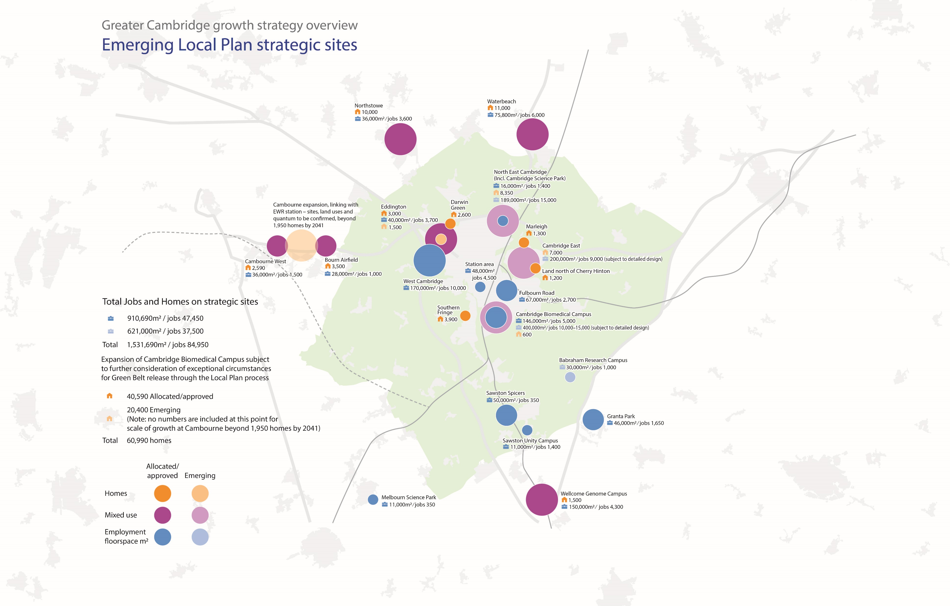

Slide 8
Local Updates
Bourn Airfield – Planning permission issued – awaiting next steps from landowners
Cambourne Business Park – Permission issued
Cambourne High Street – Application under consideration

Slide 9
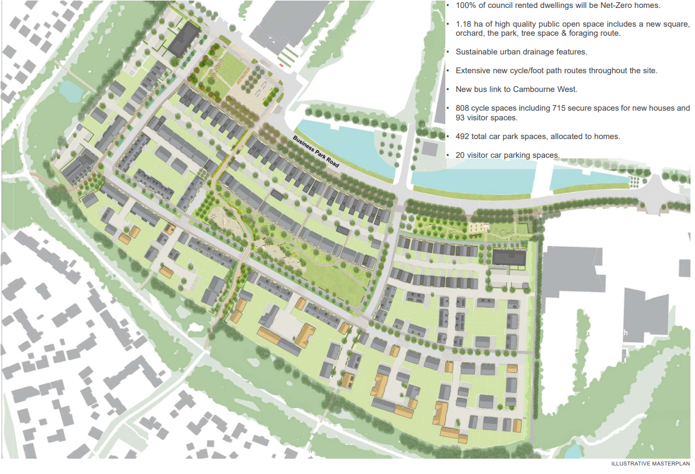
South Cambridge Investment Partnership
256 homes (including 102 affordable properties).
Pedestrian and cycle links across the site and to the surrounding area and Cambourne West.
High quality open space including a new public square, central park and foraging route.

Slide 10
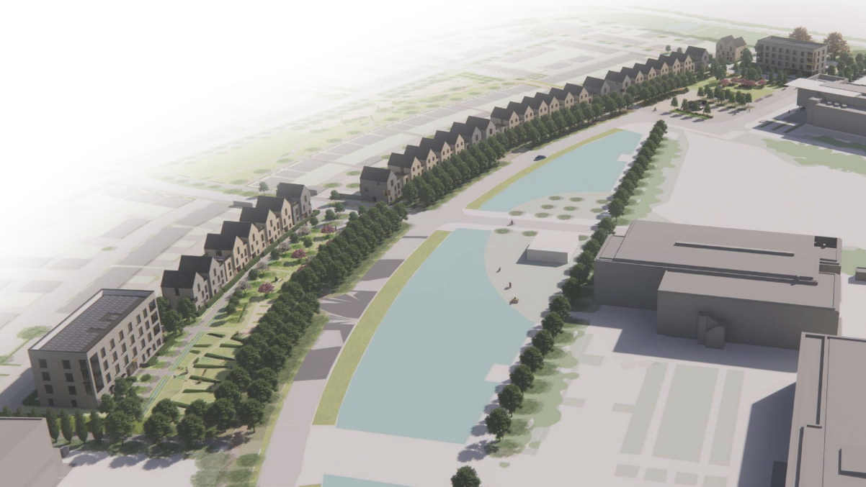
Cambourne Business Park Frontage (CGI)

Slide 11
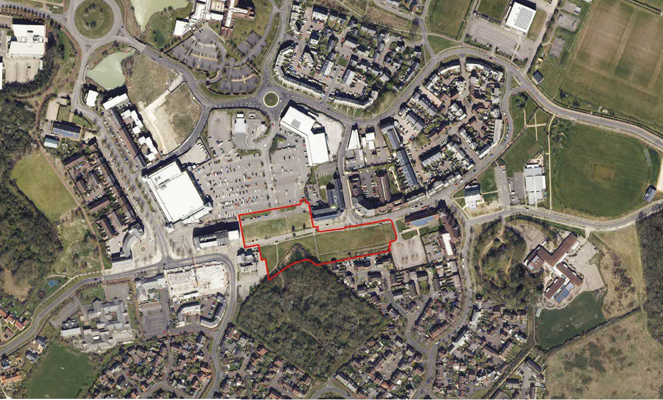

Slide 12
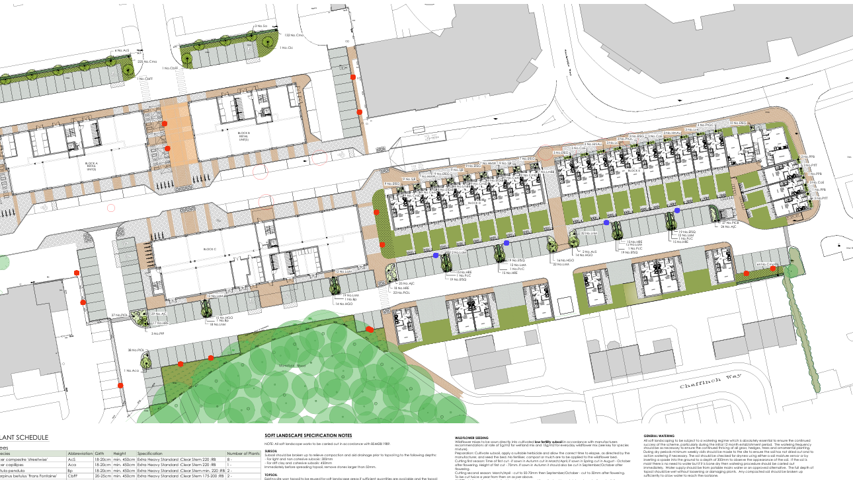

Slide 13
Questions?

