Slide 1

Keepmoat Homes
Introducing Northstowe Phase 2B:
Ashley Wray & Joe Harrison

Slide 2

Northstowe Community Forum
Who we are?
Top 10 UK Housebuilder
Proud to be an HBF 5 Star Builder
UK’s largest and only dedicated Partnership homebuilder
  One of the largest strategic delivery partners for Homes England
  9,200 planned future completions across 38 sites
Operate across 9 regions nationwide
  90+ Active developments
  3,915 Homes sold in 2021
  24,000 Residential plots secured
  In 2021 69% of homes built were on brownfield land

Slide 3
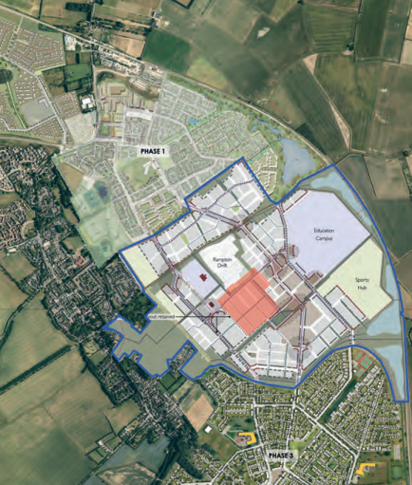
Northstowe Community Forum
The Development
Timescales:
  Start on site – November 2022
  Sales Release – Q1 2023
  First Home Complete – Q3 2023
*Site coloured red on the adjacent plan

Slide 4
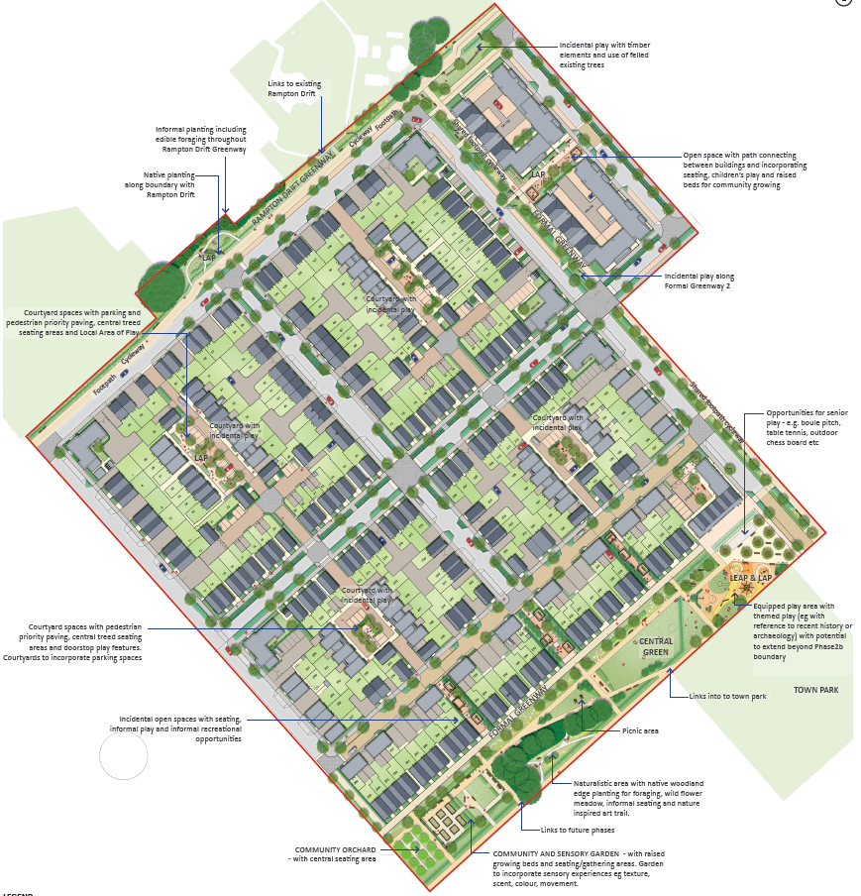
Northstowe Community Forum
The Development
300 Homes
Mixture of 1 & 2 Bed Apartments
2 – 4 bed Houses

Slide 5
Questions?

